Slide 1
Virginia Public Health and Healthcare Preparedness Academy
FY 2017 HPP-PHEP Funding Opportunity Announcement Update
June 1, 2017
Notes:
Speaker: Chris—welcome, intros, walk through agenda

Slide 2
Agenda
HPP and PHEP: Two Distinct Programs, but Aligned
Domain Strategy and Capability Crosswalk
Overview of the Six Domain Strategies, Activities, Outputs, and Outcomes
Measurement and Evaluation Plan
Key FOA Changes and Administrative Updates

Slide 3
HPP and PHEP: Two Distinct Programs, but Aligned
Notes:
Speaker: Melissa

Slide 4
HPP Prepares the Private Health Care Delivery System; PHEP Prepares Governmental Public Health
Public Health
Health Care
Primarily focuses on populations¹
Emphasis on disease prevention and health promotion for the whole community at a systems level, targeting major threats to the health of populations¹
Interventions aimed at the environment, human behavior, and lifestyle¹
Overlap
Primarily focuses on the individual¹ and health care entities
Emphasis on disease diagnosis, treatment, and care for the individual patient¹
Predominantly medical interventions,¹ such as diagnosing and treating injuries or illnesses, examining patients, taking medical histories, prescribing medications, etc.²
Identification and management of infectious diseases (e.g., HIV, flu) and chronic diseases (e.g., asthma, obesity-related conditions)
Emergency response (e.g., Hurricane Sandy, pandemic flu, 9/11)
Example Roles
Epidemiologist
Public health laboratorian
Planner/evaluator
Health communications specialist
Example Roles
Hospital executive director
Physician
Registered nurse
Emergency medical technician
Content derived from:
¹https://www.hsph.harvard.edu/about/public-health-medicine/
²http://www.bls.gov/ooh
Notes:
Speaker: Melissa--We get a lot of questions about benefits of grant alignment and what the difference is between health care and public health – we would like to clarify these issues up front
We are distinct from FEMA - we are not infrastructure-focused
We are the only source of federal funding for these programs
If we have sustained funding, then we won’t need surge funding. We have only needed surge funding fro Ebola, H1N1, and Zika

Slide 5
HPP and PHEP: Aligned but Distinct
HPP and PHEP programs align and complement one other, but HPP and PHEP funds are not interchangeable.
Though funding flows through the same 62 state, local, and territorial awardees:
HPP builds resilience among health care delivery system entities by increasing their collective ability to maintain operations and expand health care capacity during a medical surge. Primary subawardee are health care coalitions and individual health care facilities.
The PHEP program builds capacity within state, local, territorial, and tribal public health agencies to assure that the nation’s public health system is resilient and “response ready” for any type of public health event or disaster.
Notes:
Speaker: Melissa

Slide 6
Domain Strategy and Capability Crosswalk
Notes:
Speaker: Chris
These slides are for your awareness: all of the capabilities map to domains

Slide 7
Domain Strategy and Capability Crosswalk
Strategy | 2017-2022 Health Care Preparedness and Response Capabilities | 2012-2017 Public Health Preparedness Capabilities
1. Strengthen Community Resilience | Capability 1: Foundation for Health Care and Medical Readiness | Capability 1: Community Preparedness Capability 2: Community Recovery
2. Strengthen Incident Management | Capability 1: Foundation for Health Care and Medical Readiness Capability 2: Health Care and Medical Response Coordination Capability 3: Continuity of Health Care Service Delivery | Capability 3: Emergency Operations Coordination
3. Strengthen Information Management | Capability 2: Health Care and Medical Response Coordination | Capability 4: Emergency Public Information and Warning Capability 6: Information Sharing
Notes:
Speaker: Chris

Slide 8
Domain Strategy and Capability Crosswalk
Strategy | 2017-2022 Health Care Preparedness and Response Capabilities | 2012-2017 Public Health Preparedness Capabilities
4. Strengthen Countermeasures & Mitigation | Capability 1: Foundation for Health Care and Medical Readiness Capability 3: Continuity of Health Care Service Delivery | Capability 8: Medical Countermeasure Dispensing Capability 9: Medical Materiel Management and Distribution Capability 11: Non-pharmaceutical Interventions Capability 14: Responder Safety and Health
5. Strengthen Surge Management | Capability 3: Continuity of Health Care Service Delivery Capability 4: Medical Surge | Capability 5: Fatality Management Capability 7: Mass Care Capability 10: Medical Surge Capability 15: Volunteer Management
6. Strengthen Biosurveillance | N/A | Capability 12: Public Health Laboratory Testing Capability 13: Public Health Surveillance and Epidemiological Investigation
Notes:
Speaker: Chris

Slide 9
Overview of Six Domain Strategies, Activities, Outputs, and outcomes

Slide 10
Domain 1: Community Resilience
Domain Strategy: Strengthen Community Resilience
The ability of a community, through public health agencies and health care coalitions, to develop, maintain, and use collaborative relationships among government, private health care organizations, and community organizations to develop and use shared plans for responding to and recovering from disasters and emergencies.
Activity 1
Activity 2
Activity 3
Activity 4
Activity 5
Partner with stakeholders by developing and maturing health care coalitions (HCCs)
Characterize probable risk of the jurisdiction and the HCC
Characterize populations at risk
Engage communities and health care systems
Operationalize response plans
Sample Outputs
Risk assessments/HVAs
HCC preparedness plan
Plans with procedures/ processes in place to address community-specific needs and vulnerable populations
Notes:
Speaker: Melissa to kick off; Melissa and Chris to address the various joint activities
This domain includes the most shared activities
HCC resource assessments
Established HCC and public & private partnerships
Post incident assessments of PH, medical & mental/behavioral infrastructure
Coordinated trainings and exercises and continuous quality improvement

Slide 11
Domain 2: Incident Management
Domain Strategy: Strengthen Incident Management
The ability to establish and maintain a scalable operational structure with processes that appropriately engage all critical stakeholders and support the execution of core public health and health care capabilities and incident objectives.
Activity 1
Activity 2
Activity 3
Activity 4
Activity 5
Coordinate emergency operations
Standardize incident command structures for public health
Establish incident command structures for health care organizations and HCC
Ensure HCC integration and collaboration with ESF-8
Expedited fiscal procedures are in place for ensuring funding reaches impacted community during an emergency response
Sample Outputs
Risk communication systems
Emergency operation centers primary/alternate
Incident management systems
Response plans
Recovery plans
COOP plans
Notes:
Speaker: Chris (Melissa can address the differences between activities 2 and 3)

Slide 12
Domain 3: Information Management
Domain Strategy: Strengthen Information Management
The ability to 1) develop systems and procedures that facilitate the communication of timely, accurate, accessible information, alerts and warnings using a whole community approach and 2) exchange health information and situational awareness with federal, state, local, territorial, and tribal levels of government, health care coalitions, and their individual members.
Activity 1
Activity 2
Activity 3
Share situational awareness across the health care and public health systems
Share emergency information and warnings across disciplines and jurisdictions and HCCs and their members
Conduct external communication with public
Sample Outputs
Information sharing platforms for HCC members
Defined essential elements of information
Risk communication materials
Health care situational awareness protocols and systems
Trained risk communication staff

Slide 13
Domain 4: Countermeasures and Mitigation
Domain Strategy: Strengthen Countermeasures and Mitigation
The means to provide resources for awardees, as well as health care coalitions and their members, to increase their ability to store and deploy medical and pharmaceutical products that prevent and treat the effects of hazardous substances and infectious diseases, including pharmaceutical and non-pharmaceutical equipment (e.g., vaccines, prescription drugs, masks, gloves, and medical equipment) and the resources to guide an all-hazards approach to contain the spread of injury and exposure using mitigation strategies (e.g., isolation, closures, social distancing, and quarantines).
Activity 1
Activity 2
Activity 3
Manage access to and administration of pharmaceutical/ non-pharmaceutical interventions
Ensure safety and health of responders
Operationalize response plans
Sample Outputs
Storage and distribution centers
Inventory management systems
Points of dispensing/alternate nodes
Trained POD staff
Safety and “just in time” trainings
Notes:
Speaker: Chris

Slide 14
Domain 5: Surge Management
Domain Strategy: Strengthen Surge Management
The ability to coordinate health care, medical, and support staff volunteers; share resources, staff, and patients, as necessary and appropriate, across a health care coalition so that each member health care organization can effectively manage surge incidents by creating additional direct patient care capacity across a community; use and coordinate the expertise of the public health, health care, and emergency management disciplines to ensure the public has access to high-quality direct patient care and mass care during emergencies; and prevent and manage injuries and fatalities during and after a response to an emergency or incident of health significance.
To Manage Public Health Surge:
To Manage Medical Surge:
Activity 1
Activity 2
Activity 3
Activity 4
Activity 5
Activity 6
Activity 7
Activity 8
Address mass care needs: e.g., shelter monitoring
Address surge needs: e.g., family reunification
Coordinate volunteers
Prevent/ mitigate injuries, and fatalities
Plan for health care facility evacuations
Address emergency department and inpatient surge
Develop alternate care systems
Address specialty surge: peds, chem/rad, burn/trauma, behavioral _health, infectious _diseases
Sample Outputs
Electronic volunteer registry systems
Patient tracking systems
Medical surge plans at the system level
Coordinated patient distribution and movement based on patient needs
Notes:
Speaker: Melissa
Both HPP and PHEP have surge capability, but the activities show how their focus areas are different.
Both programs have a new focus on infectious disease
Coordinated public health & health care agencies
Real time monitoring of patient acuity for rapid decompression

Slide 15
Domain 6: Biosurveillance
Domain Strategy: Strengthen Biosurveillance
The means to conduct rapid and accurate laboratory tests to identify biological, chemical, and radiological agents; and the ability to identify, discover, locate, and monitor through active and passive surveillance, threats, disease agents, incidents, outbreaks and adverse events, and provide relevant information in a timely manner to stakeholders and the public.
Activity 1
Activity 2
Activity 3
Conduct epidemiological surveillance and investigation
Detect emerging threats/injury
Conduct laboratory testing
Sample Outputs
Electronic disease surveillance systems
Laboratory response networks
Laboratory testing capability
Integrated laboratory and epidemiology systems
Notes:
Speaker: Chris

Slide 16
Domain Strategy Outcomes
Outcomes
Impact
Earliest possible identification and investigation of an incident
Reduced exposure to risk
Prevent or reduce morbidity and mortality from public health incidents whose scale, rapid onset or unpredictability stresses the public health and health care systems
Timely implementation of intervention and control measures
Established public health recommendations and control measures in place for All-Hazards
Timely communication of situational awareness and risk information
Prioritized emergency public health and health care services and resources sustained throughout all phases of emergencies and public health and medical incidents
Continuity of emergency operations throughout the surge of an emergency or incident
Continuity of routine public health & health care services and supply chain during an emergency response and recovery
Earliest possible recovery and return of the public health and health care systems to pre-incident levels or improved functioning
Timely coordination and support of response activities with health care and other partners
Sustainable health care coalitions
Coordinated review of lessons learned during an incident or exercise
Immediate care for incoming patients and continuity of care for existing patients during an incident
Notes:
Speaker: Chris (with Melissa providing input)
Performance measures are proxy measures for these outcomes
We provided you with our measures in a separate document

Slide 17
Key FOA changes and Administrative updates
Notes:
Speaker: Melissa

Slide 18
HPP changes and administrative updates
Notes:
Speaker: Melissa

Slide 19
Process to Develop the 2017-2022 Health Care Preparedness and Response Capabilities
Beginning in 2015, HPP conducted a Capabilities Needs Assessment; hosted meeting and calls with the public and SMEs; held a broader national engagement period; and developed TRACIE
The Capabilities Needs Assessment and broader stakeholder input highlighted:
As written, some of the 2012-2017 capabilities, functions, and tasks are outside of the scope of HCCs (e.g., Fatality Management and Volunteer Management)
The 2017-2022 capabilities need to better clarify the roles and responsibilities of health care and public health
Notes:
Speaker: Melissa
Received and then adjudicated over 1800 comments from stakeholders and awardees
Process included a review of existing programmatic materials, a survey on the capabilities, awardee and HCC focus groups, engagement of HPP partner community (50+ national healthcare and public health associations), and federal interagency.
Based on feedback, there was a need for:
Simplified language and reduced overlap between capabilities
Clarity of the role of HCCs in health care preparedness
Further guidance on how to operationalize health care preparedness and response capabilities

Slide 20
2017-2022 Health Care Preparedness and Response Capabilities
Refined capabilities focus more on health care service delivery preparedness and emergency response coordination.
Capability | Capability Goal
Foundation for Health Care and Medical Readiness | The community’s health care organizations and other stakeholders—coordinated through a sustainable HCC—have strong relationships, identify hazards and risks, and prioritize and address gaps through planning, training, exercising, and managing resources.
Health Care and Medical Response Coordination | Health care organizations, the HCC, their jurisdiction(s), and the ESF-8 lead agency plan and collaborate to share and analyze information, manage and share resources, and coordinate strategies to deliver medical care to all populations during emergencies and planned events.
Continuity of Health Care Service Delivery | Health care organizations, with support from the HCC and the ESF-8 lead agency, provide uninterrupted, optimal medical care to all populations in the face of damaged or disabled health care infrastructure. Health care workers are well-trained, well-educated, and well-equipped to care for patients during emergencies. Simultaneous response and recovery operations result in a return to normal or, ideally, improved operations.
Medical Surge | Health care organizations—including hospitals, EMS, and out-of-hospital providers—deliver timely and efficient care to their patients even when the demand for health care services exceeds available supply. The HCC, in collaboration with the ESF-8 lead agency, coordinates information and available resources for its members to maintain conventional surge response. When an emergency overwhelms the HCC’s collective resources, the HCC supports the health care delivery system’s transition to contingency and crisis surge response and promotes a timely return to conventional standards of care as soon as possible.
Notes:
Speaker: Melissa

Slide 21
HPP Changes in the 2017-2022 FOA
Awardees can only make subawards to HCCs that meet core membership requirements:
Hospitals (a minimum of two acute care hospitals)
Emergency medical services
Emergency management organizations
Public health agencies
Each funded HCC must develop a preparedness plan by the end of BP1
Each funded HCC must develop a response plan by the end of BP2
HCCs must be engaged in response activities
Each funded HCC must conduct an annual exercise using the Coalition Surge Tool Exercise
Enhanced focus on infectious disease surge capability and capacity
Developed guidance to improve HCC infectious disease coordination among members and between health care and public health sectors

Slide 22
FY 2017 FOA: Renewed Focus on Funding for HCCs
HPP has re-examined the amount of awardee-level direct costs (ALDC) that awardees may retain for managing and monitoring the HPP cooperative agreement.
The average ALDC across awardees for budget periods 3-5 was 21%
Awardees may retain direct costs for managing and monitoring the HPP cooperative agreement during the 2017-2022 project period. HPP consulted with ASTHO, AHA, and AAMC to develop the following guidance, which is included in the new FOA:
ALDC (excluding subawards to HCCs and health care entities) must be limited to no more than 18% of the HPP cooperative agreement award
By the end of BP5, ALDC (excluding subawards to HCCs and health care entities) must be no more than 15% of the HPP cooperative agreement award
ASPR will consider requests for exemptions on a case-by-case basis.
HPP cooperative agreement funds must primarily support collaborative HCC development; individual facility funding cannot be used to meet CoPs of the CMS Emergency Preparedness and Response Rule.
Notes:
Speaker: Melissa
Why define Awardee-Level Direct Costs as the sum of Personnel, Fringe and Travel? Because a review of every budget line item shows the vast majority of these 3 object class categories are composed of Awardee-Level Direct Costs items.
HPP reviewed application budget data from BP3 to BP5. ALDC were found in all object classes and vary across awardees based on different accounting practices making it impractical to look at 4,300+ line items
These 3 Direct Cost categories appear to be a reasonable proxy for determining Awardee-Level Direct Costs. In comparison, we analyzed how this figure compared with a thorough analysis of Awardee-Level Direct Cost budget items. We did this by adding all ALDC line items from all 8 Direct Cost Categories (a very laborious process) and found that they accounted for 16% of Total Direct Costs. Using the proxy method we meet one objective of having an easy to calculate figure that provides a reasonable yet generous estimate of ALDC.
Awardee-Level Direct Costs
Object Class BP5 Total Awardee-Lev. Dir Costs Percent State-Level Direct Costs
Personnel $27,965,865 $23,116,606 83%
Fringe $12,184,298 $10,155,185 83%
Travel 1/ $2,043,680 $1,486,236 73%
Supplies $2,011,942 $454,651 23%
Equipment $914,536 $18,352 2%
Contract $163,480,551 $399,404 0%
Consultant $793,526 $158,516 20%
Other $7,968,941 $46,380 1%
Total/
Weighted
Average $217,363,339 $35,835,330 16%
1/ Awardee Level Direct Costs includes all travel costs except for specific programs e.g. MRC or ESAR-VHP or those clearly marked as for training or exercising. Travel such as "In State travel", "various" and by location (e.g. county name) are considered ODM.

Slide 23
2017 HPP Performance Measures
The 2017 performance measures allow HPP to objectively track trends in HCC member engagement, coordination, communication, patient care, and continuous learning
28 measures (6 apply only to territories and freely associated states)
Collect baseline in the first budget period
50% of the performance measures are exercise-based
8 of the 28 measures can be captured during an approximately 4-hour Coalition Surge Test exercise
2 measures can be captured during a communications exercise, defined in forthcoming technical documentation
4 measures that apply to territories and freely associated states only can be captured during the Hospital Surge Test exercise
Notes:
Speaker: Melissa
- Also utilized several channels to develop performance measures WITH stakeholders

Slide 24
Messaging HPP’s Impact
HPP has impact messaging resources available for your consideration:
HPP educational outreach template to present local examples of program impact
Narrative impact stories about successful exercises, responses, and preparation that demonstrate HPP’s impact in a tangible, easy to understand way; communicate best practices; and recognize our joint success as a program:
Email a short description of your story to your Field Project Officer or HPP@hhs.gov
HPP will schedule a quick phone call to gain more context and will draft the story, ensuring your approval
HPP will disseminate the story through various channels, including PHE.gov
Email your Field Project Officer or HPP@hhs.gov for more information

Slide 25
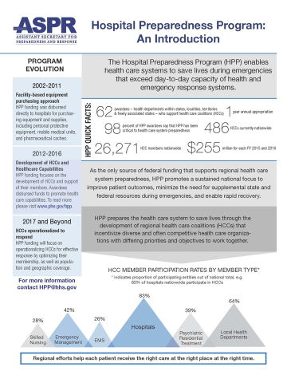
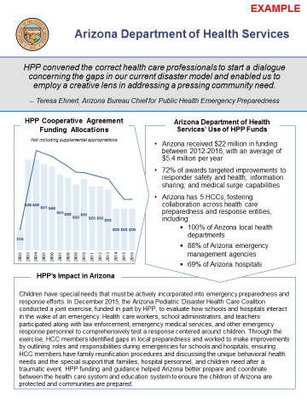
HPP Educational Outreach Template
Notes:
Another method of disseminating success stories

Slide 26
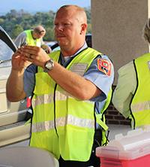


Example HPP Impact Stories
Virginia Drive-thru Flu Vaccinations | Hurricane Matthew | Republican National Convention
VA Northwest HCC Vaccinated approximately 515 people in 2.5 hours during 2015 drive-thru influenza point of dispensing exercise Seamless integration of public health, health care, Medical Reserve Corps, the Community Emergency Response Team, and emergency medical services | Georgia Region J HCC Began coordinating situational awareness among HCC members and partners for collaborative, informed decision-making 5 days before hurricane landfall Evacuated over 1,200 patients – some just out of surgery – without any loss of life 24 hours before hurricane landfall | Northeast Ohio Regional HCC Coordinated surge support with 27 medical facilities Regularly surveyed health care facilities to ensure inventories of specialized equipment, contact information, blood inventories, and bed availability were up-to-date in preparation for over 50,000 Convention visitors
Additional Impact Stories are Accessible on the HPP Homepage: www.phe.gov/hpp

Slide 27
HPP External Partner Community Quarterly Meetings
A significant component of HPP’s Impact Project is to strategically engage external stakeholders, including awardees, to develop an HPP Partner Community to ensure an exchange and collaboration of ideas and demonstrate mutual relationship value
NHPP developed a registry of external organizations and individuals within these organizations with the greatest potential to influence and impact HPP’s success in communicating its value to key audiences
External stakeholders include national trade associations representing health care providers and public health, foundations, academic institutions, and other nonprofits whose missions align with HPP’s preparedness, response, and recovery efforts
Consistent Messaging and Engagement =
Fewer Messages and More Messengers

Slide 28
HPP External Partner Community
Alliance for Biosecurity
American Academy of Ambulatory Care
American Academy of Emergency Medicine
American Academy of Pediatrics
American Academy of Physician Assistants
American Association of Critical Care Nurses
American Burn Association
American College of Emergency Physicians
American College of Health Care Administrators
American College of Health Care Executives
American College of Preventive Medicine
American College of Surgeons
American Health Care Association
American Hospital Association
American Medical Association
American Nurses Association
American Psychological Association
American Public Health Association
American Society for Microbiology
American Trauma Society
Association for Professionals in Infection Control and Epidemiology
Association of American Medical Colleges
Association of Health Care Emergency Preparedness Professionals
Association of Public Health Laboratories
Association of State and Territorial Health Officials
Biotechnology Innovation Organization
Children’s Hospital Association
Coalition for Health Funding
Council of State and Territorial Epidemiologists
Emergency Nurses Association
Emory University
Health Care Ready
Health Industry Distributors Association
Infectious Diseases Society of America
International Association of Emergency Managers
International Enviro Guard
International Safety Equipment Association
Johns Hopkins Bloomberg School of Public Health Center for Health Security
MedStar Washington Hospital Center
Medxcel Facilities Management
National Association of Accountable Care Organizations
National Association of Community Health Centers
National Association of County and City Health Officials
National Association of State EMS Officials
National Association of EMS Physicians
National Association of EMTs
National Association of Home Care and Hospice
National Association of State Alcohol and Drug Abuse Directors
National Association of State Mental Health Program Directors
National Business Group on Health
National Council for Behavioral Health
National Emergency Management Association
National Governors Association
National Homeland Security Association
National Public Health Information Coalition
National Rural Health Association
Pacific Island Health Officers Association
Pharmaceutical Research Manufacturers of America
Society for Health Care Epidemiology of America
Trauma Center Association of America
Trust for America’s Health
Urgent Care Association of America

Slide 29
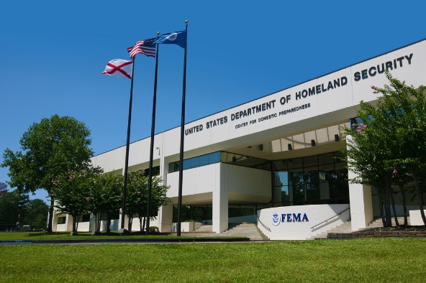
HCC Response Leadership Course
Developed by the Division of National Health Care Preparedness Programs (NHPP) and FEMA’s Center for Domestic Preparedness (CDP)
Held at CDP in Anniston, Alabama
Three day course provides instruction and exercise opportunities to guide coalitions in preparing and responding as a HCC leadership team
Photo credit: FEMA.gov
Target Audience: Health care leaders, public health leaders, emergency medical service leaders, emergency management professionals and public officials
27 participants in the class representing three HCCs with 9 participants per HCC
Travel, lodging, and meals will be provided for non-federal participants who are registered through CDP for the course

Slide 30
PHEP changes
Notes:
Speaker: Chris

Slide 31
PHEP Changes in 2017-2022 FOA
Requirements/Recommendations by Domain:
Community Resilience
Incorporates National Health Security Preparedness Index (NHSPI) as a gauge of state and local progress and gaps
Provides CDC planning resources and tools when planning for at-risk populations
Provides training and technical assistance on the CDC Community Assessment for Public Health Emergency Response (CASPER)
Strengthens planning and support for tribal nations
Notes:
Speaker: Chris

Slide 32
PHEP Changes in 2017-2022 FOA
Requirements/Recommendations by Domain:
Incident Management/Information Management (Joint Activities)
Develops a public health and health care system “common operating picture” for information sharing and improved response coordination
Ensures improved coordination and information sharing between public health and healthcare partners when managing outbreaks of infectious disease.
Countermeasures and Mitigation
Continues the medical countermeasure (MCM) operational readiness review process
Focuses on planning and demonstration/verification of MCM capability through exercises or real incidents
Notes:
Speaker: Chris

Slide 33
PHEP Changes in 2017-2022 FOA
Requirements/Recommendations by Domain:
Biosurveillance
Aligns and supports CDC National Surveillance Strategy
National Syndromic Surveillance System
National Notifiable Diseases Surveillance System (BioSense)
Electronic Death Reporting
Electronic Lab Reporting
Supports public health informatics
In partnership with CSELS, provide funding for an informatics fellowship pilot
State health officials must ensure PHEP and Epidemiology and Laboratory Capacity (ELC) programs conduct joint planning and resource allocation
Notes:
Speaker: Chris

Slide 34
PHEP Changes in 2017-2022 FOA
Requirements/Recommendations by Domain:
Biosurveillance
Laboratory Response Capability: LRN-Biological Laboratories
Establishes standards for LRN-B Advanced and Standard laboratories and supports staff training requirements
Clarifies LNR-B membership requirements
Sets performance standards for LRN-B proficiency testing and emergency call-down drills
Laboratory Response Capability: LRN-Chemical Laboratories
Provides dedicated funding for LRN-C equipment purchase for nerve agents and toxic metals
Sets performance standards for LRN-C proficiency testing, emergency call-down drills, and packaging and shipping requirements and exercises
Notes:
Speaker: Chris

Slide 35
2017 PHEP Measurement and Evaluation Strategy
Establishes program and performance measures across all domains including laboratory response capability/proficiency, epidemiological response, implementation of control measures, timeliness of risk communication messaging, emergency management and coordination, timely communication of situational awareness
Includes measures that provide information on key program elements:
State emergency operations center activations (partial of full activation)
Percent of funds that support local health departments and tribes
Time (in days) to execute subawardee contracts (not event related)
Number of days to execute subawardee contracts during Ebola and Zika
Submission of public health preparedness capabilities planning assessment data
Participation in CDC MCM operational readiness reviews
Submission of after-action reports and improvement plans
Notes:
Speaker: Chris

Slide 36
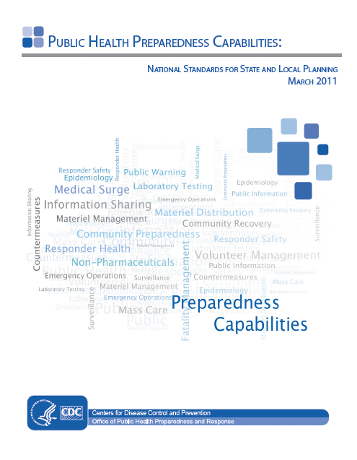
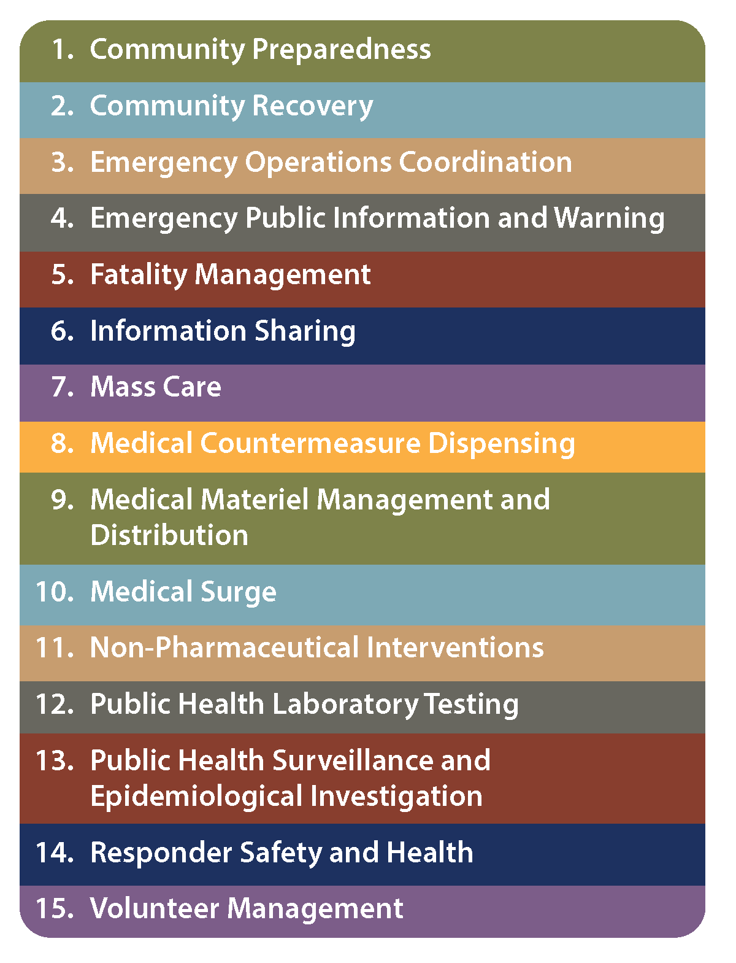
Public Health Preparedness Capabilities
Notes:
Through the PHEP cooperative agreement, the PHEP Program has awarded more than $11 billion nationwide as of fiscal year 2016 to support critical preparedness activities at the state and local levels.

Slide 37
Public Health Preparedness Capabilities Update
Current 15 capabilities are expected to be retained
Modifications to current capability content based on stakeholder and other inputs
Revised capabilities available July 2018
Phased approach:
Collect input from subject matter experts
Mobilize work groups to revise content
Vet working draft, finalize updated content
Conduct formal clearance and release final document
Notes:
The current 15 capabilities will be retained
“We don’t expect to have 14 or 16 capabilities” (SOCO)
“Generally anticipate Capability Functions remaining stable” (SOCO)
“Modifications mostly at the Task and Resource Element level” (SOCO)
Priority Resource Elements will reflect an operational focus/active language
Other Resource Elements will be reviewed and adjusted as necessary
Task descriptions will be titled, revised and reviewed for brevity as necessary
References such as end notes, citations, references, footnotes and hyperlinks will be revised
Tier One Capabilities will remain Tier One
(1) Community Preparedness,
(3) Emergency Operations Coordination,
(4) Emergency Public Information and Warning,
(6) Information Sharing,
(8) MCM Dispensing,
(9) Medical Materiel Management and Distribution
(12) Public Health Laboratory Testing,
(13) Public Health Surveillance and Epidemiological Investigation

Slide 38
PHEP Impact Project
Messaging, Outreach, and Education
Goal:
Develop clear and compelling messages about the impact of the PHEP Program on state and local preparedness and response efforts
Clearly articulate the role of public health in ensuring the health and safety of the community during a public health emergency
Develop an outreach and education strategy
Educate key decision-makers
Speak in a unified voice

Slide 39
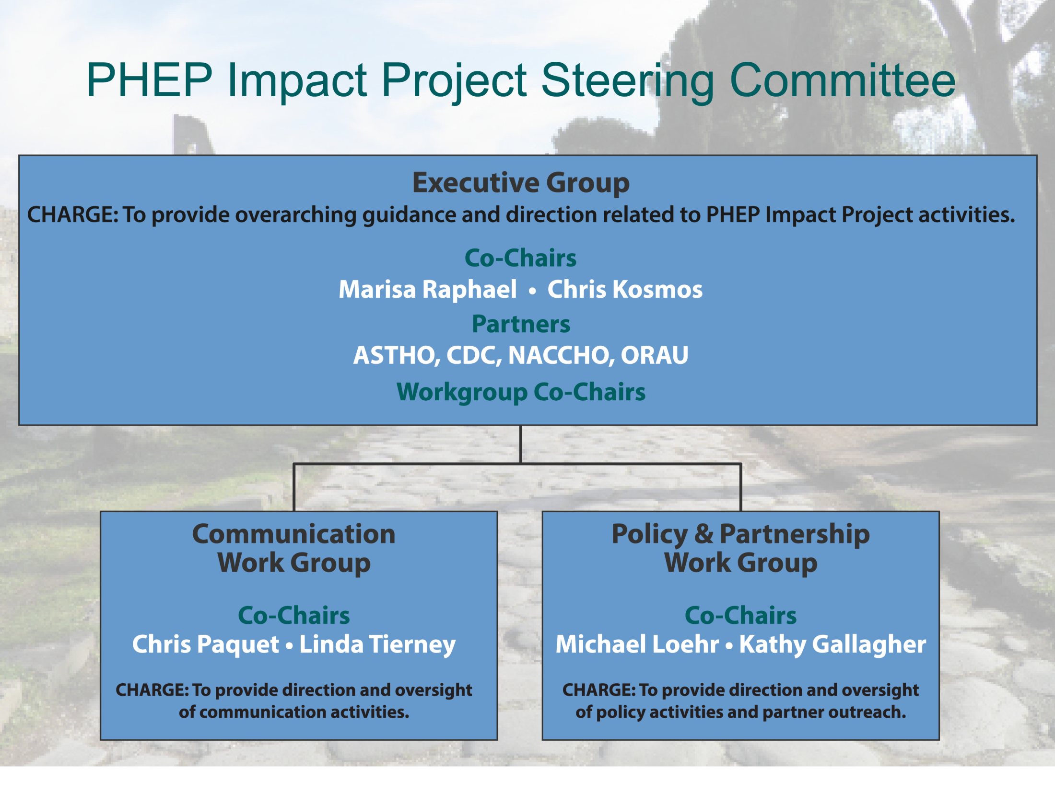
Notes:
CDC launched project in May 2015 to increase awareness of the PHEP Program and the impact its long-term sustainability has on protecting the health and safety of our communities
Steering Committee launched in December 2016
Project Overview
CDC launched the PHEP Impact Project in May 2015 to increase awareness of the PHEP Program and the impact its long-term sustainability has on protecting the health and safety of our communities.
PHEP Impact Project Steering Committee
CDC launched the PHEP Impact Project Steering Committee in December 2016, to coordinate the public health preparedness community’s communication and advocacy efforts.
Executive Group
Charge: To provide overarching guidance and direction related to PHEP Impact Project activities
Co-Chairs: Chris Kosmos and Marissa Raphael
Partners: ASTHO, NACCHO, ORAU, CDC
Workgroup Co-Chairs
Communication Workgroup
Charge: To provide direction and oversight of communication activities.
Co-Chairs: Linda Tierney and Chris Paquet
Policy and Partnership Workgroup
Charge: To provide direction and oversight of policy activities and partner outreach.
Co-Chairs: Kathy Gallagher and Michael Loehr
What we want to Accomplish
Vision
The vision of the PHEP Impact Project Steering Committee is to protect America’s health, safety, and security by ensuring the sustainability of the Center for Disease Control and Prevention’s (CDC’s) Public Health Emergency Preparedness (PHEP) Program through financial and policy efforts.
Mission
The PHEP Impact Project Steering Committee aims to achieve the vision by:
Developing a cadre of stakeholders and partners (referred to as champions) that can carry PHEP Program messages
Developing clear and action oriented materials that articulate the contribution to state and local public health and importance of the PHEP Program
Getting the materials into the hands of the right champions to further our reach
PHEP Impact Project Partner Meeting February 28 Awardee Partner Meeting to Finalize:
Development of 2017 strategic project plan
Short-term deliverables
Milestones for communications and policy/partnership workgroups
Attendees
Select PHEP awardees
Local preparedness directors
ASTHO, NACCHO and ORAU representatives

Slide 40


PHEP One-pager Template
Notes:
Communication Milestones:
PHEP-awardee one-pager template
Review of Existing PHEP communication materials
Create and maintain PHEP Impact Project online toolkit
Host Communication Training/Workshops
Promote communication materials and assess effectiveness of efforts
Having an informal gathering this week with state health officials of states represented on the Labor, Health and Human Services, Education, and Related Agencies Subcommittee to discuss the one-pager template, and get feedback on what other products they think would be good to have a part of the online toolkit.
Oklahoma
Idaho
Arkansas,
Tennessee
Maryland
Alabama
Washington
Michigan
Connecticut
California
Wisconsin
Massachusetts
What other milestones the communication workgroup should focus/prioritize?

Slide 41
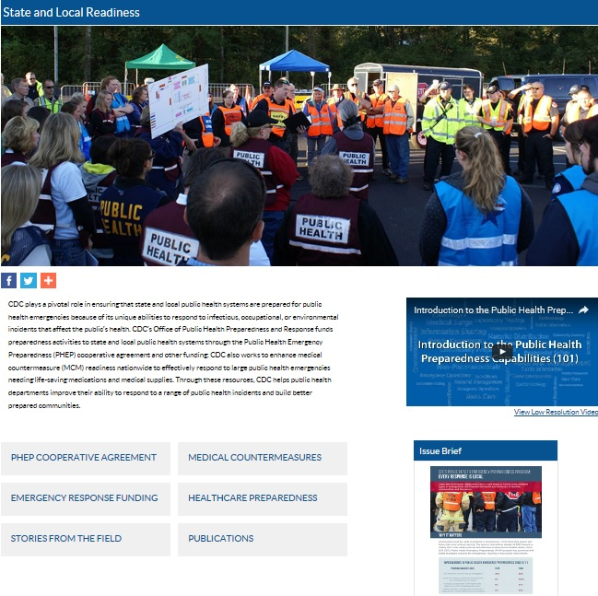
New PHEP Website: State and Local Readiness www.cdc.gov/phpr/readiness

Slide 42
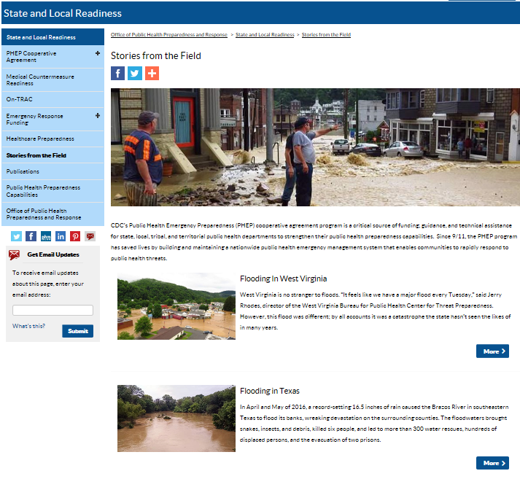

New PHEP Content: PHEP Stories from the Field www.cdc.gov/phpr/readiness/stories

Slide 43
MCM Operational Readiness: 2015-2016 Implementation Overview
487 MCM ORRs conducted: questionnaire + site visit to assess ability to distribute / dispense MCMs
132 MCM ORRs conducted by CDC
50 states
4 directly funded localities
8 territories and freely associated states
70 local planning jurisdictions
355 MCM ORRs conducted by awardees at local planning jurisdictions
Observations
Plans and procedures are relatively mature
Testing, exercising, and staffing are less developed
Notes:
See one, Do one, Teach one

Slide 44
MCM ORR: Lessons Learned and Redesign
What we learned from 2015-2016 Implementation
Plans and procedures are relatively mature;
Testing, exercising, and staffing are less developed
SharePoint platform was problematic
Tool needed modification
Need to address state/local staffing gaps
U.S. territories and freely associated states require different strategy
Awardee/partner feedback guiding MCM ORR tool redesign
Revised tool and new data collection system ready for July 2017 implementation
Notes:
Initial focus (2017-2018) on Capabilities 8 and 9 priority resource elements
Revised ORR tool will incorporate vaccination elements
New five-year exercise requirements
Allow testing of mass vaccination plans
Pandemic influenza planning elements will be incorporated in awardee-specific MCM technical assistance action plans based on the results of Pandemic Influenza Readiness Assessment (PIRA)

Slide 45
Discussion

