Slide 1
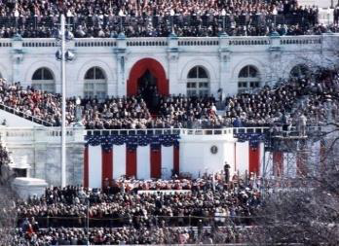
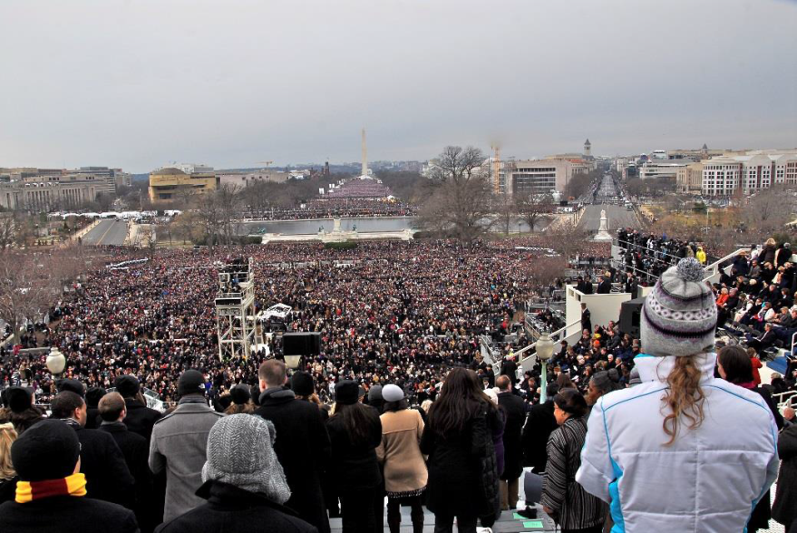
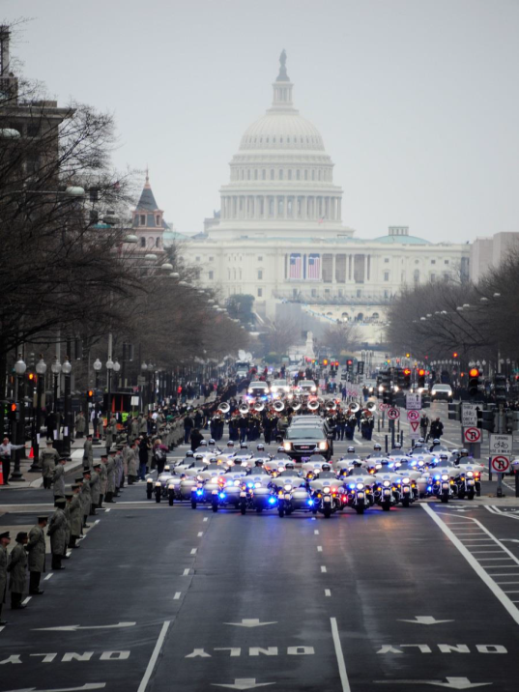
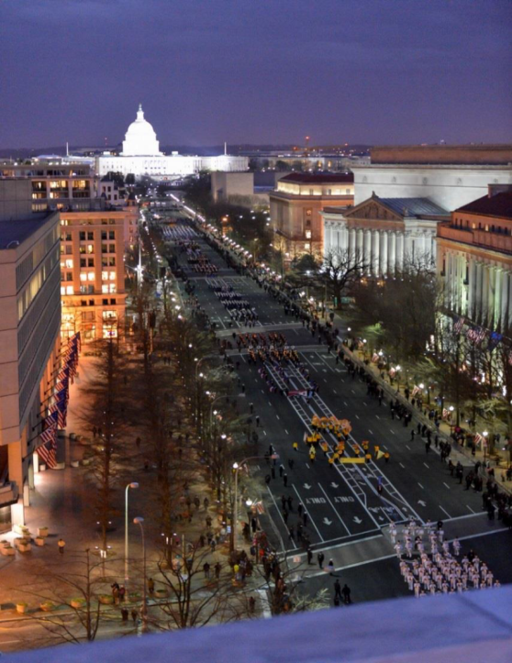
“ESF 8 Planning for the Presidential Inauguration”

Slide 2
Objectives
List the key elements, features and programs necessary to plan a large scale event
Describe the challenges associated with planning for a large event with multiple jurisdictions

Slide 3
National Special Security Event (NSSE)
What Is It?

Slide 4
National Security Special Event
Events of national significance which by virtue of their political, economic, social, or religious significance may be targets of terrorism or other criminal activity

Slide 5
NSSE – Planning Framework
Event Coordinator
Oversees preparation for entire event – Planning & Implementation, Crisis Response, Consequence Management
Promotes partnerships between local, federal and military agencies
Coordinates requests for and utilization of federal support
Public Safety (Executive) Steering Committee
Comprised of lead planning representatives from USSS, FBI, FEMA, primary state & local agencies and other federal agencies as required
Oversees development and implementation of comprehensive, integrated security plan
Provides subject matter expertise to the planning process
Serves as final arbiter of disputes within or among subcommittees
Subcommittees (numbers and specific subcommittees vary)
Staffed by interagency subject matter experts and stakeholders
Develop and implement specific aspects of security plan
Report regularly to Steering Committee/Event Coordinator
Names and number of subcommittees vary from event to event

Slide 6
NSSE Primary Agencies
U.S. Secret Service is the lead agency for security design, planning and implementation
Federal Bureau of Investigation (FBI) is the lead agency for intelligence, counterterrorism and federal criminal violations
Federal Emergency Management Agency (FEMA) is the lead agency for emergency management
Public Health and Medical is the lead sector for public health and medical services
Notes:
U.S. Secret Service Lead Federal agency responsible for coordinating the development and implementation of the overall security plan
▪Federal Bureau of Investigation Lead Federal agency responsible for coordinating intelligence, crisis management, hostage rescue, and counter-terrorism planning
▪Federal Emergency Management Agency Lead Federal agency responsible for response and recovery planning and coordination in relation to a natural disaster or other emergency should it occur during a NSSE
Presidential Policy Decision 22 (PPD 22) Consolidated all NSSE related directives under one comprehensive policy and firmed up support by other government agencies

Slide 7
NSSE Coordination & Planning Structure
Executive Steering Committee
United States Secret Service
Federal Bureau of Investigation
Federal Emergency Management Agency
District of Columbia Homeland Security and Emergency Management Agency
District of Columbia Fire and EMS
Metropolitan Police Department
U. S. Coast Guard
Joint Force Headquarters – National Capitol Region
Washington Area Metro Transit Police
U. S. Park Police
U. S. Capitol Police
District of Columbia National Guard
U.S. Attorney’s Office
U.S. Department of Defense
U.S. Department of Health & Human Services
National Park Service
General Services Administration
Joint Congressional Committee on Inaugural Ceremonies
Presidential Inaugural Committee (November)

Slide 8
NSSE Coordination & Planning Structure
Subcommittees
• Airspace Security • Multi-Agency Communication –
• Civil Disturbance & Prisoner Processing Center
• Consequence Management • Joint Base Andrews
• Counter Surveillance • Legal
• Credentialing • Maritime Security
• Crisis Management • Parade Route
• Critical Infrastructure Protection • Public Affairs
• Crowd Management • Reviewing Stands
• Explosive Device Response • Tactical
• Fire / Life Safety / Hazmat • Training
• Geospatial • Transportation/Traffic
• Health and Medical • Venue Security
• Intelligence • VIP / Dignitary Protection
• U.S. Capitol

Slide 9
NSSE Coordination & Planning Structure
Health & Medical Subcommittee (HMSC)
Dept. of Health & Human Services (HHS)/Asst. Secretary for Preparedness & Response
US Secret Service
DC Dept. of Health (DOH)/Health Emergency Preparedness & Response Administration
DC DOH/Office of Communications /Community Relations
DC Dept. of Behavioral Health
DC Dept. of Human Services
DC DOH/Animal Services Program
DC DOH/Infectious Diseases Program
DC DOH/Food Safety and Hygiene Inspection Services Division
DC Fire/EMS
DC Homeland Security & Emergency Management Agency
DC Metropolitan Police Dept.
DC National Guard
DC Office of the Chief Medical Examiner
AMTRAK
American Red Cross-NCA
American Red Cross-BioMedical Svcs
Dept. of Homeland Security (DHS)/BioWatch Program
DHS/FEMA/Office of National Capital Region Coordination
HHS/CDC
HHS/FDA
Dept. of Defense (DOD) Joint Forces Headquarters - NCR
DOD Joint Regional Medical Planning Office
DOD NCR Medical Directorate
DOD Public Health Command District – FT Belvoir

Slide 10
NSSE Coordination & Planning Structure
Health & Medical Subcommittee (HMSC)
MD Dept. of Health & Mental Hygiene (DHMH)/Office of Preparedness & Response
MD DHMH/PIO
MD DHMH/OMCE
MD DHMH/Office of Communications
MD DHMH/Behavioral Health Administration
MD DHMH/Center for Food Defense & Emergency Response
MD DHMH/Center for Zoonotic and Vector-Borne Diseases
MD DHMH/Environmental Health Bureau
MDHR Office of Emergency Operations
Dept. of Labor/OSHA
Dept. of State/Medical Operations
FBI Washington Field Office
MD Emergency Management Agency
MD Institute for Emergency Medical Services Systems
Montgomery County/DHHS
National Park Service
Office of the Attending Physician
Smithsonian
US Capitol Police
US Dept. of Agriculture
US Park Police
VA Dept. of Health (VDH)/NoVA-Preparedness
VDH/NoVA-Epi
VDH/NoVA-PIO
NVHA/RRCC
White House Medical Office
WMATA Police Dept.
WV Army National Guard

Slide 11
NSSE Coordination & Planning Structure
Health & Medical Subcommittee (HMSC)
Mission
To coordinate, develop, and implement an integrated health and medical response plan to help ensure the health & safety of participants, attendees, and support staff over a 2-day period with multiple venues.

Slide 12
Planning Process
Determine Size and Scope of the Event
Review Previous Event/Similar Event Concept of
Operations/After Action Reports
Identify Risks/Threats to Participants and Spectators
Impact on Infrastructure
Impact on Transportation
Security Considerations
Conduct Gap Analysis
Identify Resource Requirements for Event Support
Identify Resource Requirements and Contingency Actions

Slide 13
Planning Process
Determine Size and Scope of the Event
Define the Mission
Understand the Inter-Agency Communications and Coordination Process
Executive Steering Committee
Multiple Subcommittees
Health & Medical Subcommittee
Consequence Management Subcommittee
Fire/Life Safety/HAZMAT Subcommittee
Review Operational Considerations
Identify Risks/Threats to Participants and Spectators
Impact on Infrastructure
Impact on Transportation
Security Considerations
Communications/Information Sharing – Internal and Mass Communication
Roles and Responsibilities

Slide 14
NSSE Coordination & Planning Structure
ESF8 Functional Areas
Assessment of Public Health/Medical Needs
Health surveillance
Medical surge
Health/Medical/Veterinary Equipment and Supplies
Patient Movement
Patient Care
Safety and Security of Drugs, Biologics, and Medical Devices
Blood and Tissues
Food Safety and Defense

Slide 15
NSSE Coordination & Planning Structure
ESF8 Functional Areas
Agriculture Safety and Security
All-Hazards Public Health and Medical Consultation, Technical Assistance, and Support
Behavioral Healthcare
Public Health and Medical Information
Vector control
Potable Water/Wastewater and Solid Waste Disposal
Mass Fatality Management, Victim Identification, and Decontaminating Remains
Veterinary Medical Support

Slide 16
NSSE Coordination & Planning Structure
Functional Work Groups - Inauguration
Operational Coordination – Normal/Consequence Management/Recovery Operations ♦ Medical Intelligence ♦ Critical Information Requirements
Pre-Hospital Care ♦ Hospital Care/Medical Surge ♦ Blood & Blood Products ♦Patient Movement/Transportation (local-NCR-outside of NCR)
Mass Fatality Management
Health Surveillance
Behavioral Health
Patient/Family Reunification

Slide 17
NSSE Coordination & Planning Structure
Functional Work Groups - Inauguration
Veterinary Medicine Support
Food Safety & Security
CRBN Detection, Medical Counter Measures Dispensing
Public Health & Medical Information
Vector Control ♦ Potable Water/Wastewater & Solid Waste Disposal

Slide 18
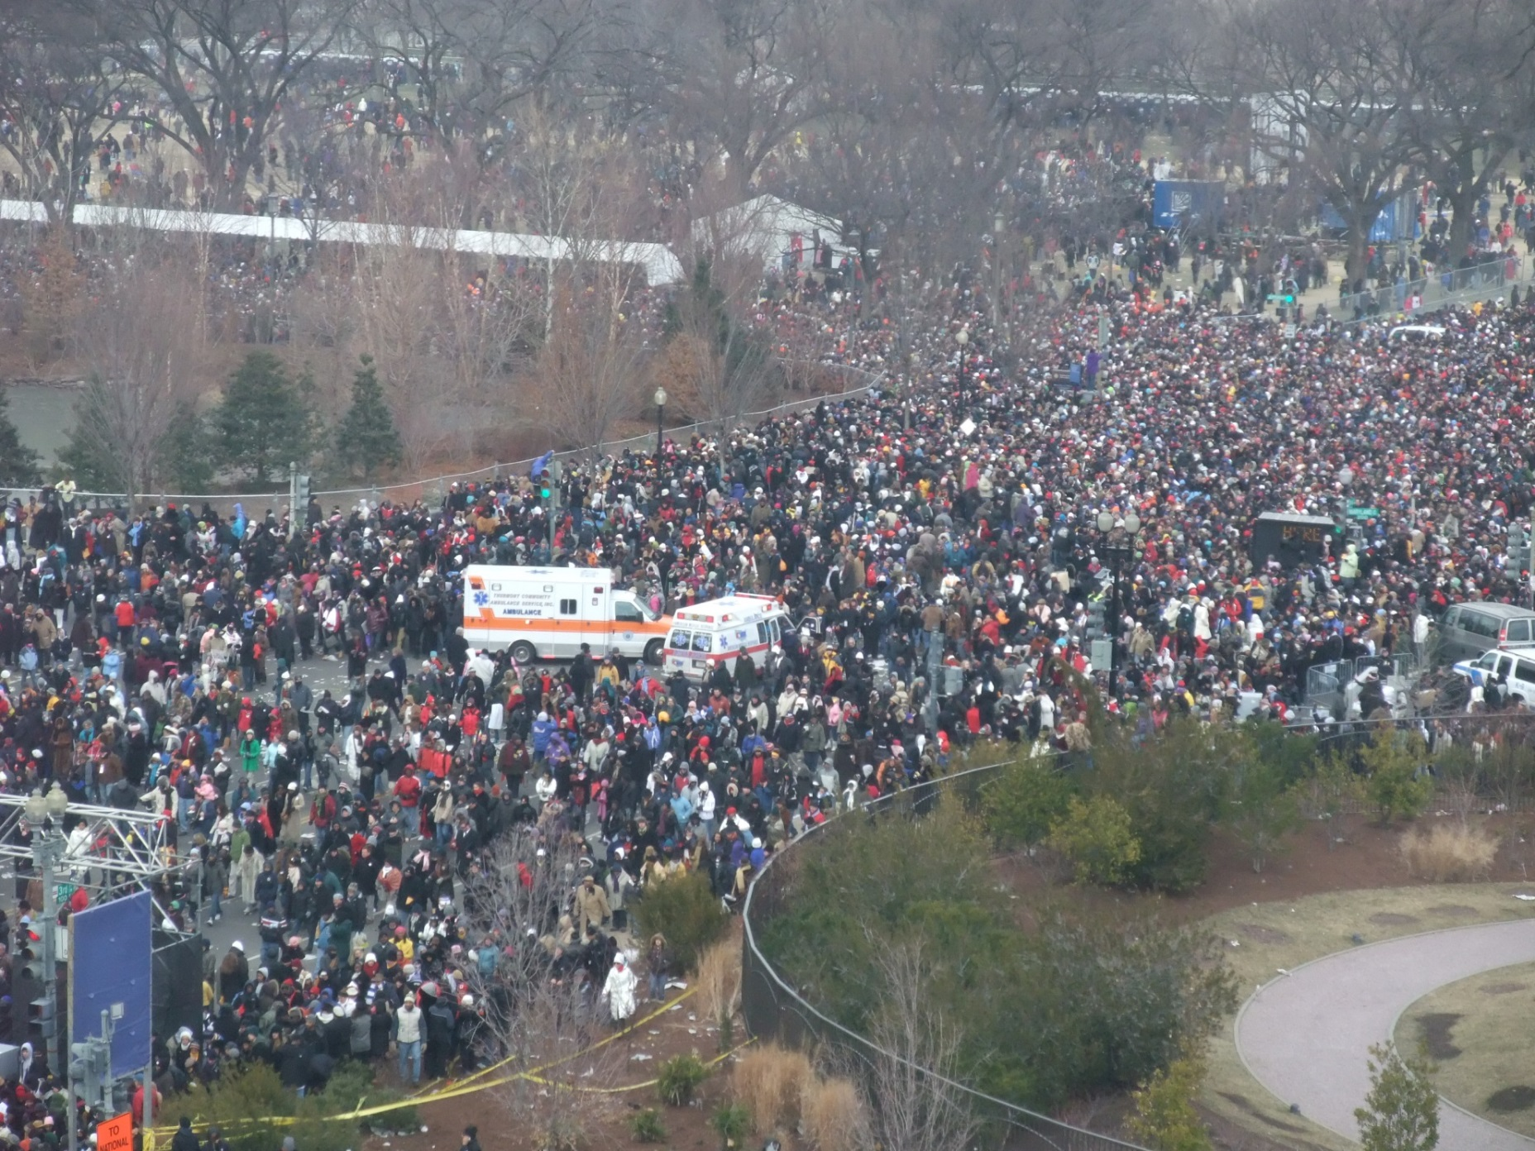
QUESTIONS

Slide 19
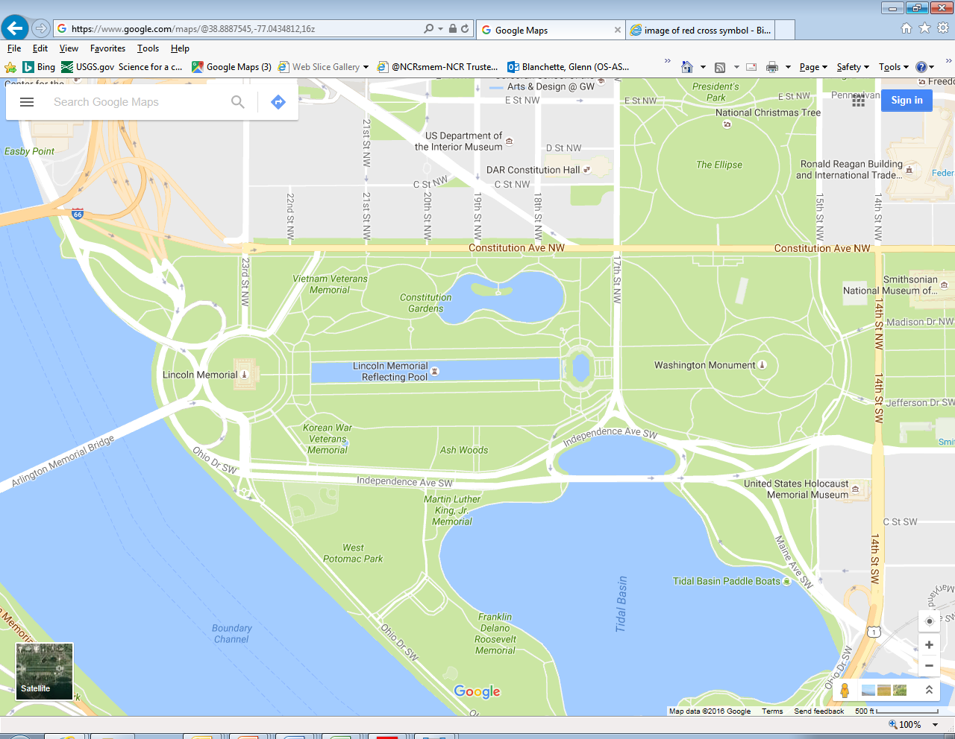

Concept of Operations
(Welcome Rally/Concert – Mall)
ATP
ATP
M11
M9
Welcome Rally
M10
ATP
M8
M12
M7
FAR
ATP
ATP
Medical Aid Stations (MAS)
Ambulance Transfer Point
Family Reunification Site
ATP
UNCLASSIFIED//FOUO
As of: 05 JAN 17
Notes:
Source: DHHS (G. Blanchette) / NPS (T. Moore) / AMR
Lincoln Memorial will serve as the stage for Make America Great Again! Celebration on 19 JAN 17.
UPDATE: (03 JAN)
Site walk w/ PIC, NPS, DHHS, FEMS, DOH, AMR. Fencing / access plan is still unknown.
Planning Assumption: 75K to 200K attendees possible but dependent upon performers/acts
DHHS provides (5) Medical Aid Stations (ALS-capable)
AMR provides (5) ALS-capable transport units
MCAU provides walking Mobile Teams
NPS and DHHS provide Medical Aid Stations

Slide 20
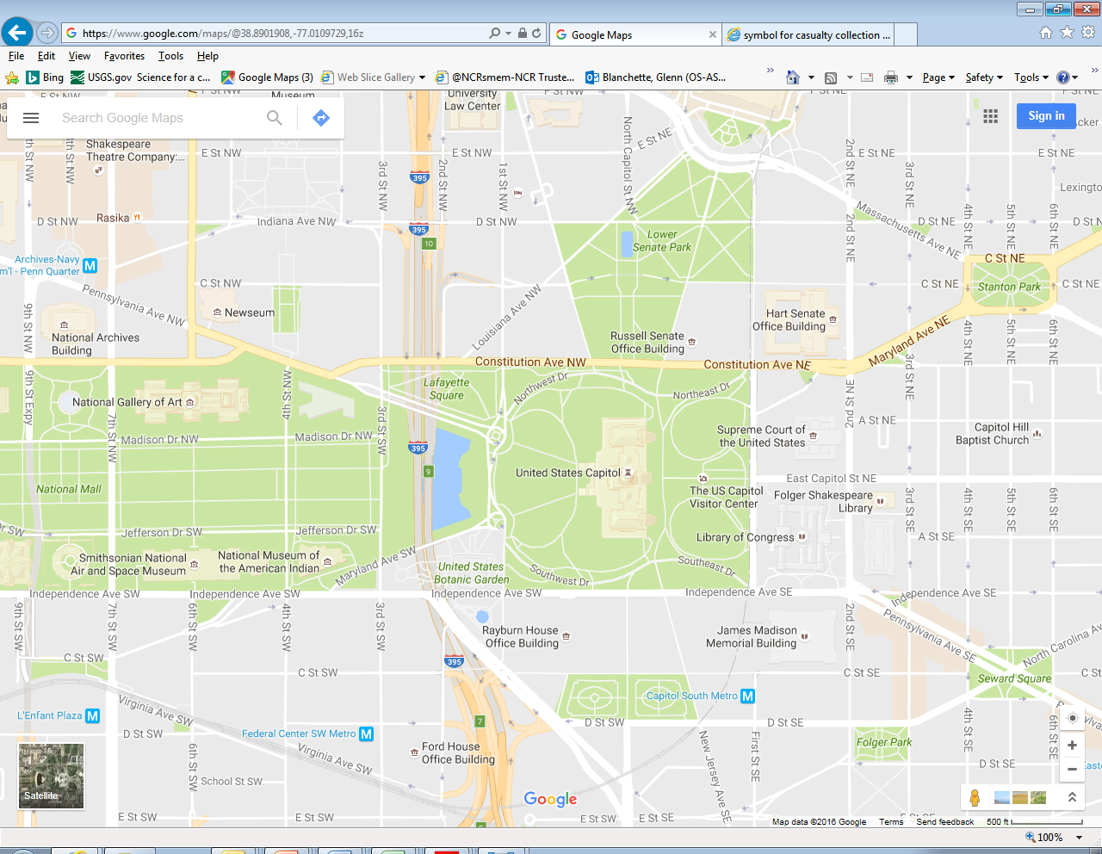



2017 Presidential Inauguration
Medical Footprint
(Swearing-In Ceremony – US Capitol)
HART Building
C1
C2
T1
C3
U.S. Capitol Building
T2
C4
RAYBURN Building
Ford Building
C5
2017 Medical Aid Stations (MAS) (Capitol)

Slide 21
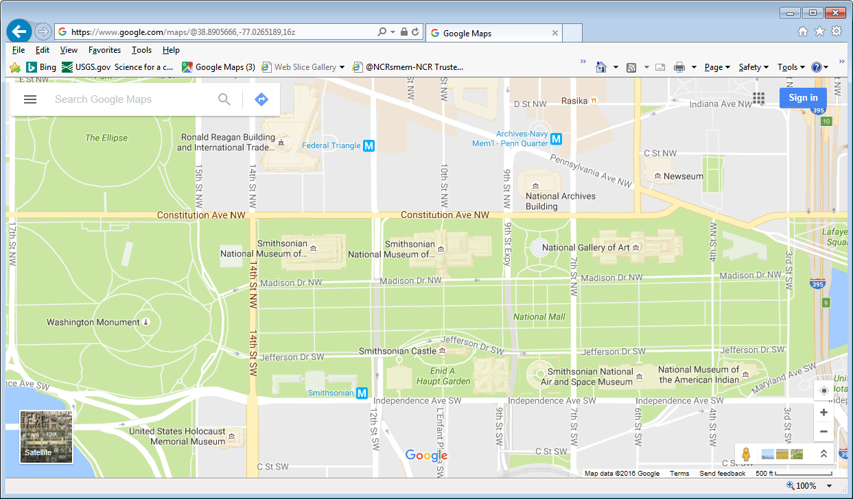
Concept of Operations
(Swearing-In Ceremony – Mall)
P6
P4
P3
P2
T1
C2
M6
FAR1
M4
M2
M5
M3
C3
P1
M1
C4
M7
T2
FAR2
FAA
T3
Med Aid Stations
C – Capitol / M – Mall / T – Trmt & Triage /
P - Parade
FAR - Family Reunification
UNCLASSIFIED//FOUO
As of: 05 JAN 17
Notes:
Source: DHHS (G. Blanchette) / NPS (T. Moore)
Mall Medical Aid Stations (MAS) (20 JAN 17):
Note: Blue Line indicates extension of US Capitol perimeter onto the 3rd Street Panel of the Mall
FEMS will provide (12) Bike Teams, (40) Ambulances (ALS and BLS) and 30-40 Gators… and FEMS LNOs at all the tents. (Source: Chief Mills)
USSS to provide site agents for all zones.

Slide 22
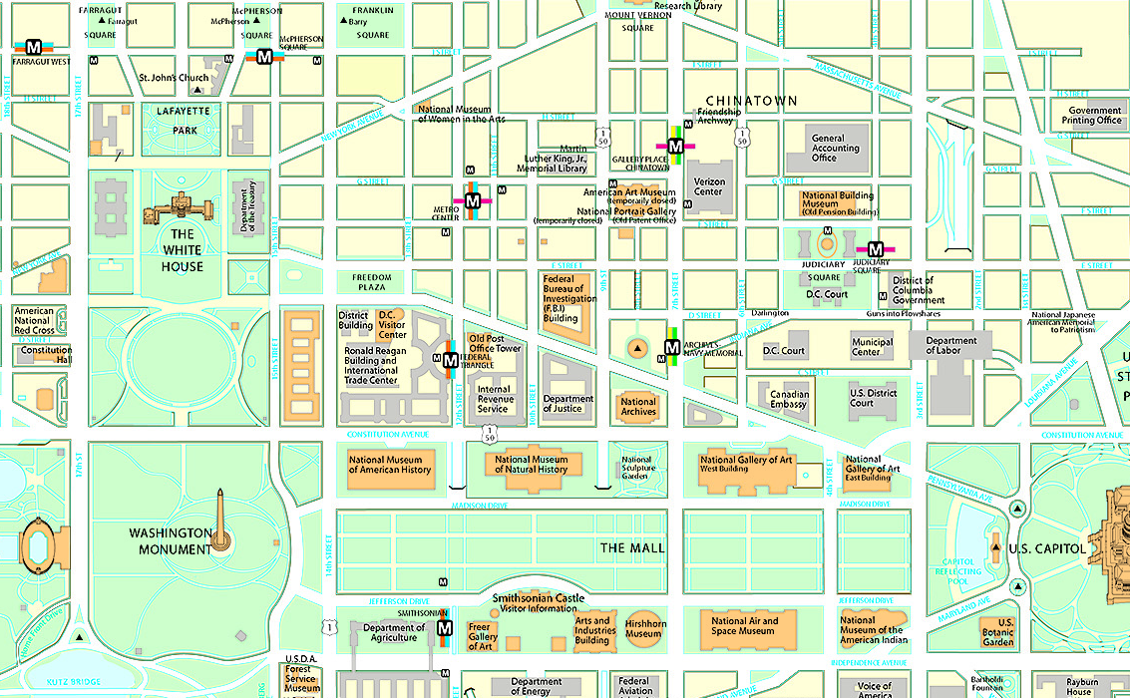
Concept of Operations
(Parade)
RCP 4 @ 15th & E ST
P8
(NPS MAS)
P7 & MED C2
15th & New York
JOINT WEST
P5
13th & E ST
RCP 2 @ 10th & Penn
ARMY
P3
7th & Penn
MARINES
NAVY
P6
15th & E ST
AIR FORCE
JOINT EAST
Parade Assembly Area
P4
10th & Penn
(near IRS)
P2
3rd & Conn
P1
12th & Jefferson Dr
(near DOA)
UNCLASSIFIED//FOUO
Medical Tent
JTF-NCR Warming Tent
Parade Start Point
As of: 05 JAN 17
Notes:
Source: DOD-FBCH (M. Diaz) and NPS (T. Moore)
UPDATE: (03 JAN) site walk w/ PIC, NPS, DHHS, FEMS, DOH, AMR. Fencing / access plan is still unknown.
USSS previously provided bike rack security fencing along parade route during past Inaugurals.
Mark Diaz briefed DOD would employ mobile medical teams patrolling outside their assigned MAS, in order to support the standing crowds.

Slide 23
NOVA MACC Goal
Promote situational awareness information sharing, critical resource management, strategic policy coordination, and multi-
jurisdiction, inter-governmental collaboration in support of the 2017 Presidential Inauguration and significant incidents that impact Northern Virginia and/or the National Capital Region during the Inaugural Period.

Slide 24
NOVA MACC Functions

Slide 25
NOVA MACC Staffing

Slide 26
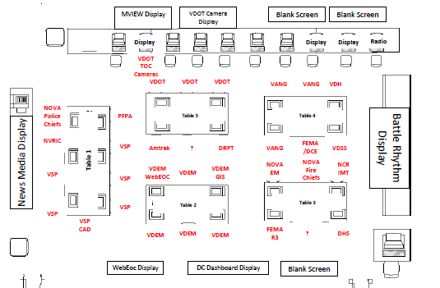
NOVA MACC

Slide 27
NOVA MACC Roles

Slide 28
VDH prepared to deploy Personnel, Supplies, Equipment
Epidemiologists- No requests by either DC or the Federal Government to deploy to DC. In 2009 and 2013 VDH supported in District operations with personnel. DCDOH is fully staffed and anticipate no need this year.
Environmental Health practitioners-No requests have been made at this time. FDA working directly with LHD’s who have food vendors supporting NSSE designated Balls/Galas. To date we are only aware Arlington has a vendor.
Liaisons to Federal and District of Columbia Agencies-A request was made to RHCC to staff DC Unified Communications Center (MedComm). That request will be fulfilled virtually from RHCC. HHS SOC is not requesting a VDH Liaison Officer to support SOC Operations this year. In 2009 and 2013 VDH supported in person or virtually.
Liaisons to the State MACC-VDH will support MACC operations located in Fairfax in person and/or virtually. VDH has four personnel available to support shift work at the MACC (Walker, Sockwell, Andrew-Spear, Keatts). Sockwell, Spear, and Keatts have been registered for State WEBEOC training on 12 Jan for MACC support.
MRC Volunteers- Federal request from National Park Service to roster twenty two (22) BLS MRC volunteers to augment medical aid tents on the National Mall January 20th, 18 operational, four on standby. Rostering through VVHS is complete. Credential requests are completed and are being picked up for volunteers by National Park Service Staff to distribute at staging are morning of.
SNS-on heightened awareness/standby
Chempack-VDH will not be moving assets into the District. MD will support with two EMS CHEMPACKS.
Radiological Resources-on heightened awareness/standby

Slide 29
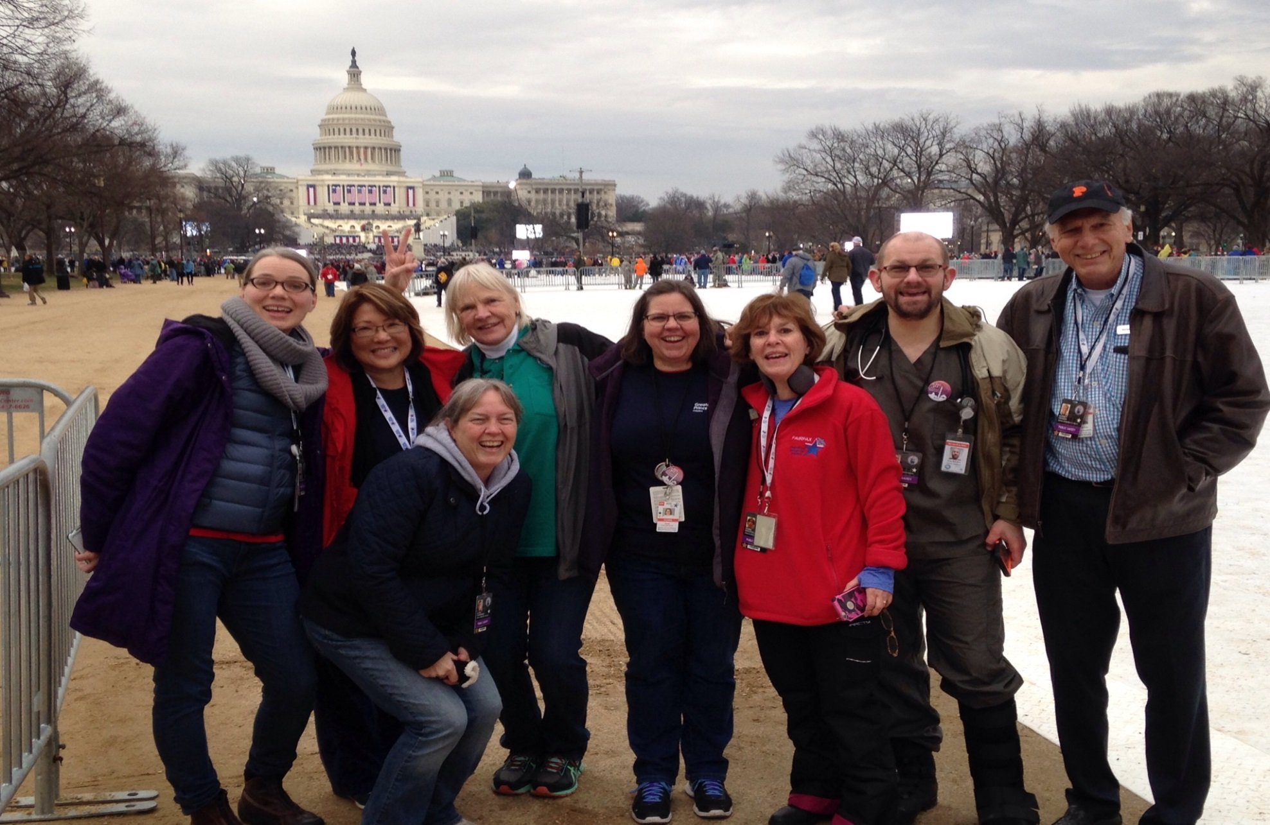
MRC Volunteers on the Mall

Slide 30
VDH Concept of Operations
Staff ESF 8 (Health and Medical) and ESF 3 (Public Works & Engineering) in the Virginia Emergency Operations Center (VEOC) as required.
Augment JIC and VFC as required.
Prepare to activate VDH Emergency Coordination Center (ECC) within two hours of notification.
Prepare to activate the Virginia Strategic National Stockpile (SNS) Receive, Stage and Store Site (RSS) and implement Medical Countermeasure Distribution within six hours of notification.
ESSENCE-Office of Epidemiology has developed an enhanced plan for disease surveillance and investigation in the VDH Northern Region and NCR in coordination with DC, Maryland and Bio-Watch.
VDH Office of Drinking Water (ODW) -increase alert level and prepare to respond
VDH Office of Emergency Medical Services (OEMS)- monitor EMS mutual aid requests and deployment of EMS resources. Karen Owens (OEMS) and Chris Cook (RHCC) involved in Patient Movement Planning with NDMS.

Slide 31
VDH Conops Cont’d
VDH Office of Chief Medical Examiner (OCME) -participated in mass fatality planning with DC / MD Medical Examiners
VDH Central, Eastern and Western Regional Teams and Local Health Districts- prepare to provide support as requested
MRC volunteers- on standby if not rostered In direct support
Coordinate with Division of Consolidated Laboratory Services (DCLS) - to have Emergency Response Staff on call for response within one hour of notification
Review Northern Virginia Bio-Watch data; initiate Emergency Notification Plans for a Bio-Watch Actionable Result.
Preparing for the possible deployment of CHEMPACK.
Identify sites for the pre-deployment of radiation countermeasures.

Slide 32
NVHA Basic Concept of Operations
RHCC will be active on day of the Inauguration and other days as determined necessary, likely 1 shift of 12 hrs. Staffing will be at least an Incident Commander, Operations Chief, Logistics position, and Communications Officer. Other positions will be placed on-call.
RHCC participated in two no-notice Hospital bed status drills with DC and Maryland. Dates were December 28th and January 5th.
VHASS will be used to gather hospital status updates (beds, resource needs, etc.) and to capture patient tracking info (all patients from Inauguration activities will be placed in VHASS patient tracking system). Updates will be requested at least every 2 hrs.
Conference calls with member hospitals will take place on a regular schedule, likely 3 calls in total.
RHCC will virtually support DC Fire / EMS to provide status / coordination of patient transfers into Nova hospitals. Decisions regarding individual patient transports will be made by DC Fire & EMS at the Office of Unified Communications (OUC), in coordination with reps from the DC, MD, and VA hospitals who will be based at the OUC and RHCC.
All efforts will be made to rotate and distribute all EMS transports to NCR hospitals so that no hospital receives more than 2 transports per hour.
All efforts will be made to preserve the surge capacity of hospitals located within 10 miles of DC
Zone 1 Hospitals: Virginia Hospital Center, INOVA Alexandria Hospital, Inova Mount Vernon Hospital and Inova Fairfax Medical Campus were requested to increase staffing on the 20th as they would be the first line facilities to receive patients from DC

Slide 33
NVHA Tiered Hospital Zone CONOPS
Zone | Concept of how they will be utilized
Zone 1 – Hospitals located within 10 miles of DC (in order of proximity): Inova Alexandria Hospital Virginia Hospital Center Inova Fairfax Medical Campus Trauma Level I Inova Mt. Vernon Hospital Inova Healthplex Springfield (BLS only) Inova Healthplex Lorton(BLS only) Fort Belvoir Community Hospital (DoD patients only) | 1st due for EMS transports coming out of DC. These facilities should expect to receive transports from DC on Friday, January 20th (Inauguration Day) – especially IAH and VHC if needed.
Zone 2 – Hospitals located within 10 to 20 miles of DC (in order of proximity): Inova Fair Oaks Hospital Sentara Northern Virginia Medical Center Reston Hospital Center Trauma Level II Inova ECC Fairfax (BLS only) Inova ECC Reston (BLS only) Mary Washington Hospital Trauma Level II | 2nd due for EMS transports coming out of DC if capacity of Zone 1 hospitals is exceeded. Note that MWH is farther away than 20 miles but is a level II Trauma Center and could receive trauma patients by air if the capacity of trauma centers in DC, MD and IFH and Reston is exceeded or these facilities are not accessible.
Zone 3 – Hospitals located more than 20 miles outside of DC (in order of proximity): Novant:UVA Health Prince William Medical Center Inova Loudoun Hospital Stone Springs Hospital Center Inova ECC Cornwall (BLS only) Novant:UVA Health Haymarket Medical Center Stafford Hospital Fauquier Hospital Spotsylvania Regional Medical Center Inova Healthplex Ashburn (BLS only) Inova Cornwall (BLS only) Mary Washington Free Standing ED (BLS only) | Will only be transported to directly if an incident of significance occurs and/or capacity of Zones 1 and 2 exceeded.

Slide 34
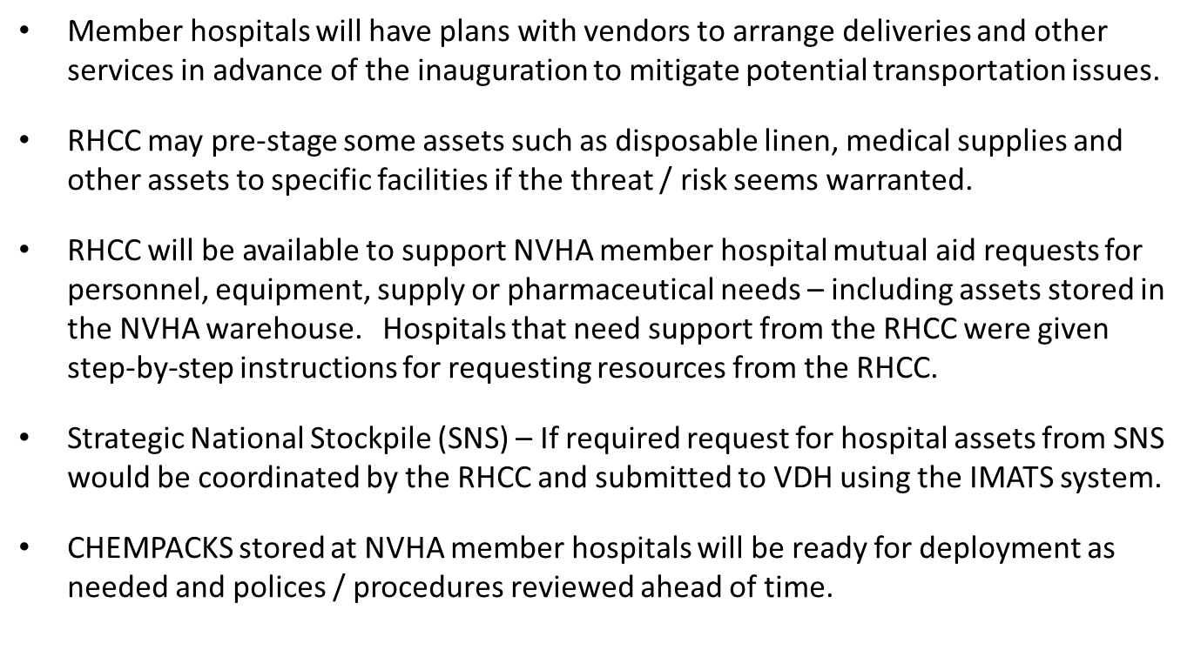
NVHA Logistics and Supply Management Plan

Slide 35
RHCC / Hospital Info Flow
Comm Flow
NOVA MACC & other regional EOC’s
DC Fire Unified Communications Center
RHCC
Other Virginia RHCC’s
Northern Virginia Hospitals
Virginia Dept of Health (central office)
Outside Agencies
& Support

Slide 36
Challenges
Coordination with Local, State and Federal partners
Expectation Management – Internal and External
Information Management
Getting Agency/Personnel Engaged in to the Process
Managing Information Requirements from Different Agencies
Understanding and Managing Local/State/Federal Equities
Concurrent State Planning Process

Slide 37
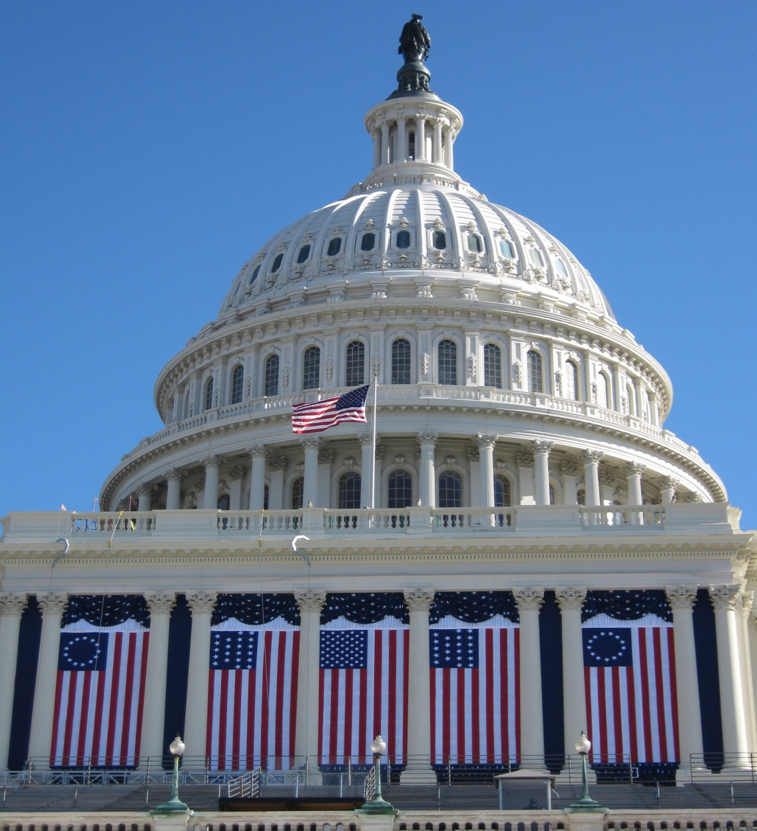
QUESTIONS

