Slide 1
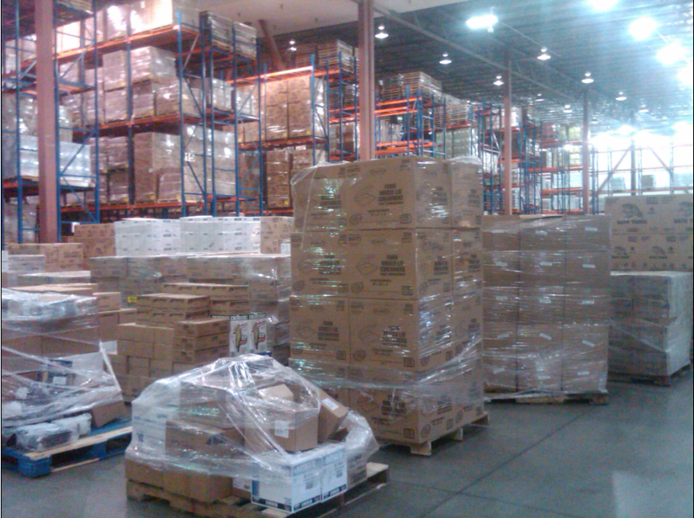
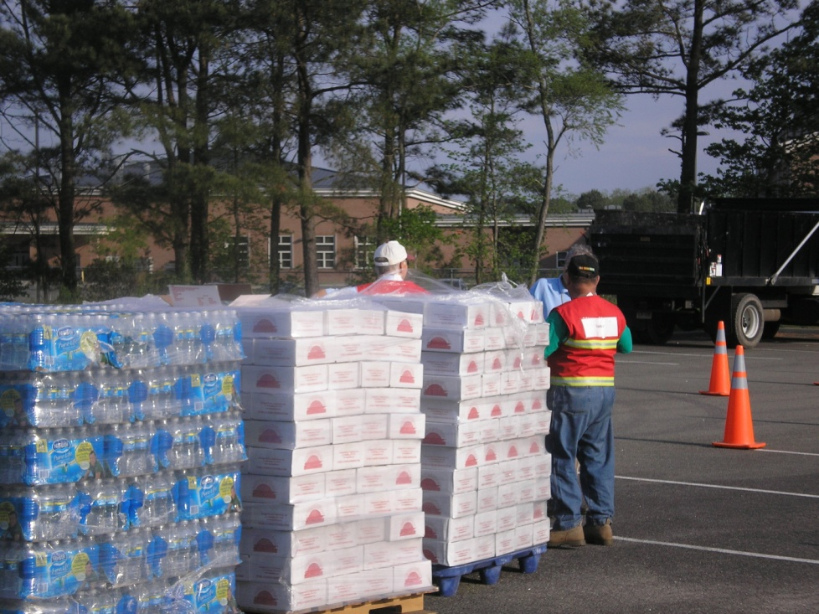
Leveraging Resources During Emergencies
Jason C. Eaton
Branch Chief of Logistics
Virginia Department of
Emergency Management

Slide 2
Resource Portals in Virginia
Local resources – public sector, volunteer, and private sector (60-70%)
Local mutual aid (MOU’s and MOA’s)
Private Sector MOU’s and MOA’s (VaWARN)
Resource contracts
Statewide Mutual Aid (SMA) - Locality to Locality
Local resource requests to the State
State agency resources - public sector and volunteer
State Agency to State Agency resource sharing
State Disaster Services Contracts and other Vendors
Emergency Management Assistance Compact (EMAC) - State to State
State resource requests to the Federal Government
Federal Resources - public sector and DOD resources
GSA Contracts
Federal Contracts

Slide 3
Private Sector Resource Network
Local resources – private sector contracts (60-70%)
Private Sector MOU’s and MOA’s (VaWARN) – water and wastewater
Local Volunteer Groups
Local Emergency Management
Mutual aid (MOU’s and MOA’s)
Local disaster contracts
Local response capabilities
Access to next tier of support – requests to the state
*The Key to Success is a great relationship with your local Emergency Management*

Slide 4
Foundational Resource Management
Preplanning = Success
Defined Processes and
Procedures
Sourcing Redundancy
Test/Exercise the System

Slide 5
Preplanning = Success
Have you done a Resource “Gap Analysis”?
What are your threats?
What do you have and what do you need based on the threat?
Sustainment – how long can you support before external help is critical?
Have you developed your Resource “Team”?
Leadership
Resource Coordinator
Procurement/Finance
Do you have a plan that incorporates how you will obtain resources?
Internal resource acquisition
Internal/external resource acquisition - contracts
Seeking assistance through local government

Slide 6
Defined Processes/Procedures
Do you have SOP’s/processes in place to support resource acquisition and implementation?
Does that process integrate into the next resource tier or could it become a “cog in the wheel?”
Do you know how to make a request to the next resource tier?
Without processes/procedures – you will be successful (hopefully) but it could have been easier and more efficient – the “Recipe Approach” and you get to go on vacation

Slide 7
Resource Redundancy
Do you have a “Football”? – resource information redundancy
“No” = single point of failures/24/7/365 on call
Do you always fish in the same spot? What if you need more fish or they just are not biting today?
Did you “Google”?

Slide 8
Testing the System
Exercise your resource management plan instead of waiting for it to get implemented
Evaluate the plan’s effectiveness
Revise your plan as necessary
Exercise the plan (let’s hope you don’t have to use it)

Slide 9
When You Ask For Resources, How Should That Request Look?

Slide 10
Making Requests – What to Include

Slide 11
For More Information on Virginia’s Logistics Programs
Jason C. Eaton
Branch Chief of Logistics
jason.eaton@vdem.virginia.gov
http://www.vaemergency.gov/em-community/em-resources/logistics

