Slide 1
Naval Air Station Oceana Jet Fuel Spill
Judy Cooling
Larry Hill
Virginia Department of Health
June 1, 2017

Slide 2
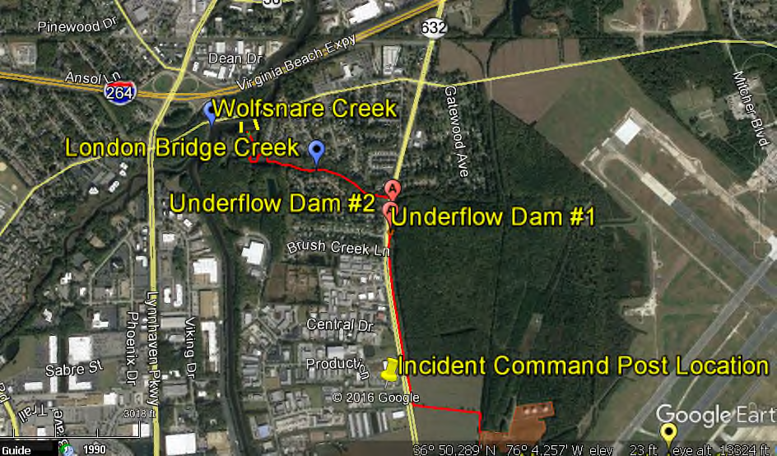
Location
Wolfsnare Creek/London Bridge Boulevard Area

Slide 3
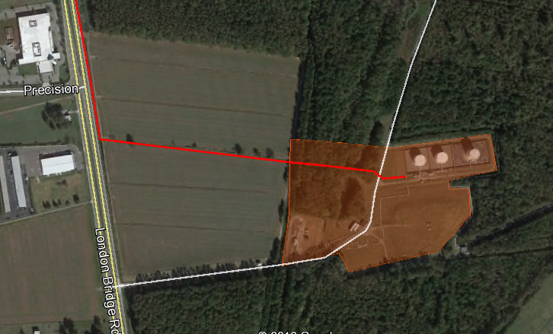
Fuel Tanks – NAS Oceana
Notes:
Approximately 94, 00 gallons jet fuel spilled from Oceana’s fuel tank farm and leaked off-site into Wolfsnare Creek and surrounding areas on Wednesday, May 10. The leak was discovered and reported around 6:30 a.m. on Thursday, May 11.
The residential communities of Brookgreen, Cheltenham Square, London bridge Landing, London Bridge Manor, Nottingham estates, Nottingham South, and the Evergreens were impacted by the incident.
Media initially reported incident as 9,400 gallons of fuel spilled. NAS Oceana indicated the spill would be cleaned up in 2 days.
Initially not seen as a public health issue.

Slide 4
Unified Command
National On Scene Coordinator (NOSC): U.S. Coast Guard (because fuel had entered the waterways)
State On Scene Coordinator (SOSC): Department of Environmental Quality (DEQ)
Navy On Scene Coordinator (NOSC): NAS Oceana CO (Responsible Party)
Local On Scene Coordinator (LOSC): City Emergency Manager
Virginia Beach Department of Public Health/VDH was a “Cooperating Agency” … not part of the Unified Command leadership. VBDPH/VDH brought in as Subject Matter Experts and “trusted voice for public health”.
Notes:
Other cooperating agencies included: EPA, VDEM, Port of Virginia, Hampton Roads Incident Management Team, USDA, Virginia Beach Animal Control, and HEPACO (clean-up contractor).
VBHD staff responding included Health Director, Environmental Health Manager, Epidemiologist, and Emergency Coordinator.
Regional Team also with UC, JIC, and VBDPH.

Slide 5
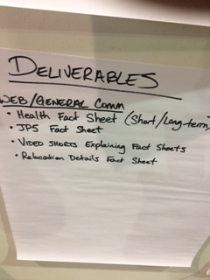
Unified Command Decisions
Clean-up in 2 phases:
Response
Remediation
Town Hall Meeting
Media Briefings and News Releases
Voluntary re-location of residents
Notes:
Response Phase – Immediate; placing booms and absorbents in the water; ensuring health and safety; air and water quality monitoring/testing. There were some high readings early in the monitoring, but never any levels that indicated a public health concern. The Virginia Beach Hazmat Team ambient air monitoring data was reviewed by VDH DEE which concluded there was not an elevated health safety risk for inhalation in neighborhoods near the spill site.
Remediation – Occurring now.
Town Hall Information Meeting – Over 100 residents attended the meeting. Primary concerns for public health were: Was it safe to breathe the air? What’s the long term effect on health on adults, kids and babies? What’s the effect on the wild life/marsh? A VBPHD FAQ sheet was available for residents.
All media briefings were conducted by NAS Oceana/Navy, with UC and cooperating agencies attending/supporting. VBPHD Health Director was also interviewed by several local media outlets.
As a result of public outcry at the Town Hall Meeting and questions/concerns being raised in the media, the Unified Command decided to offer the residents “voluntary re-location” for 7 days. At no time was the air quality deemed unsafe or any other public health concern. 51 families opted to voluntarily relocate (approximately 200 homes in the neighborhood). As of last Friday, not all residents have returned to their homes. VBPHD continues to receive calls from residents concerned about the health effects.
As of Friday, May 26, UC demobilized. DEQ will be the lead for remediation and remaining clean-up off NAS Oceana property.

Slide 6
Situational Awareness
Event Notification
VDH Division of Environmental Epidemiology (DEE), who had been alerted by VDEM, issued an Event Notification and recommended VBDPH issue a public advisory to avoid all recreational contact including fishing and crabbing in the vicinity of the release.
Situation Reporting
DEQ and VBDPH submitted daily SitReps
VDH conducted daily conference calls with VBPHD
Essential Elements of Information (EEIs) were not the same as local health districts are used to reporting in other types of events.

Slide 7
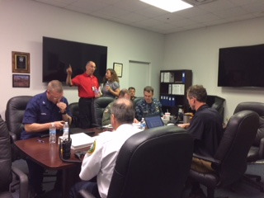
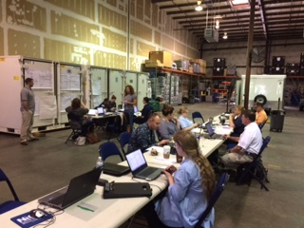
Communications/Joint Information Center

Slide 8
Lessons Learned
VDH is not a SME on jet fuel (JP5). VBPHD Health Director should have insisted the Navy bring in Subject Matter Experts (SMEs) from the US Navy and Marine Corps Public Health Center at Portsmouth Naval Hospital.
VBDPH saw event in the news, did not think it was a public health issue. Was not contacted by City Emergency Management until Saturday when they wanted a JP5 SME.
Since VBDPH was not part of the Unified Command leadership they had a hard time getting on event sitrep distribution list. We received DEQ sitrep from Central Office.
Communications flow—Local Health Department to Central Office Divisions and vice versa.

