Slide 1
Stig-ma 1. a mark of disgrace associated with a particular circumstance, quality, or person: "the stigma of mental disorder"
Notes:
-Kansas Video: http://www.adweek.com/brand-marketing/if-cancer-patients-were-treated-like-addicts-hard-hitting-psas-aim-to-stop-the-shame/?utm_campaign=nl_1&utm_source=sailthru&utm_medium=email&utm_term=AWK_Agencies
Stigma
-Inaccurate understanding of the disease of addiction.
-It took thirty years for society’s understanding of mental illness to catch up to science’s. We know that a patient with the chronic brain disease of addiction chooses to use about as much a person with depression chooses to attempt suicide.

Slide 2
“…The sense of stigma is most likely to diminish as a result of public education and broader acceptance of addiction as a treatable disease.” —Institute of Medicine
Notes:
Education
-IOM suggests educating the public that addiction is a chronic relapsing disease of the brain.
-Why? Because no amount of wrong work will get you the right result.
-To make right decisions on an issue you have to see the real nature of the problem.

Slide 3
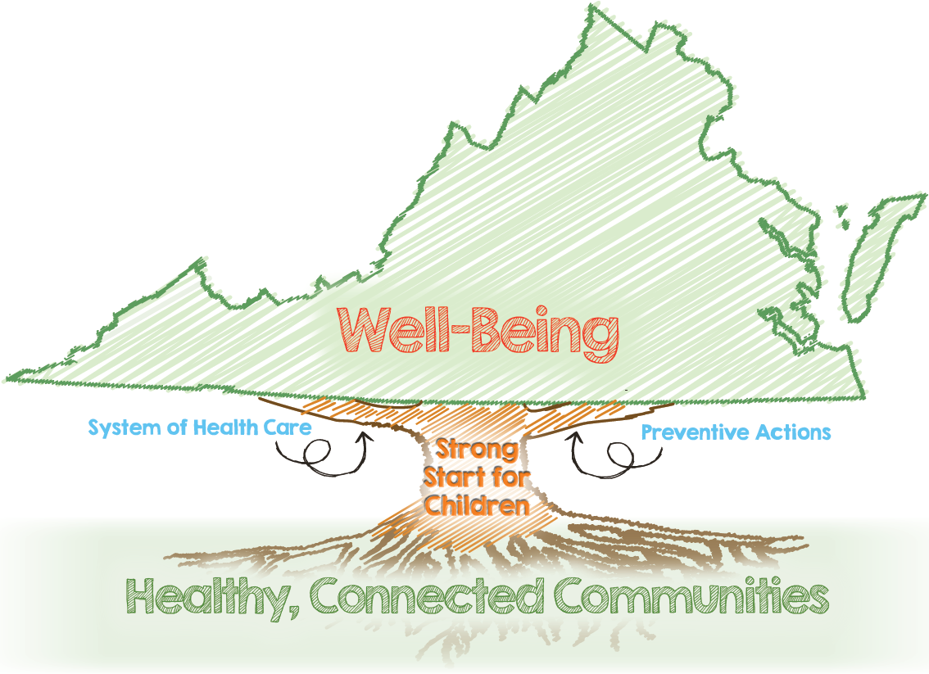
Notes:
-PfWB
-While many task force recommendations were being adopted, a group of leaders from multiple agencies attended the NGA learning collaborative in Rhode Island in the Summer of 2016.
-We realized that, consistent with the Virginia Plan for Well-Being, a healthy community response capability is crucial and the Commonwealth’s role is to support the community..

Slide 4
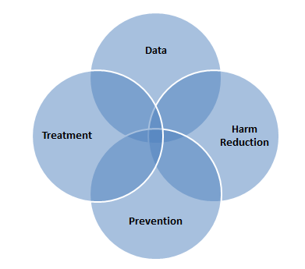
Executive Leadership
Co-Chairs: Secretary of Health &Human Resources William A. Hazel, Jr., MD
Secretary of Public Safety & Homeland Security Brian J. Moran
Policy and Legislative Recommendations
Goal Setting
:
Local Support
State Support
VSP Region 1
VSP Region 2
VSP Region 3
VSP Region 4
VSP Region 5
VSP Region 6
VSP Region 7
Local needs, implementation of prevention strategies, efforts, scoring
Resources, consultation, programs, policy interventions
4
Notes:
-ELT
-Out of this realization came the Gov exec Dir 9 and a declaration of a Public health emergency.
-Explain org chart. We decided to use a pop health strategy. Use data to focus efforts in three areas of activity: Prevention, Screening/Treatment/Recovery and Harm Reduction.
-As the addiction meme changed, what was the evidence it was making a difference?

Slide 5
Notes:
Prevention-
-Because of the changing meme around addiction
-Addiction 101 slide- public safety and HHR coming together. Recognition of addiction as a disease that we can’t arrest our way to a cure.

Slide 6
Notes:
-BOM regulations- Gov McAuliffe worked with Republican Delegate Todd Pillion on a bipartisan bill that resulted in one of the strongest sets of BOM regulations in the country. In two years the medical community moved from fighting almost any attempt to limit practice to working closely with legislators and administration leadership.

Slide 7
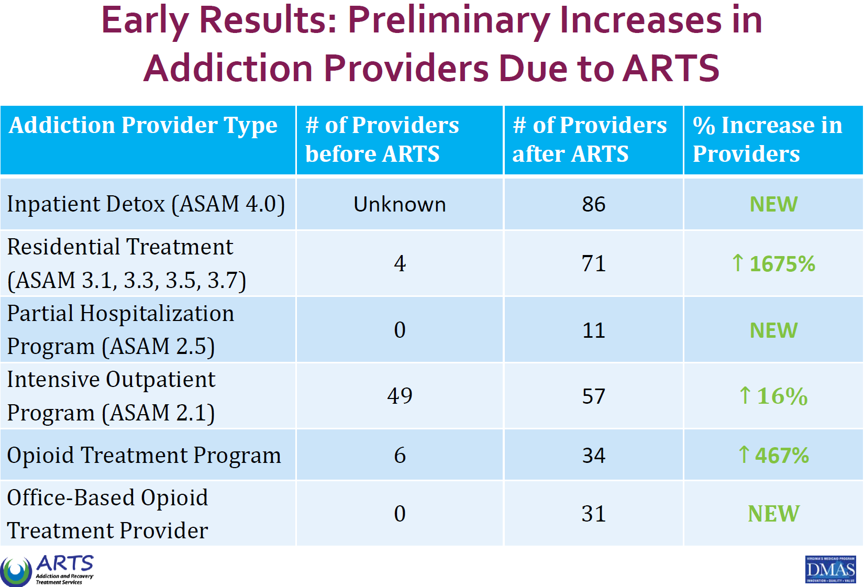
Notes:
Treatment
-Two years ago we found bipartisan support for $12 million to fund and 1115 Medicaid Waiver. This year we succeeded in avoiding a cut to that funding in the face of a budget shortfall of xx billion.
-ARTS. Maps.
-ADM sessions. 1000 new providers

Slide 8
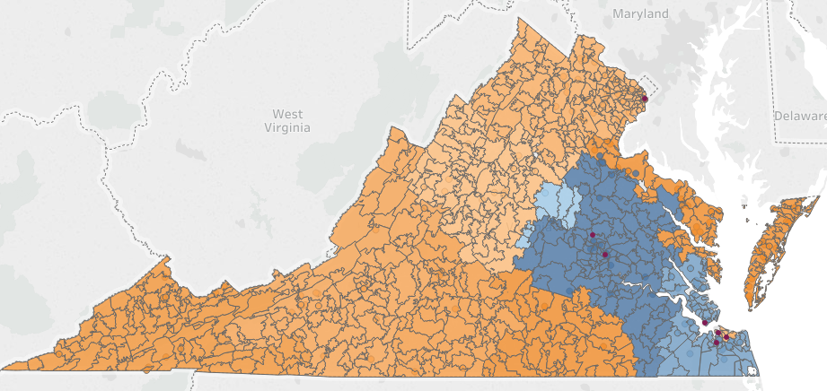
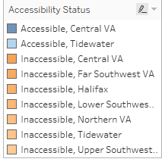
Before ARTS Medicaid Provider Network Adequacy Opioid Treatment Program
Source: Department of Medical Assistance Services - Provider Network data (March 20, 2017).
Circles # of Medicaid providers included in network adequacy access calculation.
Accessible is considered to be at least two providers within 60 miles of driving distance.
Driving distance is calculated by Google services based on the centroid of each zip code.

Slide 9
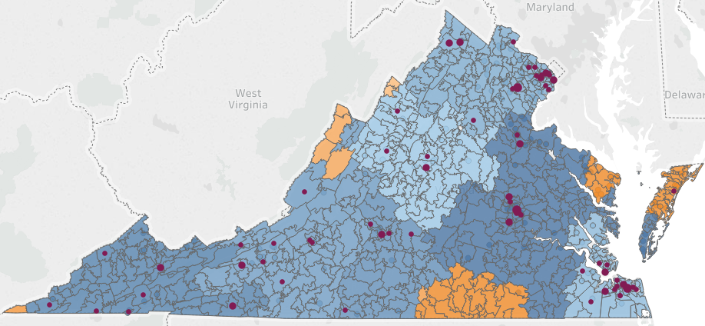
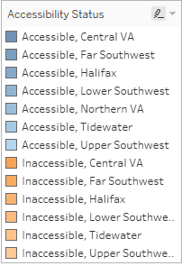
After ARTS Medicaid Provider Network Adequacy Opioid Treatment Program
Source: Department of Medical Assistance Services - Provider Network data (March 20, 2017).
Circles # of Medicaid providers included in network adequacy access calculation.
Accessible is considered to be at least two providers within 60 miles of driving distance.
Driving distance is calculated by Google services based on the centroid of each zip code.
9

Slide 10
State Senate Districts
Notes:
Harm Reduction
-The Centers for Disease Control recently released a list of 220 counties in the United States that are at risk to have similar outbreaks of HIV and Hepatits C as occurred in Scott County, Indiana. Six of these counties lie in SWVA.
-Two years ago an effort by the administration to pass a syringe exchange bill didn’t even get out of subcommittee.
-This year, Gov McAuliffe personally advanced a similar bill sponsored by Republican Delegate Dr. John O’Bannon. It passed with overwhelming majorities in both Republican controlled houses. Why? Because the meme of addiction has changed to one of a chronic relapsing disease of the brain, largely as a result of public education and workforce development efforts that started in 2014 with Gov McAuliffe’s task force.

Slide 11
All Opioid Deaths Vs. All Drug Deaths An envisioned future…
¹ ‘All Opioids’ include all versions of fentanyl, heroin, prescription opioids, and opioids unspecified
² Illicit and pharmaceutically produced fatal fentanyl overdoses are represented in this analysis. This includes all different types of fentanyl analogs (acetyl fentanyl, furanyl fentanyl, etc.)
Notes:
OD Curve
-Despite all our efforts, the problem continues to worsen. Will our new response structure focusing on developing a healthy community response capability be sufficient to create an envisioned future where the curve changes direction? I do not know. Jury is still out.
-I do know that we are increasingly doing the right work. Going in right direction.

