Slide 1
Coordination During a Human Rabies Investigation
Michael Keatts
NW Region Health Emergency Coordinator
Ryan McKay
Emergency Coordinator
Thomas Jefferson HD

Slide 2
Situation Overview
May 10: TJHD and Piedmont HD notified of possible case of rabies identified in a patient acquired while visiting India with a tour group
Individual resided in Piedmont HD and sought care at 3 different facilities in TJHD
Low risk, high consequence

Slide 3
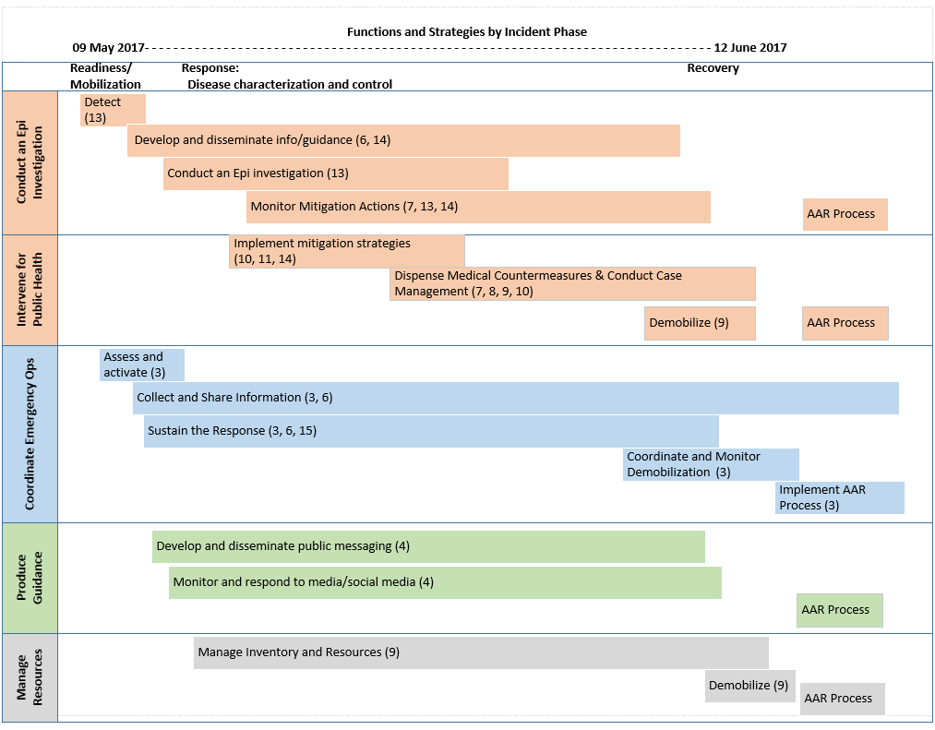

Slide 4
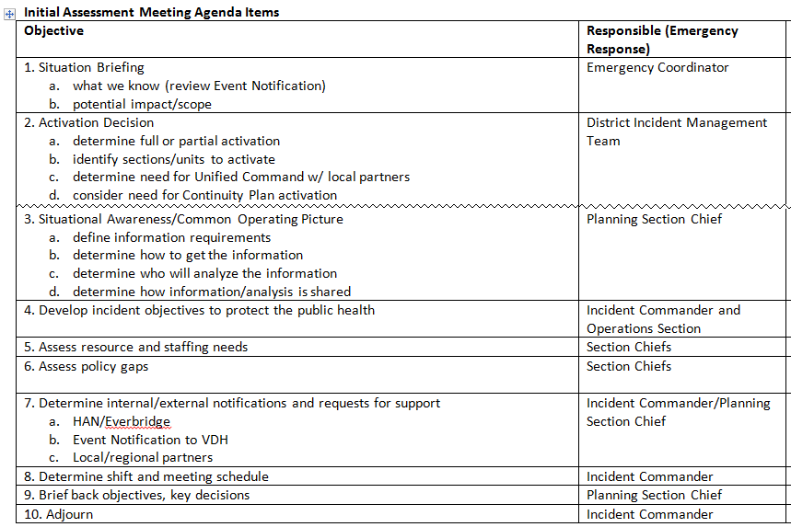

Slide 5
Assessment and PEP Recommendation Data for Human Rabies Response
Group | # needing Assessment | # number assessed | # Recommended for PEP
EMS and Healthcare Facility Staff | 216 | 207 | 69
Family and Close Contacts | 18 | 18 | 2
Total | 234 | 225 | 71

Slide 6
State Veterinarian, OCRE, and Piedmont HD Coordinated development of talking points for “town hall’ meeting with Yogaville community
Yogaville is a communal group composed of a variety cultural backgrounds creating need to consider cultural sensitivities when developing and delivering messages

Slide 7
TJHD Post-exposure Prophylaxis Data by Facility
Location | Day 0 | Day 3 | Day 7 | Day 14
CAHD | 47 | 47 | 42 | TBD
External Facility | 13 | 13 | 15 | TBD
Undetermined | 9 | 9 | 9 | TBD
Total | 69 | 69 | 66
Day 0 includes Rabies Immunoglobin (RIG) and one dose of Rabavert
TJHD conducted three full days of POD operations at CAHD
External facilities include hospital ED and Waynesboro Health Department (Central Shenandoah HD)

Slide 8
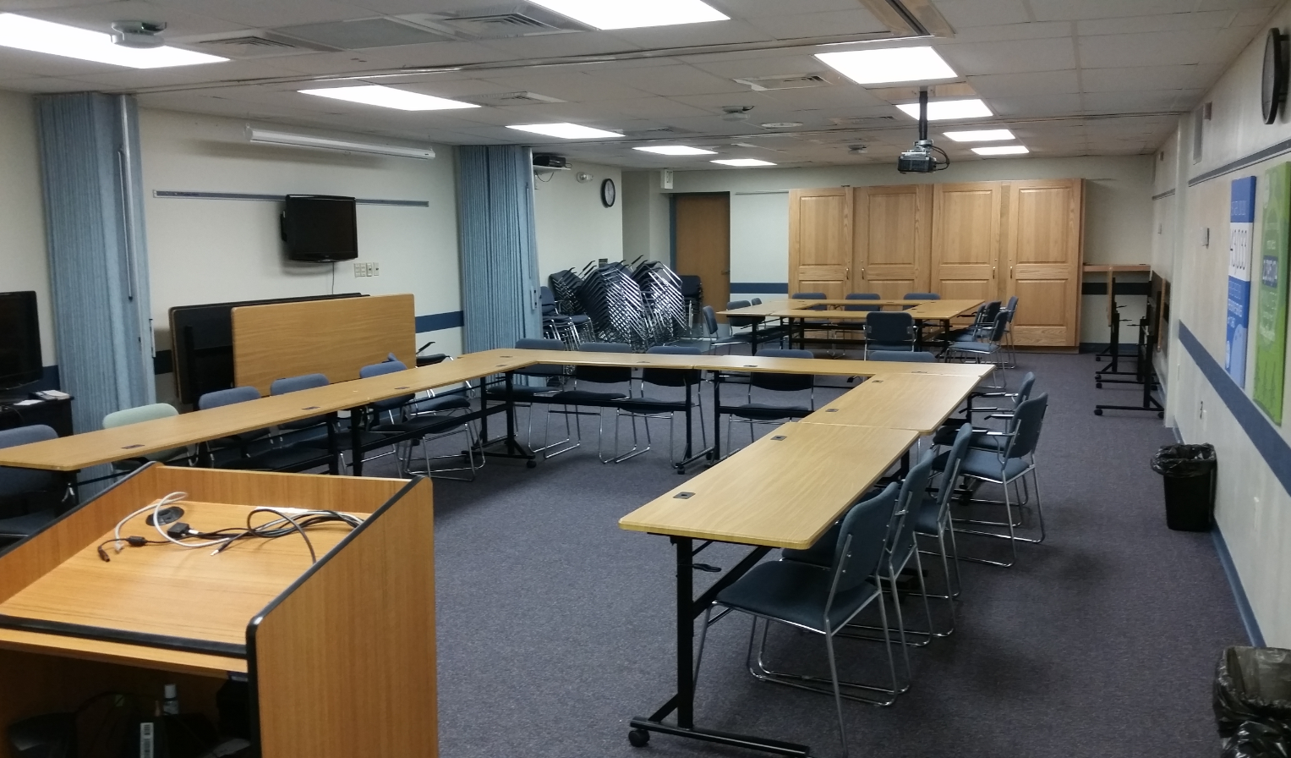

Slide 9
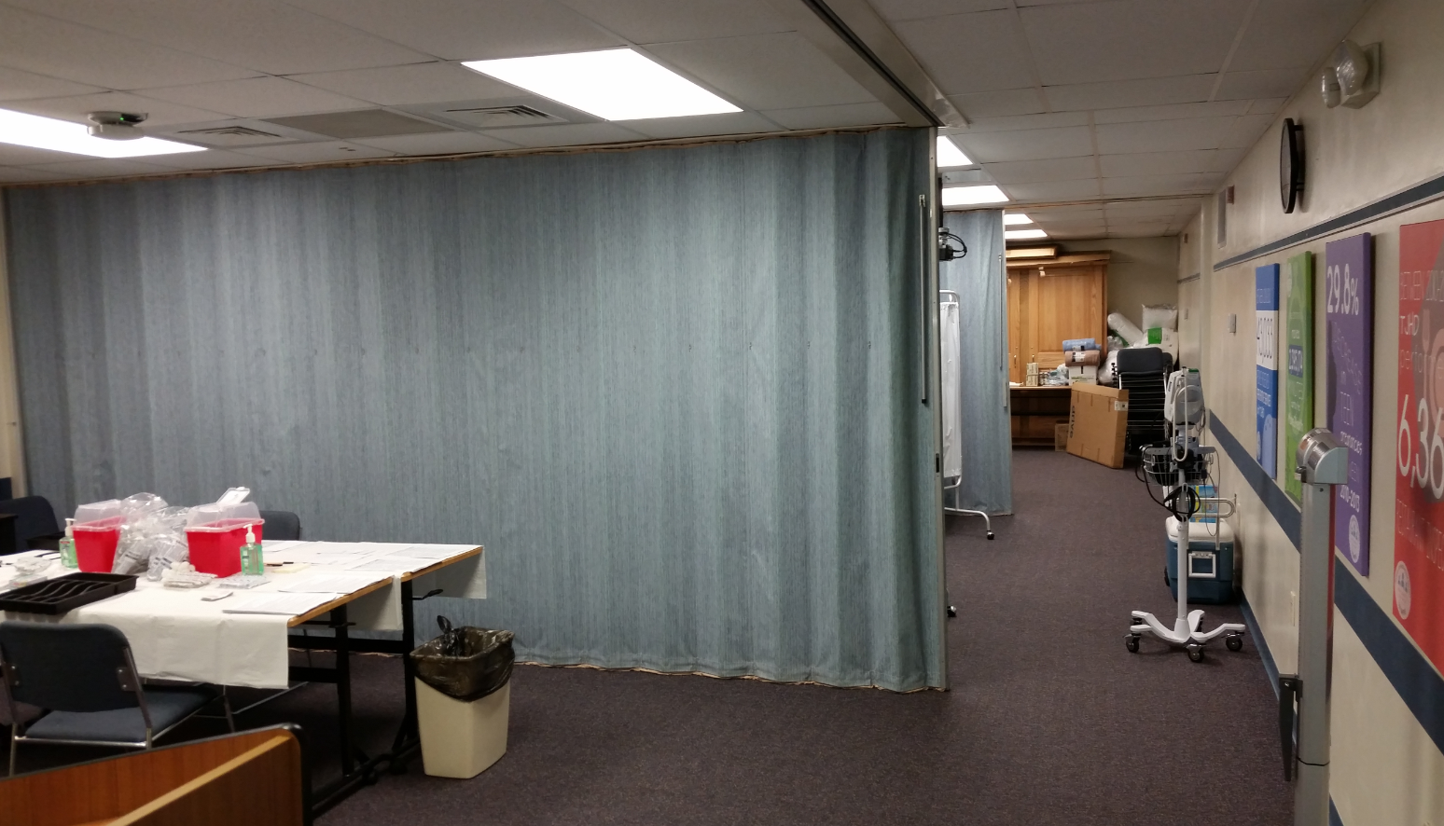

Slide 10
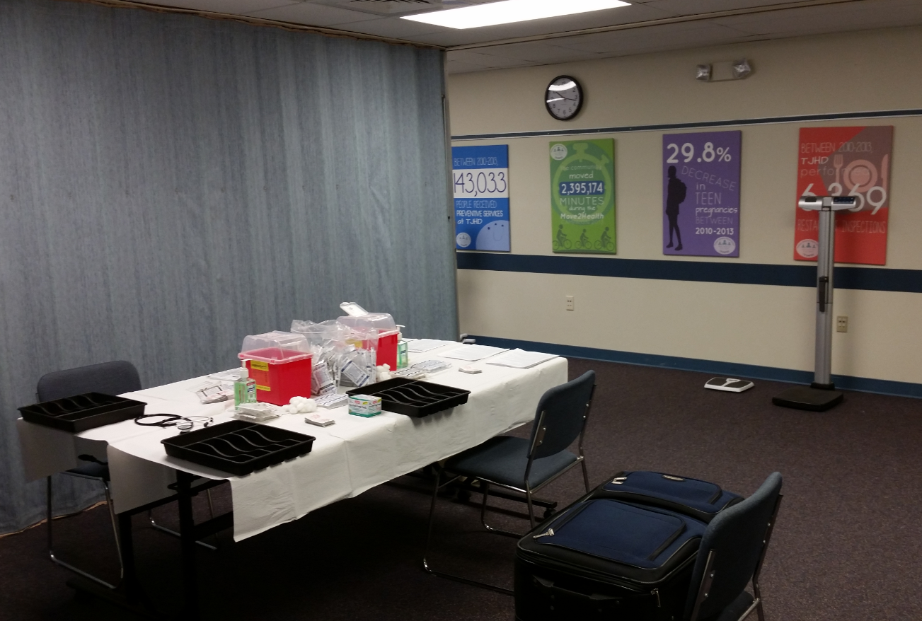

Slide 11
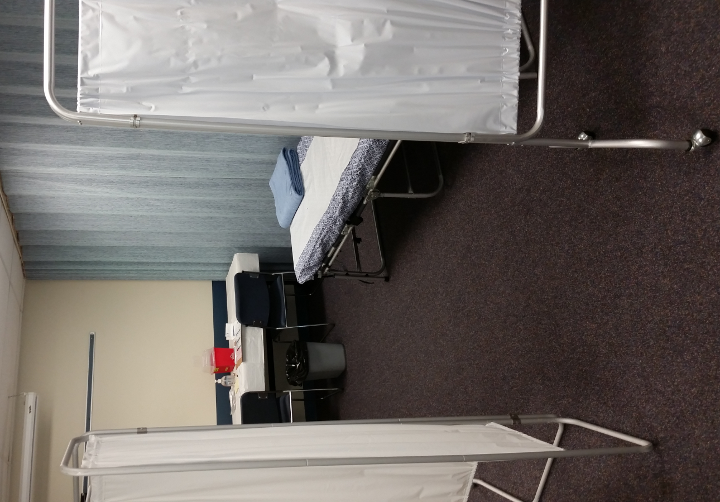

Slide 12
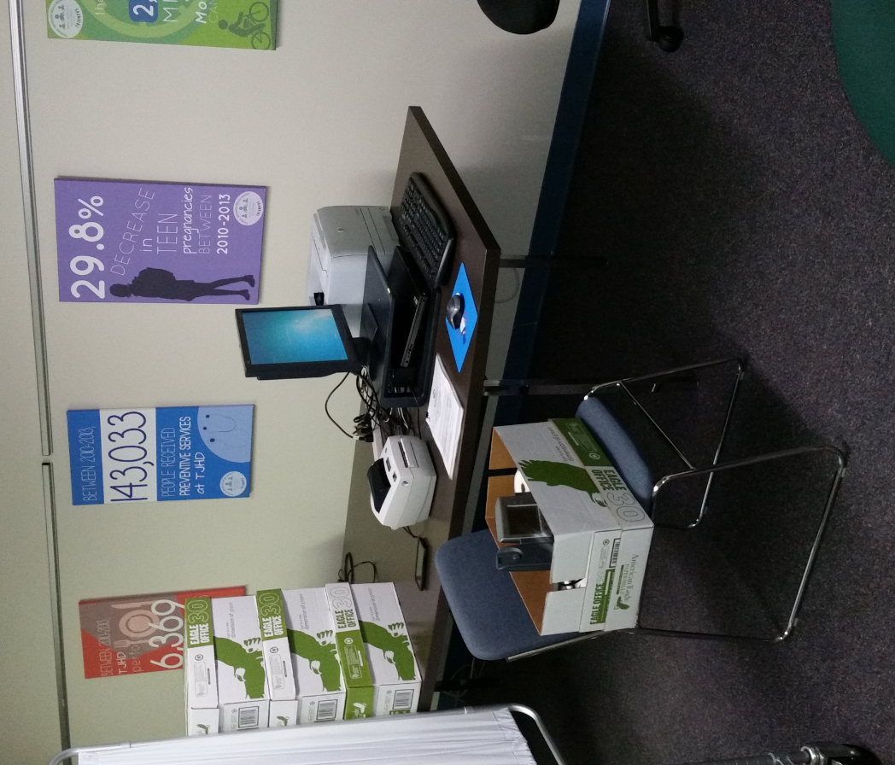

Slide 13
PHEP Capabilities
Capability 3 – Emergency Ops Coordination
Capability 4 – Emergency Public Info/Warning
Capability 5 – Fatality Management
Capability 6 – Information Sharing
Capability 7 – Mass Care
Capability 8 – MCM Dispensing
Capability 9 – Medical Material Mngt./Distri.
Capability 10 – Medical Surge
Capability 11 – Non-Pharmaceutical Interventions
Capability 12 – PHL Testing
Capability 13 – PH Surveillance and Epi Investigation
Capability 14 – Responder Safety and Health
Capability 15 – Volunteer Management

