Slide 1
Community Assessment for Public Health Emergency Response (CASPER):
Fairfax County Health Department's Perspective
Fairfax County
Health Department

Slide 2
What is a CASPER?
Epidemiologic technique designed to provide quick and at low cost, household-based information about a community’s needs in a simple format to decision-makers.
Developed specifically for use in communities affected by disaster; the North Carolina Department of Public Health and Guilford County pioneered the use of CASPER to collect primary data about public health needs as a part of a Community Health Assessment.
CASPER involves conducting door-to-door surveys on a random sample of households using a questionnaire.
Notes:
Following any type of disaster, public health and emergency management professionals must be prepared to respond and meet the needs of the affected public. The Community Assessment for Public Health Emergency Response (CASPER) enables public health practitioners and emergency management officials to determine rapidly the health status and basic needs of the affected community . CASPER is a specific set of tools designed to provide quick, inexpensive, accurate and reliable household-based public health information. CASPER uses valid statistical methods to gather information about health and basic needs, allowing public health and emergency managers to prioritize their response and distribution of resources accurately. The CDC HSB uses the acronym CASPER to distinguish it as a household-based needs assessment. CASPER may also be used for conducting Health Impact Assessments (HIAs) or other community level surveys during non-emergency situations, like we will be conducting this upcoming weekend here in Fairfax County. Regardless of the setting and objectives, once the decision to conduct a CASPER has been made, it can be initiated within 72 hours.

Slide 3
Presentation Objectives
Understand the purpose of the CASPER program
Describe the assessment components of a CASPER (questionnaire, sampling, analysis)
Describe CASPER operations and use of the Incident Command System (ICS) and response tools

Slide 4


Presenters
Shawn Kiernan, Communicable Disease/ Epidemiology Supervisor
  Focus on the perspective from an LHD epidemiologist
  Discuss role of the epidemiologist
Jesse Habourn, Public Health Emergency Management Coordinator
  Describe the application of ICS to CASPER as a planned event
  Operational considerations to perform a safe and efficient CASPER

Slide 5
Team Approach
Get all key players involved early and often
  Who is involved?
Start planning about 6 months in advance
  Everyone should agree on approach as much as possible
Set a date and clear you calendars as much as possible during and week after.
  Consider weather and other events
Notes:
monthly meetings

Slide 6
FCHD CASPER Objectives
Collect community data on emergency preparedness, communication, and communicable disease
Train FCHD staff how to conduct a CASPER in the event of an emergency in Fairfax County
Complete CASPER June 4-16, 2016.

Slide 7
Epidemiologist’s Role
Questionnaire Development
CASPER Sample
Cluster Approach (which houses to visit from a sampling perspective)
Training - Epidemiology of CASPER & Interviewing 101
Analysis of Data
Final Report
Presentations/ Publication of Findings

Slide 8
Questionnaire Development
Existing templates available
Approximately 50 questions
Questions mainly yes/no or multiple choice questions allowing for easier analysis
Major topic areas:
  Demographics
  Emergency preparedness
  Methods of communication
  Communicable disease information
  Actions during an emergency

Slide 9
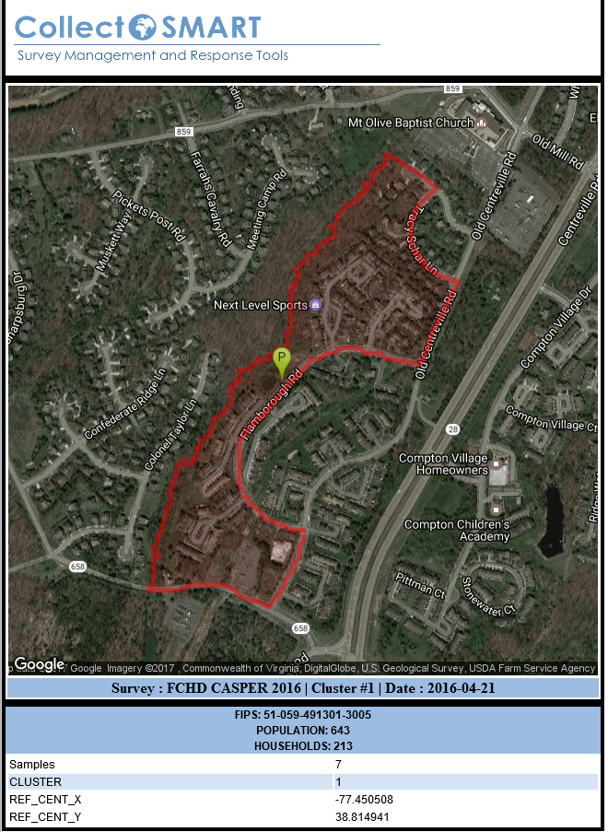
CASPER Sample
Teams of 2 survey 45 “clusters” randomly selected based on census blocks

Slide 10
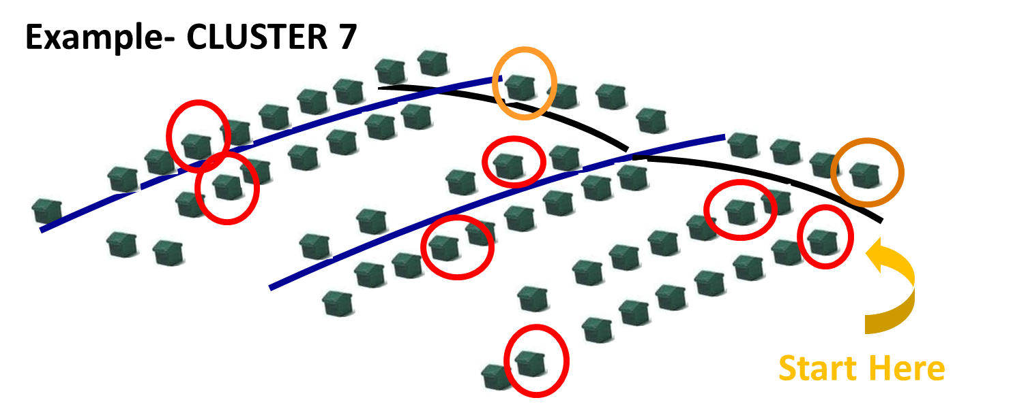
Cluster Approach
7 households per cluster; approach every 7th household
Operational logistics outweighed epidemiological bias concerns

Slide 11
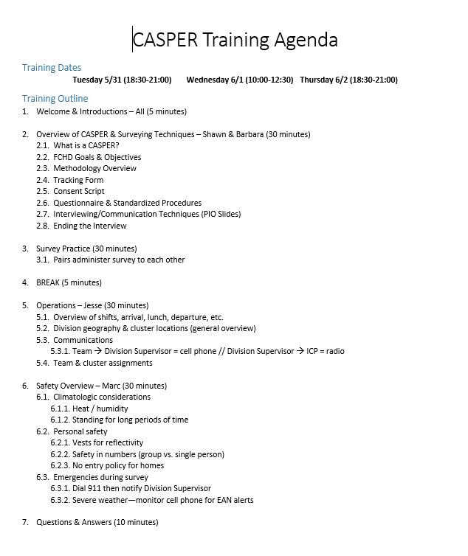
Training
Epi’s Role

Slide 12
Analysis of Data
Analysis examined percent of answers for each question and are displayed in tables in the technical report
Further analysis allowed for extrapolation of results to entire Fairfax County population through projected frequencies, counts, and 95% confidence intervals.

Slide 13
CASPER Results
253 interviews completed
Response Rates
Completion Rate | 80.3%
Cooperation Rate | 47.9%
Contact Rate | 14.3%
Notes:
The completion rate represents how close interview teams came to collecting the goal number of interviews (n=315). Completion rates below 80% (n=252) result in an unacceptably low number to represent the sampling frame.
The cooperation rate is the proportion of households at which contact was made and the household agreed to complete an interview. It represents both the eligibility and the willingness of the community to complete the CASPER interview. The lower the number of contacts made, the more the sample becomes one of convenience.
The contact rate is the proportion of all households at which contact was attempted and the household successfully completed an interview. Higher contact rates indicate better representativeness of the sample to the population. Lower contact rates indicate that field interview teams had to attempt interviews at many households (i.e., knock on many doors) in order to obtain the necessary number of interviews. The lower the contact rate, the more the sample becomes one of convenience at the second stage.

Slide 14
CASPER Results
Comparing Fairfax County race/ethnicity demographics of the projected CASPER percentages with the 2015 US Census data.
Race/Ethnicity | 2015 US Census Data (Fairfax County) | 2016 Fairfax CASPER- Projected Estimates
White | 66.1% | 62.8%
Asian | 19.5% | 20.1%
Hispanic | 16.4% | 15.6%
Black | 10.1% | 10.6%
American Indian/Alaskan Native | 0.6% | 0.7%
Native Hawaiian or Other Pacific Islander | 0.1% | 0.4%

Slide 15
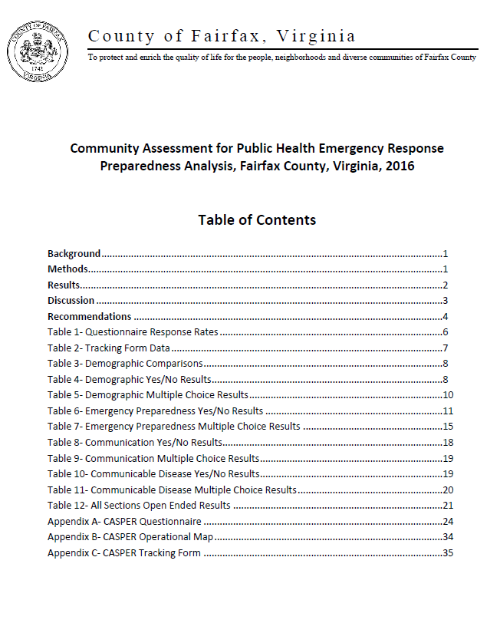
Final Report
Preliminary Report- Ready in week after CASPER
Final Report- Ready in one Month after CASPER
Templates are available

Slide 16
Presentation/ Publication of Findings
The results of FCHD’s CASPER can be used to evaluate the needs of the County from different perspectives, therefore it is recommended that FCHD share this report with key partners throughout the County.
A full copy of the report along with a news release summarizing the major findings can be found at: http://www.fairfaxcounty.gov/hd/hdnews/2016hdnews/2016-sep-27-casper-preparedness-survey-results.htm.
Further analysis of CASPER data

Slide 17
Operational Considerations
Use ICS as for any planned event
Pre-planning essential:
  Drive clusters in advance, provide detailed maps
  Communicate in advance with HOAs, building management
Notify public safety partners in advance
Develop weather-related thresholds to pause/cancel operations
Safety planning based on geography and area zoning
Don’t skimp on training

Slide 18
Application of ICS
Planning P is critical
Organize operations by division (geography)
  Each Division Supervisor oversee 3 to 5 teams
Division Supervisors familiar with area of operation
Logistics, especially COML, essential
Identify an ICP as close to center of AO as possible
Tailor operational period to weather conditions
Activate a Safety Officer and Assistant Safety Officer(s)
Resource and operational tracking critical

Slide 19
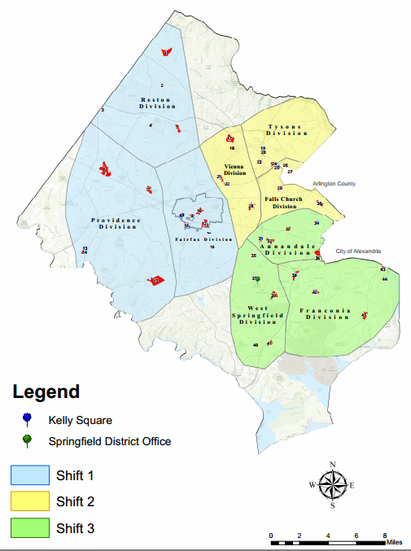

Slide 20
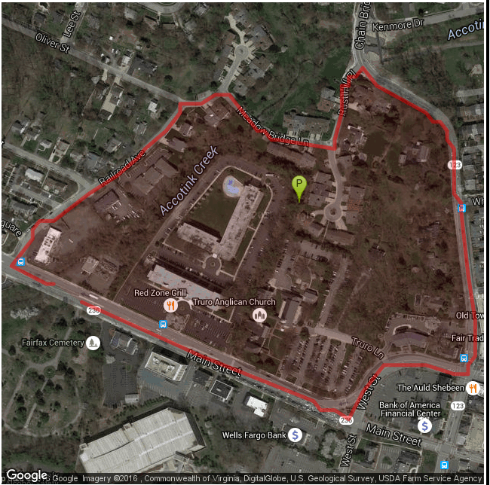
Cluster Maps
Mark starting location
Identify nearby bathrooms
Identify management offices
Provide details on:
  Zoning
  # of dwellings
  Sidewalks (or lack thereof), dangerous intersections
  Available parking

Slide 21
Safety Considerations
Weather
Traffic
Time of day/night
Unknown neighborhoods and commercial areas
Dogs! Bees!
Visibility (ICS vests, reflective striping, ID as Health Dept.)
Cold approaching strangers; confrontational situations
Teamwork essential

Slide 22
CASPER Training
CASPER Methodology
Interviewing techniques
Scripts, forms, questionnaire (and opportunity to practice)
Command and control
Safety
Team interactions
Contingency plans for weather, hazards
Working a cluster

Slide 23
Operational Lessons Learned
Saturdays difficult; Sundays better; weekday nights best
Communication is critical for safety
Approach is everything
More language interpreters
50 questions is too many
Carefully select wording of questions
Maintain a presence in the field

Slide 24
