Slide 1
Virginia Public Health & Healthcare Preparedness Academy Field Epidemiology Seminar Traveler Associated Illness June 1, 2017
Costi D. Sifri, MD
University of Virginia School of Medicine
Division of Infectious Diseases & International Health

Slide 2
Disclosures
None to Declare
Some case specifics have been changed to protect personal health information

Slide 3
Deaths Related to International Travel
N = 2463
Hargarten S, et al. Ann Emerg Med. 1991;20:622-6

Slide 4
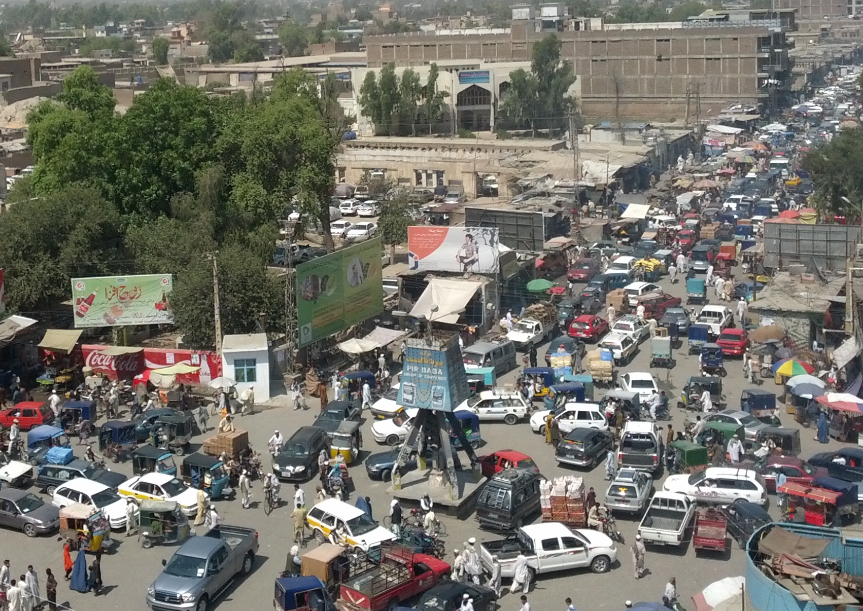
Deaths Related to International Travel
Hargarten S, et al. Ann Emerg Med. 1991;20:622-6

Slide 5
Case Presentation
March 2015
19 y/o student presents with fevers and rash 3 days after returning from São Paulo, Brazil for Spring Break
10 day mission trip, working outside building a school
Slept outside on a roof, numerous mosquito bites, saw rats on the roof
Ate local food, swam in local river, 1 day trip to Amazon River Basin
Vaccines up to date, including
hepatitis A, typhoid, HBV, influenza, MMR, meningococcus
No malaria chemoprophylaxis

Slide 6
Case Presentation
Acute onset fever one day earlier, Tm 103°F
Pruritic rash started on neck, arthralgias
Additional sx: myalgias, retro-orbital headache
No abdominal pain, nausea, vomiting, diarrhea, dysuria
A few other students had similar, milder illness
Exam: nontoxic, normal conjunctivae and oropharynx, supple neck, normal chest/abdomen, maculopapular rash most prominent over shoulders
Labs: WBC 12.2 (78^{S} 12^{L} 9^{M} 1E), HGB 14.1 mg/dL, PLT 189, Cr 0.8 mg/dL, normal LFTs, CXR NAD

Slide 7
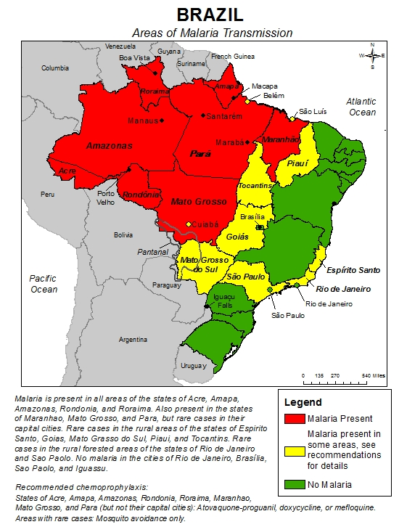
Case Presentation
Differential Diagnoses
*Chikungunya virus
*Dengue virus¶
*Malaria
Typhoid fever
Acute schistosomiasis
Leptospirosis
Hantavirus virus
Acute HIV
Tick borne illness (e.g. rickettsial infection)
Acute EBV (mononucleosis)
Malaria transmission in Brazil
¶ Recent reports of dengue outbreak in Brazil

Slide 8
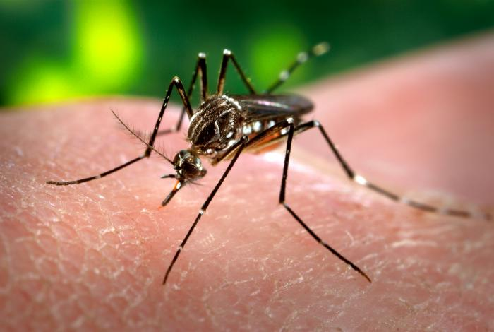

Slide 9
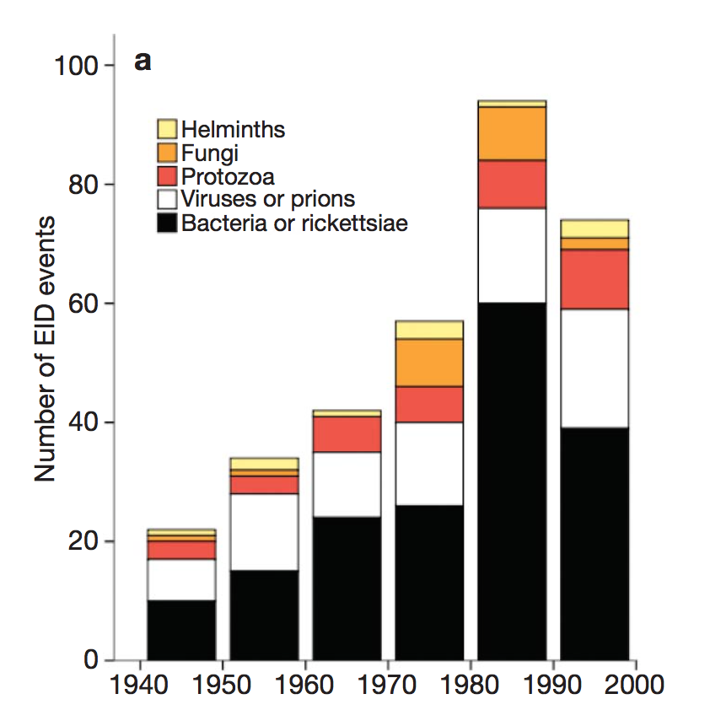
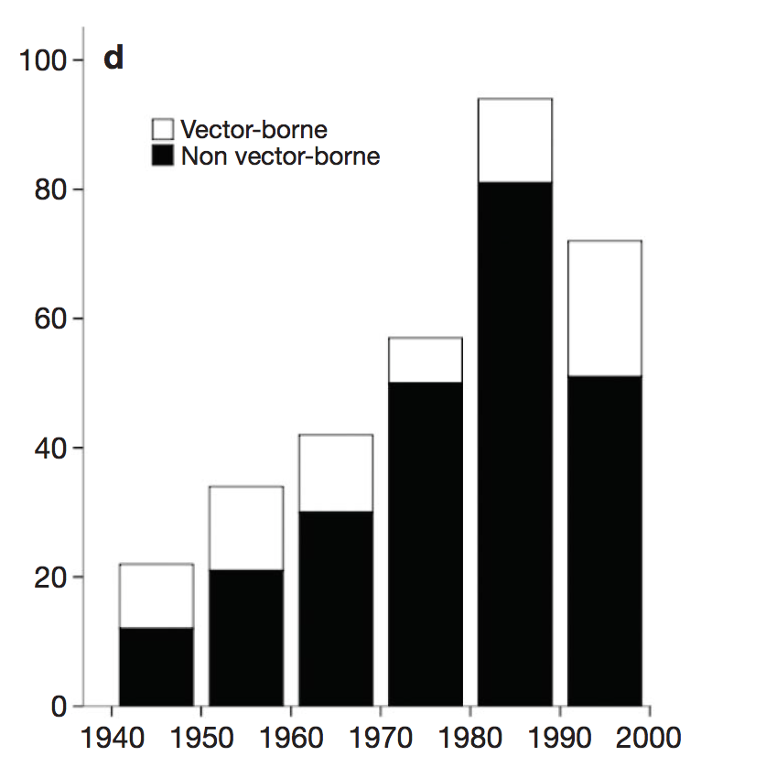
Emerging infectious disease 1940-2004
~1/3 viruses, ~1/3 vector borne
Pathogen class
Vector vs non-vector
Jones KE, et al. Nature 2008;451:990-3

Slide 10
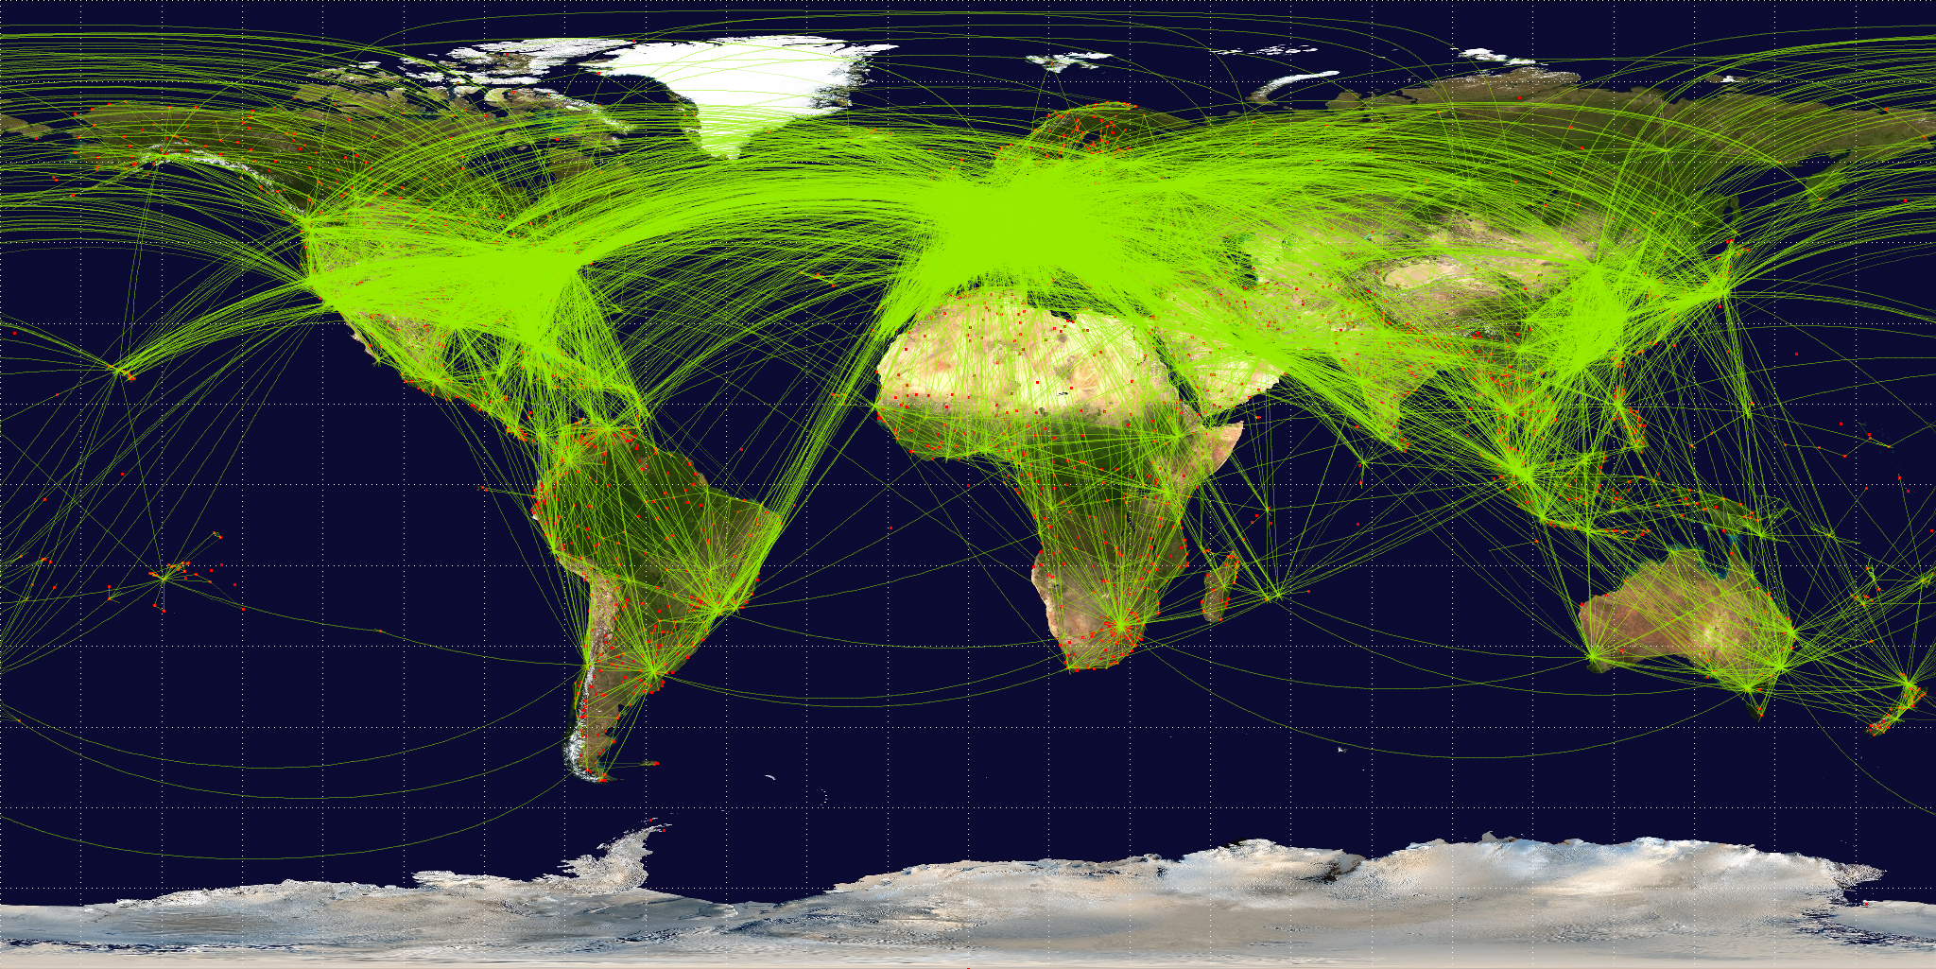
A Connected World
The world is growing ever more connected
Daily Flight Paths
Source: http://contrailscience.com
Notes:
Interconnected world. But there are additional factors: increasing worldwide population, increasing urbanization, loss of natural animal habitats and increased human/non-domestic animal interactions, climate change.

Slide 11
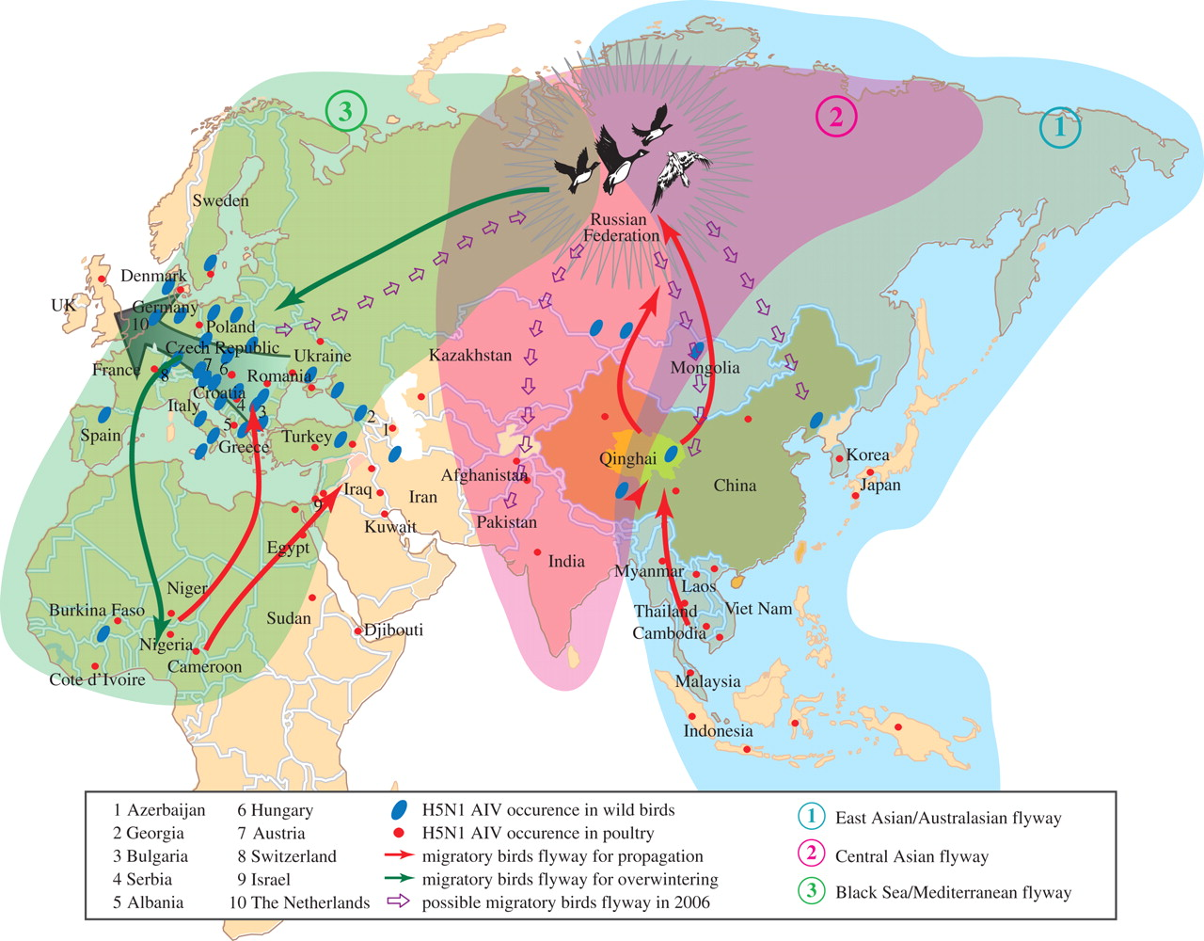
A Connected World
The world is growing ever more connected
Potential migratory bird routes
for Avian influenza H5N1, 2005-06
Ma Y, et al. Philos Trans R Soc Lond B Biol Sci. 2009;364:2725-37
Notes:
Interconnected world. But there are additional factors: increasing worldwide population, increasing urbanization, loss of natural animal habitats and increased human/non-domestic animal interactions, climate change.

Slide 12
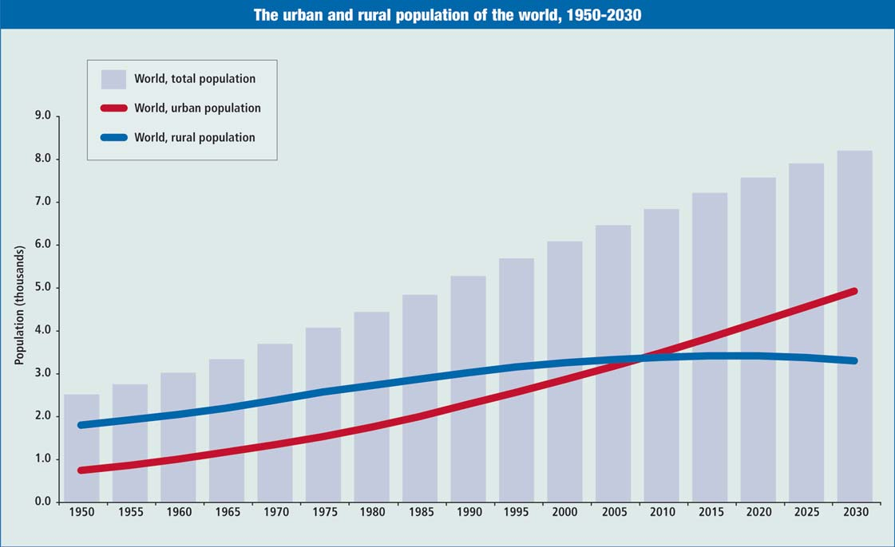
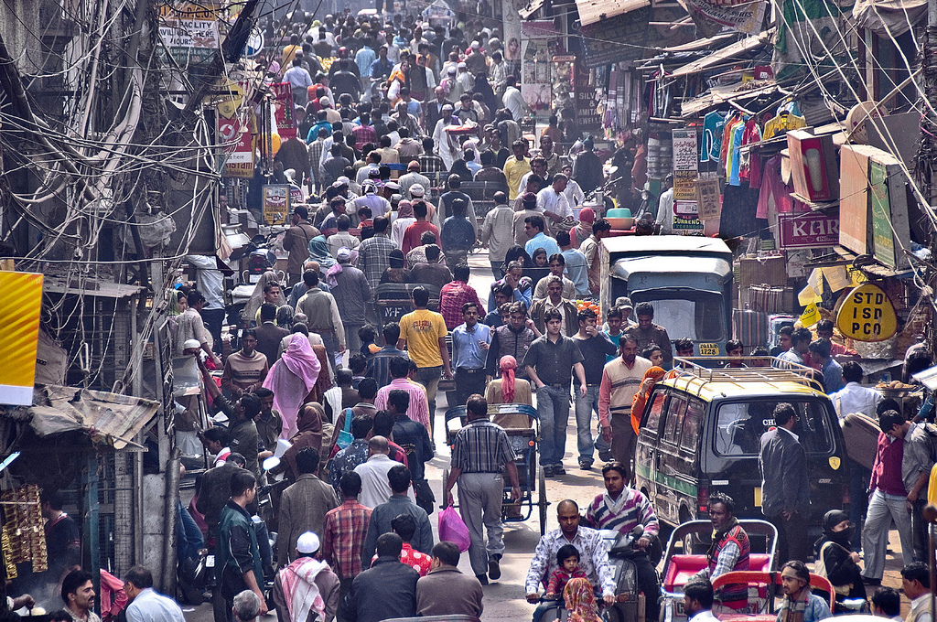
A Crowded World
Urban Population Growth
Source: www.un.org

Slide 13
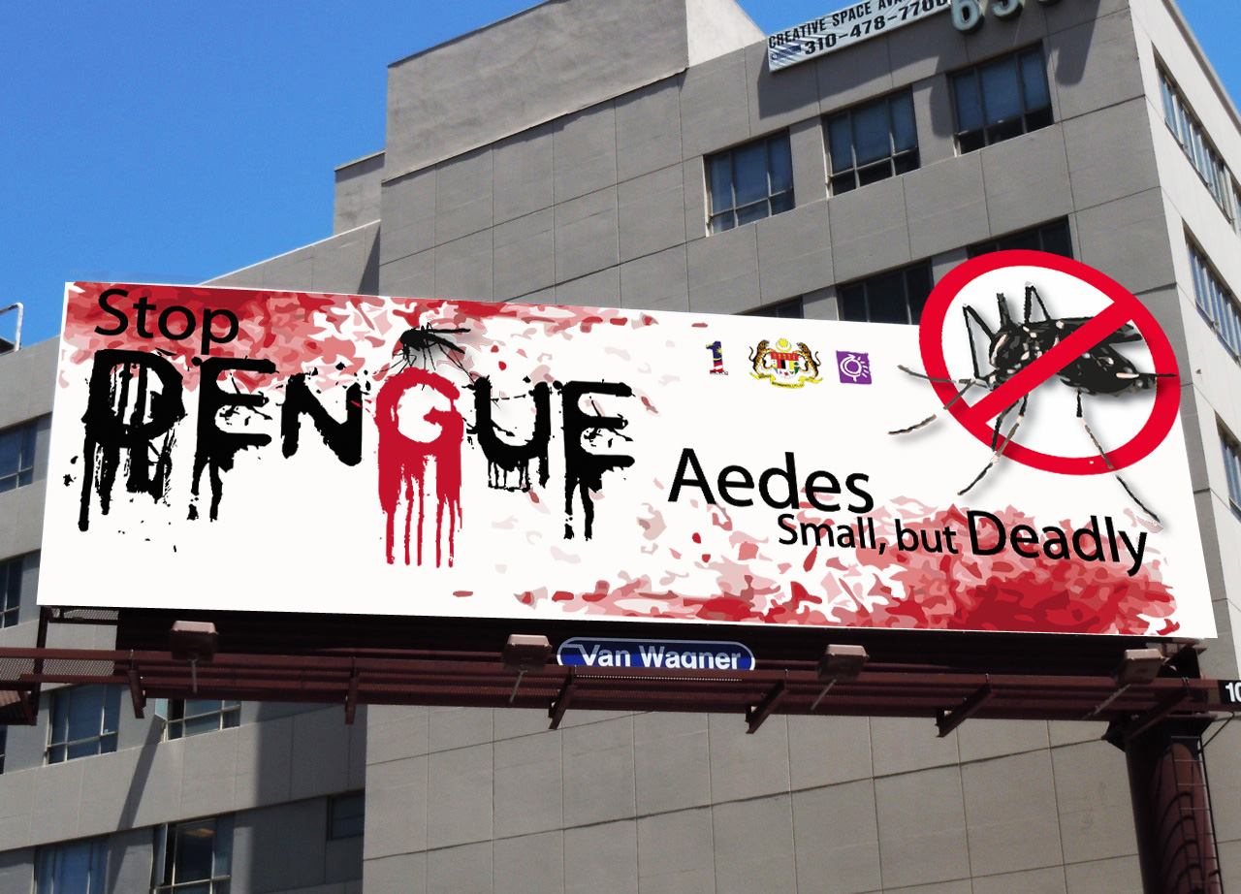
Dengue and Chikungunya

Slide 14
Dengue
Mosquito-borne flavivirus that causes fever, headache, arthralgia/myalgia, mild rash, mild to severe bleeding
Explosive growth 1980-90s (>100 countries)
Four serotypes (DENV-1 to DENV-4)
Long term homotypic immunity
Heterotypic immunity wanes, thought to lead to “immune enhancement” – up to 100-fold increased risk of dengue hemorrhagic fever and dengue shock syndrome
50-100 million cases and 22,000 deaths annually
Chikungunya
Mosquito-borne alphavirus that causes fever and severe polyarthralgia
1st locally-acquired cases in the Caribbean, Dec 2013
Explosive growth in the Americas: 56,000 cases in the first 6 months (R₀ 5.2)
>1.7 million cases worldwide
Notes:
Most important mosquito borne viral illness in the world today – even surpassing malaria. flavivirus – yellow fever and WNV> 30x increase over the last 50 years. heterotypic protective immunity wanes gradually over one to two years. capillary permeability appears to be due to endothelial cell dysfunction rather than injury. DHF/DSS risk increases up to 100-fold after infection with a heterotypic dengue serotype

Slide 15
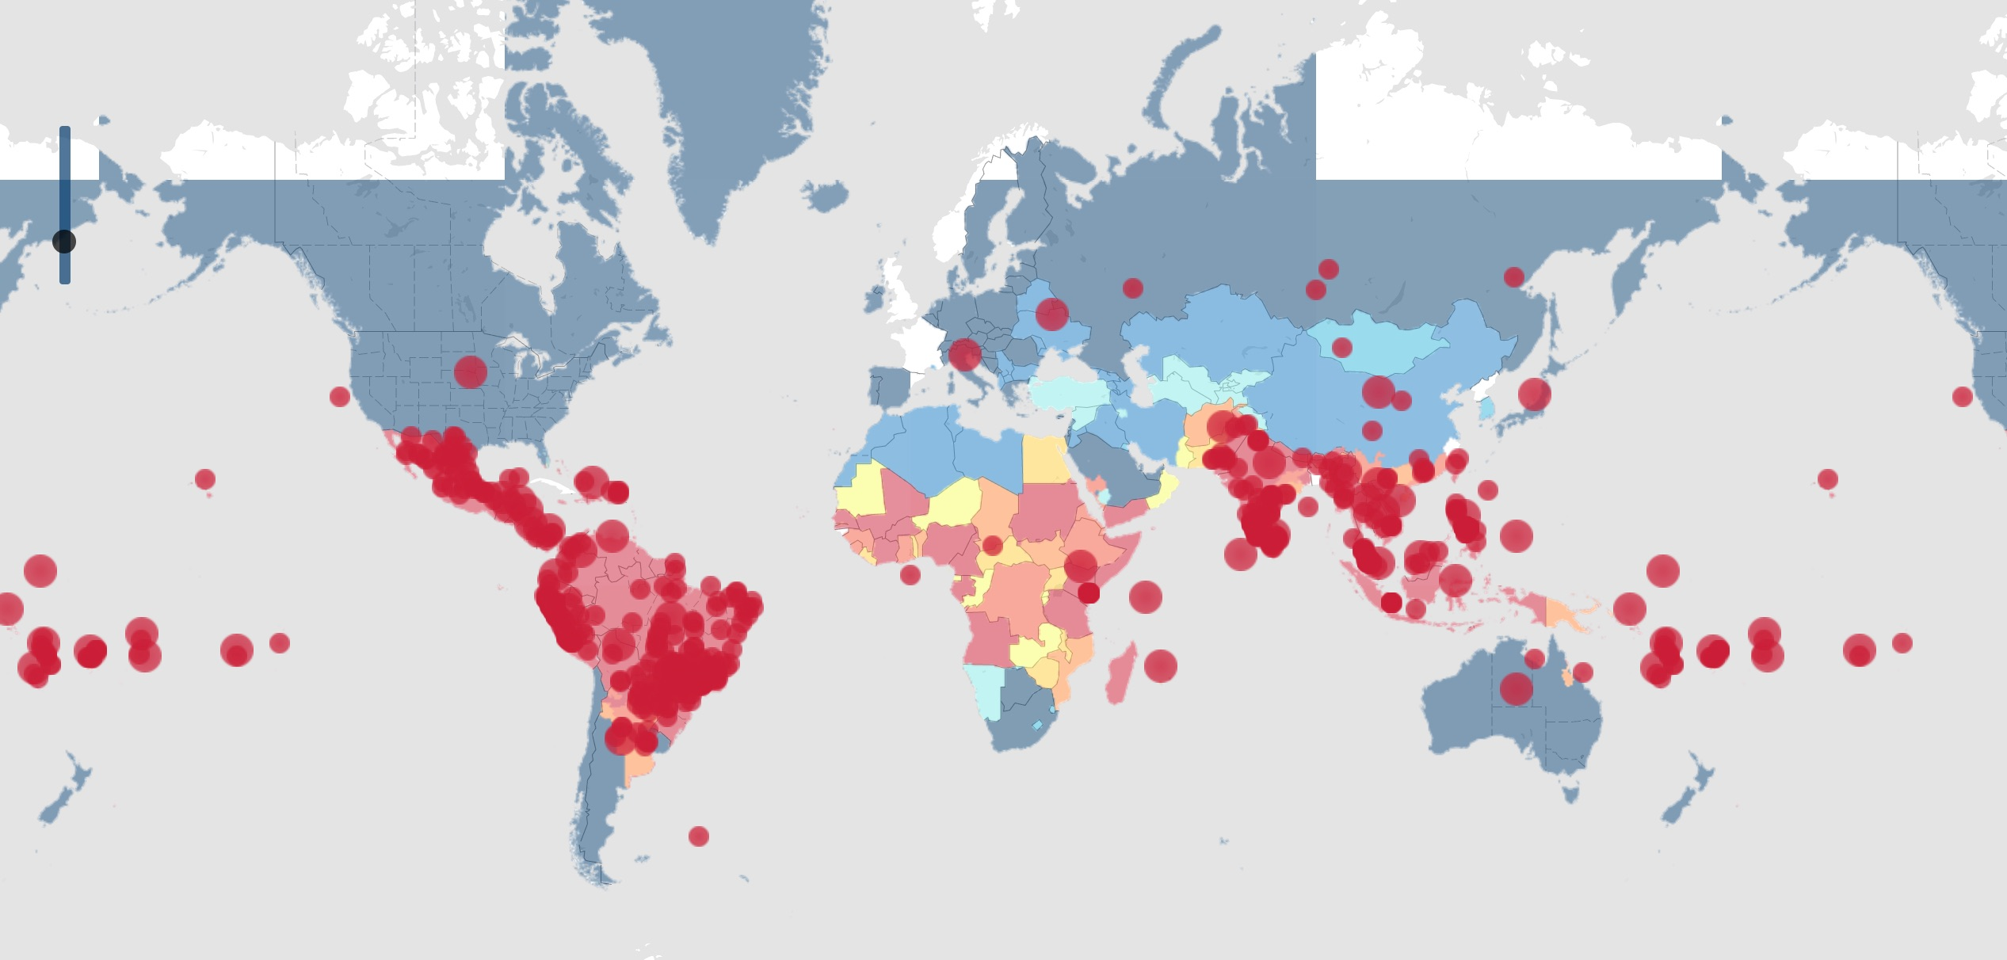
Dengue
Dengue alerts for the last 30 days
Source: www.healthmap.org/dengue/en/ (accessed May 10, 2017)
Notes:
Dengue belt – 30 degrees North and South latitude. Winter temps average > 50F.

Slide 16
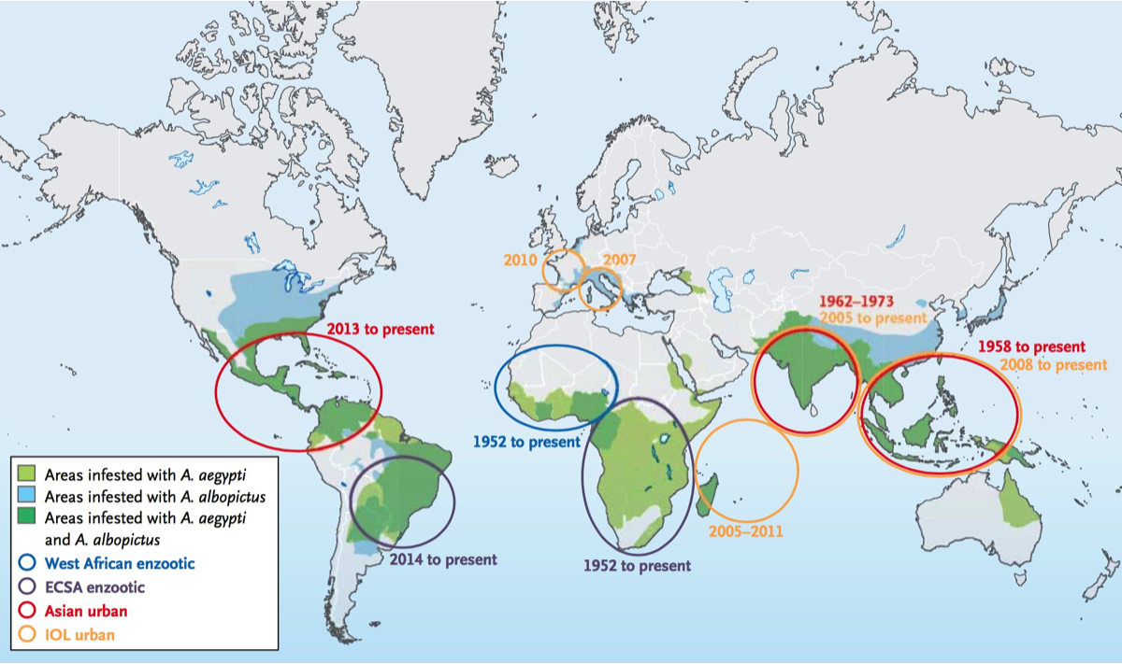
Chikungunya
Weaver CW, et al. N Engl J Med 2015; 372:1231-9

Slide 17
Chikungunya vs. Dengue
Broad clinical overlap, shared vectors, co-circulation, occasional co-infection
Treatment approaches differ, distinguishing is important
Diagnostic evaluation through Public Health (serology, PCR, culture)
 | Chikungunya | Dengue
Mosquito | A. aegypti A. albopictus | A. aegypti A. albopictus
Median incubation period | 3-4 days | 4-7 days
Fever (>39°C) | +++ | +
Arthralgia | +++ | +/-
Arthritis | + | -
Myalgia | + | ++
Rash | Maculopapular | Petechial (& maculopapular)
WBC | Lymphopenia | Neutropenia
Thrombocytopenia | + | +++
Hemoconcentration | - | ++
Hemorrhage | +/- | ++
Shock | - | +
Staples JE, et al. N Engl J Med 2014; 371:887-9. Weaver CW, et al. N Engl J Med 2015; 372:1231-9.

Slide 18
Chikungunya vs. Dengue
Broad clinical overlap, shared vectors, co-circulation, occasional co-infection
Treatment approaches differ, distinguishing is important
Diagnostic evaluation through Public Health (serology, PCR, culture)
 | Chikungunya | Dengue
Mosquito | A. aegypti A. albopictus | A. aegypti A. albopictus
Median incubation period | 3-4 days | 4-7 days
Fever (>39°C) | +++ | +
Arthralgia | +++ | +/-
Arthritis | + | -
Myalgia | + | ++
Rash | Maculopapular | Petechial (& maculopapular)
WBC | Lymphopenia | Neutropenia
Thrombocytopenia | + | +++
Hemoconcentration | - | ++
Hemorrhage | +/- | ++
Shock | - | +
Staples JE, et al. N Engl J Med 2014; 371:887-9. Weaver CW, et al. N Engl J Med 2015; 372:1231-9.

Slide 19
Chikungunya vs. Dengue
Broad clinical overlap, shared vectors, co-circulation, occasional co-infection
Treatment approaches differ, distinguishing is important
Diagnostic evaluation through Public Health (serology, PCR, culture)
 | Chikungunya | Dengue
Mosquito | A. aegypti A. albopictus | A. aegypti A. albopictus
Median incubation period | 3-4 days | 4-7 days
Fever (>39°C) | +++ | +
Arthralgia | +++ | +/-
Arthritis | + | -
Myalgia | + | ++
Rash | Maculopapular | Petechial (& maculopapular)
WBC | Lymphopenia | Neutropenia
Thrombocytopenia | + | +++
Hemoconcentration | - | ++
Hemorrhage | +/- | ++
Shock | - | +
Staples JE, et al. N Engl J Med 2014; 371:887-9. Weaver CW, et al. N Engl J Med 2015; 372:1231-9.

Slide 20
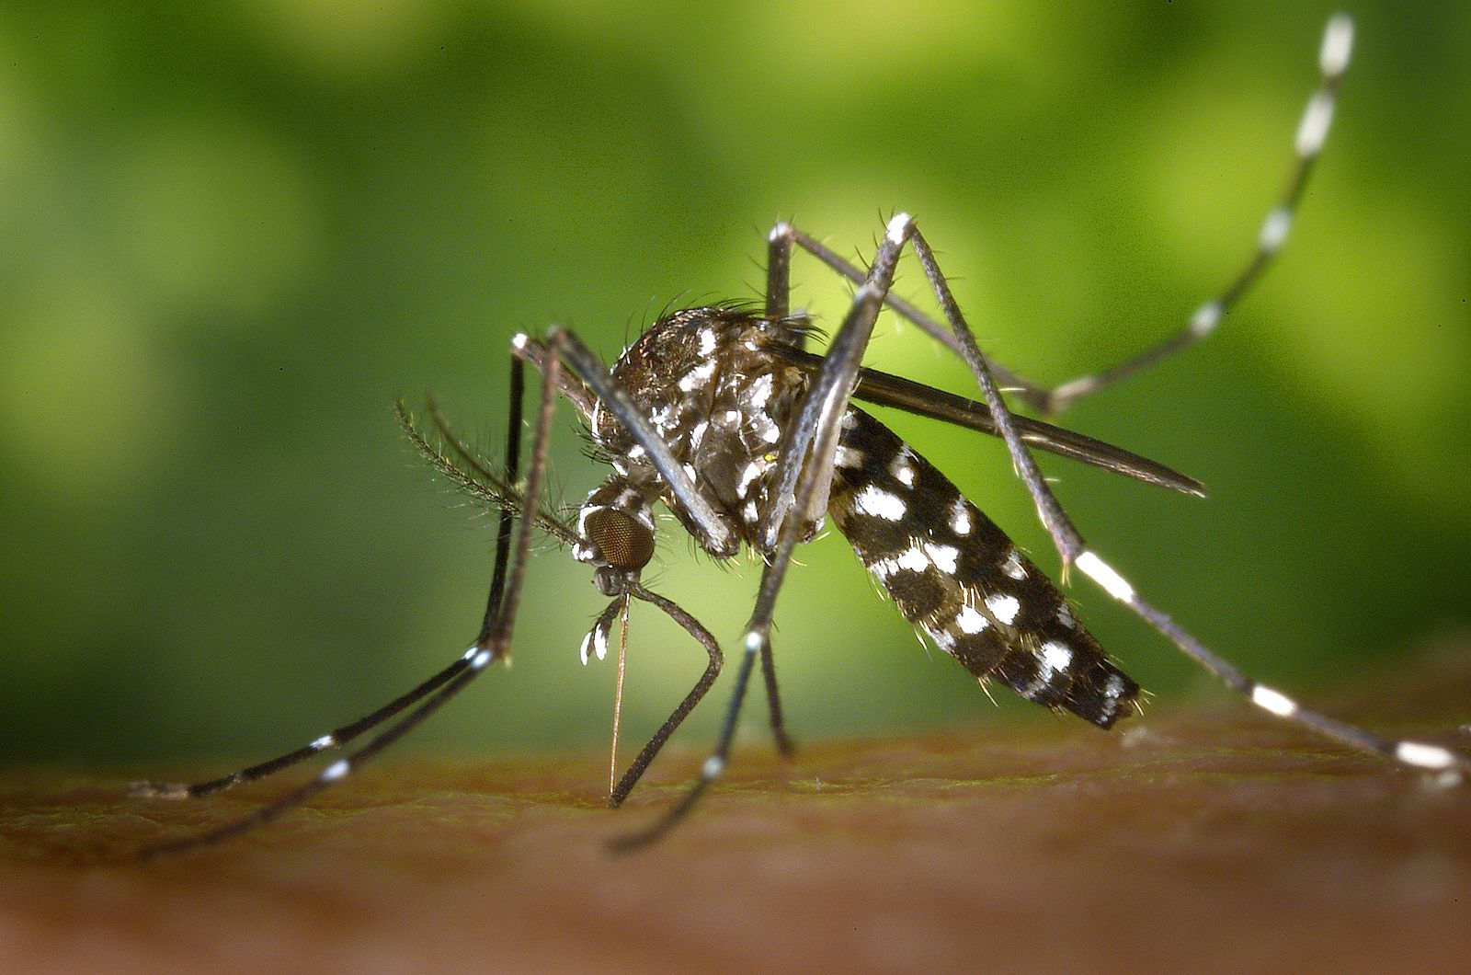
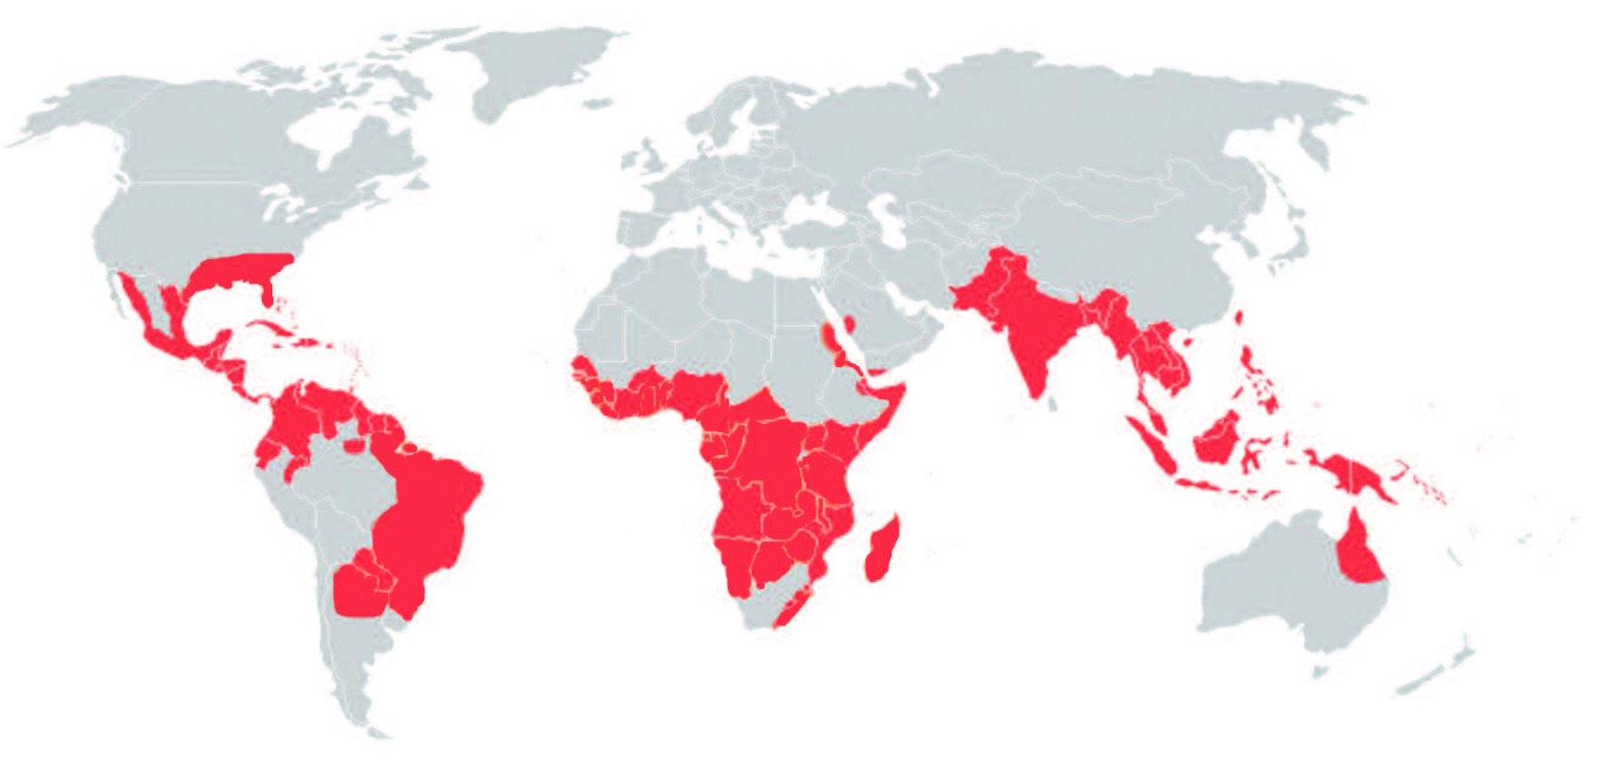
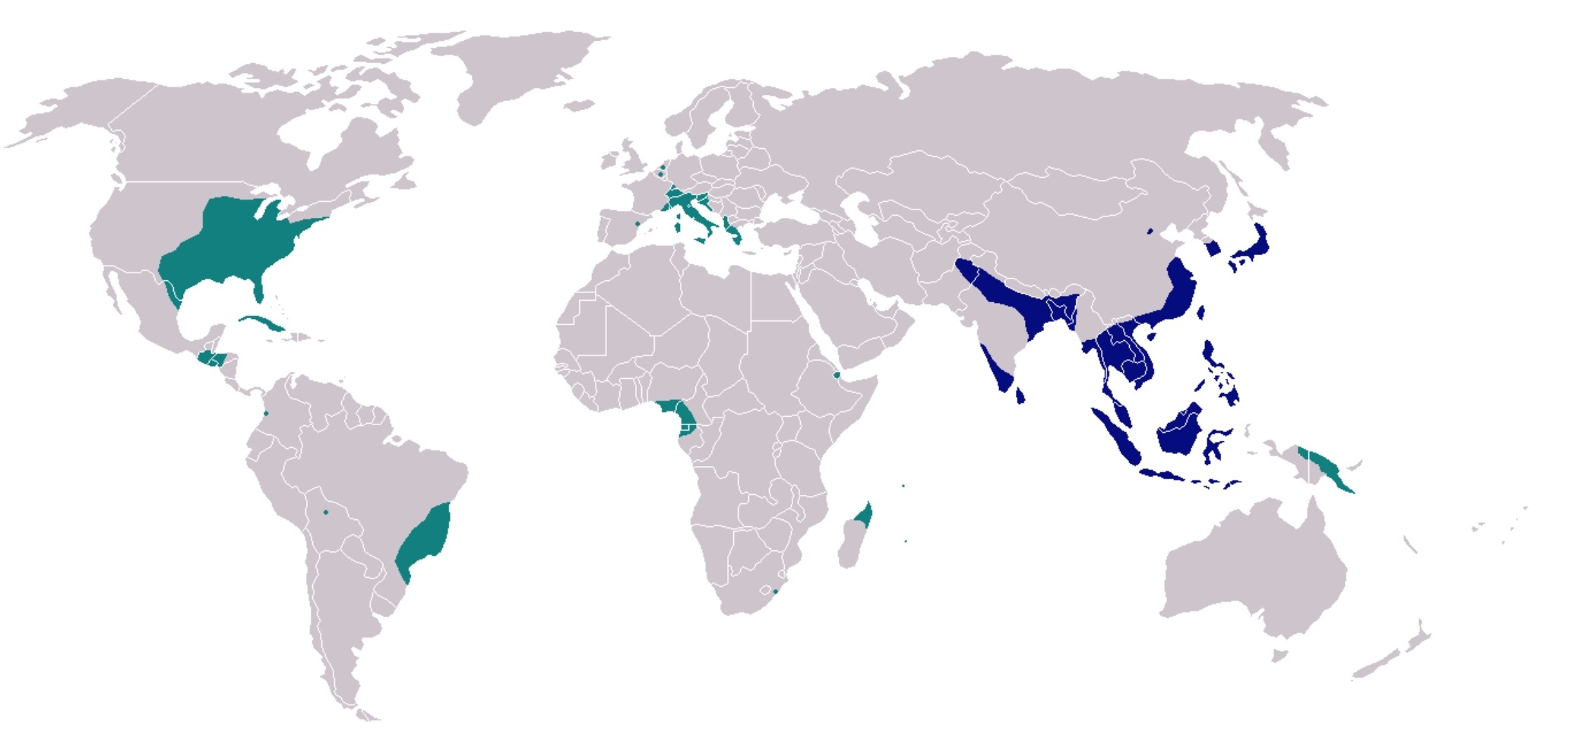
Aedes Mosquito Geographic Distribution – Global
Aedes aegypti
Yellow fever mosquito
Aedes albopictus
Asian tiger mosquito
Notes:
Aedes – frequent daytime feeders. A aegypti – more domestic and in households. A ablopictus – through VA and to upper midwest, but more outside. Urban (domestic) cycle rather than sylvatic (jungle) cycle.

Slide 21
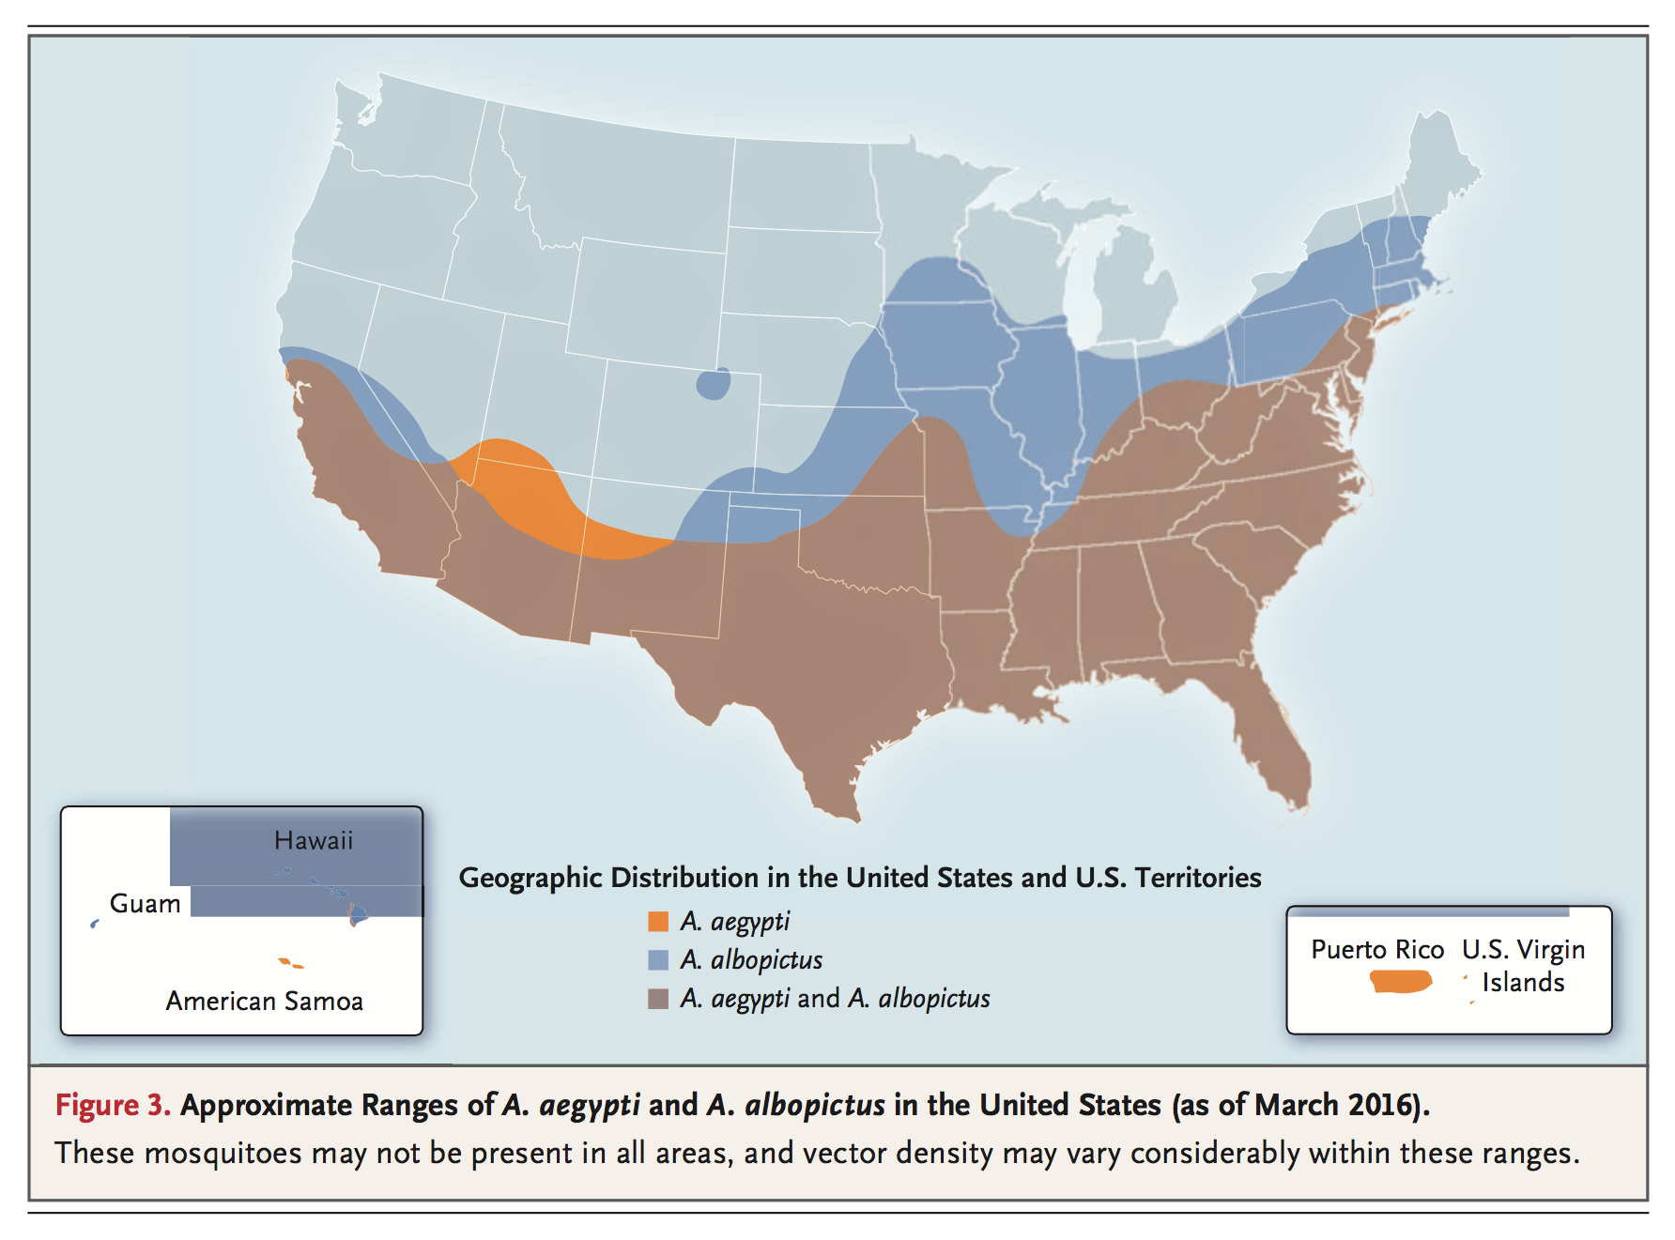
Aedes Mosquito Geographic Distribution – U.S.
Petersen L, et al. N Engl J Med. 2016;374:1552-63
Notes:
Aedes – frequent daytime feeders. A aegypti – more domestic and in households. A ablopictus – through VA and to upper midwest, but more outside. Will Zika be an issue in VA – is it warm and humid enough? Are there enough hosts to sustain local transmission? What about living conditions in the US (cistern rain water, air conditioning)? Mosquito control operations in the US?
There are 58 species (25 common species) of mosquitos in VA. A. aegypti is uncommon is VA (container breeder, human prefs, but uncommon in VA), A. albopictus (container breed that prefers humans but more indiscrimate AND very common in VA). Came to VA in 1991. “Most common backyard problem in VA.” Daytime active.

Slide 22
Case Presentation
19 y/o student with fever, rash, and arthralgia after 10 day trip to São Paulo, Brazil in March 2015
Diagnosis | Test
Chikungunya | Negative acute anti-CHIKV IgM/IgG Negative convalescent anti-CHIKV IgM/IgG
Dengue | Negative acute anti-DENV IgM/IgG Negative convalescent anti-DENG IgM/IgG
Malaria | Negative BinaxNOW, Negative thick/thin Giemsa smears

Slide 23
Case Presentation
19 y/o student with fever, rash, and arthralgia after 10 day trip to São Paulo, Brazil in March 2015
Diagnosis | Test
Schistosomiasis | Negative anti-MAMA Ab
Leptospirosis | Negative Leptospira Ab
Hantavirus | Negative IgM/IgG serology
Acute HIV | Negative ELISA, negative p24, Negative HIV NAT
Influenza | Negative influenza nasopharyngeal PCR
EBV | Negative monospot
Tick borne illness | doxycycline x 7d
Typhoid fever (bacterial infection) | ceftriaxone x 2d

Slide 24
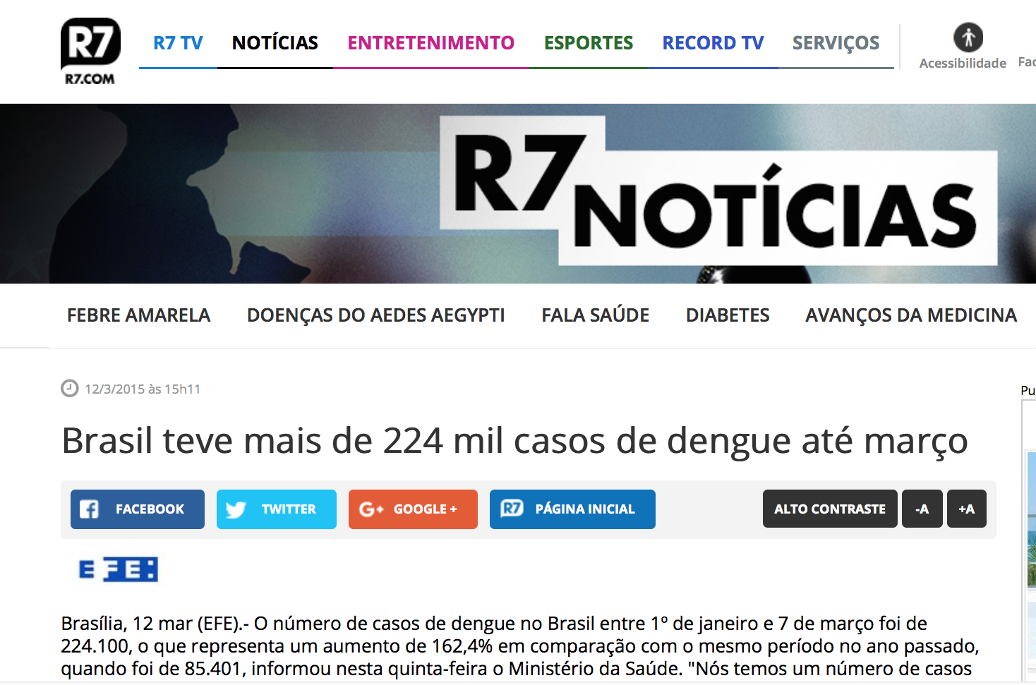
“Brazil had more than
224,000 cases of dengue by March”

Slide 25
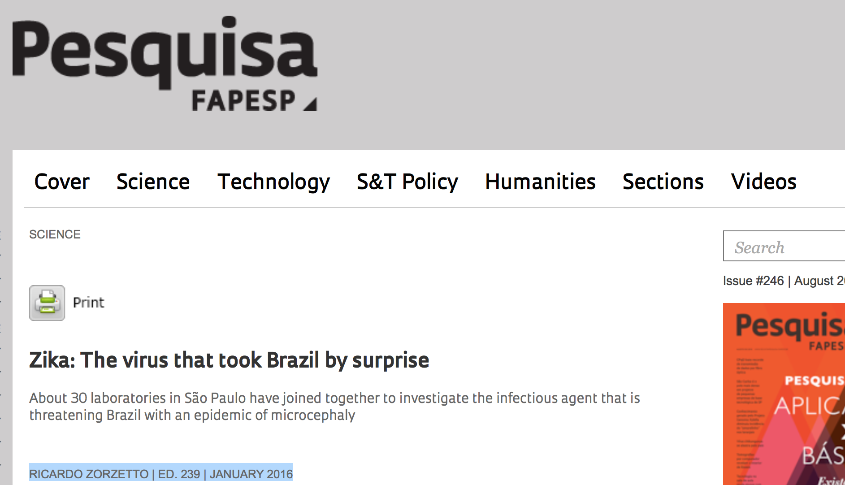
“The first case [of Zika] in São Paulo was detected on May 19, 2015 … It is possible that Zika has been circulating for a few months.”

Slide 26
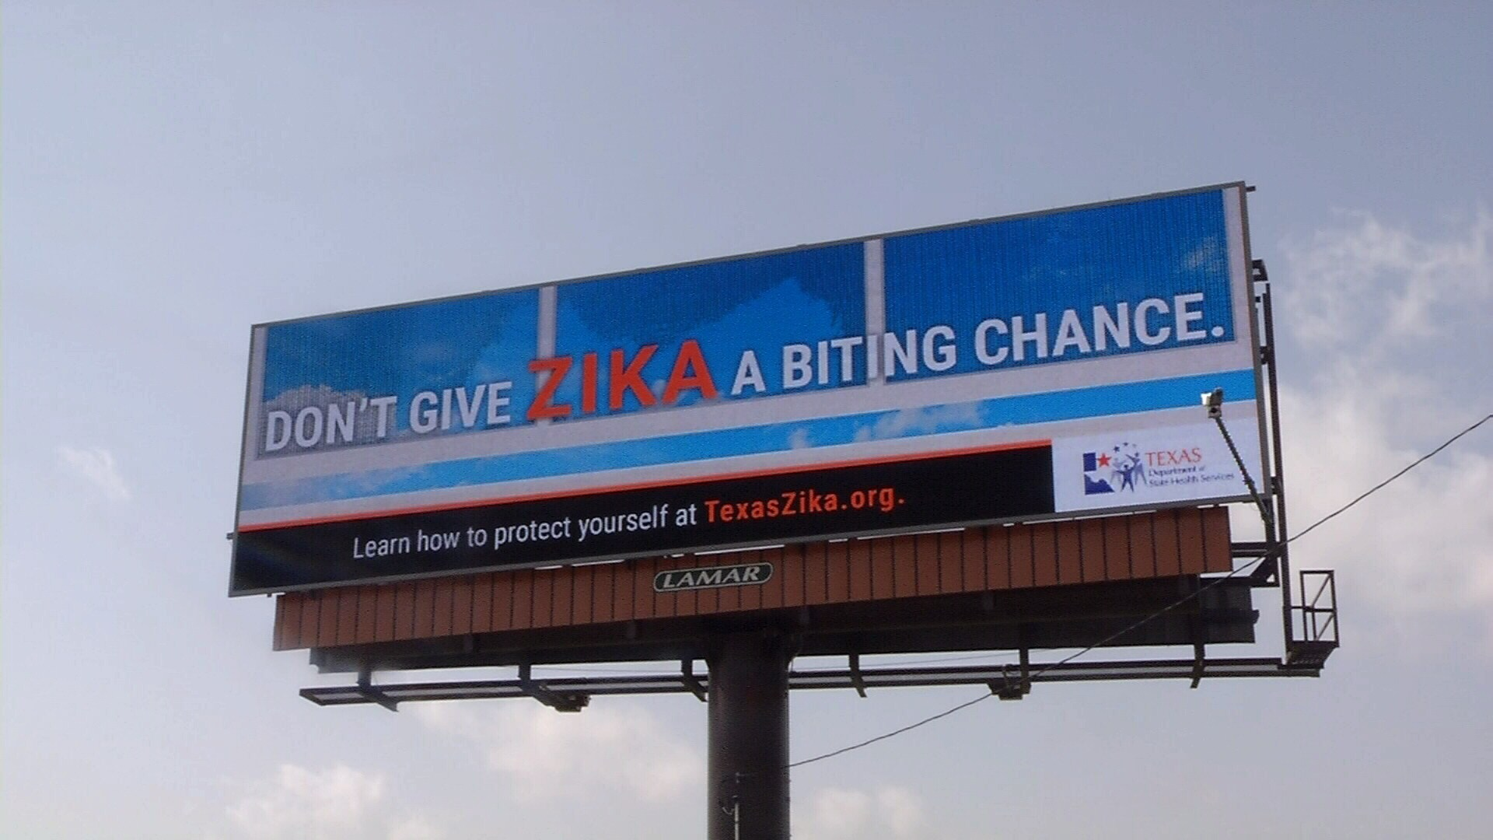
Zika Virus

Slide 27

Return to the past
… the last time an infectious pathogen (rubella virus) caused an epidemic of congenital defects was more than 50 years ago …
Lyle Petersen, MD MPH & colleagues
Director, Vector Borne Diseases
NCEZID, CDC
New Engl J Med - May 16, 2016

Slide 28

First time in history
Never before in history has there been a situation where a bite from a mosquito could result in a devastating malformation.
Tom Frieden, MD MPH
Director, CDC
Fortune - April 13, 2016

Slide 29
What is Zika Virus?
Single-stranded RNA virus (flavivirus)
Several dozen mosquito-borne flaviruses including dengue, yellow fever, Japanese encephalitis, and West Nile viruses
Primarily transmitted by two type of Aedes mosquitoes
Aedes aegypti (primary) and Aedes albopictus (secondary)
Additional modes of transmission
Intrauterine and perinatal transmission (mother to fetus)
Sexual transmission (M>F, M>M, F>M)
Laboratory exposure
Blood transfusion
Petersen L, et al. N Engl J Med. 2016;374:1552-63

Slide 30

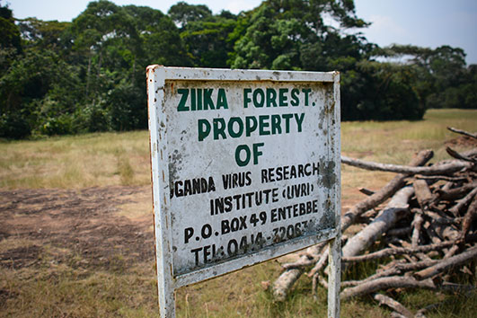


Zika Virus
1947: first isolated from a macaque, Zika Forest
1952-2006: only 14 sporadic human disease cases reported from Africa and SE Asia
Prof. Alec Haddow
Source: www.universitystory.gla.ac.uk

Slide 31
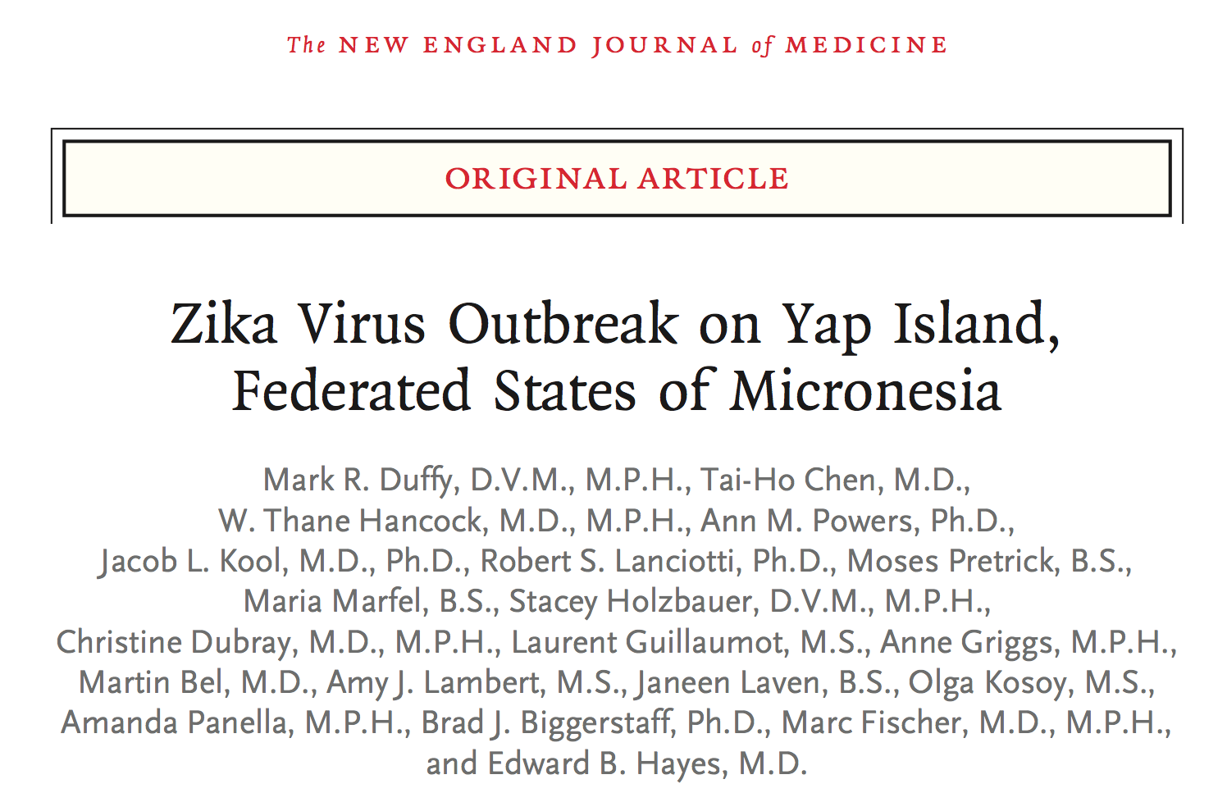
Zika Virus
2007: First outbreak, Yap, Federated States of Micronesia (population 7391)
Attack rate 73%
Only 20% symptomatic
Asian genotype
2013-14: >30,000 suspected cases reported from French Polynesia and other Pacific Islands
Duffy MR, et al. N Engl J Med 2009;360:2536–43
Cao-Lormeau VM, et al. Emerg Infect Dis. 2014;20:1085-6

Slide 32
Zika virus arrives in the Americas
Mar 2015. Brazil report mild febrile rash illness (7,000 cases) to WHO from NE Brazil; 13% Dengue positive
Negative Chikungunya, enterovirus, parvovirus B19, measles
Apr 2015. First cases of Zika virus infection identified in NE Brazil
May 2015. First confirmed case of Zika virus infection in São Paulo, Brazil
Oct 2015. Brazil HD informs WHO of increased number of infants with microcephaly in NE Brazil
Feb 2016. Increased microcephaly noted found after retrospective review in French Polynesia
Source: www.paho.org

Slide 33
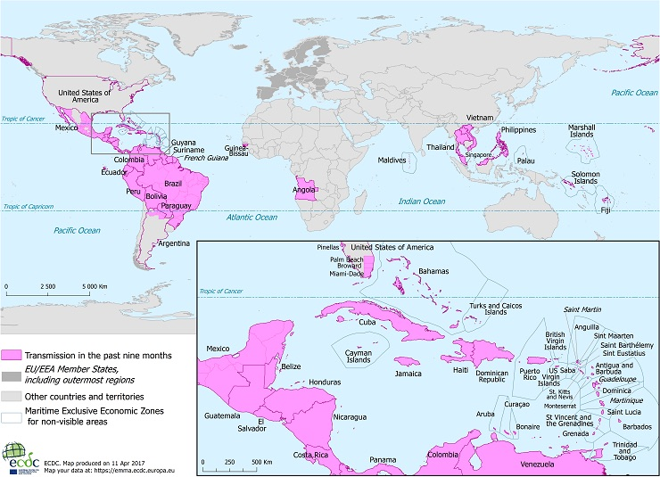
Countries & territories with active Zika virus transmission
Source: http://ecdc.europa.eu/en/healthtopics/zika_virus_infection/zika-outbreak/Pages/zika-outbreak.aspx

Slide 34
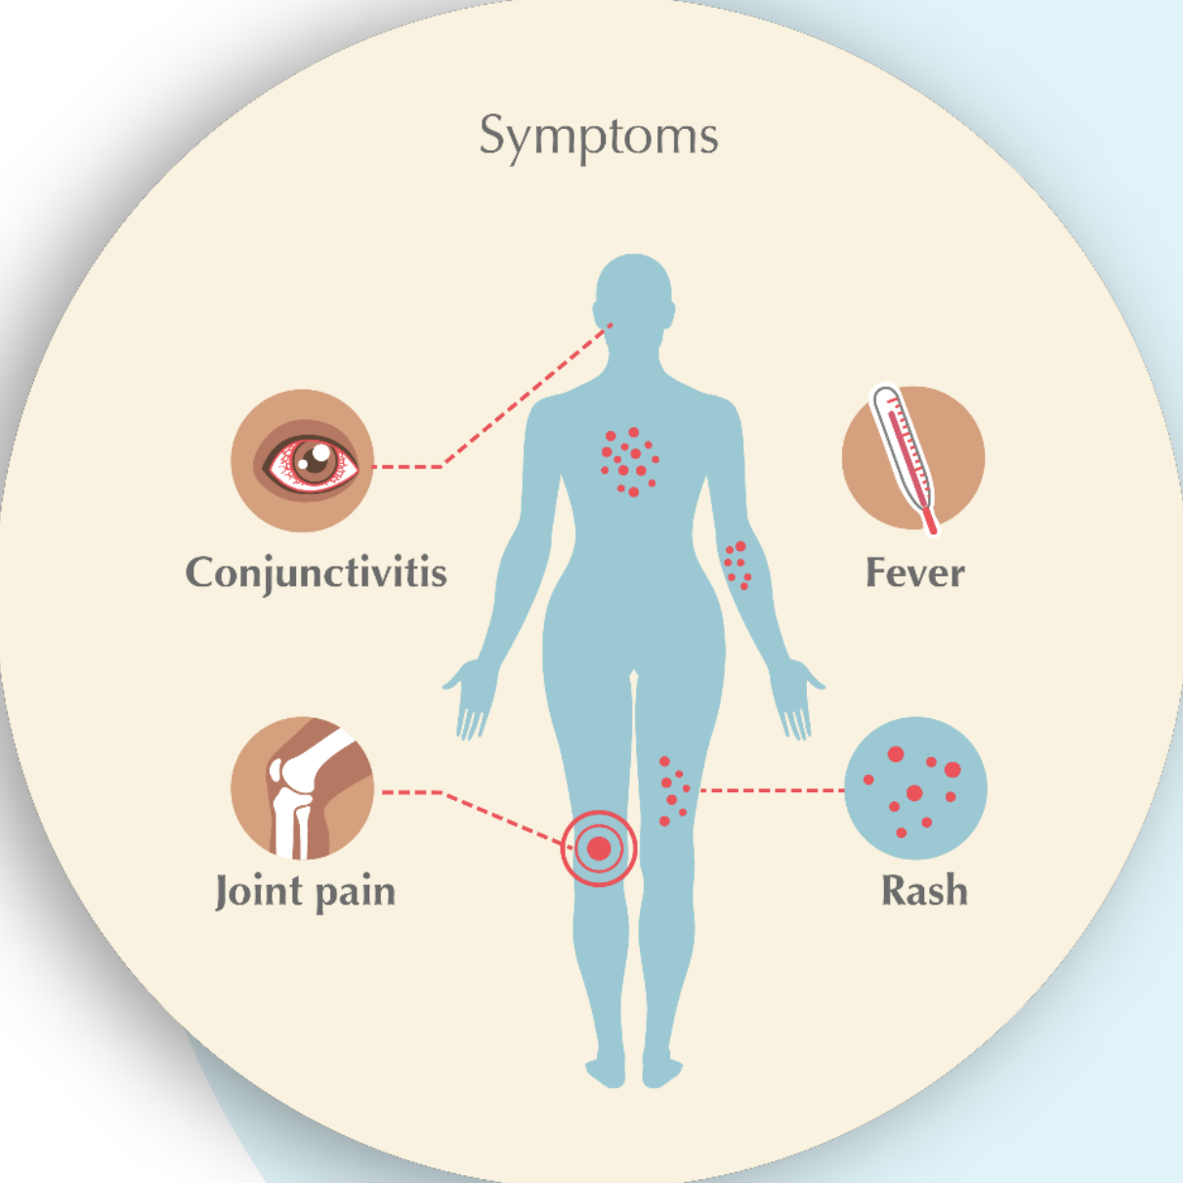
Zika clinical presentation
Only 20% symptomatic
typically mild illness
Incubation period ~6 days
(range 3-12 days)
Blood, urine, semen, vaginal fluids, saliva
Illness lasts ~5-7 days
Severe disease is uncommon, death is rare
Likely lifelong immunity after recovery
55%
65%
65%
90%
Petersen L, et al. N Engl J Med. 2016;374:1552-63

Slide 35
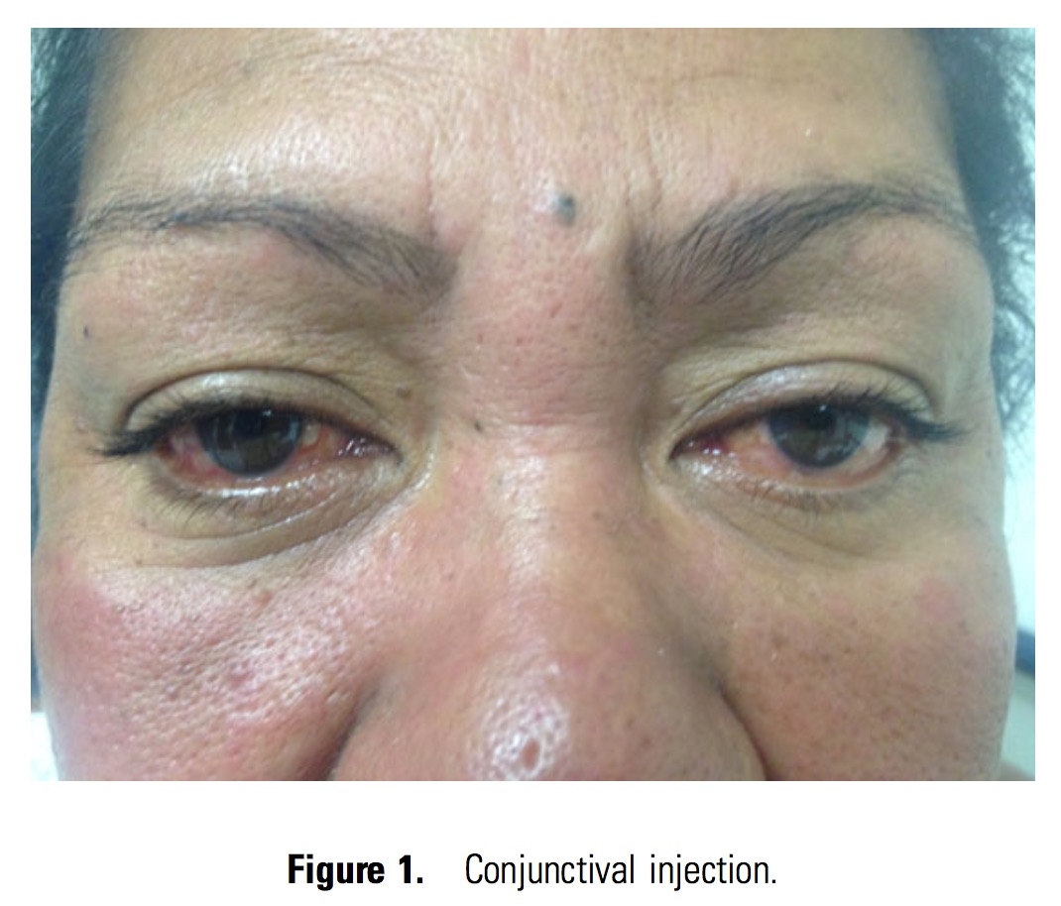
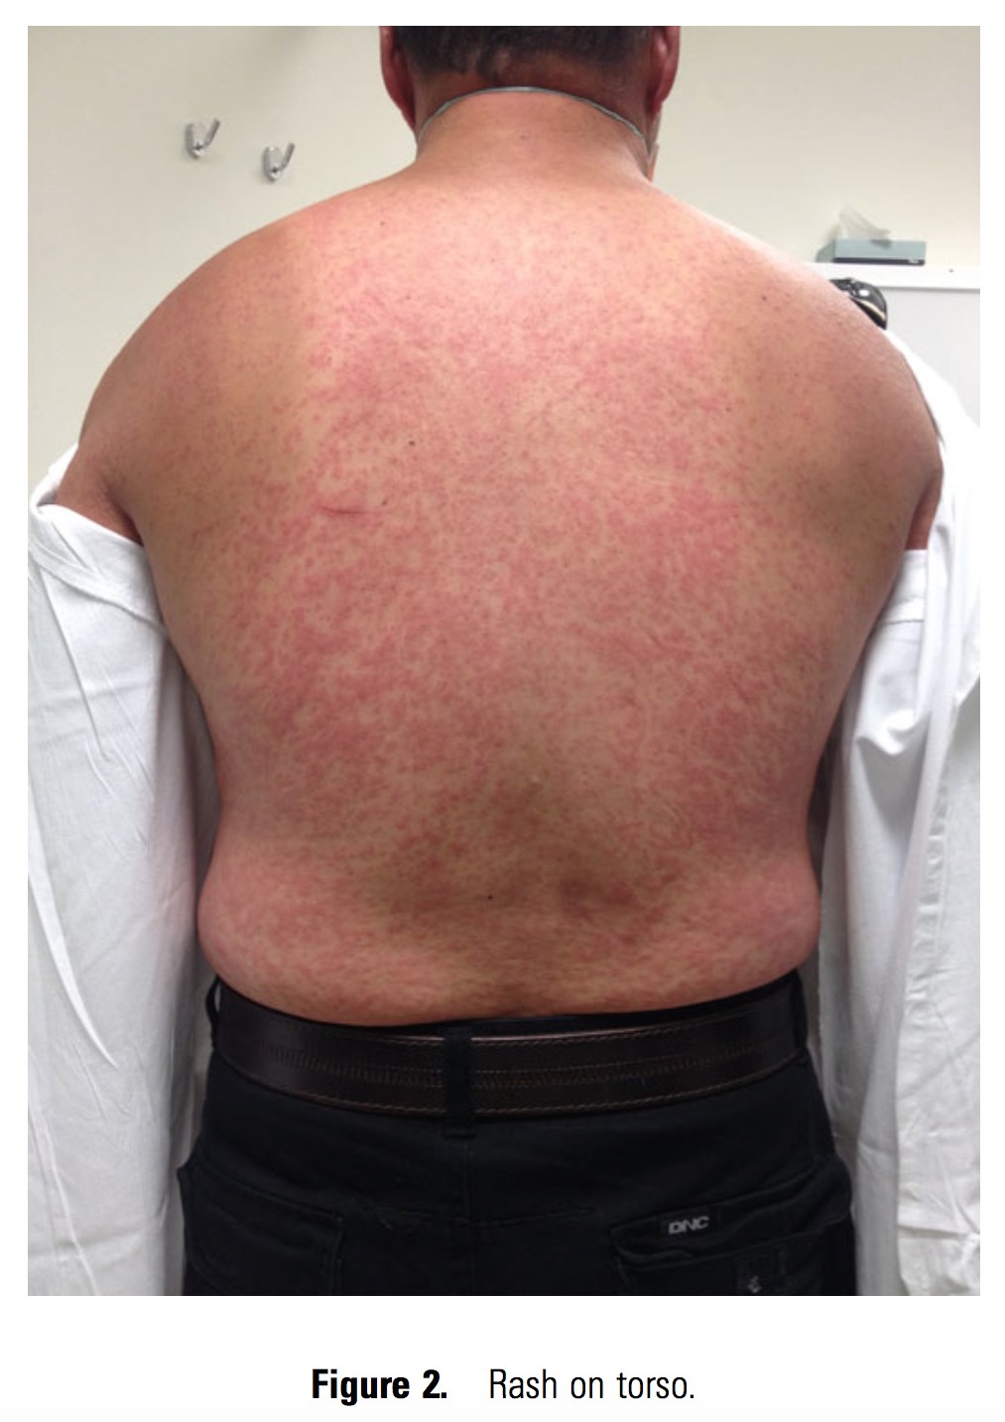
Zika clinical presentation
Macesic N, et al. Clin Infect Dis. 2015;61:1445

Slide 36
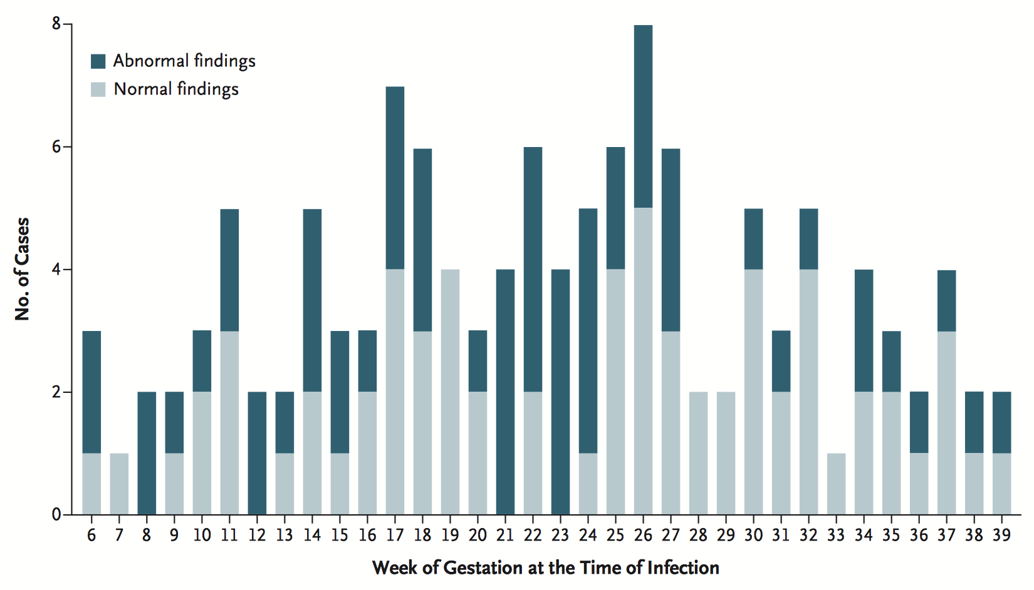
Complications of Zika virus infection
Pregnant women can be infected
Through the bite of an infected mosquito
Through sex without a condom with an infected partner
Zika can be passed to the fetus during pregnancy or around the time of birth
Infection can occur in any trimester
The clinical course is similar to that in non-pregnant people
Guillain–Barré syndrome
Frequency 1:5000 infections
Week of gestation at time of infection and risk of ultrasound abnormalities
Transmission risk 6%
Source: www.cdc.gov/zika/hc-providers/preparing-for zika/clinicalevaluationdisease.html
Cao-Lormeau VM, et al. Lancet 2016;387:1531-9
Brasil P, et al. N Engl J Med. 2016;375:2321-34

Slide 37
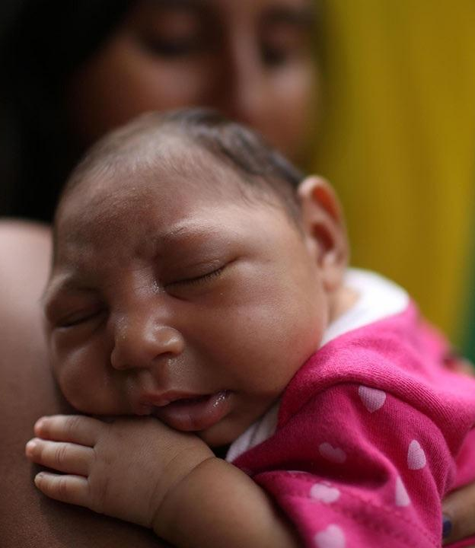

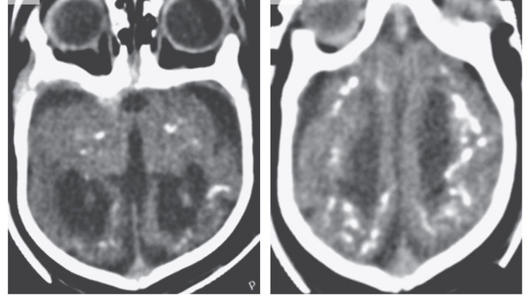
Zika virus congenital syndrome

Slide 38
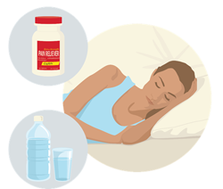
Treatment
No specific antiviral treatment available
Treatment is considered to be supportive
Cross reactivity between Zika virus and other flaviviruses, dengue or chikungunya
People infected with Zika, chikungunya, or dengue virus should be protected from further mosquito exposure during the first few days of illness
Image: www.cdc.gov/zika/symptoms/treatment.html
Source: www.cdc.gov/zika/hc-providers/preparing-for-zika/clinicalevaluationdisease.html
Notes:
No specific antiviral treatment is available for Zika virus disease
Treatment is considered to be supportive and can include rest, fluids, and use of analgesics and antipyretics
Given the cross reactivity between Zika virus and other flaviviruses, patients with suspected Zika virus infections should also be evaluated and managed for possible dengue or chikungunya virus infection
People infected with Zika, chikungunya, or dengue virus should be protected from further mosquito exposure during the first few days of illness to prevent transmission to mosquitos and reduce risk of local transmission
Image: https://www.cdc.gov/zika/symptoms/treatment.html

Slide 39
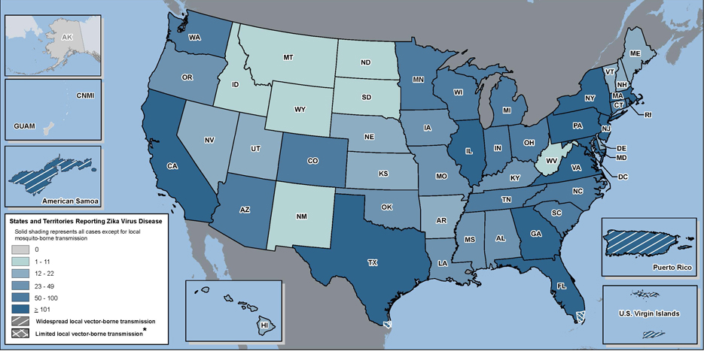
Zika Virus Disease in US, 2015-2017
As of May 3, 2017, 5,274 cases reported to CDC’s ArboNET from US states and 36,574 cases reported from US territories.
Source: www.cdc.gov/zika/geo/united-states.html (accessed May 8, 2017)
Notes:
Zika virus disease is a nationally notifiable condition. Cases are reported to CDC by state and local health departments.
This update from the CDC Arboviral Disease Branch includes provisional data reported to ArboNET for January 01, 2015 – May 3, 2017
As of May 3, 2017, 224 locally acquired mosquito-borne cases (218 in Florida and 6 in Texas) and 4,973 travel-associated Zika virus disease cases have been reported to ArboNET from the continental United States; 1 laboratory acquired case reported; 46 sexually transmitted cases; 29 cases of congenital transmission, and 1 person-to-person through an unknown route (this is a total of 5,274 cases)
To date, a total of 36,574 cases have been reported from U.S. territories, including Puerto Rico and the U.S. Virgin Islands. Sexually transmitted cases are not reported for US territories because with local transmission of Zika virus it is not possible to determine whether infection occurred due to mosquito-borne or sexual transmission.

Slide 40
Zika Virus Disease Cases in Virginia by Region
Region | Confirmed or Probable Disease
 | 2016 | 2017
Central | 17 | 1
Eastern | 10 | 0
Northwest | 18 | 1
Northern | 56 | 2
Southwest | 11 | 0
Total | 112 | 4
*Data through May 24, 2017. Cases of Zika virus disease are being classified according to the current CSTE case definition. All Virginia cases are associated with travel to a Zika-affected area.
Slide courtesy Dr. Laurie Forlano, State Epidemiologist, Virginia Department of Health
Source: www.vdh.virginia.gov/zika/zika-virus-update/ (accessed May 25, 2017)
Notes:
The first imported case in Virginia was confirmed on Jan 26, 2016 (onset date 12/2/15)
Since then, Virginia has counted a total of 118 Zika virus disease cases, as seen in the table on this slide.
VDH adopted the Council of State and Territorial Epidemiologists (CSTE) revised interim case definitions on November 30, 2016, which separated Zika virus into four categories including disease and infection, and congenital and non-congenital cases. Only Virginia residents are included in the table on this slide and only statewide and regional cumulative numbers of counted disease cases are externally reported.
All Virginia cases are associated with travel to a Zika-affected area. Currently, CDC and VDH recommend that pregnant women not travel to any area where there is a risk of Zika virus infection.

Slide 41
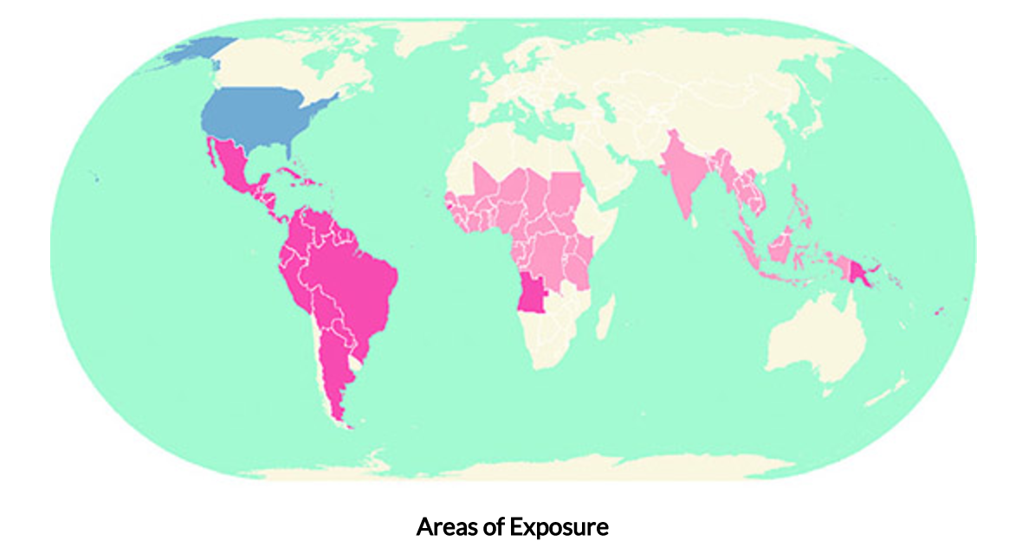


Travel-related Guidance for Zika
CDC developed a map with testing recommendations and timeframes to wait before trying to conceive by geographic location
Source: www.cdc.gov/zika/geo/countries-territories.html (accessed May 8, 2017)
Notes:
For travel related Guidance for Zika - CDC has developed an interactive World Map of Areas with Zika Risk that allows people to search for location-specific Zika information and travel recommendations and an interactive “Know Your Zika Risk” tool that offers tailored risk and prevention messages based on information provided by travelers.
The interactive map includes areas with CDC Zika Travel Notice and areas with risk of Zika but no CDC Zika travel notice. Each of these categories has different testing recommendations for people with Zika exposure.

Slide 42
I. Pregnant women who:
Recommendations and Criteria for Public Health Zika Virus Testing*
Revised 4/25/17
Algorithm will continue to be updated as new information becomes available
Traveled to†, or had sexual exposure§ with someone who traveled to, an area with a CDC Zika Travel Notice (international) or travel guidance (domestic) , regardless of symptom status¶
Public health testing
is available for individuals who meet these criteria and requires approval by local health departments
Testing is conducted by DCLS (Trioplex RT-PCR of serum and urine and IgM MAC ELISA of serum) and, if needed, CDC (Plaque-Reduction Neutralization Test).
The type of testing to be performed will depend on the time of evaluation relative to symptom onset or exposure. More details about public health testing can be found in the DCLS testing instructions.
Traveled to†, or had sexual exposure§ with someone who traveled to, an area with Zika risk but neither a CDC Zika Travel Notice (international) nor travel guidance (domestic) and had ≥1 Zika-compatible symptoms¶, including fetal abnormalities on ultrasound that may be related to Zika infection
II. Infants who:
III. Pregnant or non-pregnant individuals who:
Have suspected or confirmed microcephaly or other neurologic abnormality (diagnosed prenatally or at birth) and mother was potentially exposed to Zika virus
Were born to mothers with laboratory evidence of Zika virus infection during pregnancy
IV. People who developed Guillain-Barré Syndrome or other neurological manifestation and had potential exposure to Zika virus
Had potential transfusion, transplant, or laboratory exposure
Did not have travel† or sexual§ exposure, but had local (Virginia) mosquito exposure and ≥2 Zika-compatible symptoms¶ within 2 weeks of exposure
* Public health testing is available for those meeting the criteria above. Other scenarios can be discussed with the local health department on a case-by-case basis or healthcare providers can use private labs. Note that Zika virus testing is not recommended for asymptomatic men and women who are not pregnant (except as noted above), including asymptomatic couples who are interested in conceiving. Serum and urine are the primary diagnostic specimens for Zika virus infection. Ideally, specimens from pregnant women should be collected within 12 weeks of onset (if symptomatic) or exposure (if asymptomatic). Specimens from infants with possible congenital infection should ideally be collected within 2 days after birth; testing specimens collected within the first few weeks to months after birth may still be useful in the evaluation for possible congenital Zika virus infection.
† For this algorithm, travel exposure is defined as travel to or residence in an area with Zika risk. Public health testing criteria depend on pregnancy status, symptom status, and whether or not CDC has issued a Zika Travel Notice for international destinations and overseas US territories or CDC testing guidance for domestic areas designated as Zika cautionary areas or areas with active transmission for the particular travel exposure. See https://wwwnc.cdc.gov/travel/page/world-map-areas-with-zika for these designations by country/area.
§ For this algorithm, possible sexual exposure is defined as having had unprotected sex (including vaginal sex, anal sex, oral sex, or other activities that might expose a sex partner to genital secretions) with someone who has traveled to or lives in an area with Zika risk. Public health testing criteria depend on pregnancy status, symptom status, and whether or not CDC has issued a Zika Travel Notice for international destinations and overseas US territories or CDC testing guidance for domestic areas designated as Zika cautionary areas or areas with active transmission for the travel exposure of the sex partner. See https://wwwnc.cdc.gov/travel/page/world-map-areas-with-zika for these designations by country/area.
¶ For this algorithm, symptoms of Zika are: fever, rash, arthralgia, or conjunctivitis; or complication of pregnancy (e.g., fetal loss, fetus or neonate with congenital microcephaly, intracranial calcifications, other structural brain or eye abnormality, or other congenital central nervous system related abnormality); or Guillain-Barré syndrome.
Notes:
Virginia Department of Health and the Division of Consolidated Laboratory Services have developed this testing algorithm for recommendations and criteria for public health Zika virus testing. VDH prioritizes these populations for public health testing and provides testing through DCLS to those meeting this criteria. Other scenarios can be discussed with the local health department on a case-by-case basis or healthcare providers can use private labs.
Clinicians can find this testing algorithm on the VDH Clinician webpage.
Note that public health Zika virus testing is not recommended for asymptomatic men and women who are not pregnant (except as noted above), including asymptomatic couples who are interested in conceiving.
Serum and urine are the primary diagnostic specimens for Zika virus infection. Ideally, specimens from pregnant women should be collected within 12 weeks of onset (if symptomatic) or exposure (if asymptomatic). Specimens from infants with possible congenital infection should ideally be collected within 2 days after birth; testing specimens collected within the first few weeks to months after birth may still be useful in the evaluation for possible congenital Zika virus infection.
For this algorithm, travel exposure is defined as travel to or residence in an area with Zika risk. Public health testing criteria depend on pregnancy status, symptom status, and whether or not CDC has issued a Zika Travel Notice for international destinations and overseas US territories or CDC testing guidance for domestic areas designated as Zika cautionary areas or areas with active transmission for the particular travel exposure. See https://wwwnc.cdc.gov/travel/page/world-map-areas-with-zika for these designations by country/area.
For this algorithm, possible sexual exposure is defined as having had unprotected sex (including vaginal sex, anal sex, oral sex, or other activities that might expose a sex partner to genital secretions) with someone who has traveled to or lives in an area with Zika risk. Public health testing criteria depend on pregnancy status, symptom status, and whether or not CDC has issued a Zika Travel Notice for international destinations and overseas US territories or CDC testing guidance for domestic areas designated as Zika cautionary areas or areas with active transmission for the travel exposure of the sex partner. See https://wwwnc.cdc.gov/travel/page/world-map-areas-with-zika for these designations by country/area.
For this algorithm, symptoms of Zika are: fever, rash, arthralgia, or conjunctivitis; or complication of pregnancy (e.g., fetal loss, fetus or neonate with congenital microcephaly, intracranial calcifications, other structural brain or eye abnormality, or other congenital central nervous system related abnormality); or Guillain-Barré syndrome.
VDH Zika Algorithm, PDF available here: http://www.vdh.virginia.gov/content/uploads/sites/3/2016/11/Zika-algorithm.pdf
Hyperlinks:
Private labs: http://www.vdh.virginia.gov/content/uploads/sites/3/2016/03/Zika-testing-at-private-labs.pdf
Local health departments: http://www.vdh.virginia.gov/local-health-districts/
DCLS: https://dgs.virginia.gov/division-of-consolidated-laboratory-services/updates/hot-topics/
DCLS testing instructions: https://dgs.virginia.gov/division-of-consolidated-laboratory-services/updates/hot-topics/

Slide 43
Zika diagnostic testing
Testing approach depends on indication and timing
serum
rRT-PCR
urine
rRT-PCR
(sperm rRT-PCR)
Anti-Zika IgM Ab’s
Symptom
onset
~7d
~14d
?
~12 weeks
Adapted from Dr. Lyle Petersen, CDC

Slide 44
Sexual transmission of Zika virus
Viral RNA in semen persists in most men up to 60 days
5 men have had detectable RNA in semen 60-188 days
Replication competent virus for up to 69 days (usually less than 24 days)
Transmission has been within the first 20 days of travel thus far
Petersen EE, et al. MMWR 2016;65;1077-81

Slide 45
Guidance for pregnant women
Abstain from sex or use condoms consistently for the duration of the pregnancy
Petersen EE, et al. MMWR 2016;65;1077-81

Slide 46
Guidance for couples trying to conceive
Women
Wait at least 8 weeks after symptom onset or after the last possible exposure
Men
Wait at 6 months after symptom onset or after the last possible exposure
Both
avoid nonessential travel to areas with Zika virus transmission
use of mosquito bite prevention strategies while attempting pregnancy and during pregnancy if travel to areas with Zika virus transmission is unavoidable
Petersen EE, et al. MMWR 2016;65;1077-81

Slide 47
Case conclusion
Checked Zika IgM more than 12 months after his acute illness
Negative
No stored serum
No commercial available Zika IgG test
Cross reactive with other flaviviruses
The student made a complete recovery
Notes:
dihydroxy-propoxymethyl-guanine

Slide 48


Slide 49
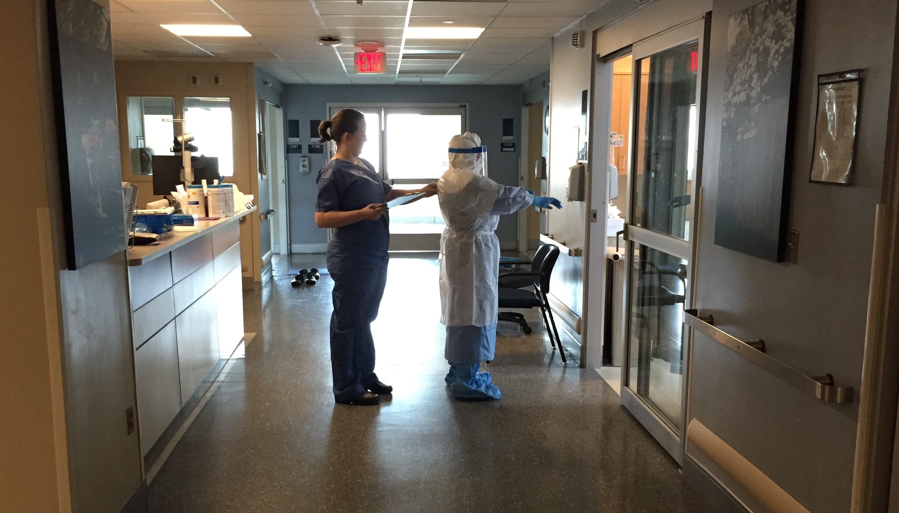
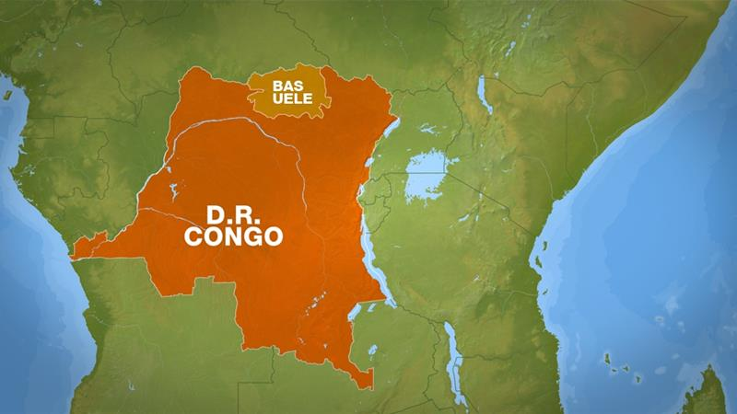
Ebola Virus Disease
2017, Democratic Republic of Congo
8th outbreak of EVD in Congo since 1976
43 confirmed, probable and suspected cases
4 deaths
300 contacts under surveillance
No healthcare worker infections
Global threat level is low – remote area, no airport
Source: http://reliefweb.int/sites/reliefweb.int/files/resources/EbolaDRC-28052017.pdf

Slide 50
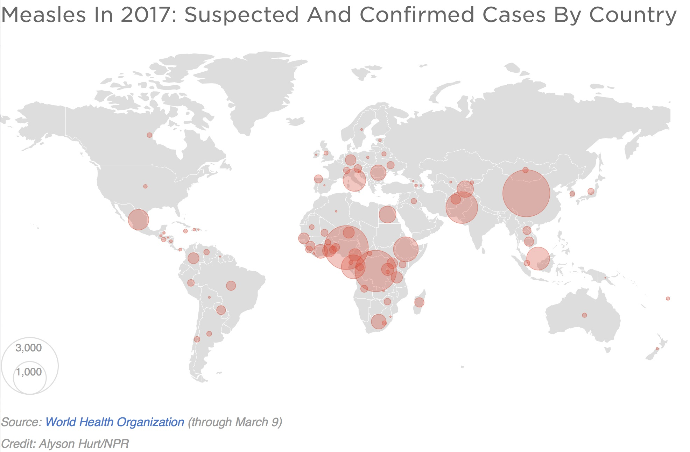
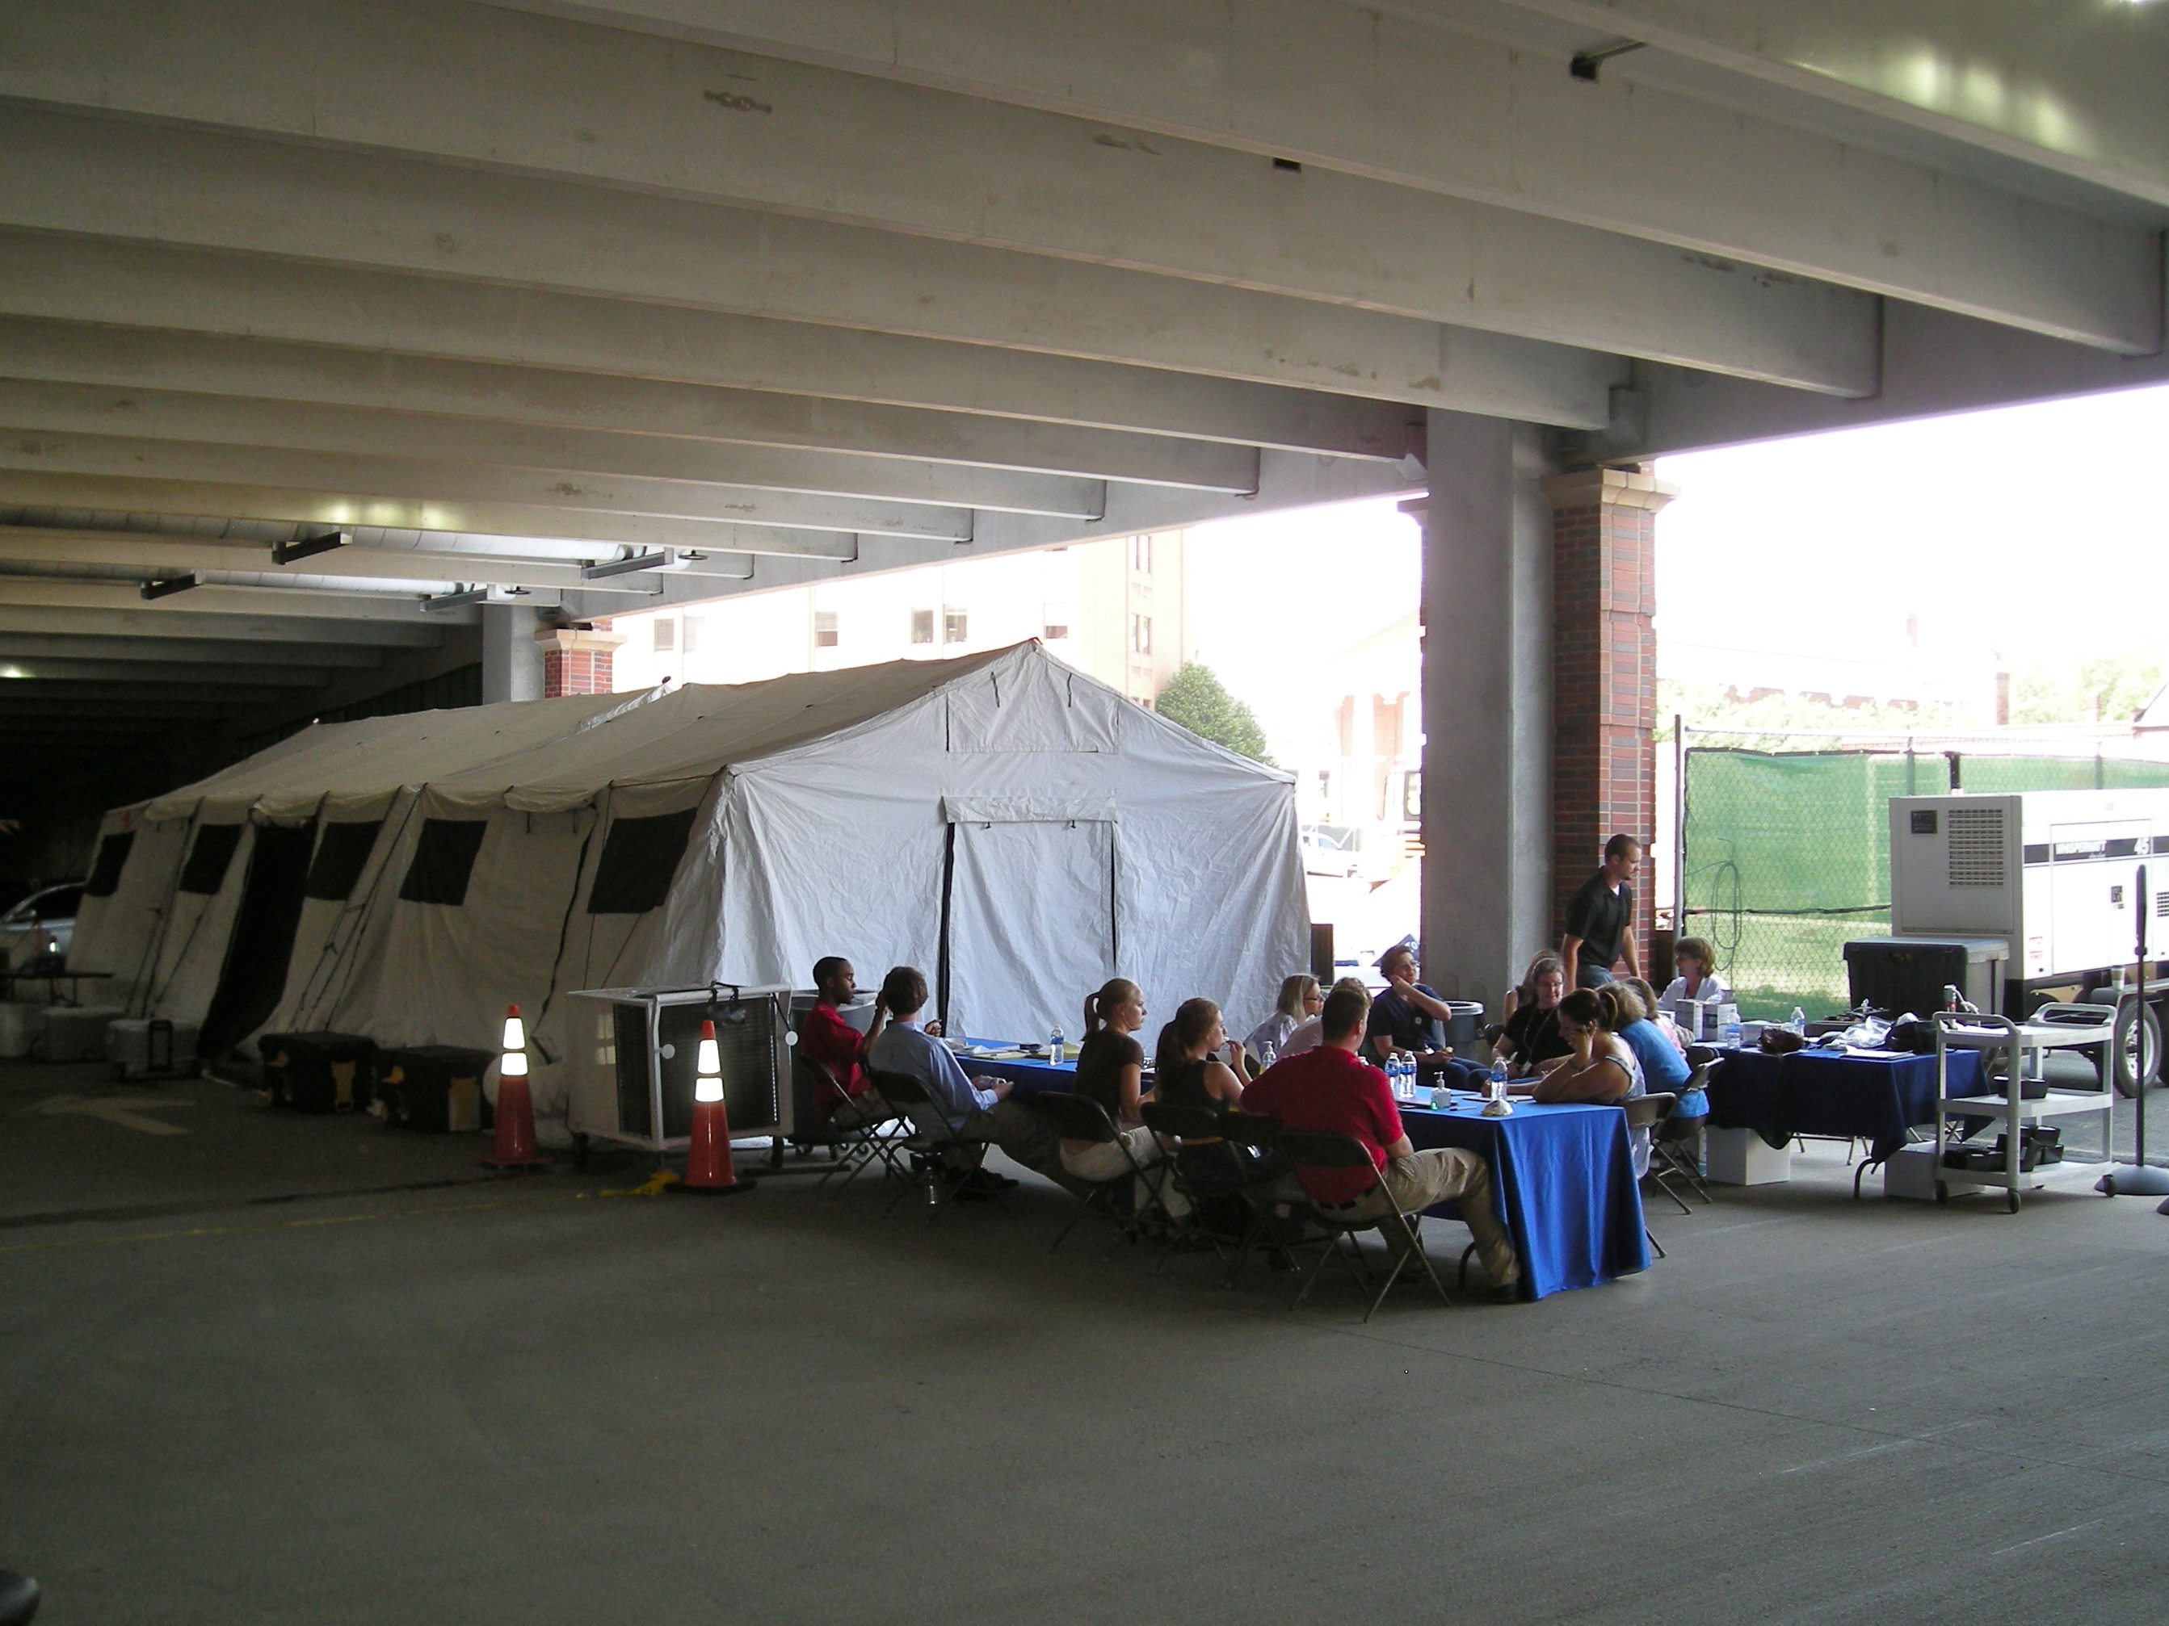
Measles
Source: www.npr.org/sections/goatsandsoda/2017/04/07/522867040/as-measles-surges-in-europe-officials-brace-for-a-rough-year

Slide 51
Superbugs (antimicrobial resistance)
Recent Examples
Carbapenem-resistant Enterobacteriaceae
bla_{KPC}, North Carolina 1996
bla_{NDM-1}, New Delhi 2009
mcr-1, China 2016
Clostridium difficile
NAP1 strain, North America 2003
Candida auris
1st Japan 2009, several clones
Notes:
Auris – dozen countries

Slide 52
Pandemic Influenza
H7N9 Influenza A (“Bird Flu”) - 5th Epidemic Wave
China 2016-17
Increasing size and duration
Most follow exposure to infected poultry or environment
Several possible person-to-person clusters
Case counts
713 cases in 2016-17
75% ICU admissions
40% mortality
1486 lab confirmed cases since 2013
Source: www.cdc.gov/flu/avianflu/h7n9-virus.htm (accessed May 23, 2017)

Slide 53
Other Potential Emerging Infections
Enterovirus D68
2014 US outbreak of severe respiratory illness, acute flaccid paralysis
Crimean-Congo Hemorrhagic Fever
Tick borne viral illness, Eastern Europe and Africa
Heartland Virus Disease
Tick borne viral illness, Midwest US (Missouri, Tennessee)
Bourbon Virus Disease
Tick borne viral illness, Midwest US (Bourbon County, Kansas)
Powassan Virus Disease
Tick borne viral illness, Northeast US
Yellow Fever
Angola 2016 – urban, >4000 confirmed/suspected cases, 137 deaths, exhausted YF vaccine stockpile
Brazil 2017 – sylvatic (near São Paulo), >1500 confirmed/suspected cases, 127 deaths
Notes:
EV-D68 – first in California, outbreak started in midwest

Slide 54
Case Presentation 2
May 2016
EMS call - 60 y/o man with agitation, chest tightness and anxiety
No significant PMH
His wife had brought him to another hospital x2 earlier that day; CC: anxiety
OSH Dx: panic attack; Rx: lorazepam
Hypertensive, agitated, complaining of shortness of breath and tingling pain in left arm
HR 80, hypertensive, flushed, O2 98% RA, afebrile, RR 24, anxious appearing
ECG - non-specific ST-T wave changes, CXR – NAD, TTE – normal, troponin neg
ACS consult for eval and acute cardiac cath – clean coronaries
Admitted to MICU for post-catheterization recovery due to confusion

Slide 55
Case Presentation 2
MICU course
Swallowing evaluation due to concern for aspiration
Difficult time with liquids - provoked anxiety
Mental status - A&Ox3 but odd according to team and family
Acute escalation in anxiety and delirium overnight
Restrained, midazolam
Called wife back to help
Additional history obtained
Notes:
Self reported anxiety with swallowing, especially liquids.
“Today HE accepted a few small bites of sold food which were well-tolerated with no signs of dysphagia. With liquids, HE grew extremely anxious and began gasping before the spoon reached her lips. We tried relaxation and visualization techniques which were minimally beneficial.”

Slide 56
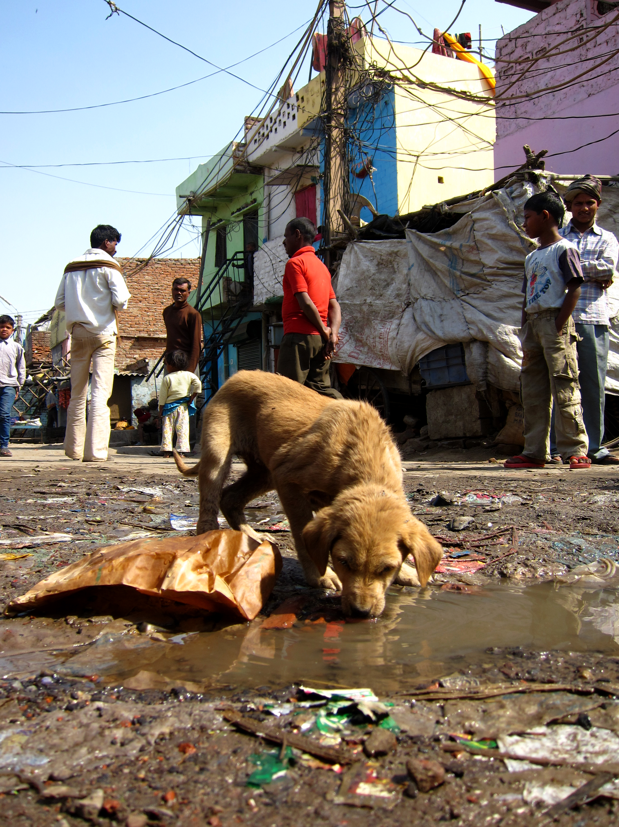
Case Presentation 2
Travel history
Returned to the U.S. 4 weeks earlier after an 8 week trip to India
He had sustained a dog bite 1-2 weeks prior to return to the US to his left hand; he did not seek medical care
No history of rabies vaccination
Confirmed to have rabies positive saliva
Died one week later
Of ~220 providers, ~40 were provided post-exposure prophylaxis
Most cared for the patient before rabies was considered
Notes:
Self reported anxiety with swallowing, especially liquids.
“Today HE accepted a few small bites of sold food which were well-tolerated with no signs of dysphagia. With liquids, HE grew extremely anxious and began gasping before the spoon reached her lips. We tried relaxation and visualization techniques which were minimally beneficial.”

Slide 57
Summary
Emerging infectious diseases are increasing
Factors include population growth, urbanization, mobile populations (travelers, migration, displaced populations), encroachment of animal habitat, environmental factors (climate change)
Emerging pathogens include
New pathogens
Bourbon virus, Heartland virus
Old pathogens, new geography
Zika virus, Ebola virus
Old pathogens, new traits
Zika virus (microcephaly), pandemic influenza, superbugs (drug resistance)
A complete Travel History is essential
It’s essential for public health officials to provide evidence-based transmission prevention guidance to first responders and for first responders to practice transmission-based prevention measures

Slide 58

Questions? Costi D. Sifri, MD csifri@virginia.edu

