Slide 1
L E S S O N S L E A R N E D HURRICANE MATTHEW Evacuation of a Health System
Virginia Public Health and Healthcare Preparedness Academy Annual Conference
Thursday, June 1, 2017
Charlie Wolverton
Director, Safety & Security / Emergency Preparedness
Southeast Georgia Health System

Slide 2
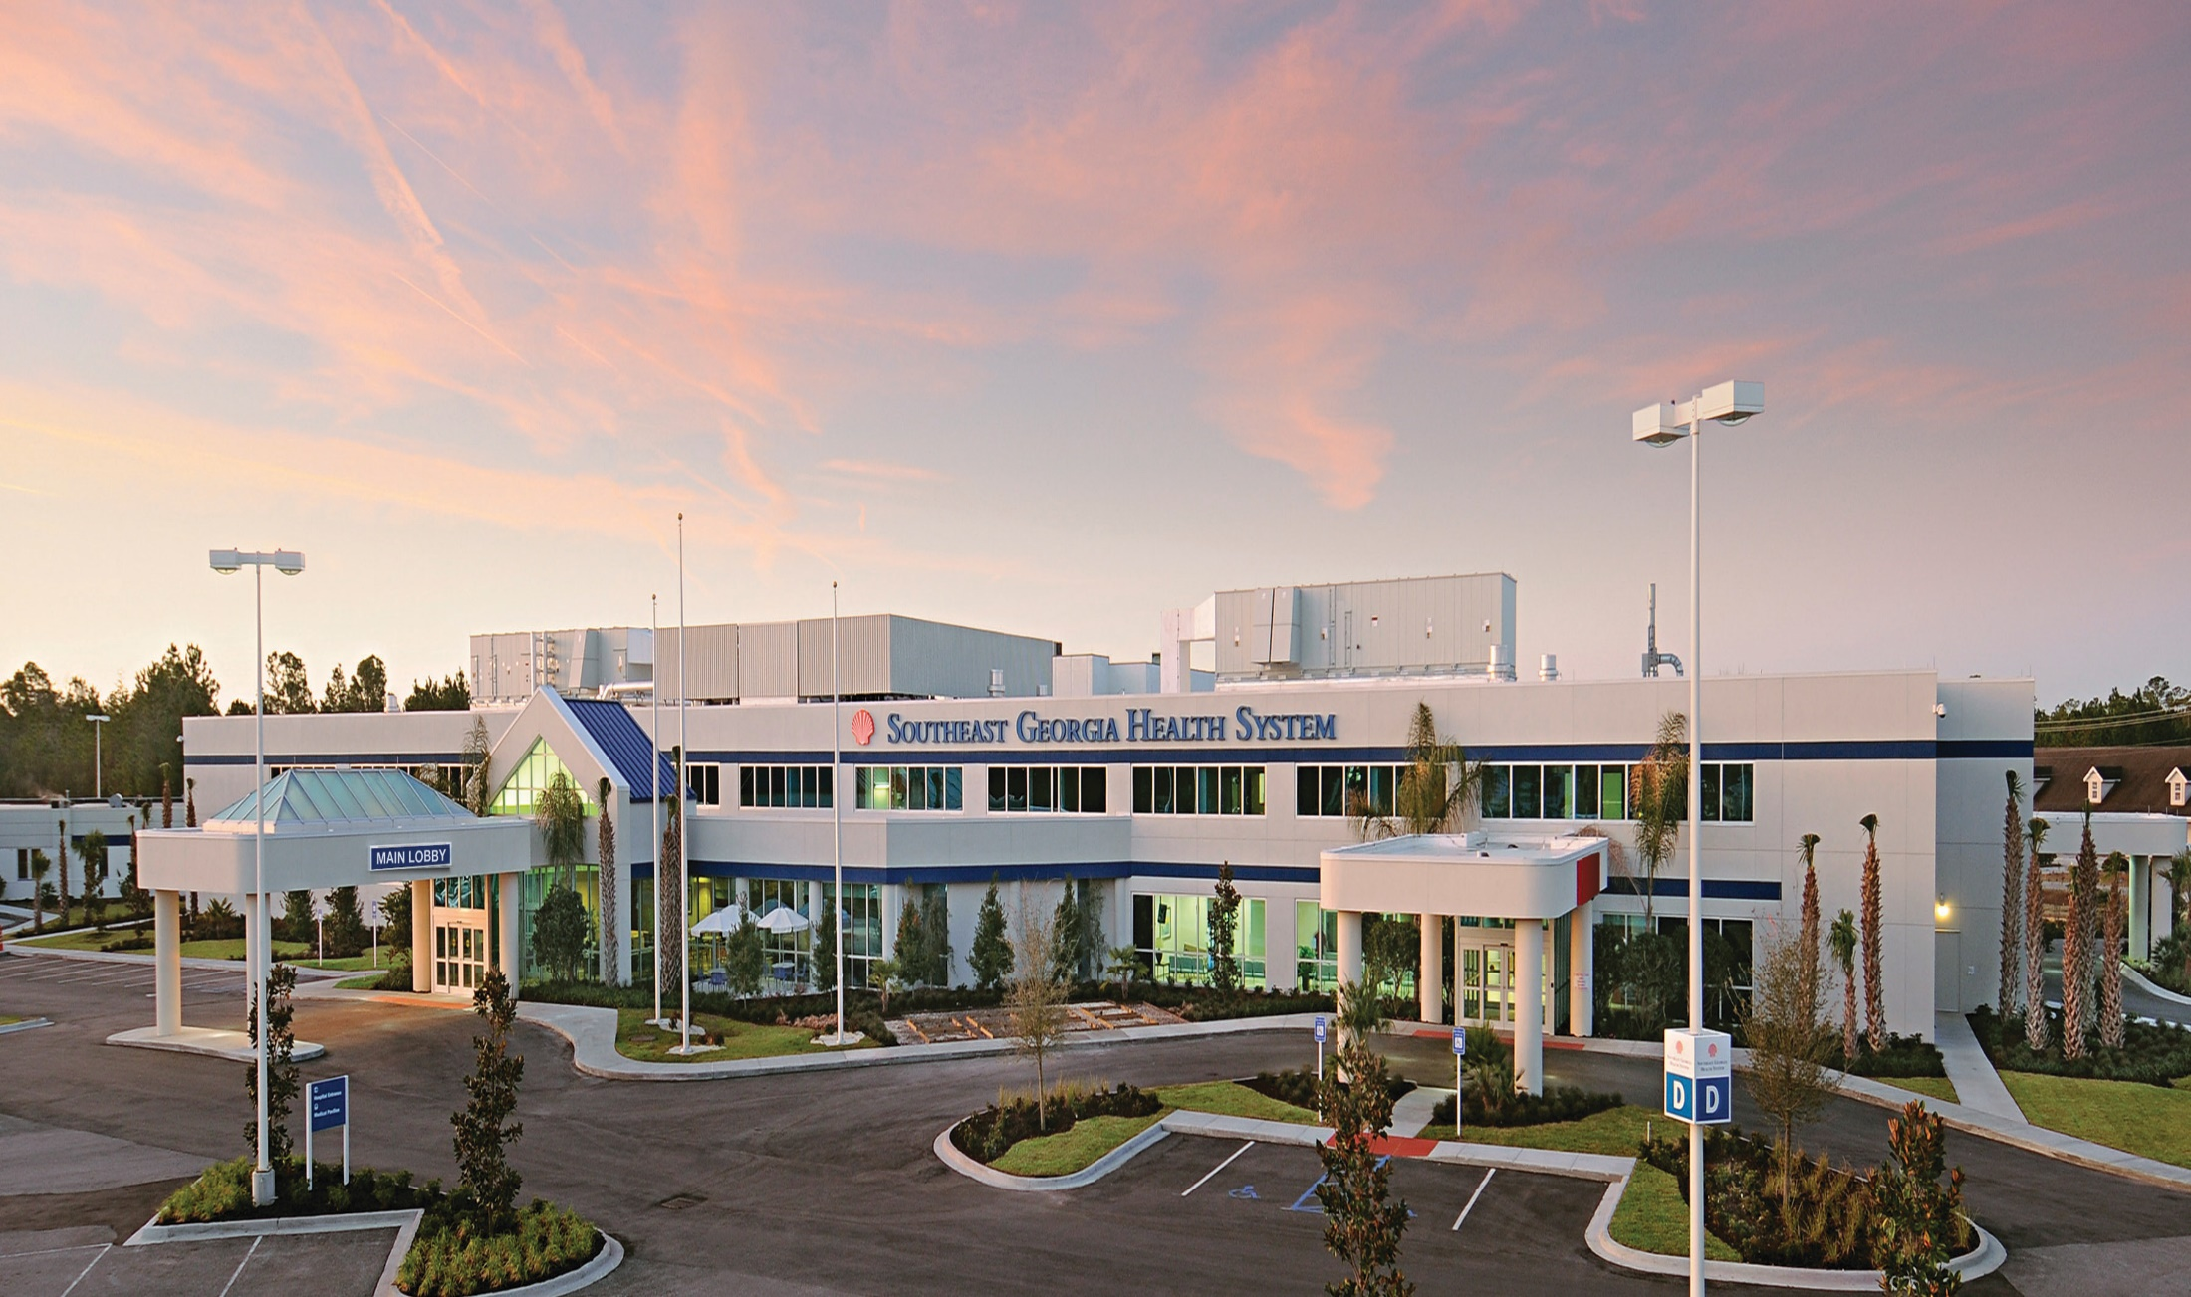
Camden Campus
Notes:
Campus furthest south

Slide 3
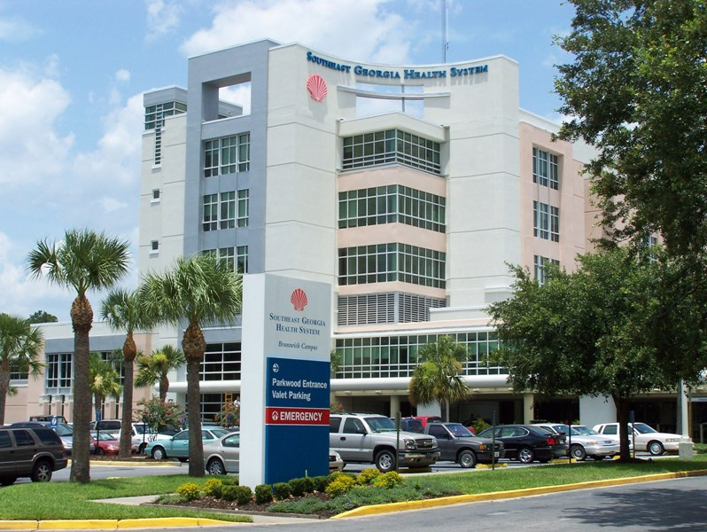
Brunswick Campus
Notes:
Largest hospital of the 2

Slide 4
Brunswick Campus (Outpatient Care Center)
Notes:
6 story Out-Patient Care Center

Slide 5
Southeast Georgia Health System
2 Hospitals – Brunswick & Camden Campuses
2 Senior Care Centers – Brunswick / St. Marys
3 Immediate Care Centers
4 Family Care Centers
20 Medical Practices
Numerous On/Off-Campus Buildings

Slide 6
EVACUATION
“To deal with a problem
you must first understand it.”
Each Facility has Unique Issues.

Slide 7
Uniquenesses of Our Facilities
Location (proximity to the coast/waterways)
Proximity to I-95 & FL evacuation traffic
Elevations
Populations – Patient/Resident Acuity
Relationships with other partners
Supplies, materials, equipment issues (just-in-time deliveries vs “the storeroom”)

Slide 8
Storms of the 1800's

Slide 9
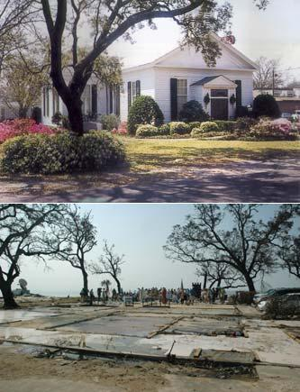

Slide 11
SGHS
Notes:
Was predicted to be a CAT 4 storm 10 miles off the coast but, at the nth hour was a CAT 2 storm 25 miles off the coast. Still, high winds and significant water accumulation.

Slide 12
Decision Time Vs Declaration Time
Not solely up to the governor; or, county/city government; or, the EMA director.
* * * * * * * * * *
The CEO decides if/when you evacuate.
Earlier declarations can help the process… but organizations want to make wise decisions, protect but not disturb our patients and staff, control costs, etc.

Slide 13
Other Decision Factors
Institutional Memory (remembering Hurricane Floyd in 1999…)
FEMA financial support tied to declaration of the emergency

Slide 14
Our Evacuation Decision
We waited for the governor’s declaration and then the county commissioner’s declaration
WE (and many others) WAITED TOO LONG!
CAT 4 storm predicted 10 miles off coast
CAT 2 storm occurred 25 miles off coast (late storm shift)

Slide 15
2 SCCs & 2 Hospitals < 2 Days
LOCATION | EVACUEES
Brunswick Hospital Campus | 183
Camden Hospital Campus | 19
Senior Care Center - Brunswick | 174
Senior Care Center – St. Marys | 69
TOTAL | 445

Slide 16
FOFI
SCC’s - first to evacuate and, in this event, first to return

Slide 17
Senior Care Centers
SCC - St. Marys to Lake Park (Valdosta)
SCC - Brunswick to Northside Baptist Church in Valdosta (75 miles away)
Used multiple local non-emergency transport vehicles – 15 hours outbound
Cash sent with both administrators

Slide 18
Senior Care Centers
Physical therapists accompanied residents
Understanding local resources is critical; Previously fostered good relationships with some EMS agencies in the relocated community;
5 U-Haul trucks took volumes of equipment and supplies
Must have a Plan B for back door storms

Slide 19
SGHS
Notes:
Was predicted to be a CAT 4 storm 10 miles off the coast but, at the nth hour was a CAT 2 storm 25 miles off the coast. Still, high winds and significant water accumulation.

Slide 20
Senior Care Centers
Residents of both SCCs were away 4 days and 3 nights
Residents were welcomed home with hot baths and showers, and gift baskets

Slide 21
L E S S O N S L E A R N E D Senior Care Centers
When evacuating, a police escort would have been helpful
Some staffing concerns; Hired temporary agency and EVS staff at relocation sites
Assure suitability of the kitchen / Additional canned food on site would have been helpful
Additional urinals for men

Slide 22
L E S S O N S L E A R N E D Senior Care Centers
Assure relationships with other (nearby) nursing homes for evacuations longer than 4 days
Incentives for team members
Ensure enough staff are available to bathe and shower returning residents

Slide 23
SCC St. Marys - Lessons Learned
Some family members picked up residents before the storm, during the storm realized how difficult it was to care for them, and following the storm, dropped them at the facility entrance
Out-of-town kennel used for staff pets
1 ECC patient

Slide 24
The Hospital OUTs and INs of Surviving a Hurricane
Timeline Sunday, October 2 to Tuesday, October 11, 2016

Slide 25
The OUTs (of patients)
Sunday, 10/2:
The Weather Channel (TWC) issued a ‘WARNING’
Monday, 10/3:
Performed facility assessment
Administrative decision to maintain services
Tuesday AM, 10/4:
TWC issued ‘possible direct hit’ projection

Slide 27
Tuesday, 10/4, 1200 Hours:
TWC issued ‘Category 3’ Warning
Began evaluating patients for potential discharge – (target 80 patients to remain)
Facility perspective: Consolidate patient locations (close St Simons Tower)
Tuesday, 2200 Hours:
Staffing plan completed
Decision to voluntarily transfer 46 patients and continue services

Slide 28
Wednesday, 10/5, Morning:
46 patients identified (nursing and case management)
Wednesday Noon:
Solidified staffing and medical staff presence
Began evaluation of elective surgery and admission patients
Decision to NOT yet transfer 46 patients

Slide 29
Thursday, 10/6, AM:
TWC: Storm turned; ‘predicted direct hit’
Mandatory evacuation ordered
Closed Camden Campus (discharged and transfered patients)
Canceled non-emergent / elective OR cases
Aligned staffing and medical staff support
Verified census; began discharge process
Began to identify/align placement for the the original 46 patients and the remaining 100 patients

Slide 30
Thursday, 10/6, 1600 Hours:
Began to empty the facility
Thursday, 2000 Hours:
Attempted to close the Emergency Care Center
Friday, 10/7, 0300 Hours:
Last patient out the door
Secured staff

Slide 31
Need for Standardized Scripts (Position Statements)
Telephone Operators (…community “lit up” the switchboard)
Medical & hospital staff to speak with patients and families
Community regarding discontinuing emergency services at both hospitals in the SE

Slide 32
Other Major Considerations
Discharged Patients (prior to storm) - Plan for patients whose families do not arrive or refuse to pick them up?
Patients who need recurring care, i.e., Dialysis, Chemotherapy, Cyberknife
Loss of electricity, water, communications, knowing unsafe conditions prohibit utility services from responding

Slide 33
Other Major Considerations
Some first responders located and transported people in the community to the hospital
Families brought relatives to the Emergency Care Center (on their way out of town) and dropped them off!
One out-patient visited her physician’s office and announced she wasn’t leaving.

Slide 34
OUTs - What we did well
Communicated to our patients, families, medical staff, and receiving facilities
Comforted our patients
Served our community without endangering our staff

Slide 35
Had complete and entire documents prepared and ready to go with our patients, along with a cover check sheet
Every receiving facility was contacted:
confirmed our patients arrived
thanked them for accepting our patients and providing a service to our community

Slide 36
The INs (Returning Patients)
Sunday, 10/9, AM:
Secured staffing and medical staff presence
Began rescheduling canceled OR patients
Sunday, 1200 Hours:
Re-opened Emergency Care Centers
No inbound transfers
No elective admissions
ONLY admission via the ECC
(5, 13, and then 25 patient census)

Slide 37
Began verification process of returning patients and coordinated return based on:
staffing
medical staff availability
clinical assessment of patient
ability to transport
ability to discharge patient safely to home

Slide 38
Sunday, 10/9, PM:
Received first returning patients
Monday, 10/10:
Began Admissions
Surgical
Maternal Health
Emergency Care Center
Continued controlled returns until all patients were home

Slide 39
COMMUNICATION
Standardized Scripts (Position Statements)
Switchboard (LIGHT-UP the switchboard)
People will want to know about their loved ones
where are they, when will they return, what is their condition, etc.
Re-opening of services
timeline
limited Vs full

Slide 40
Status of community
Availability of medical services outside of your facility
pharmacies, dialysis centers, etc.
Basic home needs of the patient: CAN the patient return to their home? Status of utility services?
Establish a separate location to coordinate patients transferring out and returning (away from your ‘normal’ patient flow)

Slide 41
INs - What we did well
KNEW which patients were arriving on a particular day
Communicated with accepting medical and clinical staff daily on expected arrivals
Placed signs to direct first responders on where to enter the facility and where to take the patient for arrival check-in

Slide 42
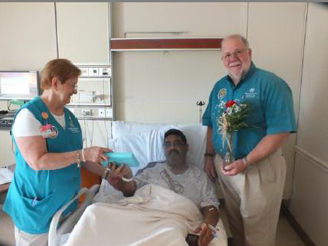
Patient arrival:
Personally greeted & welcomed everyone
Called nursing unit to alert on each arrival
Internal transport staff escorted first responders to nursing units with patient
All patients received a flower, small gift, and letter from our President and CEO, delivered by our Volunteers
Snacks for first responders & transporters

Slide 43
Post Survival Thoughts
MUST:
Master List of all patients prior to evacuation
Point person controls list
List will be needed during and (several months) after the evacuation
Be clear on when and how to close your emergency services
Scribe must keep clear & concise notes; Consistency among scribes

Slide 44
After-Action Review (AAR)
Involve those affected in this process
Identify the processes you can improve.

Slide 45
Our Hearts Thank You
HUGE thanks to:
Staff of the GA State EOC for their patience, understanding, guidance, coordination, and communication
Receiving facilities that accepted and provided excellent care to our patients
So many first responders who answered the call and safely transported and cared for our patients

Slide 46
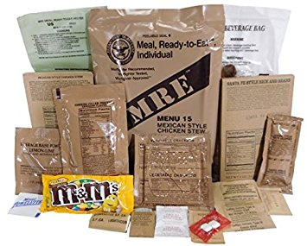
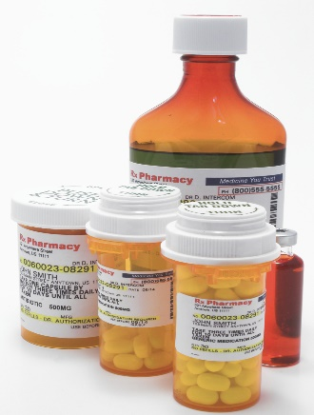
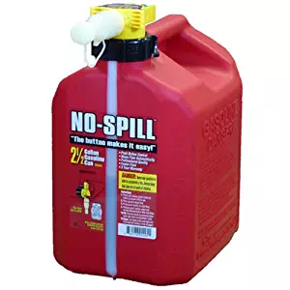
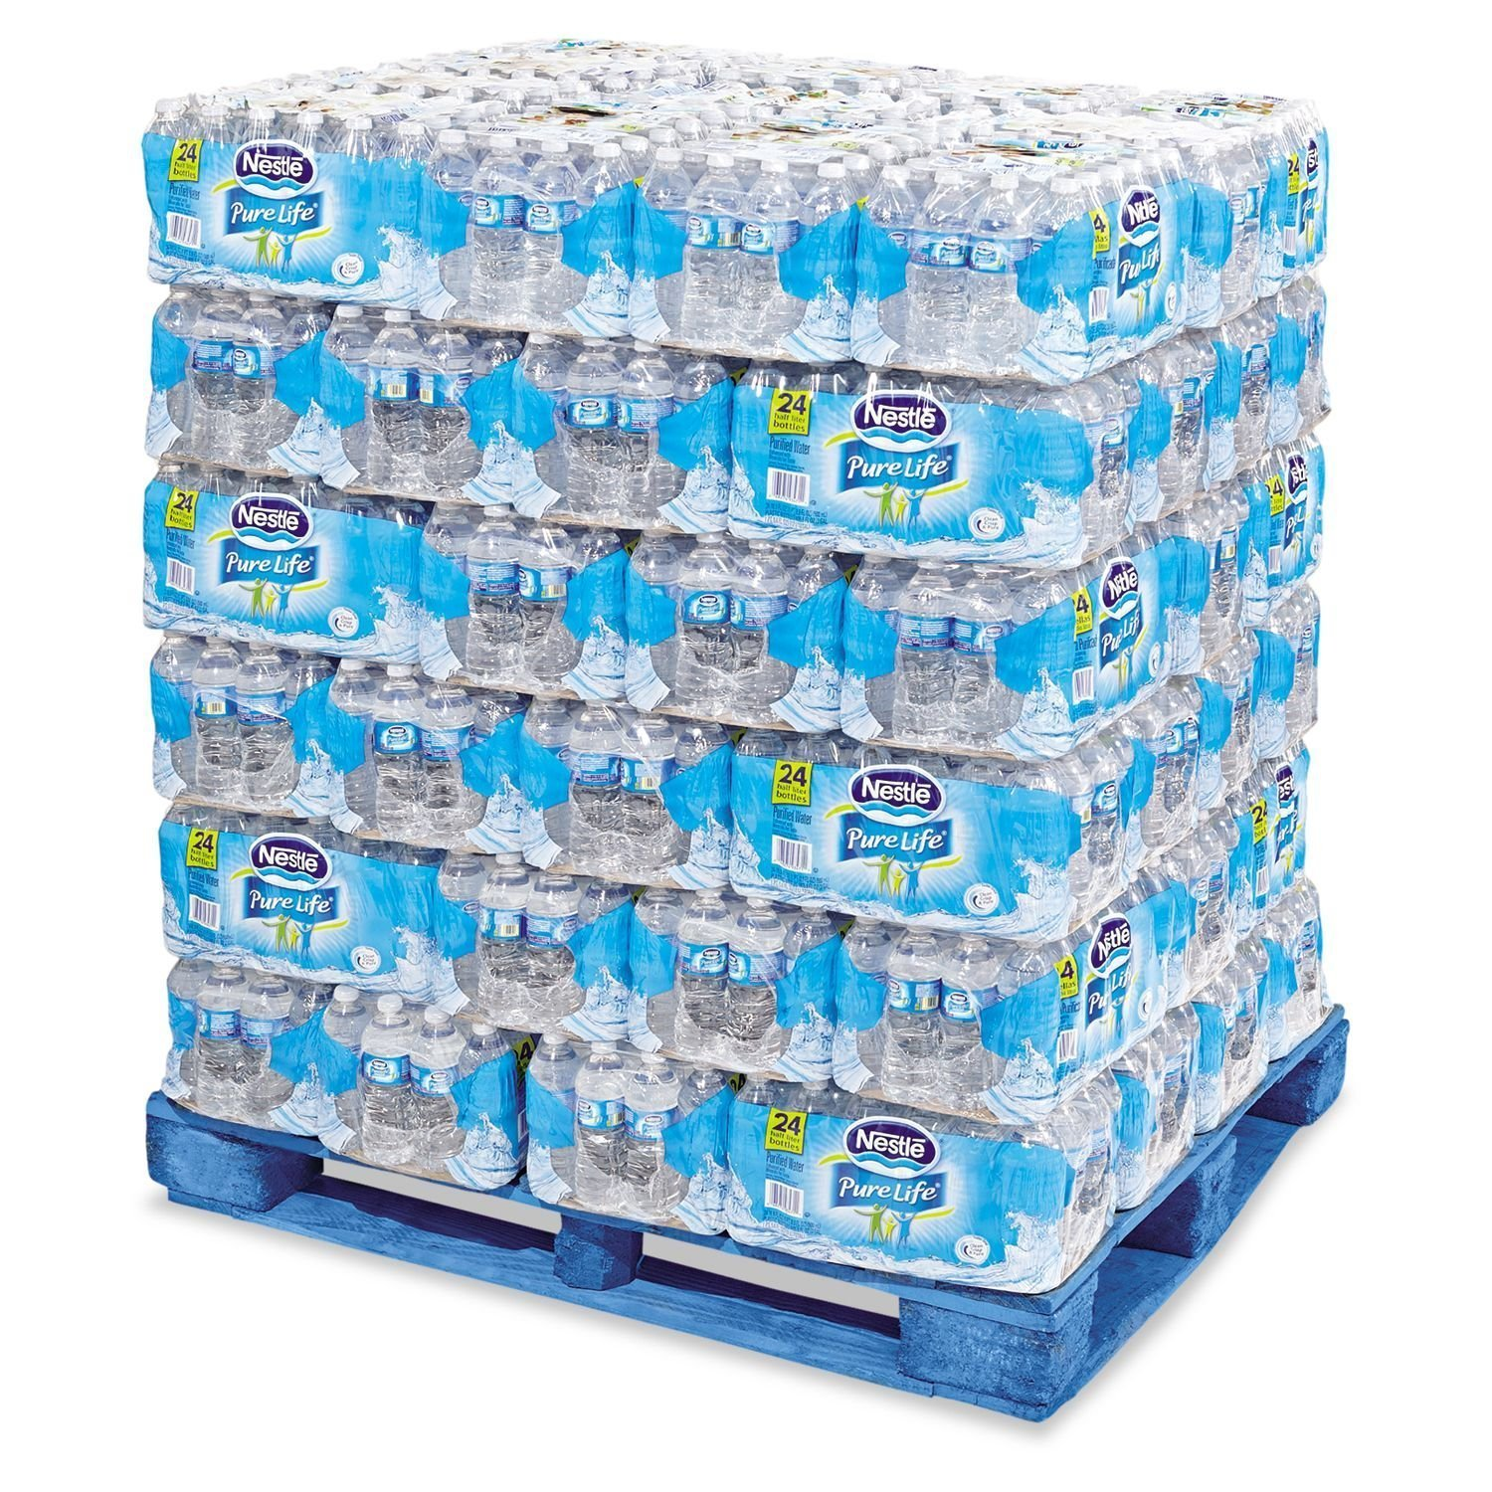
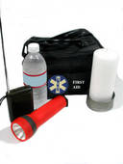
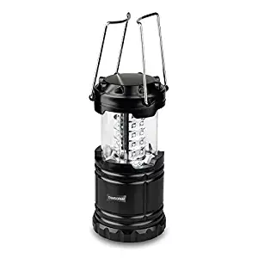
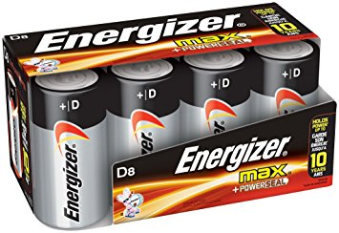
CONTINUITY OF NEEDS
How have you & your staff prepared for the basics (many most vital to life) before, during, and following the disaster?
Food
Water
Shelter
Sanitation
Cash
Medication

Slide 47
NOTIFY THE STATE!
Be sure to make the necessary
state and/or CMS notifications
regarding the evacuations of hospital patients and nursing home residents
Add this step to your plan.

Slide 48
Effective Emergency Management Programs
LEPCs/ESFs
(community planning partnerhips, sharing
of information)
Region J & Coastal
Coalition Mtgs
EMAG
It’s
All About Relationships
Drills,
Training,
Education & Experience
All Hazards Program
Evaluations/
& Adjustments
Notes:
Combating Incidental Spills consists of 4 main parts:
1. Responsibility - knowing who should be doing what
2. Equipment - having the appropriate spill kits and PPE in place
3. Procedures - having procedures written up to combat spill, and posted so that they can be used
4. Training - all personnel who handle chemicals in their departments need to be trained to clean up a spill of the department-specific chemical.

Slide 49
?

