Slide 1
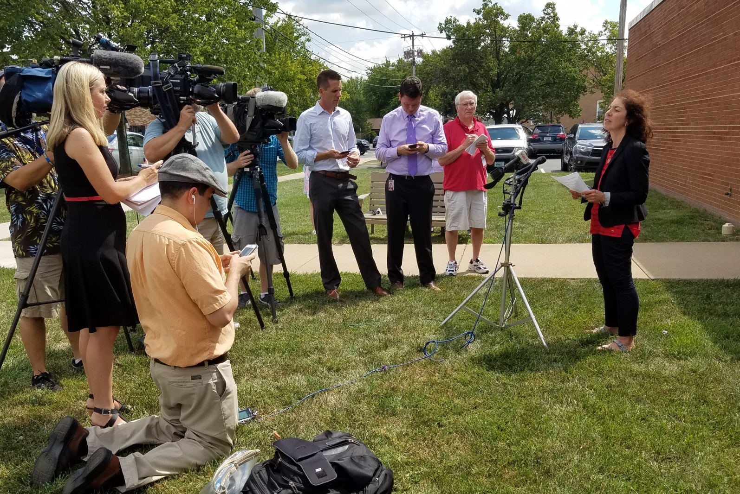
Spokesperson Review
Notes:
Briefly introduce yourself w/title and the training coordinator who is assisting you with the training for the day (if applicable).
Ask: Why are you here? What are your impressions of the media?
These questions, and the answers from the participants, can help you gauge your audience from the start of the training day as to how they view the media and what they hope to get out of today’s training.

Slide 2
The purpose of media training is to help you feel more comfortable and be more successful giving effective media interviews.
Notes:
Self-explanatory.

Slide 3
A spokesperson should:
Know your organization’s policies and your community
Understand the “big picture”
Stay within your scope of responsibilities
Be honest and open
Be empathetic
Notes:
Bullet point one: The ‘community’ aspect is very important when talking about a local public health issue and who it can effect.
Bullet point three: Never to try and speculate about a subject that the reporter may ask you about.

Slide 4
Reminders
Keep comments simple
Stick with the facts
Be conversational
Stick to Key Messages
Correct errors quickly
Notes:
Set location that suits you and tells positive parts of your story.
Describe what info you have, what you can say and what you can’t say….

Slide 5
Anticipate Questions
What happened?
How do I protect my family?
Who caused this?
Who is in charge?
Why did this happen?
What should we do?
Did you have forewarning?
What are you doing to fix this?
Notes:
After you figure out your key messages, brainstorm and anticipate questions. Make sure you know the other side of the story.
Reporters will always want to know “the five W’s”: who, what , where, when, why (and how).
They are looking for emotional statements, or statements only experts can say.
What you don’t want to be asked, probably will be. Rehearse the negatives so you know what you may have to deal with.
For larger more controversial issues, we actually put together a Q and A sheet and distribute it to all the people who may be asked questions by the press.

Slide 6
Effective Message Strategies
Don’t over-reassure
Acknowledge uncertainty or fear
Express that a process is in place
Express wishes
Give people things to do, and where to go for more information
Consider the “what if” questions
Notes:
There are several guiding principles when delivering your message to the public. Examples are (cue to bullet points and try to give real-world examples for each).

Slide 7
Transitional Phrases/Bridging
“What is most important is ….”
“What we should focus on is …”
“What the public should know is …”
“That speaks to a larger point …”
“I don’t know that answer, but what I can tell you is …”
Notes:
Transitional phrases, or bridging, allows us to move easily from one topic to another. This is very important in working with the media, as they may ask questions that we sometimes can’t answer, or the questions may veer off the topic at hand. Some examples of transitional phrases are:
(NOTE: If you have specific examples that were used either by yourself, or by someone in VDH who were interviewed, regarding any of these transitional phrases, use them).

Slide 8
Develop Key Messages
Brainstorm – Think freely and jot down all pieces of information.
Identify the most important ideas until you have narrowed the list to three key items.
Identify Supporting Data – Review ideas and find information that supports key messages.
Notes:
Go through the bullet points.

Slide 9
Developing a Message
What do you want the public to know?
Make it:
  Clear and concise
  Positive
  Expressed in terms ordinary residents can understand
Notes:
In preparing for an interview, you’ll first want to develop a message. Try to find out as much as you can about a subject. You may have to do this quickly, especially when dealing with radio and TV Usually when someone calls you from a radio station they want the sound right now. Feel free to ask them if you can put them on hold or call them back for a couple of minutes as you collect your thoughts. Regarding television, the reporter may be in the parking lot. Again, try to buy yourself a little time if you need it. It is better to give the correct information the first time, than try to take it back. Decide on a few points you want the public to know. This is your message.

Slide 10
Message Mapping
A total of 27 words for all three key messages with each key message averaging 9 words in length
9 seconds
3 messages in total
Notes:
So what exactly encompasses a message map? (Read the bullet points.)

Slide 11
Message Map Sample
Key Message 1 A powdery substance has been discovered | Key Message 2 Anthrax is not contagious | Key Message 3 Everyone needs to take proper medication within 48 hours
Support 1.1 It was discovered by our staff | Support 2.1 Anthrax can be deadly if left untreated. | Support 3.1 Medication distribution sites have been set up
Support 1.2 These are the areas affected | Support 2.2 Anthrax is spread by breathing in particles | Support 3.2 Stay tuned to local broadcasts for instructions
Support 1.3 Hazardous emergency teams are on site | Support 2.3 The federal gov’t will provide medicine | Support 3.3 Call this 555-5555 for more information
Notes:
This is an example of a message map tailored for a powdery substance that was discovered that may be anthrax. Notice that each key message has three corresponding support points.

Slide 12
Media Events
Planning
Announcement
Location/timing
Social media monitoring
Spokesperson Prep
Supporting materials
Follow Up – media monitoring
Notes:
When to have a press Conference?
Only MAJOR event or news.

