Slide 1
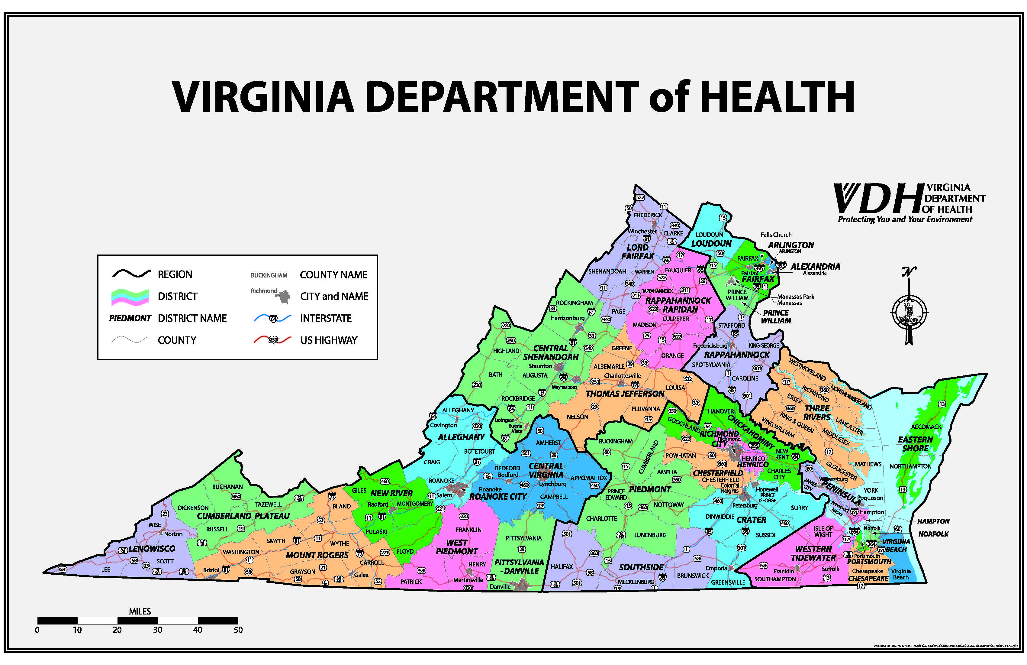

Slide 2
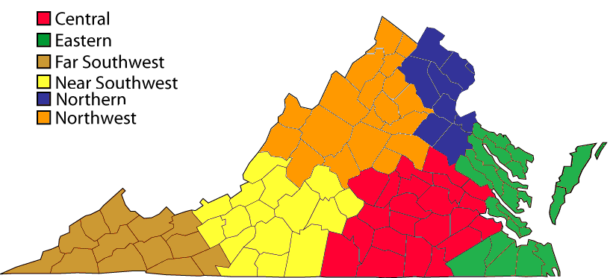
Virginia HPP Overview
Virginia Hospital and Healthcare Association Regions (VHHA)
Hospital Preparedness Program (HPP)
The Virginia Department of Health partners with The Virginia Hospital and Healthcare Association to engage community partners
Notes:
The Virginia Department of Health in coordination with the Virginia Hospital and Healthcare Association manage the HPP program for the state. As you can see here, the commonwealth is comprised of 6 healthcare coalition regions, Northern, Northwest, Eastern, Central, Near Southwest, and Far Southwest. We are very luck to have the partnership with VHHA. Through this partnership our healthcare coalitions have 100% hospital participation, as well as many members including long term care facilities, EMS councils and personnel, public health, etc.
Now a unique aspect about Virginia’s healthcare coalition is how different their hazard vulnerability is. As I’m sure you’re all aware, Northern Virginia, which we like to refer to as “the state of Northern Virginia” has a higher risk for manmade disasters than let’s say the Far Southwest might. And the Eastern region is more susceptible to flooding and hurricanes then the northwest might be.

Slide 3
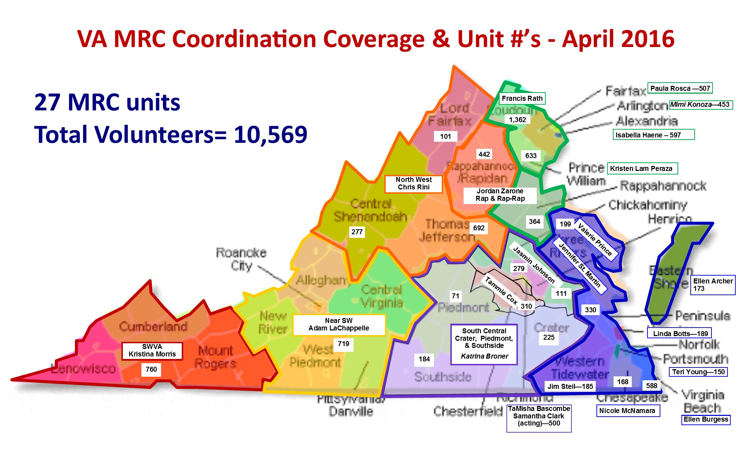

Slide 4
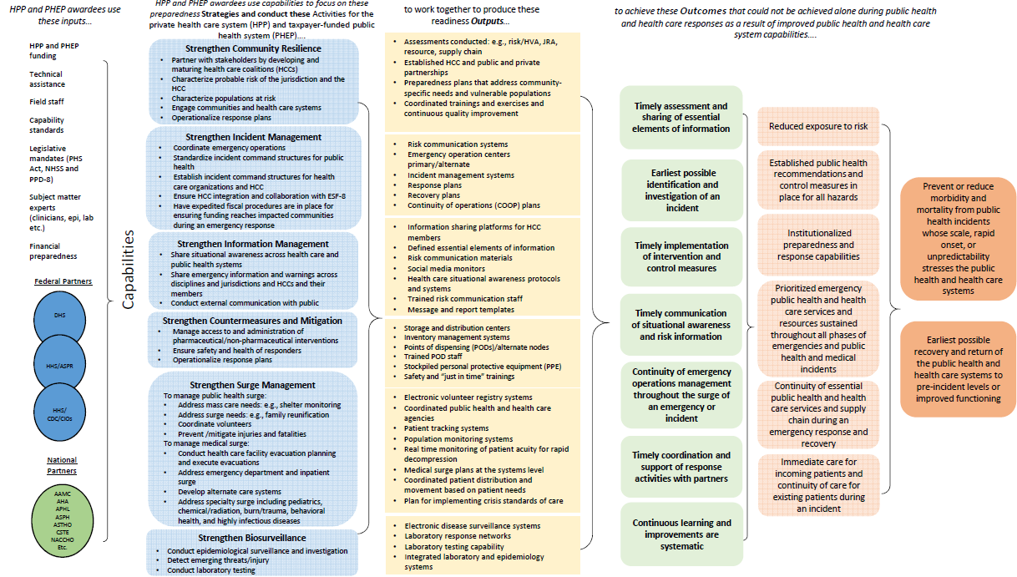

Slide 5
Public Health Preparedness Domains
1: Strengthen Community Resilience
2: Strengthen Incident Management
3: Strengthen Information Management
4: Strengthen Countermeasures and Mitigation
5: Strengthen Surge Management
6: Strengthen Biosurveillance (PHEP)
2: Strength2: Strengthen Incident Managemente Incident Management

Slide 6
HPP Outcomes
Increasingly Resilient HCCs
Enhanced HCC membership
Near-real-time Cross-regional and Cross-functional Situational Awareness and Common Operating Picture
Hazard Vulnerability Analyses in all HCCs
Enhanced response to at-risk populations
Increasingly integrated HPP and PHEP functionality
Improved responder safety and PPE inventory
Better external information-conscious HCC staff and membership
Increased surge responsiveness
Better integration of volunteers

Slide 7
PHEP Outcomes
Complete emergency preparedness portion of State Public Health Accreditation
Continue NACCHO Project Public Health Ready (PPHR) recognition for all LHDs
Increase MRC / volunteer outreach and functionality
Deeper engagement with federally recognized tribal communities
Continue a robust capabilities-driven, HSEEP-compliant exercise program
Complete public health and health care (HCC) integration at the local, regional and state levels
Integrated state THIRA with regional, local and health care facility / HCC hazard vulnerability analyses

Slide 8
PHEP Outcomes (cont’d)
Increased focus on at-risk population planning and response; and enhanced use of CMS emPOWER data during planning and in response
Better trained, more responsive work force in operations centers
Standardized VDH all-hazard Incident Management Team
Near-real-time Cross-regional and Cross-functional Situational Awareness and Common Operating Picture (same as HPP)
Enhanced administrative, logistic, financial preparedness

Slide 9
PHEP Outcomes (cont’d)
Shared accurate, real-time information with the general public and/or clinicians for emerging conditions
Provide OCME more staff trained, prepared for a mass fatality incident
Complete reformatted, consistent, operationalized family of plans
Enhanced preparedness for response to unique pathogens
Transition of cross-docking / managed inventory model for medical countermeasure distribution
Maximized results of the MCM Operational Readiness Review (ORR)

Slide 10
PHEP Outcomes (cont’d)
Complete enlistment of all-hazard MCM private pharmacy PODs
Successful completion of any PHEP/LRN emergency contact drills / Successful completion of all surge and capability exercises
Enhanced Public Health Information Systems Workforce with improved Public Health Informatics utilizing the Advanced Electronic Information Exchange and increased engagement with VA’s Poison Control Centers

Slide 11
HPP/PHEP Funding
HPP Funding
2010 | 2011 | 2012 | 2013 | 2014 | 2015 | 2016 | 2017
$8,857,019 | $9,668,881 | $8,620,629 | $8,739,318 | $8,231,128 | $6,188,517 | $6,295,382 | $6,117,444 $6,075,317
PHEP Funding
2010 | 2011 | 2012 | 2013 | 2014 | 2015 | 2016 | 2017
$16,580,677 | $16,945,680 | $14,163,377 | $14,939,373 | $14,048,975 | $14,786,946 | $14,911,408 | $13,744,023 $14,882,534
Source: Notice of Grant Award for Federal Fiscal Years 2010 through 2017
(Award totals do not include carryover funding or special/supplemental awards)

Slide 12
Results
National Health Security Preparedness index
R W Johnson’s Trust for America’s Health: “Ready or Not”
CDC Performance Snapshot
Operational Readiness Reviews
Project Public Health Ready
CBERS
Academy
Exercises
Tranquil Shift
Marble Challenge
VESTEX
Pilot Programs
Operational Readiness Review
Mission Ready Packages
Private Sector Pharmacy Partners

Slide 13
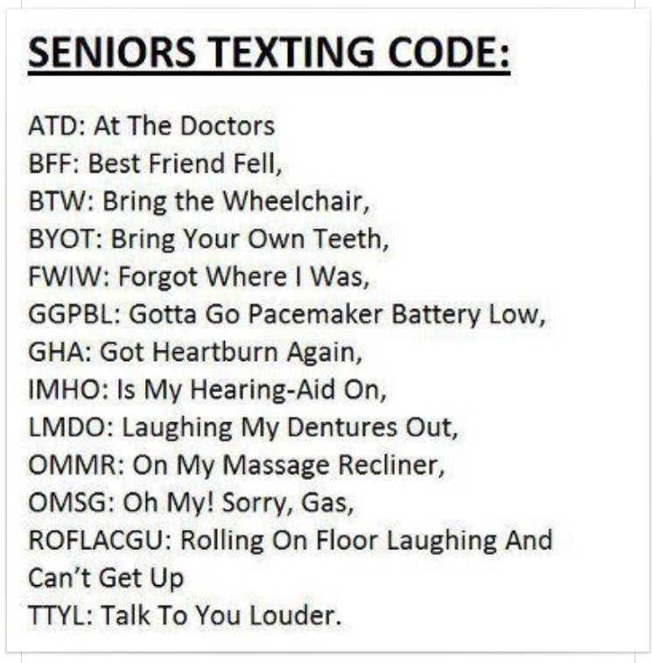

Slide 14
Active Incident Management Teams
Ebola
Zika
Addiction / Opiods

Slide 15
Questions?
Dr. Hughes Melton, Chief Deputy Commissioner Public Health and Preparedness
Hughes.melton@vdh.virginia.gov
804-864-7025
Bob Mauskapf, Director Emergency Preparedness Bob.Mauskapf@vdh.virginia.gov
804-864-7035
Cindy Shelton, Assistant Director, Emergency Preparedness
Cindy.Shelton@vdh.virginia.gov
804-864-7486
Jennifer Freeland
VDH State Volunteer Coordinator
Jennifer.freeland@vdh.virginia.gov
804-396-0543
Kim Allan, Operations Director
Kim.Allan@vdh.virginia.gov
804-864-7030
Suzi Silverstein, Director, Risk Communications and Education Suzi.Silverstein@vdh.virginia.gov
840-864-7538
Patrick Ashley, Hospital Emergency Coordinator
Patrick.Ashley@vdh.virginia.gov
804-864-7033
General Info / Contact
http://www.vdh.virginia.gov/OEP/

