Slide 1
Virginia Zika Task Force
April 1, 2016
Office of the Governor
Commissioner VDH
Virginia Zika Task Force
VDEM
VDH OEP
Governor’s Office Representative
Lt. Governor’s Office Representative
Clinician Outreach Task Group
Communications Task Group
Human Surveillance Task Group
Maternity Health Task Group
Mosquito Control Task Group
Blood/Tissue Safety Task Group
Others
Lead: VDH ORCE
DVS
Lead: VDH OEPI
Lead: VDH OEPI
Lead: Virginia Mosquito Control Association
Lead: American Red Cross
DBHDS
Input from all Task Groups
DGS DCLS
VDH Office of Family Health Services
Virginia Blood Services
DOE
LEGEND:
BHDS: Virginia Department of Behavioral Health and Developmental Services
DCLS: Division of Consolidated Laboratory Services
DCR: Virginia Department of Conservation and Recreation
DGS: Virginia Department of General Services
DOE: Virginia Department of Education
DVS: Virginia Department of Veterans Services
OEP: Office of Emergency Preparedness
OEPI: Office of Epidemiology
ORCE: Office of Risk Communications and Education
SCHEV: State Council of Higher Education for Virginia
VACO: Virginia Association of Counties
VCU Health: Virginia Commonwealth University Medical Center
VDEM: Virginia Department of Emergency Management
VDH: Virginia Department of Health
VDOF: Virginia Department of Forestry
VDGIF: Virginia Department of Games and Inland Fisheries
VHHA: Virginia Hospital and Healthcare Association
VML: Virginia Municipal League
SCHEV
VDACS
VDH OEPI
DGS
VDGIF
VHHA
VDOF
DCR
MSV
VACO
State agency
Private Sector
VML
Non-governmental organization

Slide 2
Task Force Members
Deputy Chief of Staff, Offices of the Governor and Lt. Governor
Secretary of Veterans’ and Military Affairs
Department of Emergency Management
Department of Health
Department of Health Professions
Department of Behavioral Health & Developmental Services
Department of Agriculture and Consumer Services
Department of Environmental Quality
Department of Education / State Council of Higher Education for Virginia
Department of General Services - Division of Consolidated Laboratory Services
Department of Transportation
Departments of Conservation and Recreation/Forestry/Game and Inland Fisheries
Virginia Hospital and Healthcare Association / 6 regional coalitions
Medical Society of Virginia
City, Town and County Governments
Virginia Municipal League
Virginia Association of Counties
American Red Cross / Virginia Blood Services
Others, situationally dependent, as required

Slide 3
Initiatives
Lab Capability / increased capacity at DCLS, Fairfax Health Department, George Mason University
DCLS supported OH and WV
Test result reporting
Weekly reporting of human and mosquito surveillance
Mosquito Control Contracting with private vendors
MOU with VA. Tech for vector surveillance and resistance
Distributed 10K Education Tool Kits (literature, repellant, condoms); prepared to distribute additional repellant to target groups.
Monthly Meetings with State Zika Task Force and Clinician Outreach Work Group
Establishment / maintenance of State Pregnancy Registry
Communications Progress: Airports, Locally Distributed Printed Materials, Social Media, VDH Zika Web Page / Dark Site, Radio, Bus Signage, Direct Mailing, etc.

Slide 4
Task Force / Incident Management Team Activities
Task Groups:
Maternal / Fetal Health
Vector Surveillance / Control
External Communications
Human Surveillance
Laboratory Diagnostics
Blood Supply Security
Clinician Outreach
Ongoing Actions
Blood Supply: all collections must be tested
Draft Emergency Order: Access to property
State Funding Access / No additional new federal funding.
State Plan posted on VDH Zika page.
Three Exercises conducted
Situation Reports monthly
State and local Playbooks developed citing immediate actions if local transmission is identified

Slide 5
Zika – Virginia Procedures 2017

Slide 6
Zika Procedures, 5/1/2017
Zika staff funding ends 6/30 and 7/31, 2017
Plan to scale down (1 coord, 1 data, 1 biologist)
VDH will still approve public health testing for pregnant women with exposure & their infants
Track data on those who test positive by any lab, not all who are tested
Flag cases for public health action
Pregnancy registry
Mosquito surveillance and control
Those needing additional testing

Slide 7
Mosquito Surveillance
During mosquito season (May-October), health districts will conduct mosquito surveillance if:
Zika RT-PCR positive patient, or
Patient with a Zika IgM positive or Zika IgM equivocal result (potentially viremic), or
Suspected local mosquito-borne transmission and ≥2 Zika defining symptoms.
These are the minimum for public health action. LHDs are encouraged to utilize resources and expand on mosquito surveillance activities as resources permit.
Training and supplies to be provided to some health districts
Other mosquito surveillance opportunities will be assessed on a case-by-case basis

Slide 8
Zika Epi Communications, 2017
May 24 – Clinician Forum
FICK Center, Fredericksburg
Overview, ID/lab, OB, pediatric, local health perspectives on the agenda
150 on-site or webinar; register in TRAIN
Clinician Letter planned for late April
Mosquito surveillance/control training, epi procedure training – VDH
Weekly updates on the VDH website

Slide 9
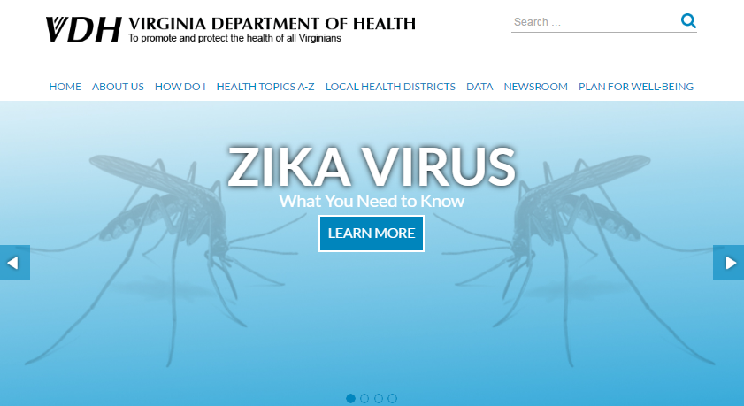
Zika Communications

Slide 10
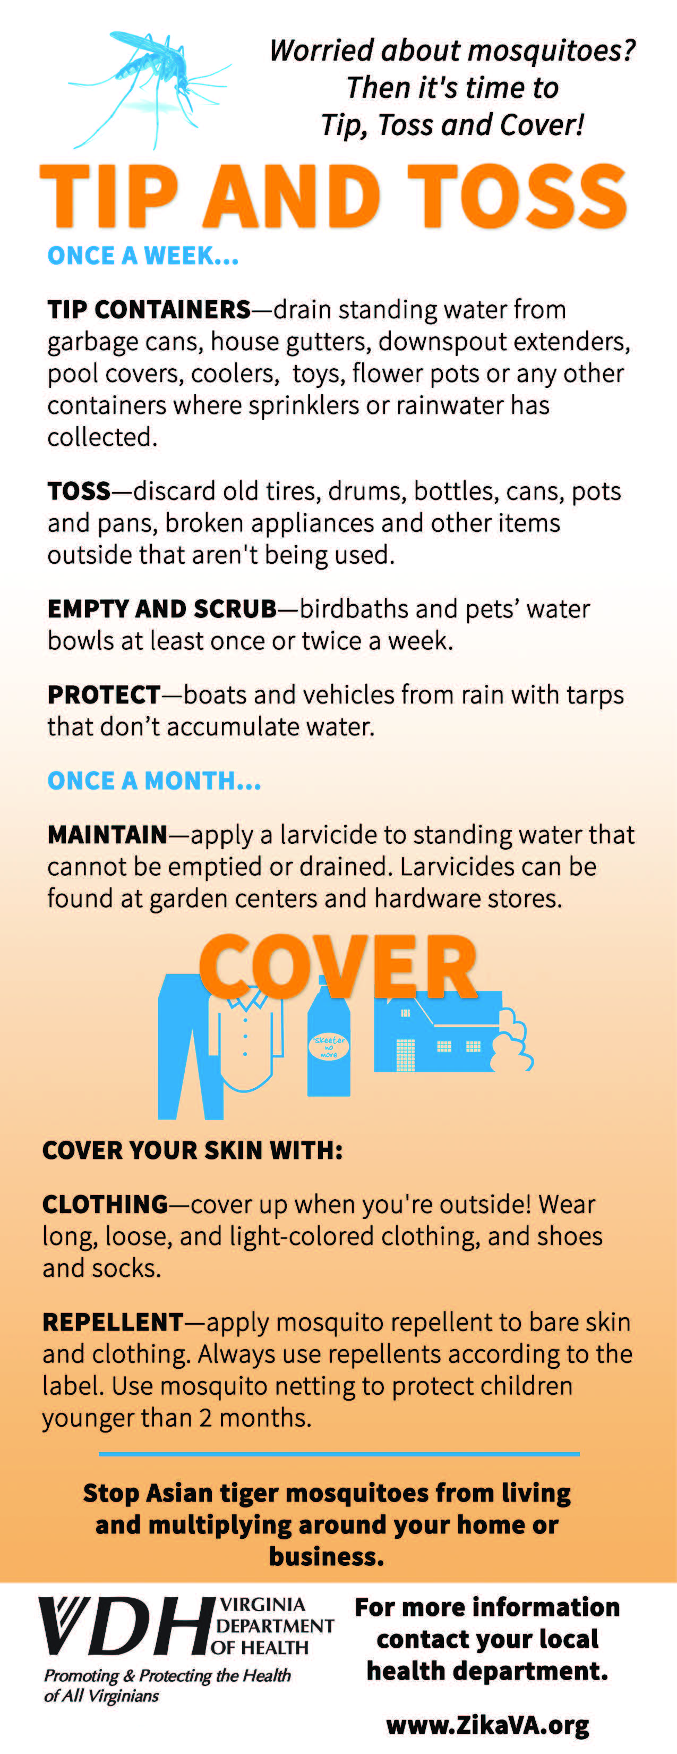
Collateral Materials

Slide 11
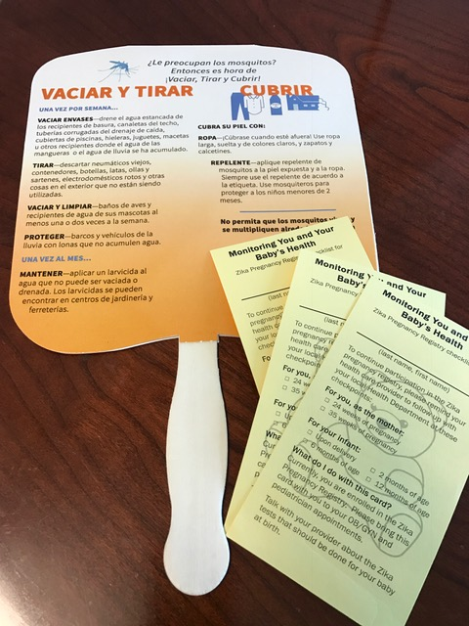

Slide 12
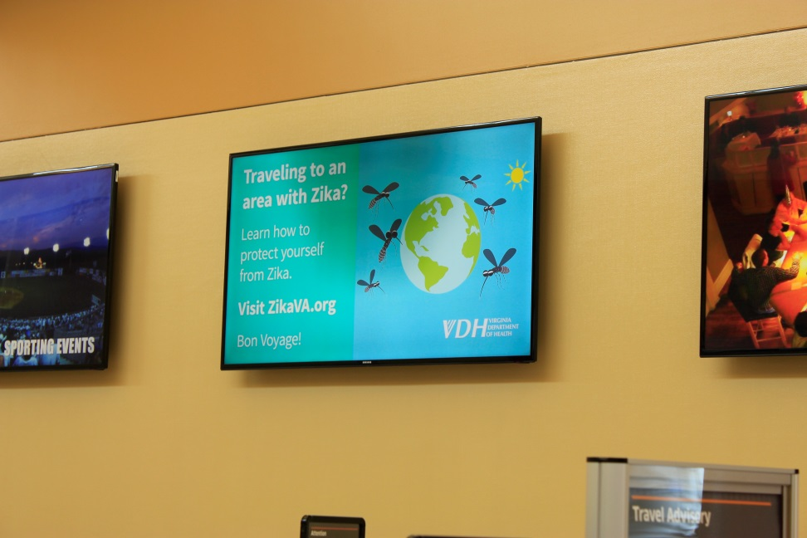

Airport Displays
Roanoke Airport

Slide 13

Reagan National

Slide 14
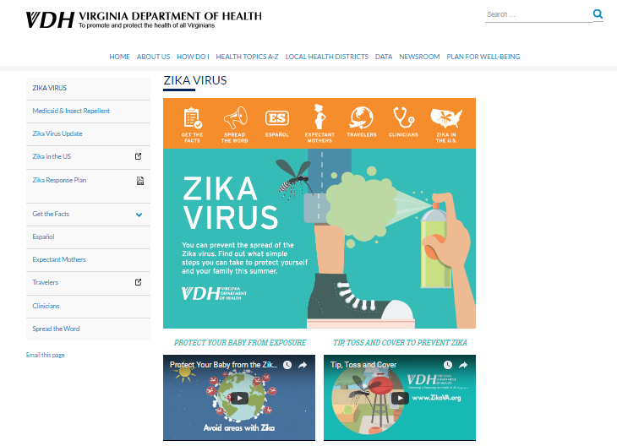
www.ZikaVa.org

