Slide 1
Health and Human Resources Sub-Panel Meeting
Emerging Health Threats
Jonathan Falk, MPH Epidemiology Program Manager

Slide 2
Ebola

Slide 3
Ebola
August 1st, 2018 Democratic Republic of the Congo (DRC) reported an outbreak of Ebola virus disease (EVD)
10th Ebola outbreak in the DRC since the virus was discovered in 1976
608 cases of EVD have been reported as of January 1st, 2019
560 Confirmed
368 Deaths (61% CFR)
6,859 contacts under surveillance as of January 1st, 2019
54,153 people vaccinated as of January 1st, 2019
Notes:
https://www.who.int/ebola/situation-reports/drc-2018/en/
CDC Travelers’ Health is set at Alert – Level 2 practice enhanced precautions. Virginia is currently not actively monitoring/tracking travelers

Slide 4
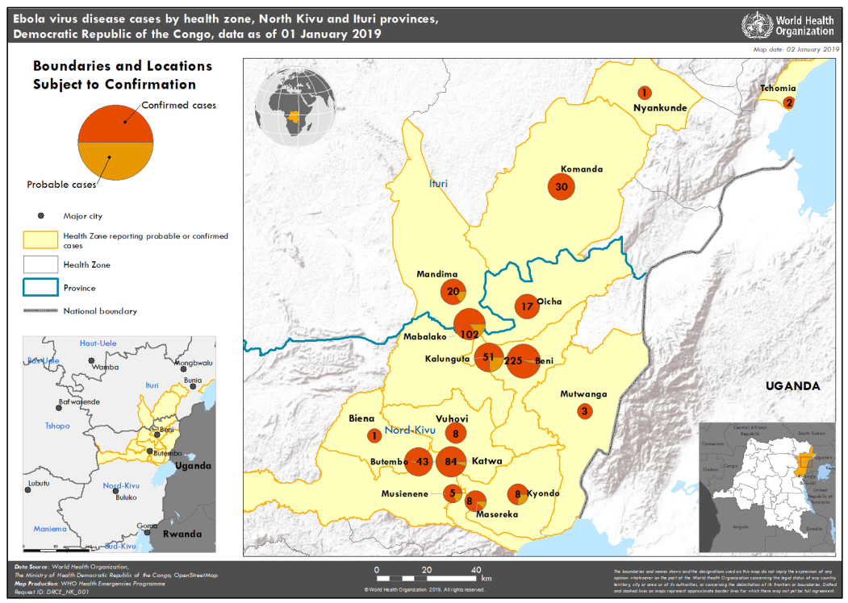
Notes:
North Kivu and Ituri are among the most populated provinces in the Democratic Republic of the Congo. The provinces are affected by intense insecurity and a worsening humanitarian context, with over one million internally displaced people and continuous movement of refugees to neighboring countries including Uganda, Burundi and Tanzania. The Democratic Republic of the Congo is concurrently responding to multiple disease outbreaks across the country.

Slide 5
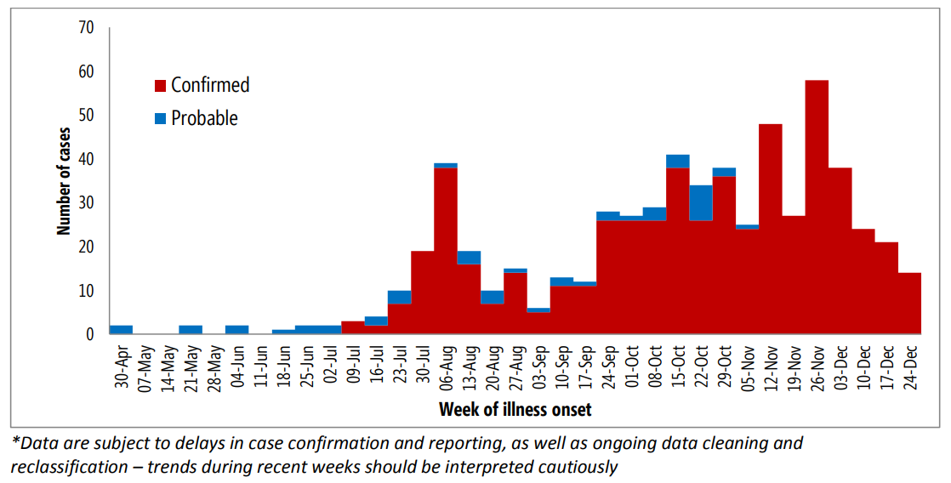

Slide 6
Measles

Slide 7
Measles
Acute viral illness characterized by a prodrome of fever and fatigue, cough, coryza, and conjunctivitis, followed by a maculopapular rash
Usually a mild or moderately severe illness but can result in complications such as pneumonia, encephalitis, and death
Average interval between exposure and rash onset is 14 days
Infectious period is typically four days before until four days after onset of rash

Slide 8
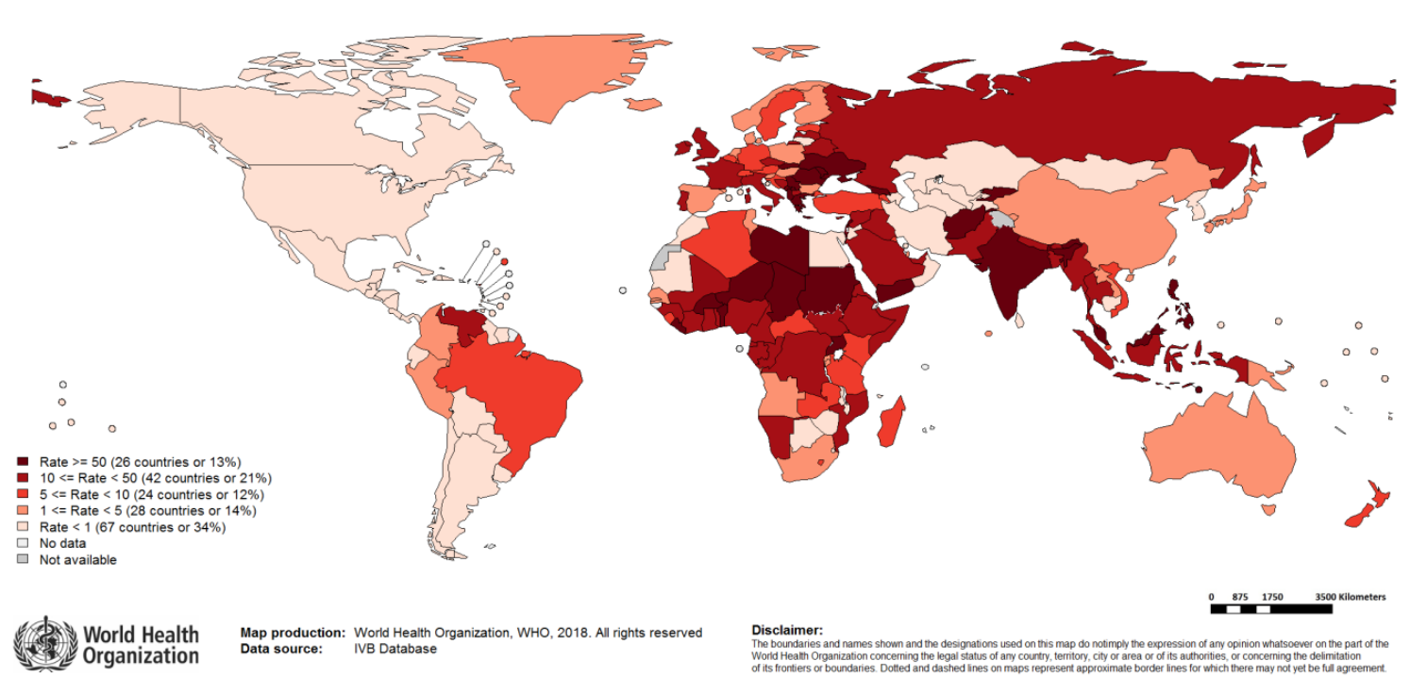
Notes:
https://www.who.int/immunization/monitoring_surveillance/burden/vpd/surveillance_type/active/measles_monthlydata/en/

Slide 9
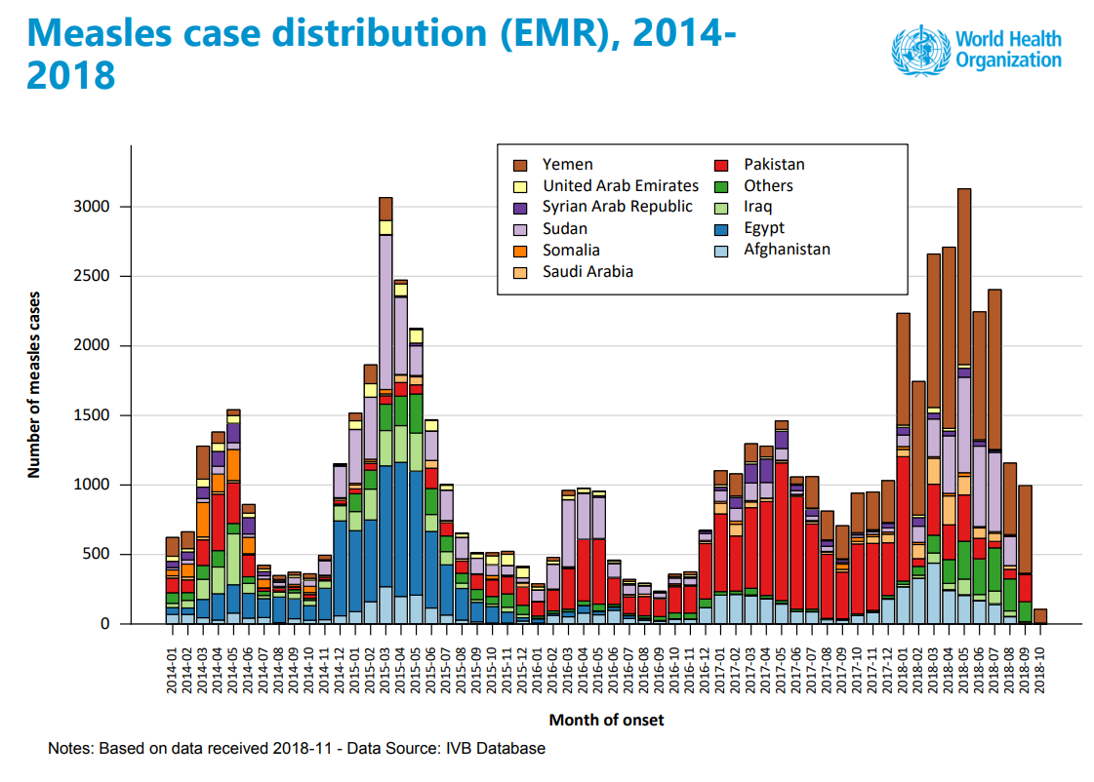

Slide 10
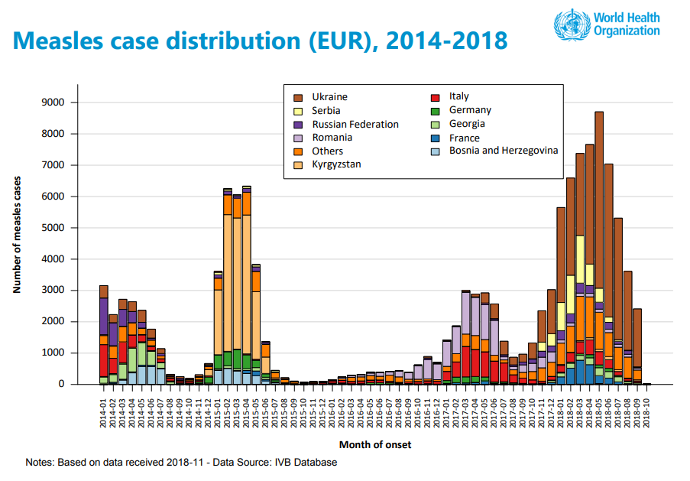

Slide 11
Measles
1,264 measles cases were reported in the U.S. from 2009-2014
Compared to 557 from 2001-2008
Approximately 90% of those cases were unvaccinated or had an unknown vaccination status
Approximately 95% of those cases were linked to imported cases
Notes:
https://www.cdc.gov/vaccines/pubs/surv-manual/chpt07-measles.html
Measles is incredibly infectious. Preventing the spread of measles requires high vaccination coverage ~98% in order for herd immunity to be effective. Responding to reported measles cases and outbreaks requires a significant amount of resources from the local and state health departments.
Since 2015 VA has had one confirmed measles case but 66 reports requiring investigation.

Slide 12
Acute Flaccid Myelitis

Slide 13
Acute flaccid myelitis (AFM)
It affects the area of the spinal cord called gray matter, which causes the muscles and reflexes in the body to become weak.
Most of the patients with AFM (more than 90%) had a mild respiratory illness or fever consistent with a viral infection before they developed AFM.
Viral infections such as from enteroviruses are common, especially in children, and most people recover. Unknown why a small number of people develop AFM, while most others recover.

Slide 14
Acute flaccid myelitis (AFM)
These AFM cases are not caused by poliovirus; all the stool specimens from AFM patients that we received tested negative for poliovirus.
Most patients have had onset of AFM between August and October, with increases in AFM cases every two years since 2014.
At this same time of year, many viruses commonly circulate, including enteroviruses, and will be temporally associated with AFM.
Most AFM cases are children (over 90%) and have occurred in 46 states and DC.

Slide 15
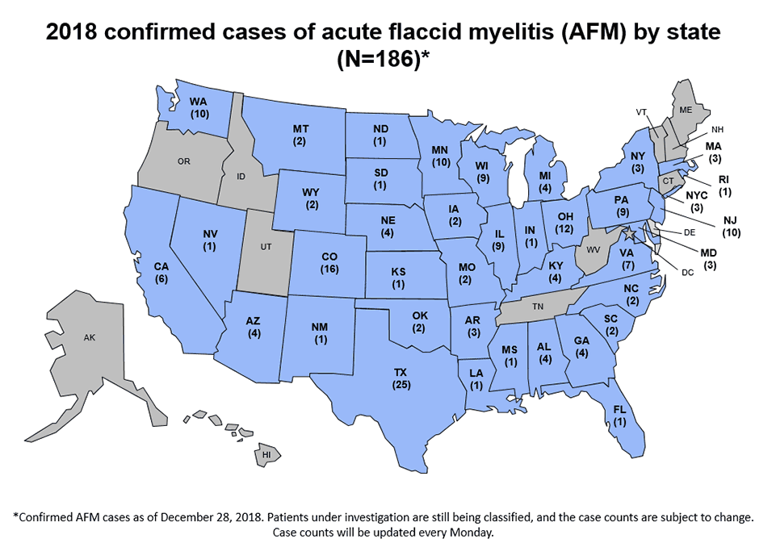
Notes:
https://www.cdc.gov/acute-flaccid-myelitis/afm-surveillance.html
Challenging when etiology is unknown. VDH continues to communicate the difference between clinical diagnosis and case classification for surveillance purposes to various stakeholders. Classification process is slower than with other situations because VDH needs CDC resources for testing and medical record review in order to classify all cases.

Slide 16
Hepatitis A

Slide 17
Hepatitis A
Acute viral illness characterized by fever, fatigue, loss of appetite, nausea, vomiting, abdominal pain, dark urine, clay-colored stools, joint pain, and jaundice
Illness can last for several weeks but most recover completely without lasting liver damage. In serious situations, hepatitis A can cause liver failure and death.
Average interval between exposure and symptoms is 28 days but can occur between 15 and 50 days
Infectious period can begin up to two weeks prior to symptom onset

Slide 18
Hepatitis A
Since March 2017, CDC has been assisting several states with hepatitis A outbreaks, spread through person to person contact, that have occurred primarily among persons who use injection and non-injection drugs, and/or persons who are homeless, and their close direct contacts.
Virginia is currently not considered an outbreak state but has been working with CDC and local health districts to monitor and prepare for possible outbreak-related cases
Notes:
These are potentially difficult to reach populations both for vaccination campaigns and case investigations. Currently districts are looking at ways to integrate hepatitis A vaccinations into community; warming shelters, drug treatment centers, jails, etc. Leveraging local community partnerships to target vaccines for these high risk populations.

Slide 19
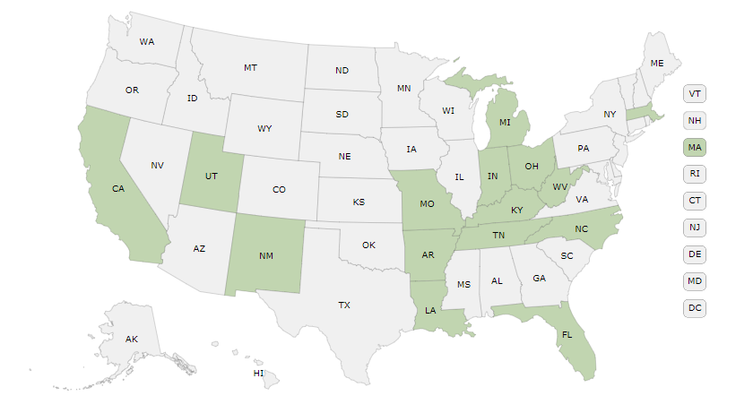
 | West Virginia | Kentucky | Tennessee | North Carolina
Cases | 2,137 | 3,265 | 597 | 51
Hospitalization rate | 50% | 50% | 63% | 76%
Notes:
Investigations into exposures and exposed can be time intensive especially if public notification and PEP required related to high risk situations, health care employee, food handler, etc.
VDH numbers
2016 189
2017 47
2018 61
5 year avg 70

Slide 20
Influenza

Slide 21
2018-2019 Influenza Season
Virginia reported Widespread influenza activity for the week ending December 29, 2018
This is the first week at Widespread for the current flu season
According to the CDC, “Flu activity is unlikely to have peaked and is expected to continue nationally for many weeks.”
Flu activity peaked in early February during the 2017-18 flu season

Slide 22
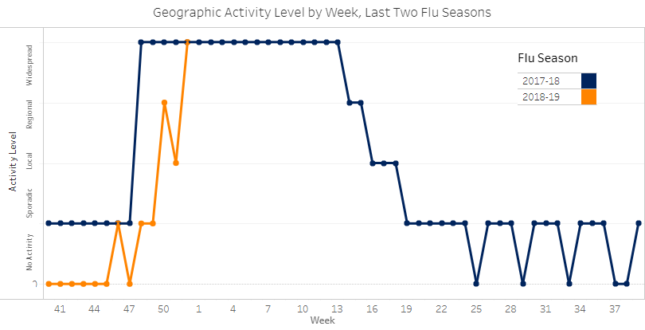
Activity Level

Slide 23
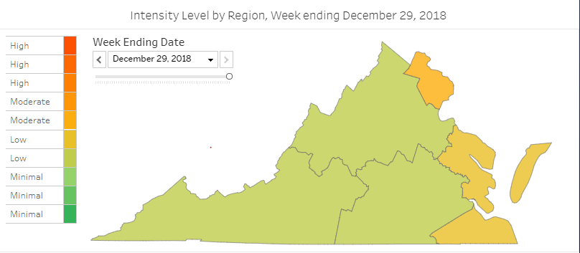
Geographic Distribution of Influenza-Like Illness (ILI)

Slide 24
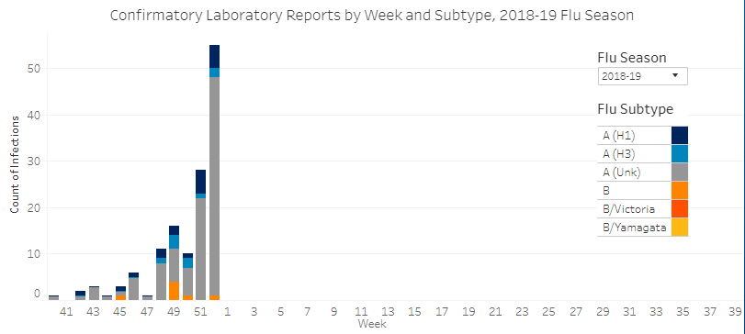
Laboratory-Confirmed Results

