Slide 1
Virginia Department for the Blind and Vision Impaired
The Little Agency That Could

Slide 2
DBVI mission
It is the mission of this Department to provide services and resources that empower individuals who are blind, vision impaired, or deafblind to achieve their desired levels of employment, education, and personal independence

Slide 3
DBVI Vision
DBVI envisions a world in which blind, vision impaired, and deafblind people can access all that society has to offer and can, in turn, contribute to the greater community. We believe this is achievable.

Slide 4
DBVI Structure
The department is an agency within the Executive Branch of Government in the Commonwealth. It is housed in the Health and Human Resources (HHR) Secretariat. Dr. Daniel Carey is the Secretary of Health and Human Resources.
The Virginia Board for the Blind and Vision Impaired once was the governing body of DBVI. It now advises the Governor, HHR Secretary, and Commissioner, while managing an endowment fund.
DBVI has three divisions, each with a Deputy Commissioner who reports to the DBVI Commissioner.

Slide 5
DBVI Comprehensive Services
Services Division
Library & Resource Center (LRC)
VA Rehabilitation Center for the Blind & Vision Impaired (VRCBVI or the Center)
Vocational Rehabilitation
Rehabilitation Teaching/Independent Living
Services to Children and Youth or Education Services
Low Vision
Rehabilitation Technology
DeafBlind Services
Orientation and Mobility
Business Relations and Outreach
Enterprise Division
Virginia Industries for the Blind
Virginia Enterprise for the Blind (VEB) or Business Enterprise Program (BEP)
Administration –
Fiscal and contract management
Facilities Management
Policy, Planning, and Evaluation

Slide 6
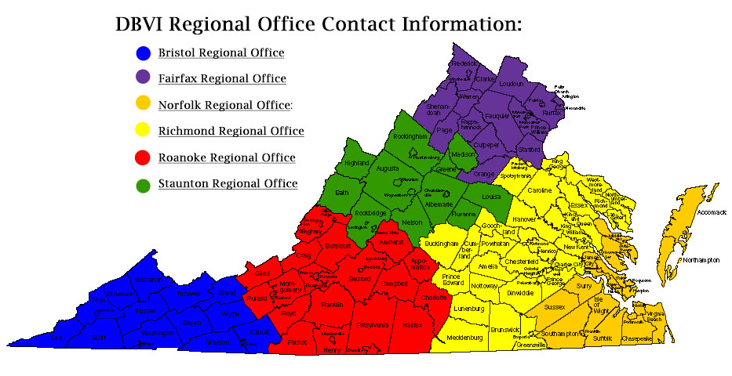
Services Division

Slide 7
DBVI and Virginia Facts
Approximately 8.4 million people in Virginia
178,000 B/VI
Over 16,000 served by DBVI annually
Approx. 10,000 served by Library and Resource Center/National Library Service
4,400 B/VI Virginians are looking for employment
Over 2,300 children and youth served
Approx. 1200 maintained or achieved independence through RT/IL
Over 300 DBVI employees
150-200 people achieve competitive integrated employment annually
105 VIB employees who are blind
1 person to make a difference - YOU

