Slide 1
Gun Violence as a Public Health Threat
HEALTH AND HUMAN RESOURCES SUB-PANEL
GOVERNOR’S SECURE and RESILIENT COMMONWEALTH PANEL
September 10, 2019

Slide 2
Emergency Department Visits for Gun-Related Injuries, 2018
1,667 ED visits
87% male
Highest proportion among 20-29 year olds (41%)
Black/African American patients account for over half of gun-related injury ED visits (53%)
Rate of gun-related injuries per 10,000 ED visits has increased 19% from 2014 to 2018.

Slide 3
Hospitalizations due to Gun-Related Non-Fatal Injuries, 2008-2017
820
784
ICD-9-CM to ICD-10-CM transition year
599
577
592
567
521
524
529

Slide 4
Hospitalizations due to Gun-Related Non-Fatal Injuries by Intent, 2017
Unintentional
72% of gun-related unintentional injuries were among persons aged 15-34 years.
Self-Harm
51% of gun-related self-harm injuries were among persons aged 25-54 years.
Assault
79% of gun-related assault injuries were among persons aged 15-34 years.
88% were male, and 69% were Black/African American.
41% occurred in the Central region, followed by 37% in the Eastern region.
76% were male, and 74% were white.
28% occurred in the Southwest region.
89% were male, and 77% were Black/African American.
47% occurred in the Eastern region, followed by 34% in the Central region.

Slide 5
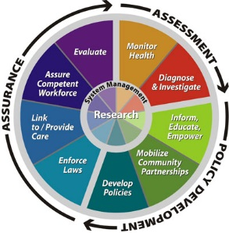
10 Essential Public Health Functions
Monitor Health
Conduct surveillance to track
gun-related deaths and injuries
Source: Centers for Disease Control and Prevention

Slide 6
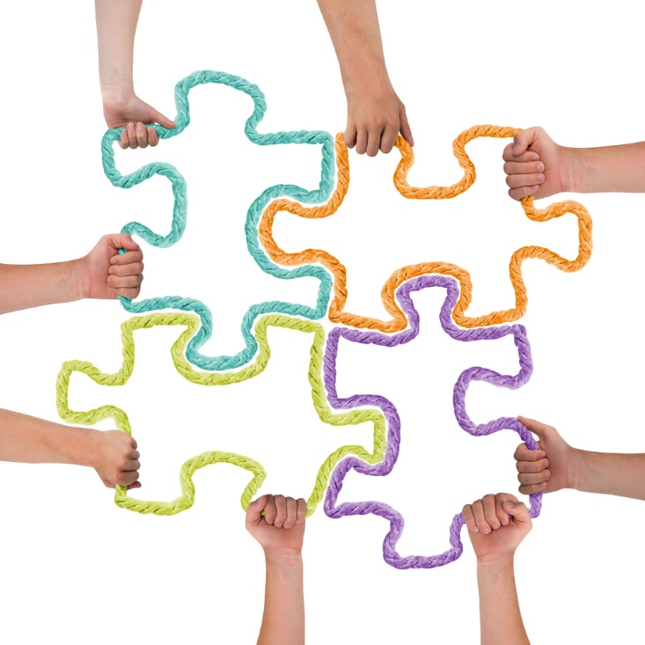
Public Health and Public Safety
Collaboration is the cornerstones of public health, Public Health 3.0
Often the only way to enact health interventions involving public policy across jurisdictions
Prospective studies of policy interventions have demonstrated little behavioral change until an enforcement component is added
Successful collaborations:
Seatbelt usage
Tobacco and alcohol sales to underage minors
Gun violence

Slide 7
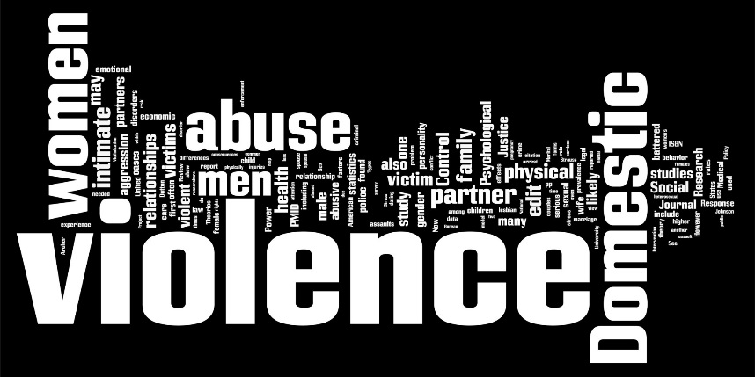
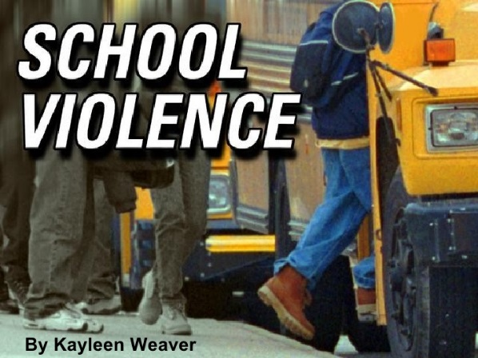
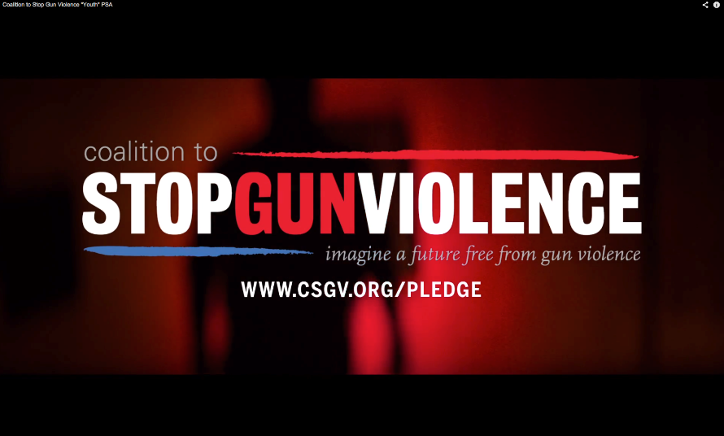
Violence Prevention
Violence prevention efforts have historically focused on particular forms of violence:
gun violence
suicide
domestic violence
bullying
gang violence

Slide 8
Reframing Gun Violence
Discussions about guns vs Debates about guns
Gun violence is not just in mass shootings but also in cases of domestic violence, suicide, community violence
Guns have the potential to greatly amplify violence
Use of a gun rather than a knife or another readily available weapon tends to make violent acts more deadly
Guns as a method of violence

Slide 9
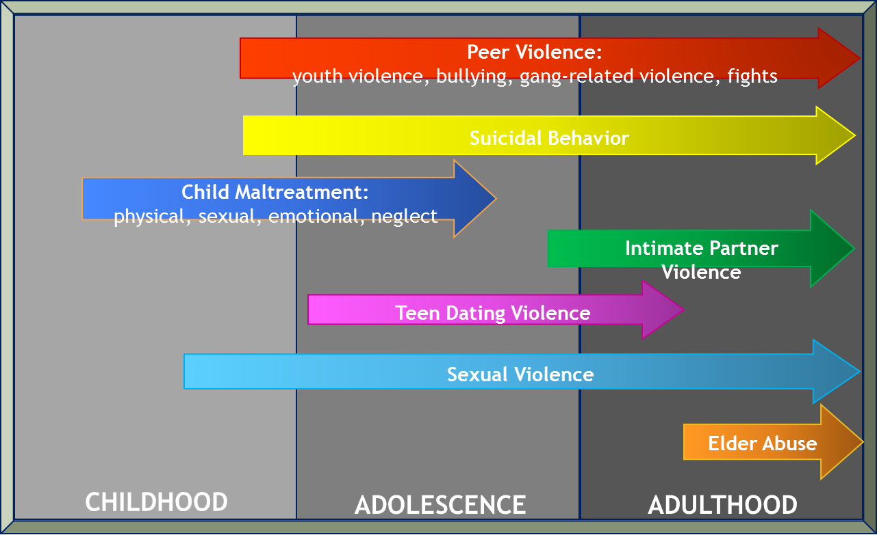
Violence Prevention
Different forms of violence are strongly interconnected:
Victims of one form of violence are likely to experience other forms
Those who have been violent in one context are likely to be violent in another
Different forms of violence share common consequences: beyond physical injuries and deaths consequences can include mental, emotional and physical health and social problems across the lifespan
Different forms of violence share common risk and protective factors

Slide 10
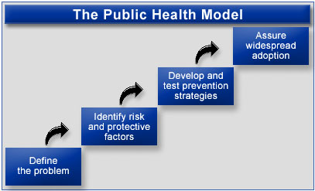
Risk and Protective Factors
Risk Factor – Characteristic that increases the likelihood of a person becoming a victim or perpetrator of violence
Protective Factor – Characteristic that decreases the likelihood of a person becoming a victim or perpetrator of violence because it provides a buffer against risk

Slide 11
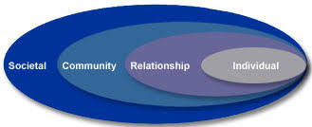
Socio-Ecological Model
Complex interplay between levels
Range of risk and protective factors
Factors at one level influence factors at another level
Necessary to act across multiple levels of the model at the same time
Source: Centers for Disease Control and Prevention, Division of Violence Prevention

Slide 12
Societal Risk Factors
NOTE: CM (Child Maltreatment), TDV (Teen Dating Violence), IPV (Intimate Partner Violence), SV (Sexual Violence), YV (Youth Violence)
Source: Wilkins, N., Tsao, B., Hertz, M., Davis, R., Klevens, J. (2014). Connecting the Dots: An Overview of the Links Among Multiple Forms of Violence. Atlanta, GA: National Center for Injury Prevention and Control, Centers for Disease Control and Prevention Oakland, CA: Prevention Institute.

Slide 13
Community Risk Factors
NOTE: CM (Child Maltreatment), TDV (Teen Dating Violence), IPV (Intimate Partner Violence), SV (Sexual Violence), YV (Youth Violence)
Source: Wilkins, N., Tsao, B., Hertz, M., Davis, R., Klevens, J. (2014). Connecting the Dots: An Overview of the Links Among Multiple Forms of Violence. Atlanta, GA: National Center for Injury Prevention and Control, Centers for Disease Control and Prevention Oakland, CA: Prevention Institute.

Slide 14
Relationship Risk Factors
NOTE: CM (Child Maltreatment), TDV (Teen Dating Violence), IPV (Intimate Partner Violence), SV (Sexual Violence), YV (Youth Violence)
Source: Wilkins, N., Tsao, B., Hertz, M., Davis, R., Klevens, J. (2014). Connecting the Dots: An Overview of the Links Among Multiple Forms of Violence. Atlanta, GA: National Center for Injury Prevention and Control, Centers for Disease Control and Prevention Oakland, CA: Prevention Institute.

Slide 15
Individual Risk Factors
NOTE: CM (Child Maltreatment), TDV (Teen Dating Violence), IPV (Intimate Partner Violence), SV (Sexual Violence), YV (Youth Violence)
Source: Wilkins, N., Tsao, B., Hertz, M., Davis, R., Klevens, J. (2014). Connecting the Dots: An Overview of the Links Among Multiple Forms of Violence. Atlanta, GA: National Center for Injury Prevention and Control, Centers for Disease Control and Prevention Oakland, CA: Prevention Institute.

Slide 16
Community Protective Factors
NOTE: CM (Child Maltreatment), TDV (Teen Dating Violence), IPV (Intimate Partner Violence), SV (Sexual Violence), YV (Youth Violence)
Source: Wilkins, N., Tsao, B., Hertz, M., Davis, R., Klevens, J. (2014). Connecting the Dots: An Overview of the Links Among Multiple Forms of Violence. Atlanta, GA: National Center for Injury Prevention and Control, Centers for Disease Control and Prevention Oakland, CA: Prevention Institute.

Slide 17
Relationship/Individual Protective Factors
NOTE: CM (Child Maltreatment), TDV (Teen Dating Violence), IPV (Intimate Partner Violence), SV (Sexual Violence), YV (Youth Violence)
Source: Wilkins, N., Tsao, B., Hertz, M., Davis, R., Klevens, J. (2014). Connecting the Dots: An Overview of the Links Among Multiple Forms of Violence. Atlanta, GA: National Center for Injury Prevention and Control, Centers for Disease Control and Prevention Oakland, CA: Prevention Institute.

Slide 18
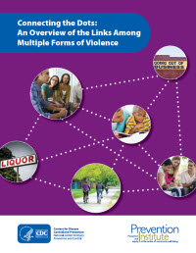
Why Focus on Shared Risk and Protective Factors?
Prevent multiple forms of violence simultaneously
Develop new partnerships
Leverage resources/funding streams
Consider a larger pool of strategies

Slide 19
Violence Prevention
To impact multiple forms of violence, prevention efforts should start early and continue across the lifespan
Focus efforts on:
Child and adolescents to achieve long-term impact
Populations and communities at highest risk of experiencing or perpetrating violence
Focus efforts on shared risk and protective factors
Identify, implement and increase approaches that have cross-cutting impact

Slide 20
For more Information
Connecting the Dots:
An Overview of the Links Among Multiple Forms of Violence
https://www.cdc.gov/violenceprevention/pub/connecting_dots.html
Heather Board, MPH
Director, Division of Prevention and Health Promotion
(804) 864-7738
Heather.Board@vdh.Virginia.gov

