Slide 1
N95 Respiratory Protection Training
David M. Wilder, DO, MPH
Public Health Physician
Fairfax County Health Department
Notes:
Welcome
Explain Program:
2 short presentations
Respirators & OSHA Respiratory Protection Program
Fit Testing Procedures
Break
Fit test demonstration
Fit testing in pairs
Low key presentation - ask questions at any time
Everything on CD or VDH website - including fit test cheat sheet

Slide 2
Training Objectives
Understand the requirements of OSHA 29 CFR Part 1910.134
Learn how to set up and administer an OSHA-compliant respiratory protection program
Recognize the differences between masks and respirators
Understand how respirators work - their capabilities & limitations
Notes:
Discuss OSHA regulations and how to set up RPP
Understand difference between mask and respirator - including an OSHA video
Learn how to put on and take off a respirator and how to do a seal checks
Most importantly, you’ll learn how to conduct fit testing and how to teach others

Slide 3
OSHA 29 CFR Part 1910 (Subpart I) “Personal Protective Equipment”
Employers must assess the workplace to determine if hazards are present, or are likely to be present, which necessitate the use of personal protective equipment (PPE).
1910.132 General requirements. 1910.133 Eye and face protection. 1910.134 Respiratory protection. 1910.135 Head protection. 1910.136 Foot protection. 1910.137 Electrical protective devices. 1910.138 Hand Protection.
+
Notes:
The requirements of the OSHA Respiratory Protection Standard are found in 29 CFR 1910.134. It is part of the larger Subpart “i” on Personal Protective Equipment.
REFER TO OSHA RPP STANDARD ON CD OR VDH WEBSITE
Notes:
1910.132 – (f) Training.
(1) Training required for each employee required to use PPE to know:
(i) When PPE is necessary;
(ii) What PPE is necessary;
(iii) How to properly don, doff, adjust and wear PPE;
(iv) The limitations of the PPE; and,
(v) The proper care, maintenance, useful life, and disposal of the PPE.
(2) Employees must demonstrate an understanding of the training and the ability to use PPE properly before using PPE.
(3) Retrain employees who lack understanding and skills to use PPE. Retraining required where:
(i) Changes in the workplace render previous training obsolete, or
(ii) Changes in the types of PPE to be used render previous training obsolete; or
(iii) Inadequacies in an affected employee’s knowledge or use of assigned PPE indicate that the employee has not retained the requisite understanding or skill.
(4) Verify employees received and understood required training through written certification containing name, date(s) of training, and subject of the certification.

Slide 4
OSHA 29 CFR Part 1910.134 “Respiratory Protection Standard”
(a) Permissible practice
(b) Definitions
(c) Respirator program
(d) Selection of respirators
(e) Medical evaluation
(f) Fit testing
(g) Use of respirators
(h) Maintenance and care
(i) Breathing air quality and use
(j) Identification of filters, cartridges, and canisters
(k) Training and information
(l) Program evaluation
(m) Recordkeeping
(n) Dates
(o) Appendices (mandatory)
A: Fit Testing Procedures
B-1: User Seal Checks
B-2: Cleaning Procedures
C: Medical Questionnaire
D: Information for Employees Wearing Respirators When Not Required Under the Standard
Notes:
These are the individual sections of the OSHA Respiratory Protection Standard.
The main sections we will cover today are –
the Respiratory Protection Program, including Fit Testing and Use of Respirators
Medical Evaluations
and Training Requirements
(Recordkeeping)

Slide 5
OSHA Respiratory Protection Program Employer Requirements
Identify & evaluate respiratory hazards in the workplace
Select and provide appropriate respirator based on these respiratory hazards
Designate a program administrator
qualified by appropriate training or experience to administer the RPP
conducts the required evaluations of program effectiveness
Develop & implement a written respiratory protection program
+
Notes:
Employers must assess the workplace to determine if respiratory hazards are present which necessitate the use of respirators and provide appropriate respirators for these hazards. A Program Administrator must be designated (which is me) and a written program implemented. You can find our FCHD Respiratory Protection Program document on the InfoWeb (and a template on the CD). SHOW FCHD RPP OR VDH TEMPLATE
NOTES:
1910.134(c)(3) The employer shall designate a program administrator who is qualified by appropriate training or experience that is commensurate with the complexity of the program to administer or oversee the respiratory protection program and conduct the required evaluations of program effectiveness.
Respiratory Protection – 1910.134(d)(1)(iii)
The employer shall identify and evaluate the respiratory hazard(s) in the workplace; this evaluation shall include a reasonable estimate of employee exposures to respiratory hazard(s) and an identification of the contaminant's chemical state and physical form. Where the employer cannot identify or reasonably estimate the employee exposure, the employer shall consider the atmosphere to be IDLH.
PPE – 1910.132(d)(1)
The employer shall assess the workplace to determine if hazards are present, or are likely to be present, which necessitate the use of personal protective equipment (PPE). If such hazards are present, or likely to be present, the employer shall:
1910.132(d)(1)(i)
Select, and have each affected employee use, the types of PPE that will protect the affected employee from the hazards identified in the hazard assessment;
1910.132(d)(1)(ii)
Communicate selection decisions to each affected employee; and,
1910.132(d)(1)(iii)
Select PPE that properly fits each affected employee. Note: Non-mandatory Appendix B contains an example of procedures that would comply with the requirement for a hazard assessment.
1910.132(d)(2)
The employer shall verify that the required workplace hazard assessment has been performed through a written certification that identifies the workplace evaluated; the person certifying that the evaluation has been performed; the date(s) of the hazard assessment; and, which identifies the document as a certification of hazard assessment.

Slide 7
Required Elements of the Written Program
Procedures for selecting respirators
Medical evaluations of employees required to use respirators
Fit testing procedures for tight-fitting respirators
Procedures for proper use of respirators in routine & emergency situations
Procedures and schedules for cleaning, disinfecting, storing, inspecting, repairing, discarding, and maintaining respirators*
Notes:
The written program document must address certain required elements, including –
Selection of respirators
Medical evaluations
Fit testing procedures
(Continued)

Slide 8
Required Elements of the Written Program (cont.)
Training of employees in respiratory hazards to which they are potentially exposed during routine and emergency situations
Training of employees in proper use of respirators, including donning and doffing, any limitations on their use, and their maintenance
Procedures for regularly evaluating the effectiveness of the program
Notes:
Training in respiratory hazards
Training in the proper use of respirators
And the continuing evaluation of the program’s effectiveness

Slide 9
Medical Aspects
Must complete medical evaluation prior to initial fit-testing and any use on the job
Must use OSHA questionnaire or medical examination that obtains the same information
Questionnaires and medical examinations are confidential
Not permitted to wear a respirator until medical clearance form signed
+
Notes:
Employees who wear respirators must complete a medical evaluation prior to their initial fit-testing and before being permitted to wear a respirator on the job.
The medical evaluations are conducted thru a medical questionnaire or an initial medical examination that obtains the same information as the medical questionnaire. If a questionnaire is used it must be the OSHA questionnaire and cannot be substantially altered.
All medical examinations and questionnaires are to remain confidential.
Employees are not permitted to wear a respirator until the medical recommendation form indicating that they are medically qualified is signed.
REFER TO HANDOUTS –
OSHA MEDICAL QUESTONNAIRE - VDH (VDH version of the OSHA Medical Evaluation form)
FCHD - Medical Recommendation for Respirator Use
FCHD - WORK FACTORS FOR RESPIRATOR USE (INDIVIDUAL AND GROUP)

Slide 10
Medical Aspects (cont.)
Annual medical evaluations not required
Reevaluation may be needed, if –
employee reports medical signs or symptoms related to ability to use a respirator
supervisor or respirator program administrator reports need for reevaluation
observations made during fit testing and program evaluation indicate need for employee reevaluation
changes occur in workplace that may result in a substantial increase in physiological burden
Notes:
Annual medical evaluations (the OSHA questionnaire) are not required.
A reevaluation my be needed, however, if –
an employee reports medical signs or symptoms that are related to his or her ability to use a respirator
a supervisor or the respirator program administrator informs the employer that an employee needs to be reevaluated
information from the program, including observations made during fit testing and program evaluation, indicates a need for employee reevaluation
or, a change occurs in workplace conditions that may result in a substantial increase in the physiological burden placed on an employee
this could include an increase in the physical work effort, a change in protective clothing worn, or a change in ambient temperature at the workplace
Medical conditions that might limit or prevent effective use of respirators could include obvious things such as angina, arrhythmias, asthma, shortness of breath, chest injuries, and other heart and lung diseases. But other conditions ranging from skin rashes to cancers potentially could have an affect.
The main obligation is on the employee to report medical changes that they think may affect their ability to wear a respirator.

Slide 11
OSHA Respiratory Protection Program Training Requirements
No employee will be permitted to work with a respirator until trained in respiratory protection
Must cover the following topics annually:
General requirements of appropriate federal & state respiratory protection standards
Potential work-related respiratory hazards and risks associated with not using and maintaining respirator properly
Function, capabilities, limitations of selected respiratory protection
How to inspect, don and remove, check seals, and wear the respirator properly
Medical s/sx that might limit/prevent effective use of respirators
+
Notes:
Employees are not permitted to work with a respirator until they have been properly trained in respiratory protection
1910.134(k)(3) The employer shall provide the training prior to requiring the employee to use a respirator in the workplace.
The following topics must be covered each year:
the General Requirements of federal & state respiratory protection standards
Potential work-related respiratory hazards and risks associated with not using and maintaining respirator properly
the Function, Capabilities, and Limitations of the respiratory protection used
How to inspect, put on and remove, check the seals, and wear the respirator properly
and the Medical signs and symptoms that might limit or prevent effective use of respirators
(maintenance and storage procedures for the respirator, if applicable)
REFER TO HANDOUT – FCHD-RPP TRAINING TOPICS

Slide 12
DIRECTIVE NUMBER: CPL-02-02-075 EFFECTIVE DATE: 11-20-2009
SUBJECT: Enforcement Procedures for High to Very High Occupational Exposure Risk to 2009 H1N1 Influenza
Notes:
This is an OSHA Directive published during the 2009 H1N1 pandemic
Basically outlines what OSHA will be evaluating during an inspection
Inspections will apparently occur only in response to a complaint
Doesn’t seem that inspections have been widespread
Don’t know if directive is still in effect now that H1N1 is down to background levels or if it becomes dominant seasonal influenza

Slide 13
OSHA Can Cite Employers for Failure to:
Identify/evaluate respiratory hazards
Conduct initial hazard assessment
Select/provide appropriate respirators
Provide respiratory protection program (w/ fit-testing & medical questionnaire)
Implement engineering, work practice and administrative controls
Have and implement a program for dealing with a respirator shortage
Notes:
These are the 6 primary areas where employers may be cited
Each is a serious violation
Penalties for serious violations start at $7000 each

Slide 14
Facemasks
Loose-fitting - don't provide complete protection
Create physical barrier between mouth and nose of wearer and potential contaminants
Help reduce exposure of wearer’s saliva and respiratory secretions to others
Help block large-particle droplets, splashes, sprays or splatter that may contain viruses and bacteria
Do not filter very small particles transmitted by coughs, sneezes or certain medical procedures
Notes:
Facemasks are –
Loose-fitting - don’t provide complete protection around edges of mask; usually disposable
A physical barrier to protect wearer against relatively large respiratory contaminants
Reduce transmission of secretions of wearer to others
Block large-particle droplets, but Do NOT filter small-particle airborne contaminants
Facemasks may be labeled as – Surgical, Medical procedure, Dental, Isolation, Laser
If there is only one strap, then it is a facemask. NIOSH does not approve respirators with only one strap.

Slide 15
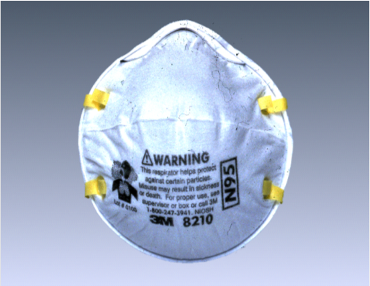
Air-Purifying Respirator (APR)
Tight-fitting respirator with a filter, cartridge, or canister that removes specific air contaminants by passing ambient air through the air-purifying element.
Notes:
Respirators protect the user in two basic ways.
The first type of respirator removes contaminants from the air, and are called air-purifying respirators (APR). APRs include particulate respirators, which filter out airborne particles, and “gas masks,” which filter out chemicals & gasses.
Other respirators protect by supplying clean, respirable air from another source. Air-supplying Respirators (ASR) comprise this category of respirators. They include airline respirators, which use compressed air from a remote source; and self-contained breathing apparatus (SCBA), which include their own air supply.
====================================================================
The classification of particulate respirators can be further subdivided into three categories:
Particulate filtering facepiece respirators – Sometimes referred to as disposable respirators because the entire respirator is discarded when it becomes unsuitable for further use due to considerations of hygiene, excessive resistance, or physical damage. These are also commonly referred to as “N95s.”
Elastomeric respirators –Sometimes referred to as reusable respirators because the facepiece is cleaned and reused but the filter cartridges are discarded and replaced when they become unsuitable for further use.
Powered air-purifying respirators (PAPRs) – A battery-powered blower moves the air flow through the filters.

Slide 16
Types of Air Purifying Respirators
Particulate Respirators
Gas & Vapor Respirators
Combination Respirators
Notes:
3 primary types of APR respirators –
*Gas & Vapor *Particulate *Combination
Gas & Vapor Respirators are used in many industrial settings. The filters are usually contained in cartridges attached to the respirator and are specific to the chemical or type of chemicals being used.
Particulate respirators protect by filtering particles, such as dusts, mists, and fumes, out of the air as you breathe. These respirators protect only against particles—not against gases or vapors.
===================================================================
The classification of particulate respirators can be further subdivided into three categories:
Particulate filtering facepiece respirators – Sometimes referred to as disposable respirators because the entire respirator is discarded when it becomes unsuitable for further use due to considerations of hygiene, excessive resistance, or physical damage. ( The most common are “N95s.”)
Elastomeric respirators –Sometimes referred to as reusable respirators because the facepiece is cleaned and reused but the filter cartridges are discarded and replaced when they become unsuitable for further use.
Powered air-purifying respirators (PAPRs) – A battery-powered blower moves the air flow through the filters.

Slide 17
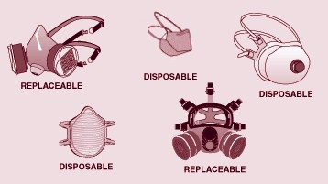
Examples of Air Purifying Respirators
Notes:
Replaceable (called elastomeric) respirators are reusable and typically have 2 filter cartridges
Often used with gas or vapor cartridge
Usually used in industry and emergency response
Other three examples are disposable filtering facepiece/N95 respirators (form-fitted, duck-billed and one w/ exhalation valve)
Show them the ones we brought—explain why its important to have a selection of types and sizes

Slide 18
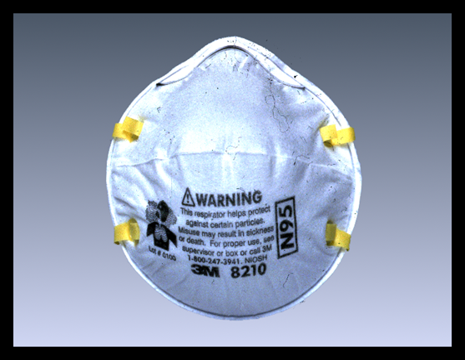
Particulate, Filtering Facepiece Respirators (Dust Masks)
Negative pressure, particulate, air purifying respirator with a filter as an integral part of the facepiece or with the entire facepiece composed of the filtering medium.
N95 commonly used in healthcare settings as part of airborne precautions
Protects against infectious aerosols
Notes:
The most commonly used air-purifying respirators in the healthcare setting are particulate filtering facepiece respirators – the N95.
Filtering facepieces are negative pressure particulate respirators with a filter as an integral part of the facepiece or with the entire facepiece composed of the filtering medium.
Protect by filtering particles, such as dusts, mists, and fumes, out of the air as you breathe. These respirators protect only against particles—not against gases or vapors.
Filtering facepiece respirators are more easily used and maintained as they are disposable, don’t have to be cleaned, are easier to store, and are less cumbersome than most reusable (elastomeric) respirators.
They are also referred to as Dust Masks by OSHA/NIOSH, but are actually respirators.
====================================================================
Primary respiratory hazards in most healthcare settings are biological organisms – such as bacteria and viruses. Usually no gas or vapor hazards that would require the use of a chemical respirator. Since airborne biological organisms are particles, they can be filtered by particulate respirators.

Slide 19
Particulate Filtering Facepiece Classification
Resistances | Efficiencies
N = Not Oil Resistant | N95 (95% efficient) | N99 (99% efficient) | N100 (99.97% efficient or HEPA)
R = Oil Resistant | R95 | R99 | R100
P = Oil Proof | P95 | P99 | P100
Notes:
Particulate Filtering Facepieces are classified by Series Letter and Efficiency Level
Many people assume the Series letter “N” in N95 stands for NIOSH, the agency that tests and approves them—However it really stands for ‘not oil resistant’
Respirators in this family are rated as N, R, or P based on their protection against oils. This rating is important in the industrial setting because some industrial oils can degrade the filter performance. Respirators, such as the ones we use, are rated “N,” as they are not resistant to oil. Other respirators are rated as “R,” if they are somewhat resistant to oil, and “P,” if they are strongly resistant or “oil proof.”
The number designation on the respirator refers to its filtering efficiency. Respirators that filter out at least 95% of airborne particles during “worse case” testing are given a 95 rating. An N-95 filter is at least 95% efficient in removing particles greater than 0.3 microns in diameter.
There are N99s and N100s in addition to the standard N95s—these are more efficient than the N95, but are not commonly used because they are more expensive and have a greater resistance – more difficult to breath through.
The extra breathing resistance may increase the possibility of leakage during inhalation, which may offset the increased filter efficiency

Slide 20
N95 Filtration Mechanisms
Interception – mid-size particles
Inertial Impact – large particles
Diffusion – small particles
Electrostatic Charge – all particles

Slide 21
Particle Filtration Involves 4 Mechanisms: Interception, Inertial Impact, Diffusion, and Electrostatic Charge
Mid-size particles captured between respirator fibers.
Airstream
Fiber
Particle
Fiber
Notes:
Good idea to show how respirators work
There are basically four ways that particles are captured in the respirator filter—3 are mechanical (interception, inertial impact, & diffusion) and the other is electrostatic.
This animation demonstrates interception. (1st CLICK)
A medium-sized particle follows the airstream as it flows around a fiber, and is captured between 2 fibers. (2nd click)
So interception involves medium-sized particles being caught between fibers

Slide 22
Particle Filtration Involves 4 Mechanisms: Interception, Inertial Impact, Diffusion, and Electrostatic Charge
Large particle inertia causes it to leave airstream and impact respirator fiber.
Airstreams
Fiber
Particle
Fiber
Notes:
A second type of mechanical collection is called inertial impact
(1st click) Here, the inertial of a very large particle does allow it to remain in the airstream as it curves to go around a fiber.
Instead it keeps going in a straight line and hits the fiber. (2nd click)
So, inertia causes a large particle to leave airstream and impact fiber

Slide 23
Particle Filtration Involves 4 Mechanisms: Interception, Inertial Impact, Diffusion, and Electrostatic Charge
Very small particles affected by Brownian motion as opposed to airstream; random motion due to molecular bombardment
Airstreams
Fiber
Particle
Fiber
Notes:
Diffusion, also called Brownian motion, provides the primary collection method for very small particles, those that are too tiny to be influenced by the airstream.
(1st click) As shown these particles randomly bounce between molecules until they strike a fiber. (2nd click)
(read or summarize the description)

Slide 24
Particle Filtration Involves 4 Mechanisms: Interception, Inertial Impact, Diffusion, and Electrostatic Charge
Respirator carries an electrostatic charge which attracts particles.
Airstreams
Fiber
Fiber
Particle
Notes:
The final collection technique is based on an electrostatic charge that the manufacturer applies to the fibers
This was done to improve collection efficiency without increasing breathing resistance.
1st click – The particle follows the airstream, then is attracted to the fiber based on the electrostatic charge.
2nd click – Electrostatic collection applies to all particle sizes

Slide 25
Why is 0.3µm Targeted?
Overall Efficiency
Increasing Efficiency
Diffusion
Interception
Impaction
medium & large particles
0.1 µm
0.3 µm
1.0 µm
10 µm
very small particles
larger particles
Particle Diameter (µm)
Notes:
Many people mistakenly believe that N95 respirators are only effective on particles down to 0.3 micron diameter. This is because NIOSH tests respirators with 0.3 micron particles. Since certain viruses and bacteria are smaller than 0.3 micron diameter, this frequently causes concerns to clinicians. Why is 0.3 micron targeted in the NIOSH testing?
(1st click) In this graph, we have efficiency on the Y axis and (2nd click) particle diameter on the x axis. (3rd click)
Particle diameter range from well below 0.1 microns to over 10.
We can plot the efficiencies of the types of collection techniques we discussed on the last slide against particle size. (4th click)
The first is diffusion, the one based on Brownian motion. As you can see, the collection efficiency goes up as the particle size gets smaller
(5th click) particles less than about 0.3 are very efficiently collected. (6th click)
The next is interception, where the particles are trapped between fibers. Here the efficiency increases as the particles get larger. (7th click)
This technique is particularly efficient for medium and large particles.
(8th click) – The last technique is impaction. Like interception, the efficiency improves with the increased size of the particle.
(9th click) – It is most effective for very large particles
(10th click) – If you integrate these 3 curves, you get a composite curve that looks like this.
(11th click) – the lowest part of this curve, or the most difficult particle size to capture, is 0.3 micron diameter. Larger and smaller particles are more efficiently captured.

Slide 26
N95 Respirator Rating
Higher Efficiency
Virus (0.02 - 0.25 µm)
Bacterium (0.2 - 2 µm)
0.3 µm
Notes:
This graft shows the same thing, but with more detail.
(1st click) – The % efficiency is plotted against particle size.
(2nd click) – As before, the particle size with the lowest collection efficiency is 0.3 micron.
(3rd click) – The % efficiency increases as particle size both increases and decreases. In fact, for the smallest and largest particles, the efficiency is almost 100%.
(4th click) – It is interesting to compare this graph with the average size of viruses. You can see that all viruses are efficiently collected. (5th click)
The same is true for bacteria which are in general a little large than viruses.

Slide 27
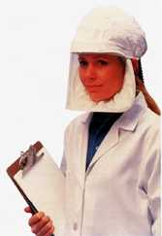
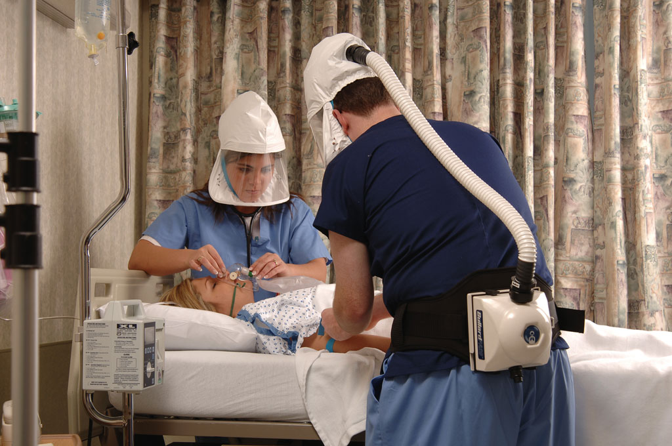
Loose Fitting Powered Air Purifying Respirator (PAPR)
Average Cost = $600 - $900 >$1000
Notes:
If you have facial hair or can’t pass a fit test, may need to use a PAPR
These are positive pressure respirators—therefore no fit testing required
(2ND CLICK)
Show how it works
Relatively comfortable but, (3rd CLICK), expensive

Slide 28

Differences between Mask and Respirator (OSHA Video)
Notes:
Note: Masks approved by FDA; Respirators approved by NIOSH

