Slide 1


UVA COVID-19 Model
Scenarios
Justin Crow
VDH Office of Health Equity
6/26/2020

Slide 2
UVA COVID-19 Model-Background
Model is developed by the UVA Biocomplexity Institute
It is designed to evaluate policy options
  It is NOT designed to precisely predict future numbers
  IF we do “x”, THEN, given what we know, we can expect “y”
We are in a period of transition, finding “the new normal”
  How will people/businesses react to the lifting of mitigation strategies?
  How well will people/businesses follow infection control guidance?
  How well will test/trace/isolate work?
Models thrive on more & better data, and the model improves every week.

Slide 3
Key Drivers in Model
Social Distancing
Infection Control
Better Detection
Transmission Rates

Slide 4
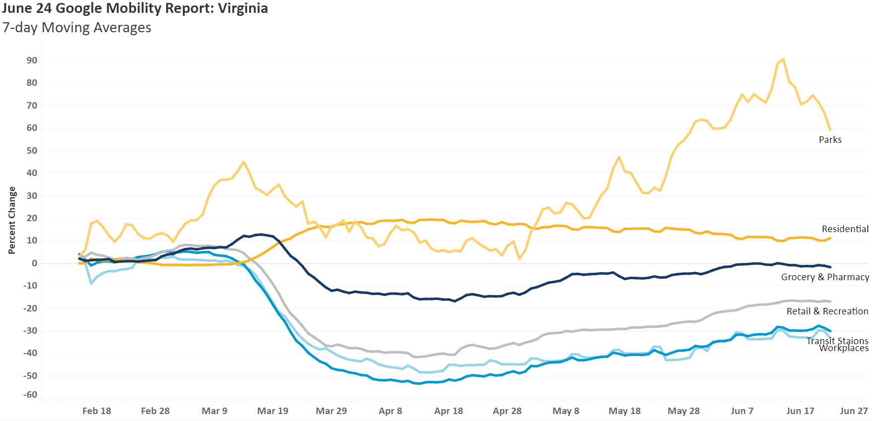
Social Distancing

Slide 5
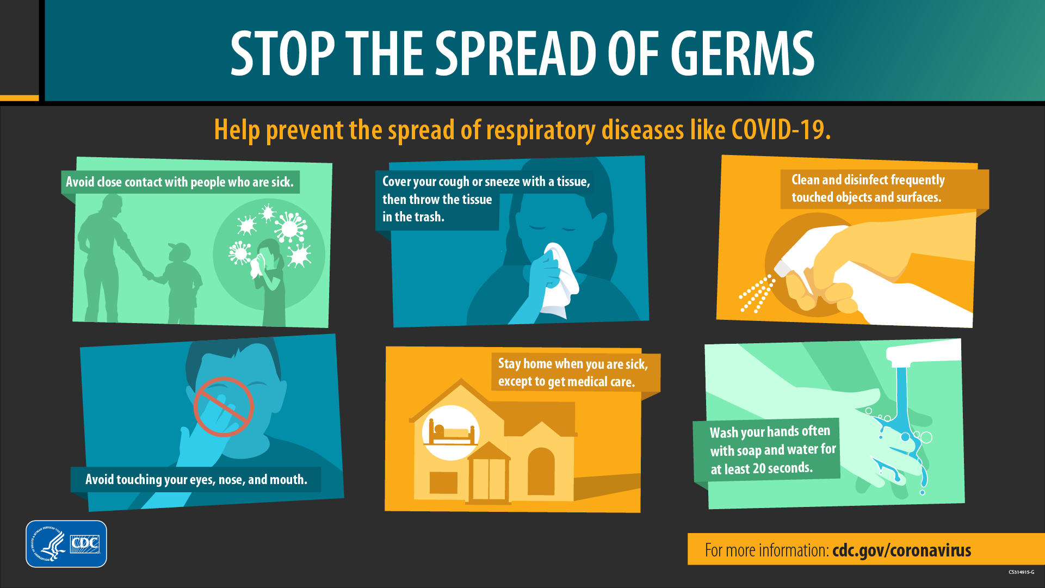
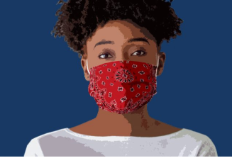
Infection Control

Slide 6
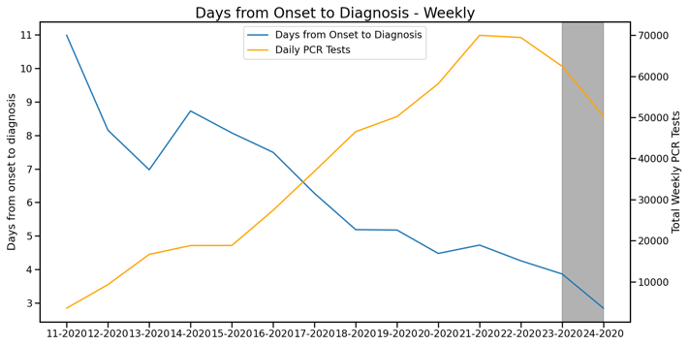
Better Detection – Symptom Onset to Diagnosis
  Days to Diagnosis
  Mid March to Late April = 7.8 days
    Late April to Mid May = 5.5 days (30% lower)
    Mid May to end of May = 4.5 days (45% lower)
5.5 days
4.5 days

Slide 7
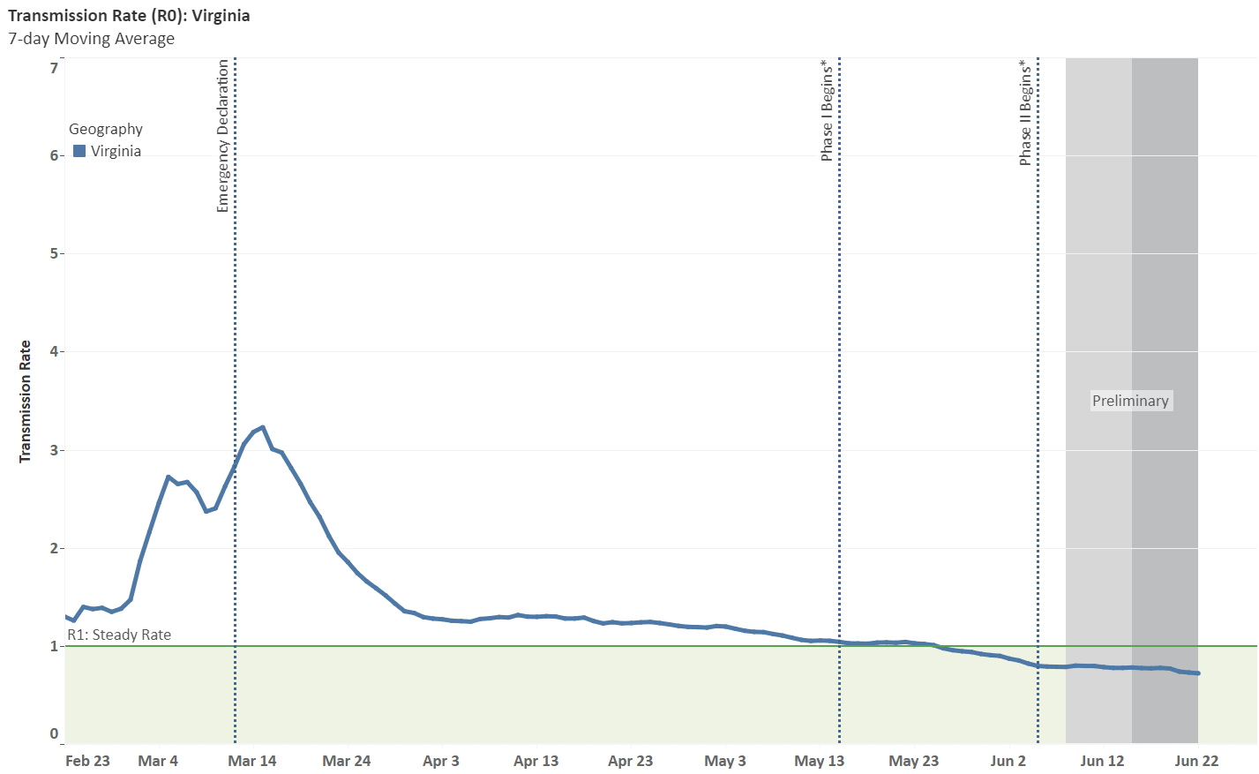

Slide 8
Scenarios Examined
Full Rebound: Back to normal on May 15
Rebound intensity after May 15
  Steady: Pause levels maintained (Social distancing + infection control)
  Light: 17% of pre-CM levels
Better Detection:
  New cases are identified and isolated more quickly through a combination of increased testing and contact tracing.
Unmitigated: Retired

Slide 9
Five Mitigation Scenarios
Scenario | Rebound Intensity | Better Detection | Name | Description
1 | Light | No | Light | Light Rebound, Detection same
2 | Steady | No | Steady | Steady Interactions, Detection same
3 | Light | Yes | Light –Better Detection | Light Rebound, Detection improved
4 | Steady | Yes | Steady – Better Detection | Steady Interactions, Detection improved
5 | Full | No | Full Rebound | Return to No mitigation

Slide 10
Scenarios Examined
Full Rebound: Back to normal on May 15
Rebound intensity after May 15
  Steady: Pause levels maintained (Social distancing + infection control)
  Light: 17% of pre-CM levels
Better Detection:
  New cases are identified and isolated more quickly through a combination of increased testing and contact tracing.

Slide 11
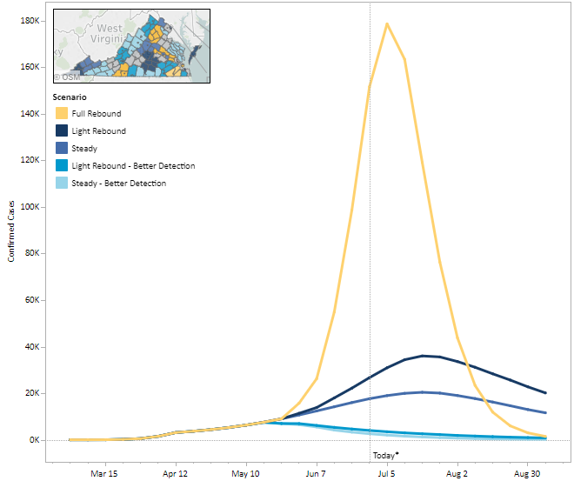
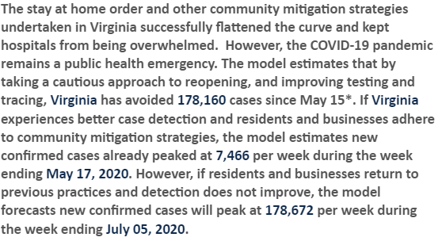
Scenario
Snapshot

Slide 12
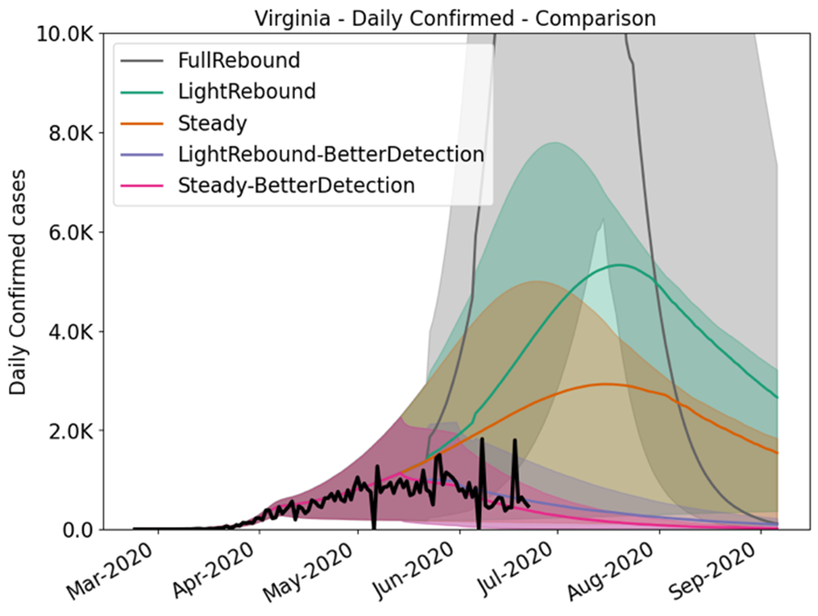
Which Scenario?
We are currently tracking the Better Detection scenarios statewide.

Slide 13
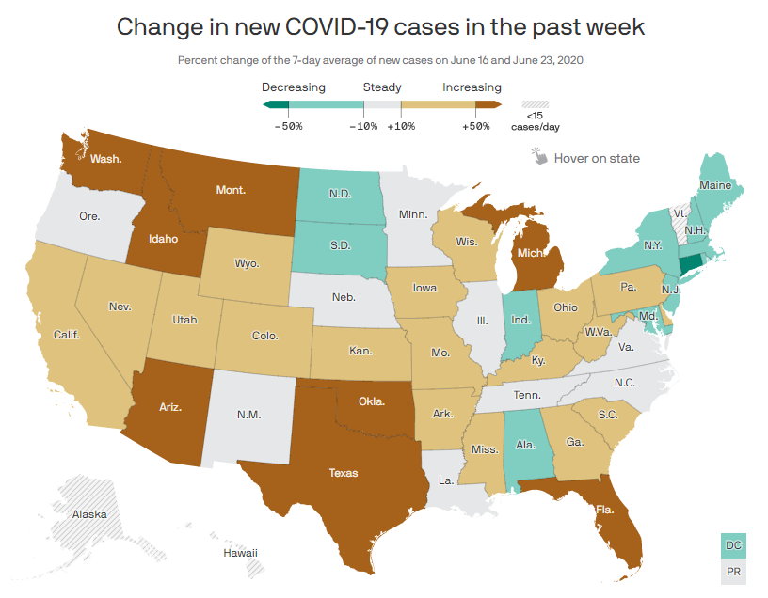
Risks, Risks, and More Risks
Cases surging in other states
Protests
Schools/Universities reopening
Seasonality
  Hurricane season
Politicization
COVID-19 Fatigue
And More!
https://www.axios.com/coronavirus-surge-map-7714f8d1-5ba1-46f8-9bf3-5d59938f2c95.html

Slide 14
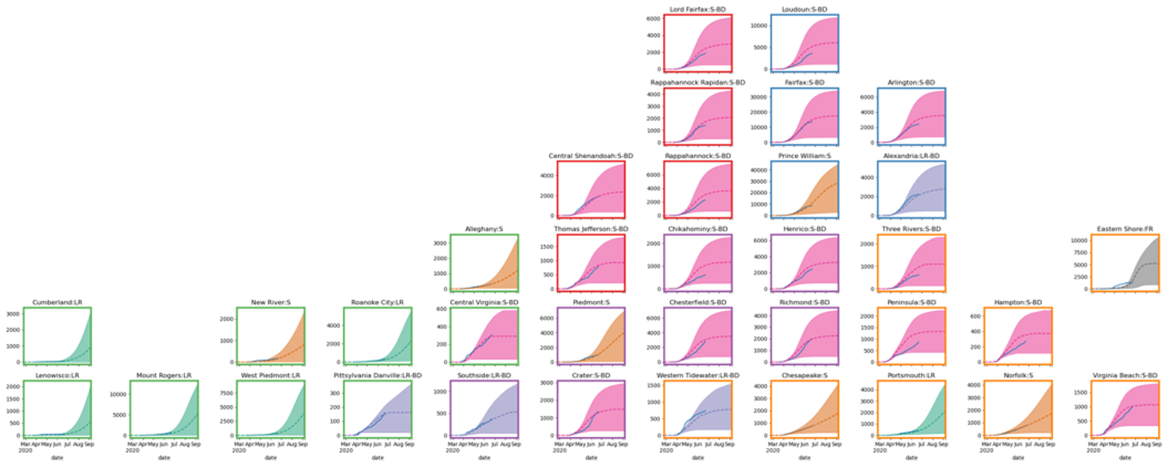
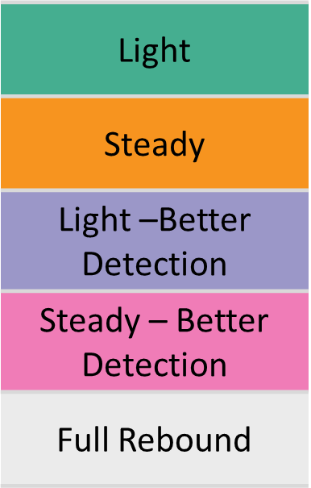
Local Differences
(6)
(6)
(4)
(18)
(1)

Slide 15

Key Takeaways
Model compares scenarios—does not make precise predictions
  Difficulty projecting human behavior
  Cannot predict policy choices
So far, so good (in Virginia)
Risks, Risks, Risks
Keep an eye on local conditions

Slide 16
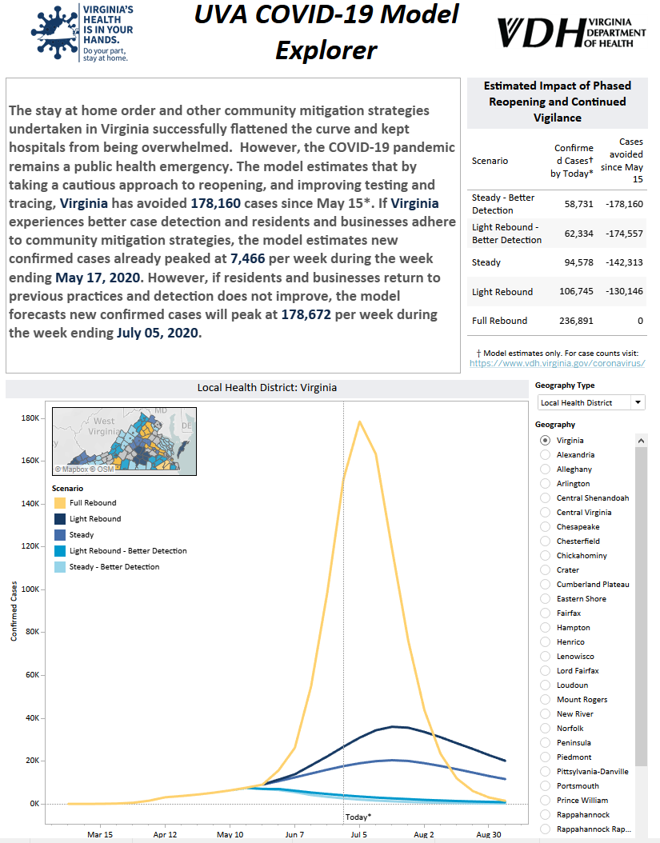
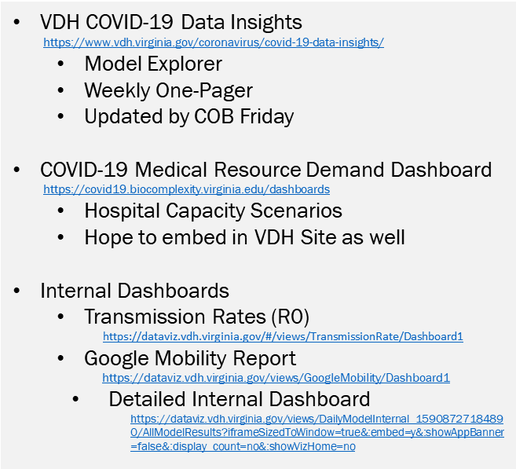
Where to find modeling results

