Slide 1
Directions for this Template
Use the Slide Master to make universal changes to the presentation, including inserting your organization’s logo
  “View” tab > “Slide Master”
Replace placeholders (indicated by brackets [ ]) with information specific to your exercise
Delete any slides that are not relevant for your exercise
Font size should not be smaller than 22pt
Rev. April 2017
HSEEP
Notes:
Jurisdictions can modify and augment this briefing as needed.

Slide 2
Institutes of Higher Education COVID 19 Self-Administered Tabletop Exercise
Evaluator Briefing
[Date]

Slide 3
Welcome and Introductions
Name
Organization

Slide 4
Meeting Agenda
[Time] [List meeting agenda items]

Slide 5
Exercise Overview
This exercise will provide participants with an opportunity to evaluate current response concepts, plans, and capabilities for a response to an infectious disease in [Institute of Higher Education].
The goal is for participants to validate coordination and communications capabilities for all-hazard incidents, verify policies and procedures for responding to infectious disease outbreaks, and to identify the overall strengths and weaknesses of emergency plans.

Slide 6
Objectives and Core Capabilities
The Objectives for this exercise were matched to both FEMA Core Capabilities and the CDC Public Health Preparedness Capabilities.
The Exercise Director and key stakeholders will determine which capabilities are to be observed during the exercise.
The exercise may have capabilities from both FEMA and the CDC.
Notes:
Core capabilities are the distinct critical elements necessary to achieve the National Preparedness Goal. During the exercise design process, the Elected Officials and the Exercise Planning Team selected exercise objectives, and aligned each objective to core capabilities, as shown here. Evaluators will observe and document how exercise objectives and capabilities are met through capability targets and critical tasks based on the participating organizations plans, procedures, and corrective actions from past exercises and real-world events.

Slide 7
Objectives and Core Capabilities
Objective 1: Examine the ability of IHE to conduct repopulation of campuses.
  Aligns to
Objective 2: Discuss the monitoring of health conditions to detect COVID-19 infection in the campus environment.
  Aligns to
Notes:
Core capabilities are the distinct critical elements necessary to achieve the National Preparedness Goal. During the exercise design process, the Elected Officials and the Exercise Planning Team selected exercise objectives, and aligned each objective to core capabilities, as shown here. Evaluators will observe and document how exercise objectives and capabilities are met through capability targets and critical tasks based on the participating organizations plans, procedures, and corrective actions from past exercises and real-world events.

Slide 8
Objectives and Core Capabilities
Objective 3: Assess the ability of IHE to perform containment to prevent spread of the COVID-19 when detected.
  Aligns to
Objective 4: Discuss the considerations for shutdown if necessitated by severe conditions in accordance with public health guidance.
  Aligns to
Notes:
Core capabilities are the distinct critical elements necessary to achieve the National Preparedness Goal. During the exercise design process, the Elected Officials and the Exercise Planning Team selected exercise objectives, and aligned each objective to core capabilities, as shown here. Evaluators will observe and document how exercise objectives and capabilities are met through capability targets and critical tasks based on the participating organizations plans, procedures, and corrective actions from past exercises and real-world events.

Slide 9
Scenario- Module 1
Faculty return to campus in late July, approximately two weeks before students are expected to return to campus and begin classes. An administrative assistant for the Geology department returns to work along with other faculty members. On her fourth day back at work, she develops a fever and cough shortly after returning from her lunch break and is sent home according to newly revised campus student/employee health protocols for those with COVID-19-like illness.
After visiting her doctor and being tested, it is determined the employee is positive for COVID-19. Her illness is mild and she is able to recover at home while in isolation. The employee reports her illness and positive lab result to her department supervisor who immediately reports her diagnosis to University X leadership.
The ill staff member is cooperative when asked to report where she had been during her infectious period (when she was possibly able to transmit COVID-19 to others), and consents to health department investigators sharing her diagnosis with her possible contacts in an attempt to identify others who might have been exposed, enroll them into contact monitoring, and reduce the risk of any contacts who become ill from spreading COVID-19. As faculty members had only just begun to report for work, it is determined the case-patient likely exposed only 10-12 faculty and staff members within her department.

Slide 10
Scenario- Module 2
Just over two weeks have passed since the staff member in the Geology department tested positive for COVID-19. University X leadership, in close partnership with the local health department, have worked diligently to perform contact tracing and monitoring. Only the spouse of the ill staff member has tested positive for COVID-19 and since he was a known contact, he had been in quarantine well before his illness started and did not spread COVID-19 to others. Like his spouse, his illness was mild and he has recovered.
No other instances of COVID-19-like illness have been reported among faculty or staff, despite extensive screening procedures that were enacted after the initial case was reported.
Students begin to return to campus and the surrounding community. Off campus students have been moving in over the past few weeks and campus residence halls conducted a staggered move-in over a two-week period to allow for additional social distancing. Orientation activities were conducted virtually prior to the arrival of students on campus in order to avoid large gatherings of students and orientation advisors. Students have been largely complaint with social distancing measures during move-in/prior to the start of classes, but the University X Office of Student Affairs has received multiple reports from concerned parents and community members that students have congregated in large numbers at private off-campus residences and on the outdoor patios of certain local restaurants.

Slide 11
Scenario- Module 2
Classes begin online and in-person one week after all students have returned to campus. Most students are compliant with established social distancing protocols, use of cloth face coverings, etc. and the semester is off to a smooth start overall.
On the fifth day of classes, a senior student studying world history reports to the student health center complaining of headaches, general malaise, and difficulty breathing. He is referred to the local hospital where he is tested for COVID-19. While waiting for respiratory swab to be taken, his nurse notices he has become lethargic and doctors perform a more extensive examination of the patient. Given his low oxygen saturations and underlying medical conditions, he is admitted for further workup. Six hours after he is admitted to the hospital, the laboratory reports he has tested positive for COVID-19.
The local health department is aware of the case because the case-patient was reported to the health department by hospital infection control staff and reaches out to the University health center during their case/contact investigation.
Initial information provided to the health department from the hospital indicates that the student is a 21 year old commuter student who resides off campus. He is enrolled in two courses this semester and he reported that in both classrooms, students practiced social distancing and wore masks. He is willing to ensure compliance with isolation requirements once he is discharged from the hospital, but refuses to name his potential contacts for fear of getting them in trouble.

Slide 12
Scenario- Module 3
The two roommates who reside with the ill student are tested and found to be positive for COVID-19. Both are members of a local fraternity and report numerous contacts among students and members of the local town owing to their living off campus and working part-time jobs at local businesses that serve large numbers of the general public. It is estimated that about 100 students and 150 members of the general public have been exposed to COVID-19.
University staff work with the Provost’s Office, the Office of Student Affairs, and the fraternity to compile a list of students who have been exposed to the cases during classes and events held at the fraternity house.

Slide 13
Exercise Participants
[List all exercise participants; identify those with limited extent of play (e.g. XXX hospital extent of play is 8 AM to 12 noon)]

Slide 14
Exercise Assumptions & Artificialities
In any exercise, assumptions and artificialities may be necessary to complete play in the time allotted and/or account for logistical limitations. Exercise participants should accept that assumptions and artificialities are inherent in any exercise, and should not allow these considerations to negatively impact their participation. During this exercise, the following apply:
The exercise is conducted in a no-fault learning environment wherein capabilities, plans, systems, and processes will be evaluated.
The exercise scenario is plausible, and events occur as they are presented.
All players receive information at the same time.
Preparedness efforts across IHE’s may differ.
COVID-19 will still remain a Public Health concern until a vaccine is developed
[List others, as appropriate]

Slide 15
Exercise Play
[Start and anticipated end timelines]
[Venue sites]
[Play will be restricted to the scenario details]
The facilitator will guide participants through exercise discussion and will control the time and discussion details

Slide 16
Exercise Schedule
Evaluator briefing: [Date/time]
[Date]
  Participant registration: [Time]
  Player briefing: [Time]
  Start of exercise (StartEx): [Time]
  End of exercise (EndEx): [Time]
  Hot Wash: Immediately after EndEx
[Date]
  Evaluator debriefing: [Time]

Slide 17
Exercise Location and Area
[List any maps or site layouts necessary for exercise discussion]

Slide 18
Exercise Identification
Evaluators [color] badges
Facilitators [color] badges
Support staff [color] badges
Players [color] badges
Observers [color] badges
Media [color] badges
Notes:
Some jurisdictions use vests and hats, in addition to or in lieu of badges. Modify this slide accordingly.

Slide 19
Documentation
Facilitator/Evaluator Handbook
  Exercise Evaluation Guides (EEGs)
Situation Manual
  Exercise Objectives
  Rules of Exercise Play
  Scenario
  Discussion Questions
Exercise Evaluation Guides
Participant Feedback Form

Slide 20
Administrative Details
[Restroom locations]
[Food and water]
[Others as necessary]
After the Hot Wash, please return:
  All badges
  All documentation (EEGs and any notes/logs)
  Participant Feedback Forms

Slide 21
Evaluation Overview
The goal of exercise evaluation is to assess an organization’s capabilities to accomplish a mission, function, or objective
Evaluation is accomplished by:
  Observing the event and collecting supporting data
  Analyzing the data to compare performance against expected outcomes
  Reporting exercise outcomes in the AAR

Slide 22
Evaluator Responsibilities
Understand the exercise objectives, core capabilities, concept, and scenario
Be familiar with the plans, policies, and procedures for the function or organization being evaluated
Use EEGs to document performance relative to exercise objectives, core capabilities, capability targets, and critical tasks
Collect and submit all evaluation data, EEGs, and materials to the Lead Evaluator after the exercise
Additional information is listed in the C/E Handbook

Slide 23
Evaluator Guidelines
DO:
  Observe and record player activities
  Focus on critical tasks and capability targets
  Assign EEG capability target ratings
  Document strengths and areas for improvement
  Complete your EEGs either during or immediately after the exercise
DO NOT:
  Leave your post at key times
  Prompt players
  Answer questions for players
  Interfere with player actions

Slide 24
Evaluation Requirements
Evaluation requirements specify what will be evaluated during the exercise and how exercise play will be assessed
Evaluation requirements are documented in the EEGs
  Core capabilities
  Capability targets
  Critical tasks
Performance ratings
Notes:
Core capabilities are distinct critical elements necessary for success and describe the efforts needed to achieve the mission (e.g. response) activities. To assess both capacity and gaps, each core capability includes capability targets.
Capability target(s) serves as the strategic target(s) for the performance and is typically written as a quantitative or qualitative statement.
Critical tasks identify the activities, resources, and responsibilities required to fulfill capability targets; in other words, “how” the capability target will be met. Capability targets and critical tasks are based on operational plans, policies, and procedures to be exercised and tested during the exercise.
Performance ratings are quantifiable and provide a clear measure how end-state expectations (capability targets) were met.

Slide 25
Exercise Evaluation Guides
EEGs will be used to track evaluation of the objectives
Evaluation requirements selected for this exercise can be found on your EEGs.
Each EEG lists the objective, core capability, capability targets, and critical tasks.

Slide 26
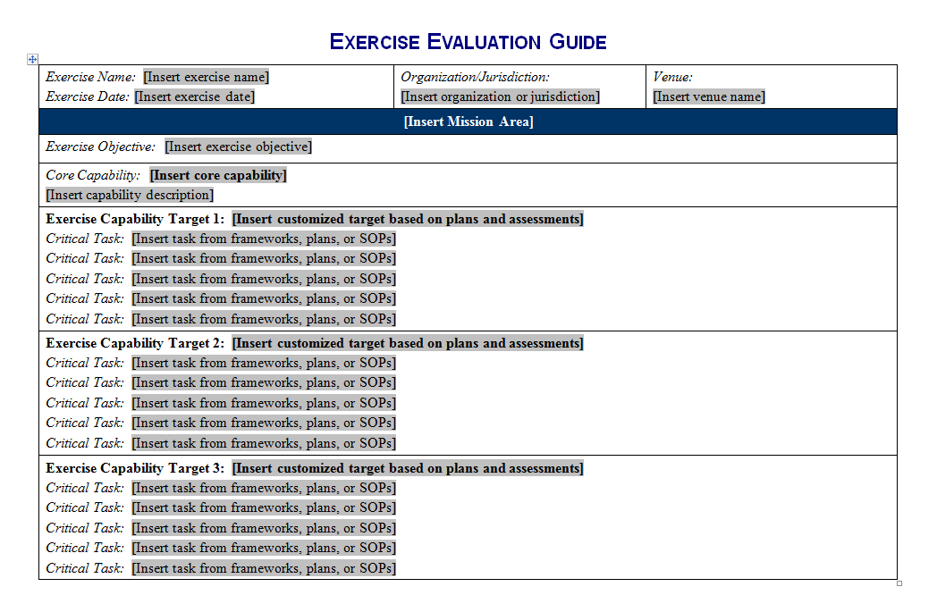
EEGs (cont’d)
Notes:
Page one of the EEG shows the exercise objective, core capability, capability targets, and associated critical tasks. The exercise design team develops this information for use by the evaluators during the exercise.

Slide 27
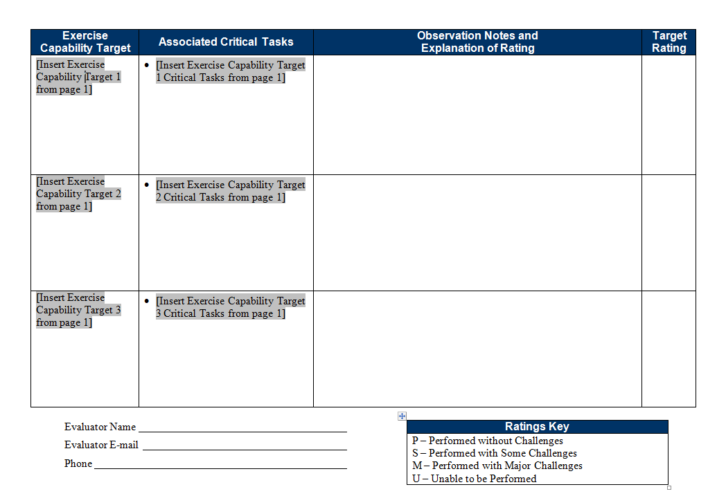
EEGs (cont’d)
Notes:
Page two of the EEG shows the capability targets and critical tasks. On this page, evaluators assign a target rating and fill in the observation notes and explanation of the target rating. This page also includes a ratings key.

Slide 28
Capability Target Ratings
Evaluators assign ratings for each capability target listed on the EEG
Review notes and observations relating to EEG critical tasks, and assign one of four ratings for the capability target:
  Performed without Challenges (P)
  Performed with some Challenges (S)
  Performed with Major Challenges (M)
  Unable to be Performed (U)
Consult the ratings definitions page in the EEG to determine the correct rating for the capability target

Slide 29
Final Reminders
Know your roles and responsibilities
Review plans and procedures being exercised
Understand the scenario
Do not prompt or interfere with players
Contact the Exercise Director or Lead Evaluator with any problems or questions
Review all exercise documents

Slide 30
Questions?

