Slide 1
Vaccination Update
Partners Call
August 14, 2020

Slide 2
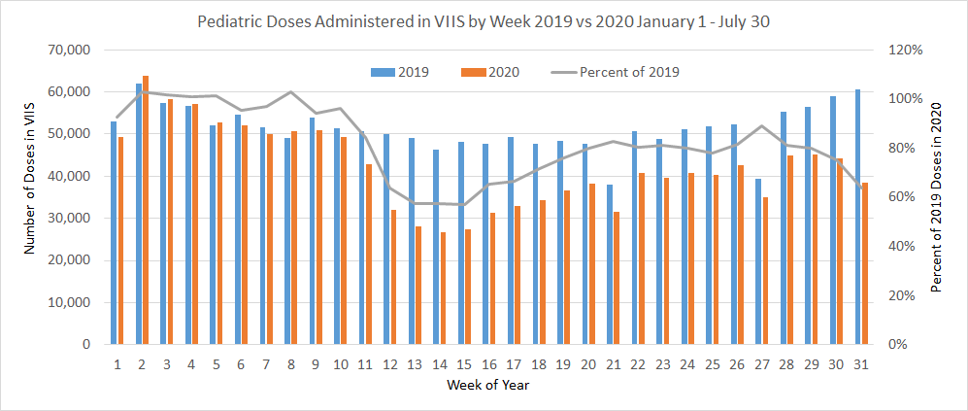
First COVID-19 Case in Virginia

Slide 3
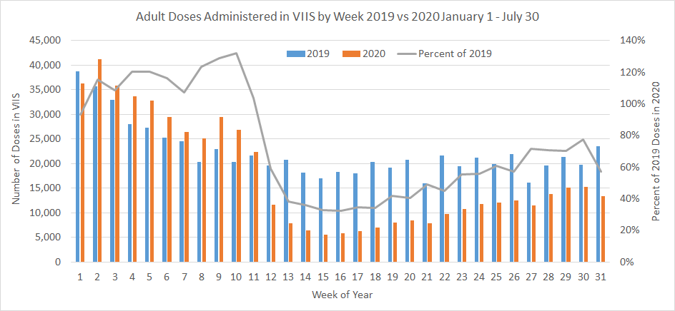
First COVID-19 Case in Virginia

Slide 4
Influenza Vaccination
It will be more important than ever to vaccinate for influenza this flu season.
Vaccine Tracking
First VVFC/VVFA Flu Shipments Arrived at CDC Depot - Contact Susan Kocen if your district is ready to receive doses.
Chargeable/EPR Flu Shipments Expected to start shipping within 2-3 weeks - DPS is confirming with districts on adequate storage.
Non-VDH Vaccinator Test in TRAIN 1092715
Non-VDH Vaccinator Training Posted to CHS Intranet/Nursing/Directives & Guidelines
Frequently Asked Questions Flu 2020/2021 Season July 28 2020

Slide 5
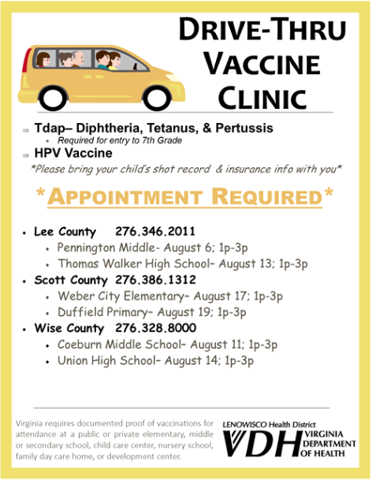

Vaccines for School Entry
Requirements have NOT been waived for back to school immunizations even if school is virtual.

Slide 6
COVID-19 Vaccine Updates
VAERS Data Sharing Plan Using Epi-X
Unredacted patient identifying information, will be posted weekly on (Epi-X) in an Excel spreadsheet.
Vaccine Safety Coordinators (VSC) will have access both to their unredacted jurisdiction-specific data and to redacted summary data consisting of cumulative report counts to date, by jurisdiction.
Cold Chain Management (Ultra)
No vaccine currently in U.S. stored at these temps (-70°C)
Recommend waiting before purchasing, etc. for ultra cold chain management
Vaccine likely distributed in 100 dose increments directly to provider through state allocation using vaccine infrastructure.
Providers need to enroll intent with state to vaccinate.
Some vaccine will be allocated outside of state chains in order to reach certain populations (e.g. Tribes, Pharmacies) with state input.

Slide 7
COVID-19 Vaccine Updates
CDC Review of Jurisdictional Plans
Plan needs to include planning regarding Tribal populations and high-risk groups.
Most products will be two dose series. Duration of protection, etc. unknown
Lead time - Once approved and ACIP recommended = vaccine out the door.
Need to start communicating now. Provider education important while vaccine very limited.
CDC will provide messaging that states can adapt
Ancillary supplies = “kitting” the vaccine. Ancillary supplies and PPE will be provided.
Consideration of additional supplies (needle size)
CDC is working on contracts at federal level to support states
Additional funding is anticipated
Private providers will be allowed to charge administration fee like H1N1.
Charge to insurance at no cost to patient.
Will be ways to charge for uninsured patients also.

Slide 8

Current Planning Activities
In-Progress:
Influenza Protocol and Standing Order (awaiting MMWR to be published)
Immunization Communications Campaigns/Messaging
Flu Press Event (In Person or Virtual)
Supplies Inventory and Ordering
LHD Survey - $1.4 million
Vaccine “kitting”
Storage of supplies
Vaccine Plan to CDC/OWS October 1, 2020
ICS Vaccine Branch - Vaccine Advisory Workgroup
COVID-19 Vaccine Pre-registration System
Pharmacy Agreements - Update and ensure vaccination is included
Targeted Population Outreach (Tribes, Health Equity, ADA, LTCF)

