Slide 1

Modeling Update
Justin Crow
Director, Division of Social Epidemiology
Office of Health Equity
Virginia Department of Health

Slide 2
UVA COVID-19 Model-Background
Model is developed by the UVA Biocomplexity Institute
Model has evolved
  Current methodology: “Adaptive Fitting”
  Based on observed cases in each health district, not scenarios
  Responsive to current trends → week-to-week volatility
Models thrive on more & better data, and the model improves every week.
Approaching a new transition period—fall
  Behavioral responses drive changes in current trends

Slide 3
Adaptive Fitting Approach
S-E-I-R metapopulation model
  133 “patches” for Virginia localities
  Includes asymptomaic infections and treatment affects
Each county fit precisely, with recent trends used for future projection
  Allows history to be precisely captured, and used to guide bounds on projections
Allows for “What-if” Scenarios
  Policy decisions and human behavior are difficult to predict
  Effects in COVID-19 environment are difficult to calibrate

Slide 4
Other Analytic/Feeder Products
Case Detection – Days from Onset to Diagnosis
Social Distancing metrics
Reproduction Rate
District Trajectory Classification
Surge Detection
Age-specific attack rates

Slide 5
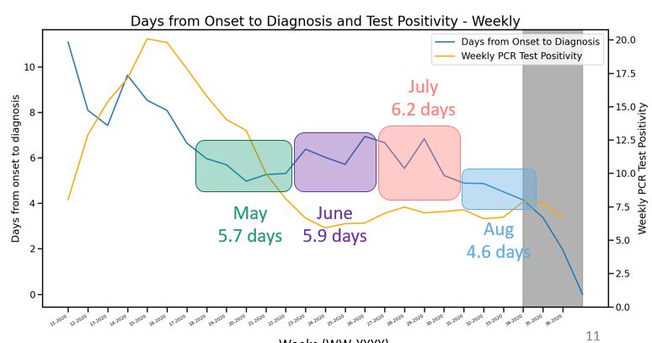
Better Detection – Symptom Onset to Diagnosis
Timeframe (weeks) | Mean days
April (13-16) | 8.42
May (17-21) | 5.71
June (22-25) | 5.85
July (26-30) | 6.24
Aug (31-34) | 4.60
Overall (13-33) | 6.15
https://www.vdh.virginia.gov/coronavirus/

Slide 6
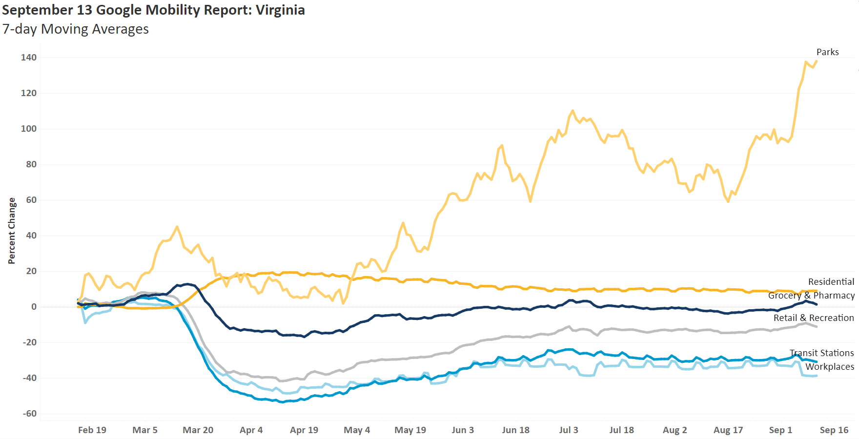
Social Distancing
https://dataviz.vdh.virginia.gov/views/GoogleMobility/Sheet1?iframeSizedToWindow=true&:embed=y&:display_count=no&:showAppBanner=false&:showVizHome=no

Slide 7
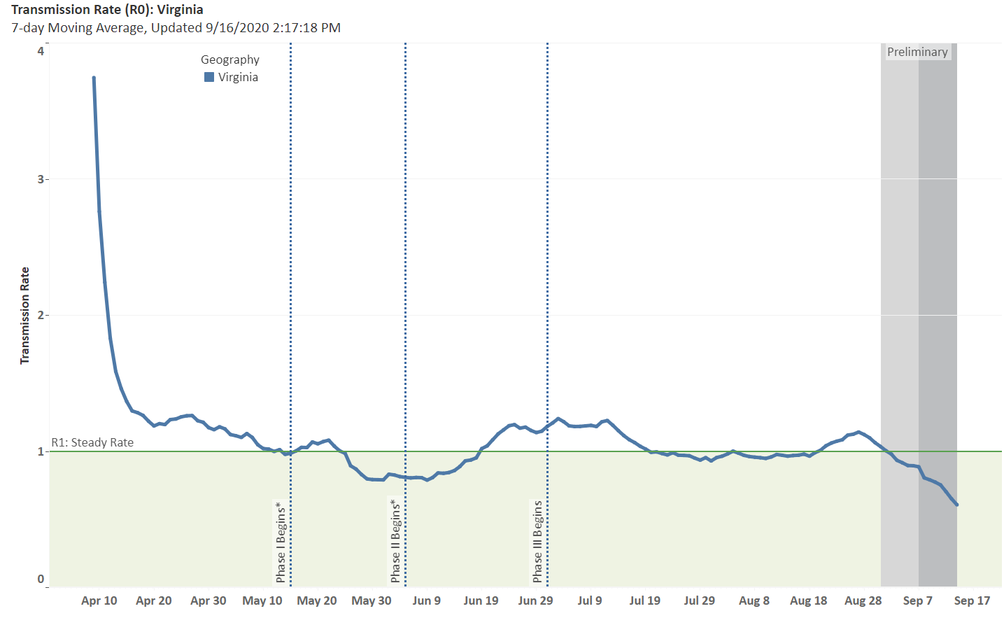
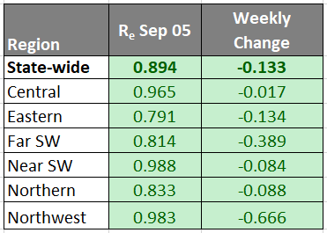

https://dataviz.vdh.virginia.gov/views/TransmissionRate/Dashboard1?iframeSizedToWindow=true&:embed=y&:display_count=no&:showAppBanner=false&:showVizHome=no

Slide 8
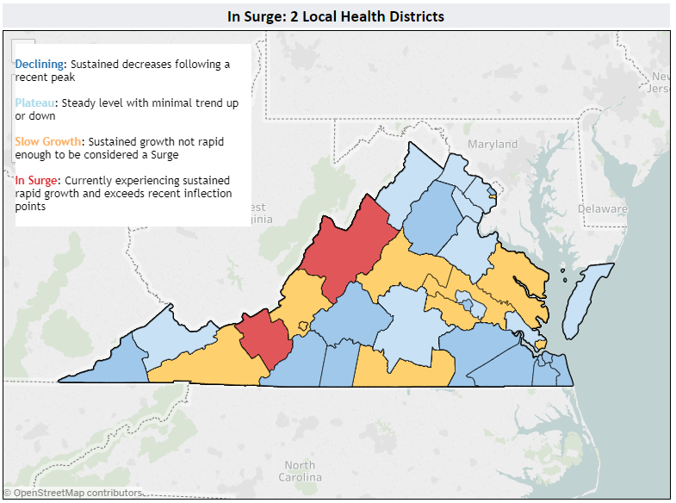
District Trajectories

Slide 9
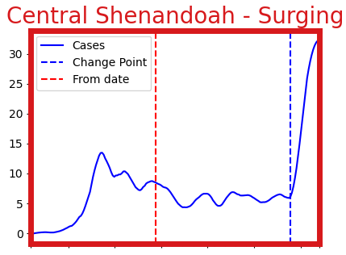
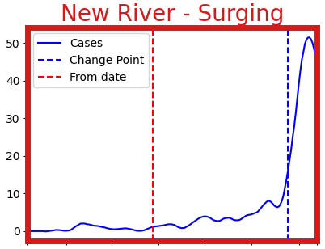
Surges

Slide 10
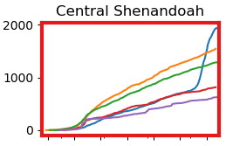
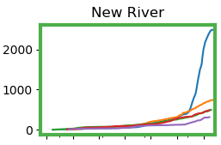
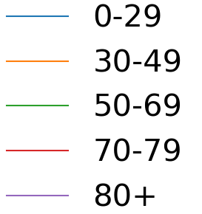
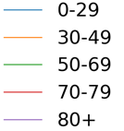
Age-Specific Attack Rates
Lower populations compared to student population
Increased testing targeting students

Slide 11
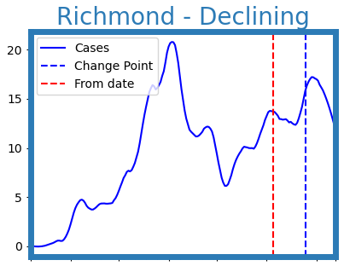
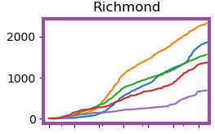
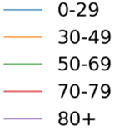
Past Surges- Richmond

Slide 12
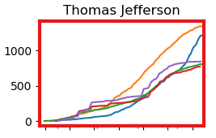
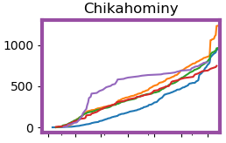
Other Districts with surges among 0-29 year olds

Slide 13
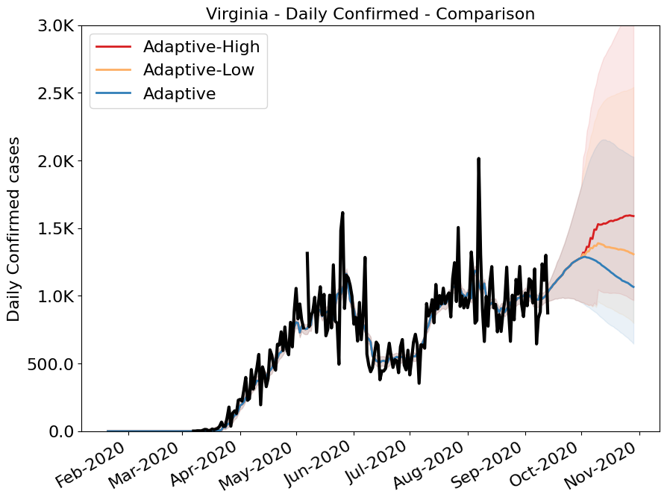
Projections
Virginia Projections
Current Course
“Adaptive fitting” approach
Precisely traces past and current cases to predict future cases
Weekly cases will peak at 8,925/week the week ending Oct 11
Two “what-if” scenarios: increased transmissibility beginning on Oct 1
Low impact (10% increase)
9,612 weekly cases the week ending Oct 18
High impact (20% increase)
11,137 weekly cases the week ending Nov 01

Slide 14
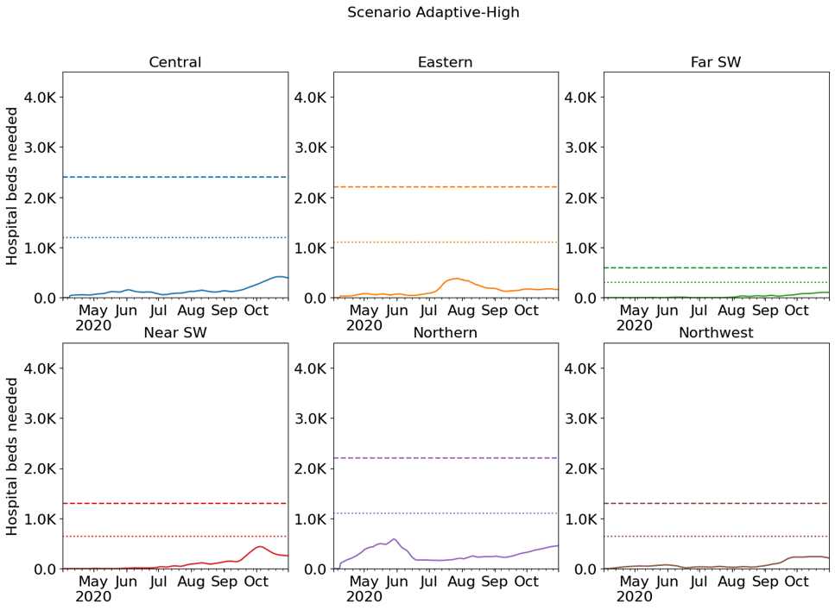

Hospital Demand and Capacity by Region
Capacities by Region – Adaptive High
COVID-19 capacity ranges from 80% (dots) to 120% (dash) of total beds
* Assumes average length of stay of 8 days
Notes:
Capacity is hard to know or estimate into the future, the hospital must continue to operate for non-pandemic services
Pandemic planners typically assume that 20% of the hospital beds can be used for pandemic under normal conditions
They also assume that a hospital under emergency conditions can expand to 120% capacity
This gives 40% of a hospital’s beds as an estimate of how many COVID patients they can absorb

Slide 15
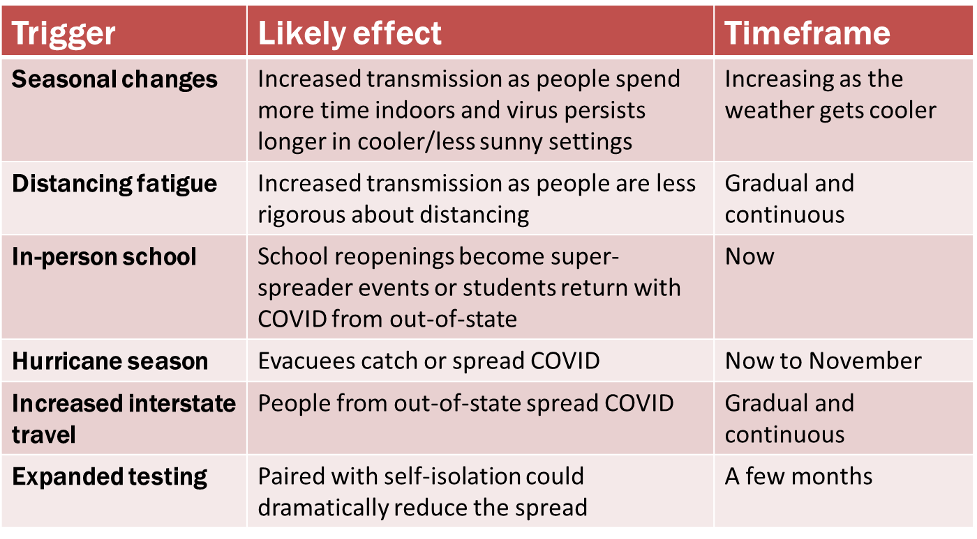

Slide 16
Where to find modeling results
VDH COVID-19 Data Insights
https://www.vdh.virginia.gov/coronavirus/covid-19-data-insights/
  Model Explorer
  Weekly Update
  UVA Slides
  RAND Corporation Slides
  Updated by COB Friday
COVID-19 Medical Resource Demand Dashboard
https://covid19.biocomplexity.virginia.edu/dashboards
  Hospital Capacity Scenarios
Internal Dashboards
  Transmission Rates (R0)
  https://dataviz.vdh.virginia.gov/#/views/TransmissionRate/Dashboard1
  Google Mobility Report
  https://dataviz.vdh.virginia.gov/views/GoogleMobility/Dashboard1
  Detailed Internal Model
    https://dataviz.vdh.virginia.gov/views/DailyModelInternal_15908727184890/AllModelResults?iframeSizedToWindow=true&:embed=y&:showAppBanner=false&:display_count=no&:showVizHome=no

