Slide 1
Directions for this Template
Use the Slide Master to make universal changes to the presentation, including inserting your organization’s logo
“View” tab > “Slide Master”
Replace placeholders (indicated by brackets [ ]) with information specific to your exercise
Delete any slides that are not relevant for your exercise
Font size should not be smaller than 22pt
Rev. April 2017
HSEEP
Notes:
Organizations can modify and augment this briefing as needed.

Slide 2
Local COVID 19 Vaccination Tabletop Exercise
Facilitator/Evaluator Briefing
[Date]

Slide 3
Welcome and Overview
[Name]
[Title (e.g., Exercise Director or Lead Planner)]
[Organization]

Slide 4
Exercise Overview
Exercise scope:
Exercise Type: Tabletop Exercise
Duration:
Location(s):
Exercise parameters:
Mission area(s): Response

Slide 5
Exercise Schedule
Time | Activity
 | [Month Day, Year]
00:00 | Registration
00:00 | Welcome and Opening Remarks
00:00 | Module 1: Briefing, Caucus Discussion. and Brief-Back
00:00 | Break
00:00 | Module 2: Briefing, Caucus Discussion, and Brief-Back
00:00 | Lunch
00:00 | Module 3: Briefing, Caucus Discussion, and Brief-Back
00:00 | Break
00:00 | Hotwash
00:00 | Closing Comments

Slide 6
Objectives,Capabilities & Scenario

Slide 7
Objectives
Increase stakeholder knowledge of the local COVID 19 Vaccination Campaign Plan and their roles to support execution of the plan upon arrival of COVID vaccines in the Commonwealth.
Validate support needed to counter Preparedness Gap Analysis estimates in accordance with the COVID 19 Vaccination Campaign Plan.
Assess the partners Support requirements for the phases of the Vaccination Campaign Strategy in accordance with the Vaccination Campaign Plan.

Slide 8
Objectives (Cont)
Evaluate the ability of locality Logistics Section to provide facilities, services and support in support of vaccination distribution in accordance with established plans, policies and procedures.
Demonstrate the ability of the Public Information Officer to deliver coordinated, prompt and actionable incident information in response to the distribution of vaccine in locality in accordance with existing plans, policies and procedures.
Demonstrate the ability of the locality to coordinate the management of vaccination distribution operations within locality in accordance with existing plans, policies and procedures.

Slide 9
Capabilities
Public Health Preparedness Capability | Healthcare Preparedness Capability | DHS Core Capability
Community Preparedness Medical Countermeasure Dispensing and Administration | Foundation for Healthcare and Medical Readiness Healthcare and Medical Response Coordination | Planning Operational Coordination Emergency Public Information and Warning Logistics and Supply Chain Management

Slide 10
Scenario
Module I:
Local COVID 19 Vaccination Campaign Plan Briefing
Module II:
December 1, 2020:
You have received notification of an impending shipment of COVID vaccine for Phase I priority groups. The supply is not sufficient to vaccinate all of the people in your health district who fall into Phase 1. Deliveries are expected to begin arriving over the next five days.
Module III:
February 16, 2021
Phase I vaccinations have been occurring since December of 2020. You have received notification that vaccine supplies have reached the necessary production volume to begin phase II of the vaccination campaign. Bulk shipments are expected to commence in the next five days.

Slide 11
Roles & Setup

Slide 12
Participant Roles and Responsibilities
Players: Players are personnel who have an active role in discussing or performing their regular roles and responsibilities during the exercise. Players discuss or initiate actions in response to the simulated emergency.
Observers: Observers do not directly participate in the exercise. However, they may support the development of player responses to the situation during the discussion by asking relevant questions or providing subject matter expertise.
Facilitators: Facilitators provide situation updates and moderate discussions. They also provide additional information or resolve questions as required. Key Exercise Planning Team members also may assist with facilitation as subject matter experts (SMEs) during the exercise.
Evaluators: Evaluators are assigned to observe and document certain objectives during the exercise. Their primary role is to document player discussions, including how and if those discussions conform to plans, polices, and procedures.

Slide 13
Exercise Setup
Exercise setup should be planned in advance
Setup includes:
Set up the Facility/Room – in plenary or in groups, depending on how you want to conduct the TTX
Allow space for food/refreshments
Audio/Visual requirements – make sure they work
Lay out supplies (paper, pens, markers, etc.)
Lay out badges, name tents, and table tents
Set up registration and table/breakout identification

Slide 14
Exercise Setup- Web Based
Exercise setup should be planned in advance for Breakout groups considerations
Web-Based Setup includes:
Utilizing a Meeting tool that allows for Break out groups within the session (e.g. Zoom if security protocols allow)
Utilizing a multi-session meeting by setting up individual sessions for each Module and additional sessions for each break out group per module for discussion
Utilizing a combination of multi-session meeting for each module and phone sessions for breakout groups

Slide 15
Facilitation

Slide 16
Facilitation
Opening remarks and multimedia presentations should be given to introduce the participants to the exercise and guide them through the process.
This exercise will be a moderated discussion.
Moderated discussions provide participants the opportunity to hear how various functional areas would respond to the presented incident and ask questions to fellow participants. The facilitator will run through a series of discussion questions to get participants to walk through their plans, policies, and procedures in response to the presented incident.

Slide 17
Tips for Facilitation
Stay neutral on content
Listen actively
Ask open-ended questions
Paraphrase to Clarify
Encourage everyone to participate
Keep control of the discussion and time
Emphasize the low-stress, no-fault environment

Slide 18
Evaluation

Slide 19
Evaluation Requirements
Evaluation requirements specify what will be evaluated during the exercise and how exercise play will be assessed
Evaluation requirements are documented in the EEGs
Capabilities
Capability targets
Critical tasks
Performance ratings

Slide 20
Exercise Evaluation Guides (1/3)
EEGs will be used to track evaluation of the objectives
[Plans to be evaluated]
The following evaluation requirements have been selected for this exercise (REFER TO EEG’s)

Slide 21
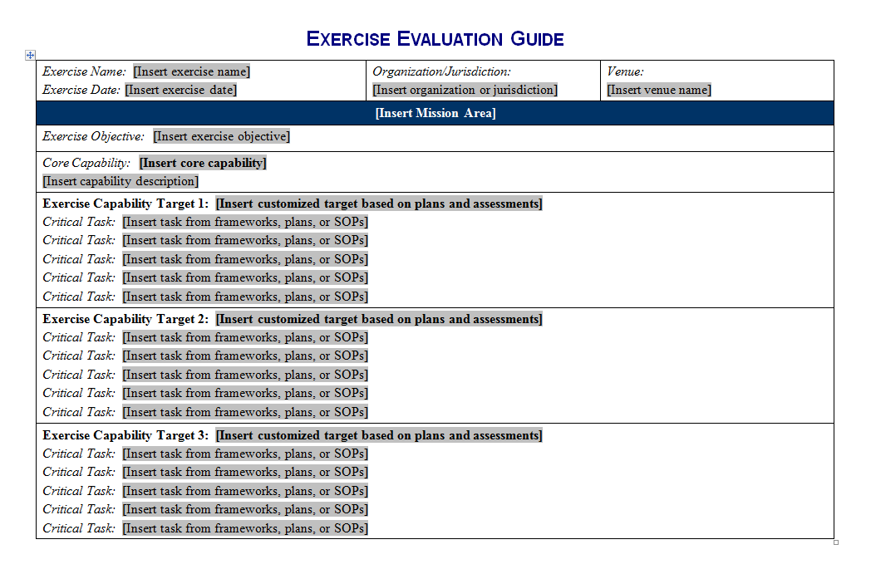
Exercise Evaluation Guides 2/3
Notes:
Screenshot of page 1 of the EEG with placeholders for exercise name, date, organization/jurisdiction, venue, objective, core capability, capability targets, and associated critical tasks.

Slide 22
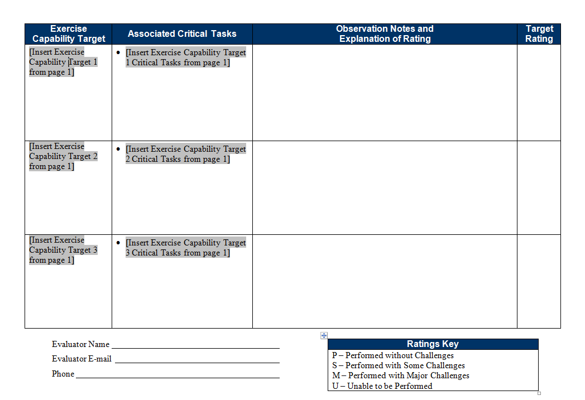
Exercise Evaluation Guides (3/3)
Notes:
Screenshot of page 2 of the EEG with placeholders for the exercise capability targets and associated critical tasks, observation notes/explanation of rating, and the target ranking. The evaluator's name, email, and phone number are included, as is a ratings key (P=performed without challenges; S=Performed with some challenges; M=Performed with major challenges; and U=unable to be performed).

Slide 23
Recording Observations
How the target was or was not met
Decisions made and information gathered
Requests made and how they were implemented
Resources utilized
Plans, policies, procedures, or legislative authorities used or implemented
Any other factors contributing to the outcomes

Slide 24
Observation Examples
Area for improvement
The HAZMAT team did not arrive to the release site for (#) (time) which was not within standards. EOC personnel did not complete the critical tasks indicated in the SOP, which delayed the HAZMAT Team response.
Strength
The Public Information office created social media templates as part of a corrective action identified during a previous exercise. The templates allowed the public information office to provide public information and warning information to multiple demographics, in multiple languages, and on multiple platforms in (#) minutes; well under the expected time.

Slide 25
Capability Target Ratings
Evaluators assign ratings for each capability target listed on the EEG
Review notes and observations relating to EEG critical tasks, and assign one of four ratings for the capability target:
Performed without Challenges (P)
Performed with some Challenges (S)
Performed with Major Challenges (M)
Unable to be Performed (U)
Consult the ratings definitions page in the EEG to determine the correct rating for the capability target

Slide 26
Evaluator Responsibilities
Understand the exercise objectives, capabilities, concept, and scenario
Familiarity with plans, policies, and procedures for the function or organization being evaluated
Use EEGs to document performance relative to exercise objectives, capabilities, capability targets, and critical tasks
Inform the Lead Controller of problems related to exercise design
Collect and submit all evaluation data, EEGs, and materials to the Lead Evaluator after the exercise
Additional information is in the C/E Handbook

Slide 27
Evaluator Guidelines: DO
Observe and record player activities
Focus on critical tasks and capability targets
Assign EEG capability target ratings
Document strengths and areas for improvement
Complete your EEGs either during or immediately after the exercise

Slide 28
Evaluator Guidelines: DO NOT
Prompt players
Answer questions for players
Interfere with player actions

Slide 29
Final Evaluator Reminders
Know your role and responsibilities
Understand the scenario
Do not prompt or get in the way of players
Contact the Exercise Director and/or Lead Evaluator with any problems or questions

Slide 30
Hot Wash
The Hot Wash is an important part of the exercise process.
This is an opportunity for players to discuss what they felt were the “highs and lows” of the discussion.
Ask players to give their opinion on what aspects of the discussed response went well, and what can be improved, based on their agencies role in the response.

Slide 31
Questions?

