Slide 1


Covid-19 Testing Update
Weekly Covid-19 Partners Call
Brooke Rossheim, MD, MPH
December 18, 2020

Slide 2
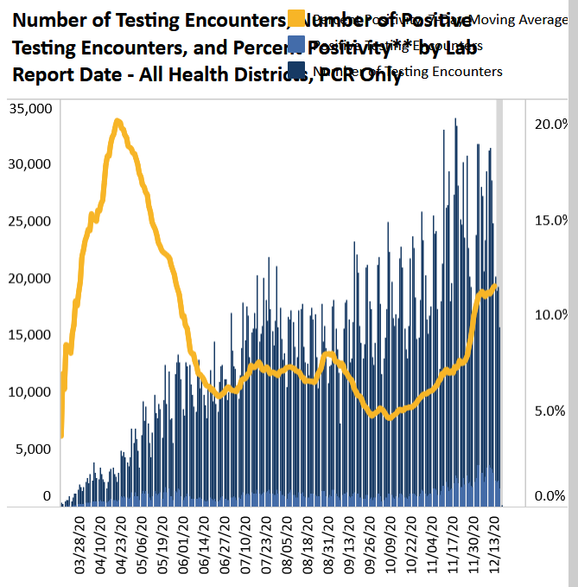
PCR Testing Only – All Health Districts
Current 7-day percent positivity rate = 11.6%
Total PCR tests = 3.81 million
Data as of 12/17/2020
www.vdh.virginia.gov/coronavirus/coronavirus/covid-19-in-virginia-testing/

Slide 3
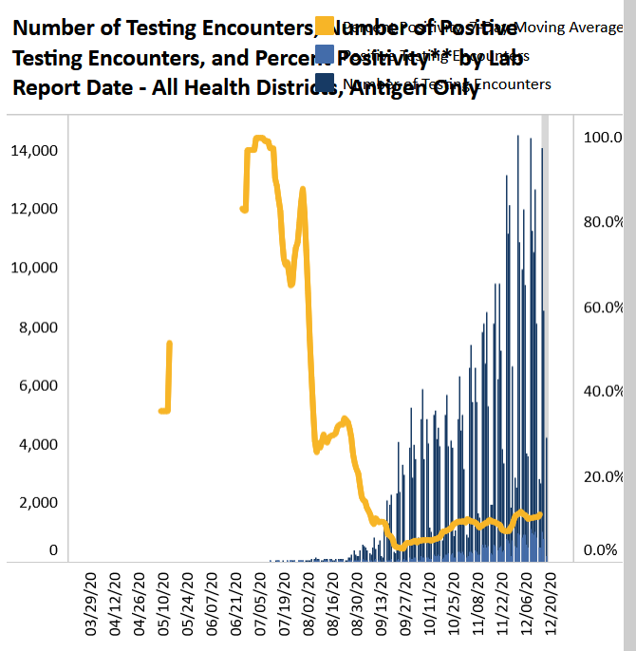
Antigen Testing Only – All Health Districts
Current 7-day percent positivity rate = 11.2%
Total antigen tests = 488,313
Data as of 12/17/2020
www.vdh.virginia.gov/coronavirus/coronavirus/covid-19-in-virginia-testing/

Slide 4
Covid-19 Pandemic – Two new home-based antigen tests
*NEW (12/15/20)* -- Ellume COVID-19 Home Test = first non-prescription, at-home antigen test with results provided at home in 15-20 minutes
Can be used in people ages 2 and older
Adults (16+): self-collected mid turbinate nasal swab; Children (2-15): swab collected by adult
If clinical picture doesn’t match test result, consult HCP - may need PCR testing
More info → www.fda.gov/media/144457/download
Abbott BinaxNOW COVID-19 Ag Card receives EUA for home use (12/16/20)
Rx continues to be required
Test performed with a “telehealth proctor” - usually not an HCP
Uses NAVICA app by smartphone
More info → www.fda.gov/media/144576/download

