Slide 1


Covid-19 Testing Update
Weekly Covid-19 Partners Call
Brooke Rossheim, MD, MPH
December 4, 2020

Slide 2
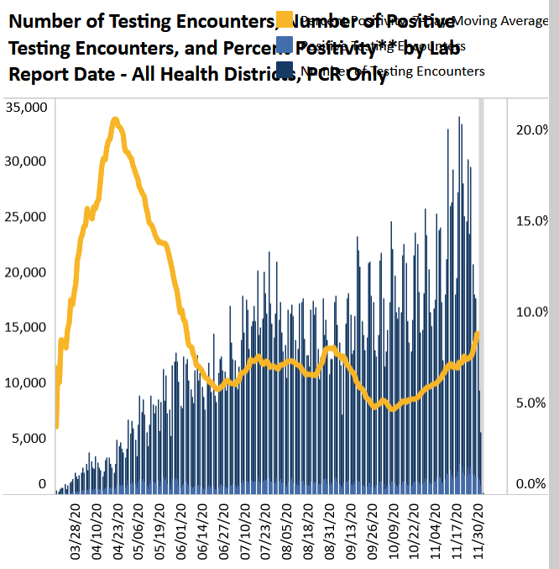
Covid-19 Pandemic – PCR Testing and Percent Positivity Rate
Data as of December 3, 2020
As of Dec 3, 2020, a total of 3.36 million PCR tests completed
Recently, more than 30,000 PCR tests completed per day
Overall 7-day moving average, percent positivity rate = 8.8% (rising)
Average lab turnaround time = 1.82 days (increasing)

Slide 3
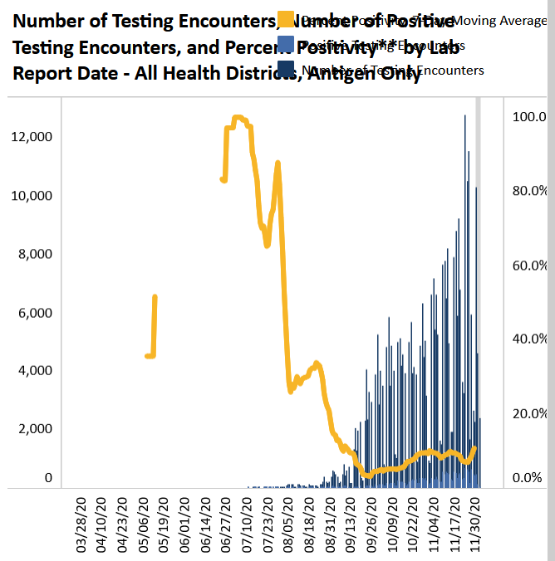
Covid-19 – Antigen Testing Encounters and Percent Positivity Rate
As of 12/3/2020, a total of 343,738 antigen testing encounters
7 day moving average, antigen-only positivity rate = 10.8%

Slide 4
Covid-19 Pandemic – Recent Antigen Test Distributions and Plans
Single requests of BinaxNOW Antigen Cards (2000 cards or less) to meet immediate needs (e.g., outbreak response, etc.)
Late Nov 2020, VDH local health districts received total of 100,000 BinaxNOW cards divided by population
In late December, VDH will send another shipment to local health districts that will be 1-3 X their original shipment
As of 12/1/2020, COVID-19 Testing Team working with the following groups regarding BinaxNOW Ag cards:
  A large retail pharmacy chain (anticipated 90,000 cards)
  Statewide EMS Councils (about 1500 cards; varied amounts)
  Additional shipments to free clinics (~5000 cards)
  Large primary care networks (anticipated ~100,000 cards total)
  Further discussions with Department of Behavioral Health and Developmental Services (DBHDS) re: test kits for their facilities
  State plans to retain approximately 10% of BinaxNOW cards to support emergent needs and/or outbreak responses

