Slide 1

Respiratory Protection Program Training
Notes:
Hello! Today we will discuss the Occupational Safety and Hazard Administration, or OSHA, Respiratory Protection Program. This is a required annual training that must be completed in order to wear an N95 respirator.

Slide 2
OSHA 29 CFR Part 1910 (Subpart I) “Personal Protective Equipment”
1910.132 General requirements. 1910.133 Eye and face protection. 1910.134 Respiratory protection. 1910.135 Head protection. 1910.136 Foot protection. 1910.137 Electrical protective devices. 1910.138 Hand Protection.
Notes:
The requirements of the OSHA Respiratory Protection Standard are found in 29 CFR 1910.134. It is part of the larger Subpart “i” on Personal Protective Equipment.

Slide 3
OSHA 29 CFR Part 1910.134 Respiratory Protection Standard
(a) Permissible practice
(b) Definitions
(c) Respiratory protection
program
(d) Selection of respirators
(e) Medical evaluation
(f) Fit testing
(g) Use of respirators
(h) Maintenance and care
(i) Breathing air quality and use
(j) Identification of filters, cartridges, and canisters
(k) Training and information
(l) Program evaluation
(m) Recordkeeping
(n) Dates
(o) Appendices (mandatory)
A: Fit Testing Procedures
B-1: User Seal Checks
B-2: Cleaning Procedures
C: Medical Questionnaire
D: Information for Employees Wearing Respirators When Not Required Under the Standard
Notes:
These are the individual sections of the OSHA Respiratory Protection Standard. The main sections we will cover today are: the Respiratory Protection Program requirements, Fit Testing and Use of Respirators, Medical Evaluations, and Training Requirements.

Slide 4
Training Requirements
No employee will be permitted to work with a respirator until trained in respiratory protection
Must cover the following topics annually:
General requirements of federal & state respiratory protection standards
Potential work-related respiratory hazards and risks associated with not wearing respiratory protection properly
Function, capabilities, limitations of selected respiratory protection
Function, capabilities, limitations of selected respiratory protection
Notes:
Employees are not permitted to work with a respirator until they have been properly trained in respiratory protection.
The following topics must be covered each year:
the General Requirements of federal & state respiratory protection standards
Potential work-related respiratory hazards and risks associated with not wearing respiratory protection properly
the Function, Capabilities, and Limitations of the respiratory protection used
How to inspect, put on and remove, check the seals, and wear the respirator properly
and the Medical signs and symptoms that might limit or prevent effective use of respirators
We will cover each of these topics next.

Slide 5
General Requirements - Employer
Identify and evaluate respiratory hazards in the workplace
Select and provide appropriate respirator based on these respiratory hazards
Designate a program administrator
qualified by appropriate training or experience to administer the Repiratory Protection Program (RPP)
conducts the required evaluations of program effectiveness
Develop & implement a written respiratory protection program
Notes:
Employers must assess the workplace to determine if respiratory hazards are present which necessitate the use of respirators and provide appropriate respirators for these hazards. A Program Administrator must be designated, and a written program implemented.

Slide 6
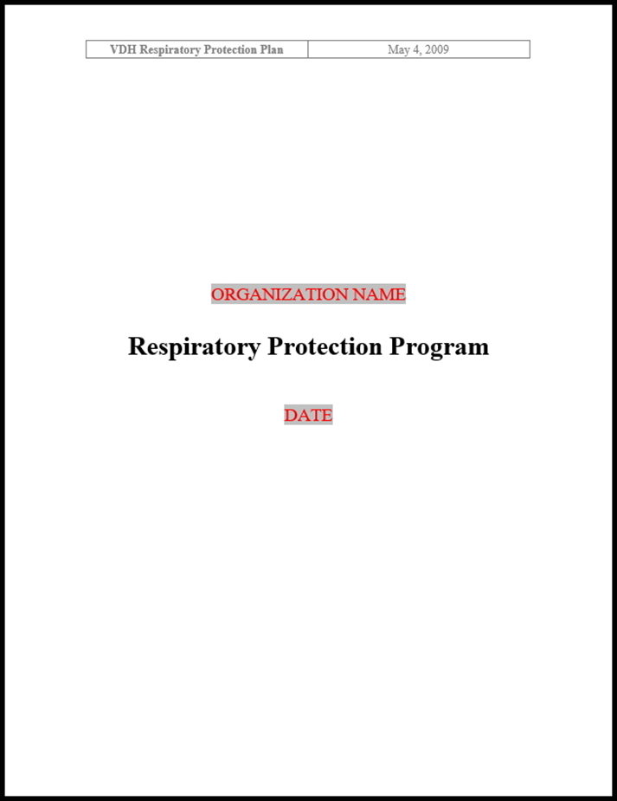
Notes:
A template for an OSHA-compliant respiratory protection program document is available from the Virginia Department of Health. Shadowed text boxes allow the organization’s name, the date, and other organization-specific information to be entered into the document. Informational notes are included in the document to explain how each section may need to be edited for the specific organization. Your organization must have a written program if employees are required to wear N95 respirators.

Slide 7
Required Elements of the Written Program
Procedures for selecting respirators
Medical evaluations of employees required to use respirators
Fit testing procedures for tight-fitting respirators
Procedures for proper use of respirators in routine & emergency situations
Procedures and schedules for cleaning, disinfecting, storing, inspecting, repairing, discarding, and maintaining respirators
Notes:
The written program document must address certain required elements, including: Selection of respirators, Medical evaluations, Fit testing procedures.

Slide 8
Required Elements of the Written Program (cont.)
Training of employees in respiratory hazards to which they are potentially exposed during routine and emergency situations
Training of employees in proper use of respirators, including donning and doffing, any limitations on their use, and their maintenance
Procedures for regularly evaluating the effectiveness of the program
Notes:
The written program document must also address: Training in respiratory hazards, Training in the proper use of respirators, and the continuing evaluation of the program’s effectiveness.

Slide 9
Medical Aspects
Must complete medical evaluation prior to initial fit-testing and any use on the job
Must use OSHA questionnaire or medical examination that obtains the same information
Questionnaires and medical examinations are confidential
Not permitted to wear a respirator until medical clearance form signed
Notes:
Medical aspects. Employees who wear respirators must complete a medical evaluation prior to their initial fit-testing and before being permitted to wear a respirator on the job.
The medical evaluations can be conducted through a medical questionnaire or an initial medical examination that obtains the same information as the medical questionnaire. If a questionnaire is used it must be the OSHA questionnaire and cannot be substantially altered.
The details of the questionnaires and any medical examinations are confidential. The employer, in this case the supervisor or fit test coordinator, are informed whether the employee is medically cleared or not medically cleared to wear a respirator.
Employees are not permitted to wear a respirator until the medical recommendation form indicating that they are medically qualified is signed.

Slide 10
Medical Aspects (cont.)
Annual medical evaluations not required.
Reevaluation may be needed, if –
employee reports medical signs or symptoms related to ability to use a respirator
supervisor or respirator program administrator reports need for reevaluation
observations made during fit testing and program evaluation indicate need for employee reevaluation
changes occur in workplace that may result in a substantial increase in physiological burden
Notes:
Annual medical evaluations (the OSHA questionnaire) are not required.
However, a reevaluation may be needed, if:
• an employee reports medical signs or symptoms that are related to his or her ability to use a respirator
• a supervisor or the respirator program administrator informs the employer that an employee needs to be reevaluated
• information from the program, including observations made during fit testing and program evaluation, indicates a need for employee reevaluation
• or, a change occurs in workplace conditions that may result in a substantial increase in the physiological burden placed on an employee. This could include an increase in the physical work effort, a change in protective clothing worn, or a significant change in the ambient temperature at the workplace.
Medical conditions that might limit or prevent effective use of respirators could include obvious things such as angina, arrhythmias, severe asthma, shortness of breath, chest injuries, and other heart and lung diseases. But, other conditions ranging from skin rashes to cancers potentially could have an effect.
The main obligation is on the employee to report medical changes that they think may affect their ability to wear a respirator.

Slide 11
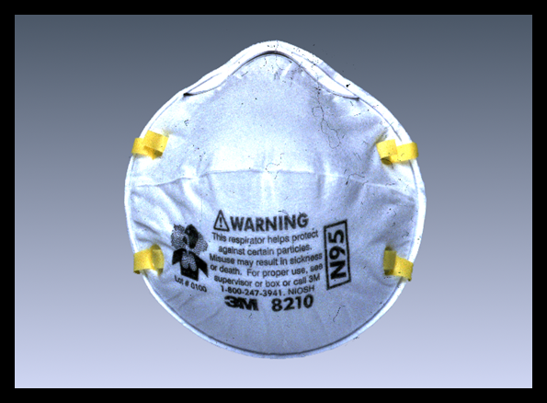
N95 Respirators
Particulate air purifying respirator
Commonly used in healthcare settings as part of airborne precautions
Protection from infectious aerosols
Notes:
N-95 respirators are the most common respirator used in the healthcare setting. N-95s are classified as a type of air-purifying respirator. They are further classified as a particulate respirators because they protect by filtering particles, such as dusts, mists, and fumes, out of the air as you breathe. These respirators protect only against particles—not against gases or vapors.
The primary respiratory hazards currently identified in the health setting are biological organisms – such as bacteria and viruses. We have not identified any gas or vapor hazards that would require the use of a chemical respirator. Since airborne biological organisms are particles, they can be filtered by particulate respirators such as the N95.
Respirators in this family are rated as N, R, or P based on their protection against oils. This rating is important in the industrial setting because some industrial oils can degrade the filter performance. Respirators, such as the ones we use, are rated “N,” as they are not resistant to oil. Other respirators are rated as “R,” if they are somewhat resistant to oil, and “P,” if they are strongly resistant or “oil proof.”
The number designation on the respirator refers to its filtering efficiency. Respirators that filter out at least 95% of airborne particles during “worse case” testing are given a 95 rating. An N-95 filter is at least 95% efficient in removing particles greater than 0.3 microns in diameter.

Slide 12
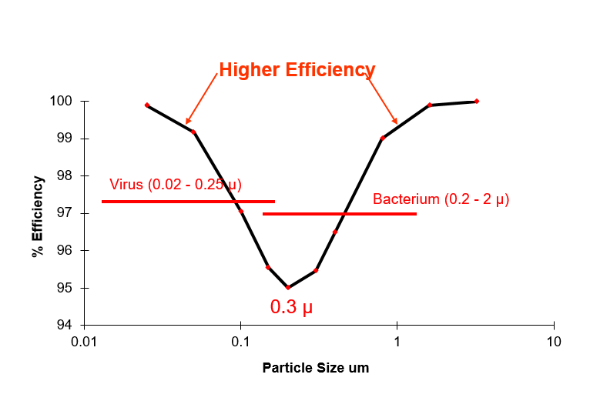
N95 Respirator Rating Filter Efficiency vs. Particle Size
Notes:
This graph shows the percentage of filtering efficiency plotted against particle size.
The particle size with the lowest filtering efficiency is 0.3 micron or micrometer.
Note that the filtering efficiency actually increases as particle size both increases and decreases. In fact, for the smallest and largest particles, the efficiency is almost 100%.

Slide 13
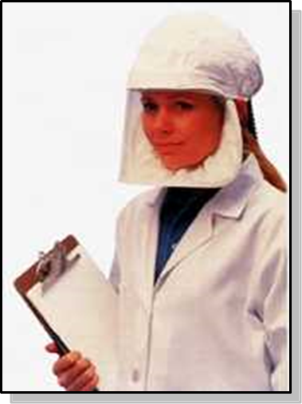
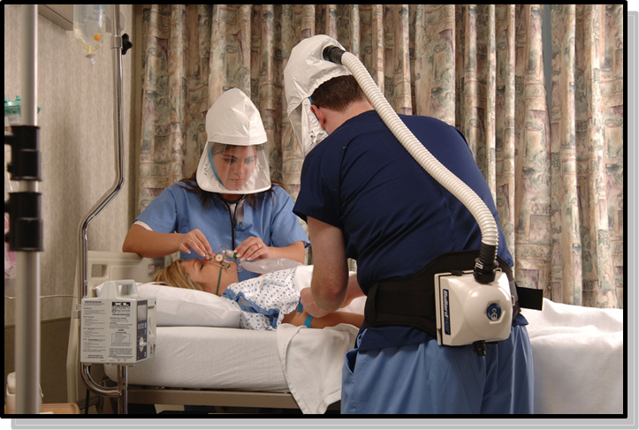
The Loose Fitting Powered Air Purifying Respirator
Notes:
Some people are not able to achieve a complete seal on fit testing, even after trying several models of respirators. If you can’t pass a fit test, you may need to use a Powered Air Purifying Respirator, or PAPR. This includes men with facial hair that interferes with a seal.
PAPRs are positive pressure respirators. A light weight pump is worn on a belt, and air is pumped through a filter and up a hose into a hood that covers the head. Since these respirators are loose fitting, they do not require fit testing.
PAPRs are relatively comfortable, but expensive. The PAPRs cost over $1000.

Slide 14
How to Properly Wear an N95 Respirator (OSHA Video)
Click here to view the OSHA video on the proper wear of an N95 respirator.
Notes:
We’ll conclude the training by watching an OSHA video on the proper wear of an N95 respirator.
Note: Masks approved by FDA; Respirators approved by NIOSH

Slide 15
Questions???
If you have questions regarding your respiratory protection program or fit testing, please contact your Respiratory Protection Program Administrator or your immediate supervisor.
Notes:
If you have questions regarding your respiratory protection program or fit testing, please contact your Respiratory Protection Program Administrator or your immediate supervisor.

