Slide 1
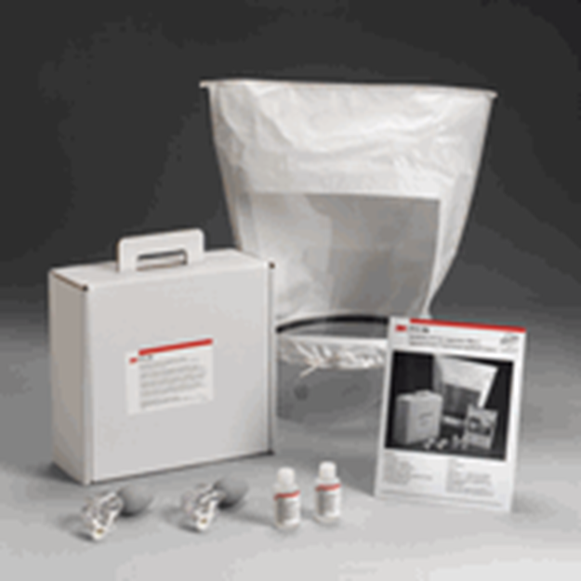
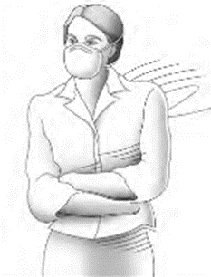
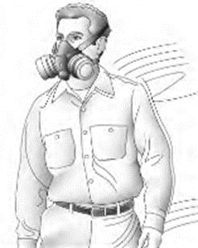
Occupational Health & Safety Programs
Respiratory Protection in the Workplace
Respirator Fit Testing
Updated: February 13, 2023

Slide 2
Respiratory Protection Program – Fit Testing
Training Objectives
Understand the RPP Standards, specifically the Fit Tester’s role
Explain when respirator fit testing is required
Identify Fit Testing equipment and its proper use
Correctly conduct the accepted respirator fit test procedures
Demonstrate the correct donning & doffing of a respirator
Describe record keeping requirements related to fit testing

Slide 3
Respiratory Protection Standard
OSHA Standard: 29 CFR 1910.134
16VAC25-60-120 General Industry Standards
Virginia is a “State Plan” state.
The employer shall be responsible for the establishment and maintenance of a Respiratory Protection Program.
Employer shall provide training, respirators, medical evaluations, and fit testing to employees.
Notes:
16VAC25-60-120. General industry standards.
A. The occupational safety or health standards adopted as rules or regulations by the board either directly or by reference, from 29 CFR Part 1910 shall apply by their own terms to all employers and employees at places of employment covered by the Virginia State Plan for Occupational Safety and Health.
Organization of the Standard (1910.134)
(a) Permissible practice
(b) Definitions
(c) Respirator program
(d) Selection of respirators
(e) Medical evaluation
(f) Fit testing
(g) Use of respirators
(h) Maintenance and care
(i) Breathing air quality and use
(j) Identification of filters, cartridges, and canisters
(k) Training and information
(l) Program evaluation
(m) Recordkeeping
(n) Dates
(o) Appendices (mandatory)
A: Fit Testing Procedures
B-1: User Seal Checks
B-2: Cleaning Procedures
C: Medical Questionnaire
D: Information for Employees Wearing Respirators When Not Required Under the Standard

Slide 4
Respiratory Protection Program Elements
Written Program
Program Administration
Respirator Selection
Medical Evaluation
Fit Testing
Respirator Training
Maintenance (Storage, Cleaning and Inspection)
Program evaluation
Notes:
Must develop a written program with worksite-specific procedures when respirators are necessary or required by the employer
Must update program as necessary to reflect changes in workplace conditions that affect respirator use
Must designate a program administrator who is qualified by appropriate training or experience to administer or oversee the program and conduct the required program evaluations
Must provide respirators, training, and medical evaluations at no cost to the employee

Slide 5
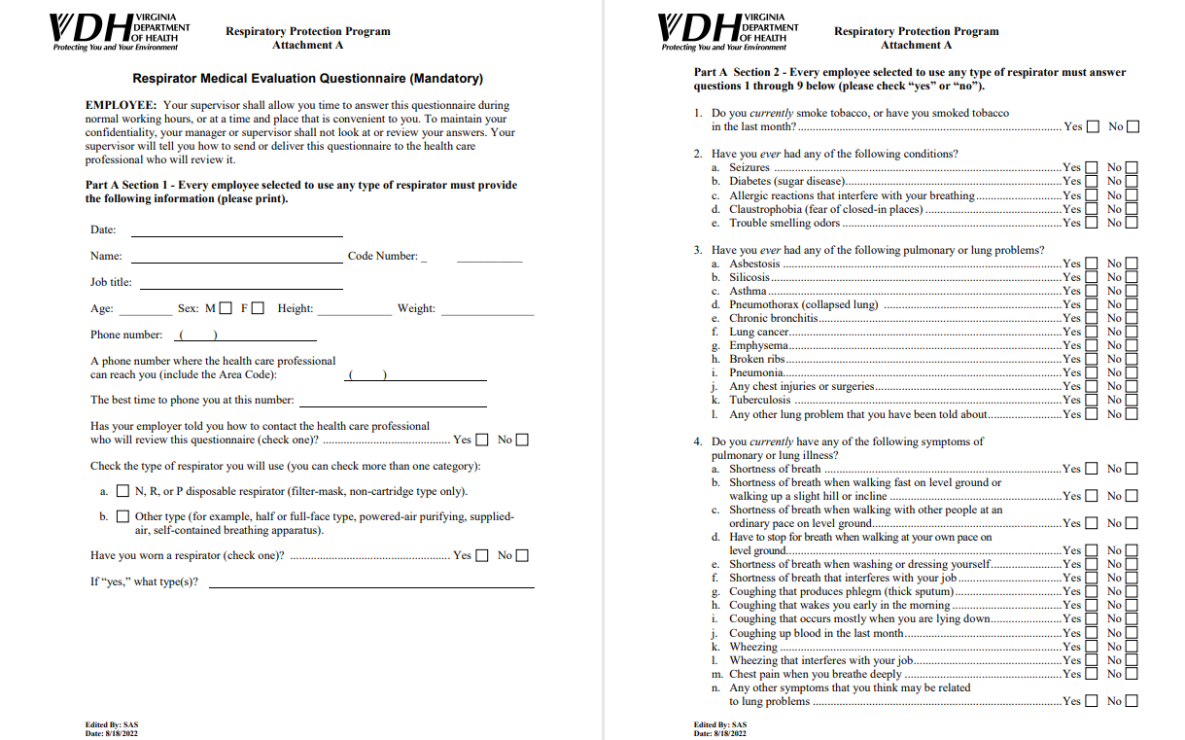
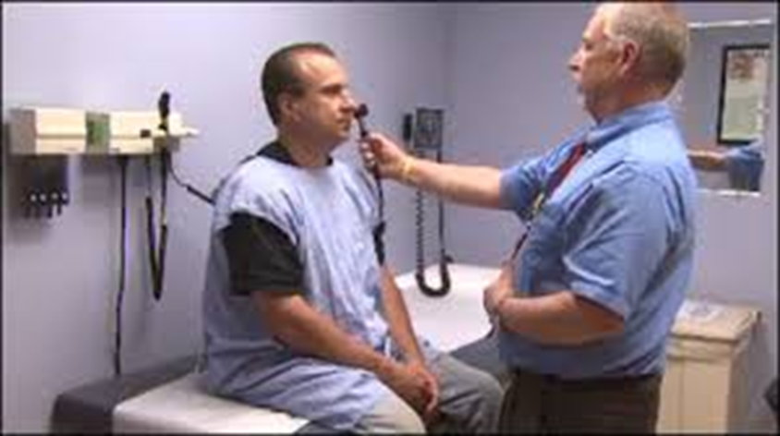
Respiratory Protection Program
Medical Evaluation
Prior to required respirator use (including fit testing).
Exception for voluntary use
Obtained by using a medical questionnaire or through a medical examination gathering the same information.
Performed by a physician or other licensed health care professional (PLHCP).
Notes:
A respirator places a physiological burden on the employee.
This burden varies with:
Type of respirator worn.
Job and workplace conditions.
Medical status of the employee.
Pulmonary
Cardiovascular
Body temperature
Senses
Psychological
Irritation and allergy
Required if:
Positive response to questions 1 - 8 in Section 2, Part A of Appendix C.
Initial medical examination indicates need for follow-up physical.
Must include any medical tests, consultations or diagnostic procedures PLHCP deems necessary.

Slide 6
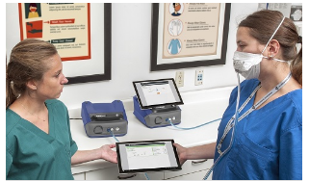
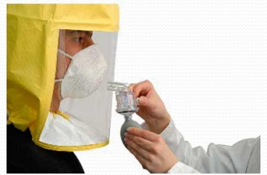
Respiratory Protection Program
Types of Fit Tests
Quantitative (QNFT)
Measures the actual level of contaminant inside and outside of the respirator, provides a numerical fit factor
Requires specialized training on QNFT device
Qualitative (QLFT)
A challenge agent (vapor or aerosol) is used
Fit is inadequate if the presence of the challenge agent is detected by the respirator wearer

Slide 7
Respiratory Protection Program
When Fit Testing is Required
Prior to initial assignment with a respirator and after medical evaluation
Must be the same make, model, style and size selected
Fit Testing requirements (other than initial)
Annually
Respirator change in make, model, or size
Noted change in employee physical conditions
Requested by the employee, Program Administrator or PLHCP
Should include “user seal check” procedures

Slide 8
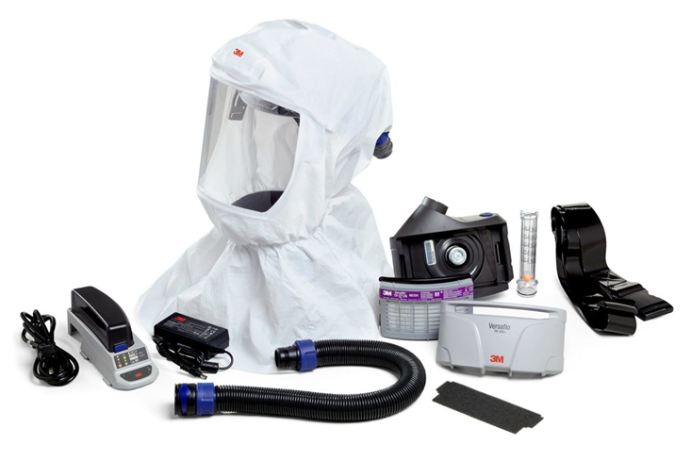
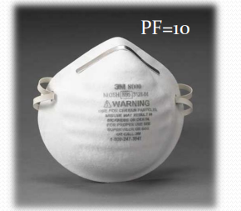
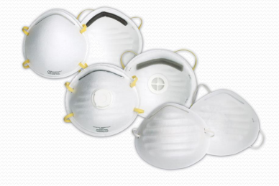
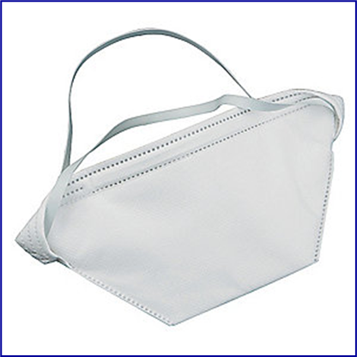
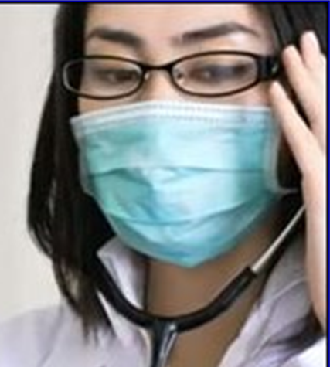
Respiratory Protection Program
Filtering Facepiece Respirators &
Powered Air-Purifying Respirators (PAPR)
PAPR
Surgical Mask
Notes:
Air Purifying Respirators (APR) – Particularly N-95 respirators
NIOSH developed a filter category scheme to help in clarifying filter effectiveness.
PAPR - An air-purifying respirator that uses a blower to force the ambient air through air-purifying elements to the inlet covering.

Slide 9
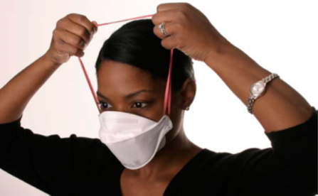
Respiratory Protection Program
Filtering Facepiece Respirators
Donning:
Hold the respirator in the palm of your hand with the straps hanging loose.
Place the N95 respirator on your face covering your nose and cupping your chin. (for folded respirator - ensure panels are extended)
Pull the upper strap over your head, resting it high on the crown or back of your head.
Pull the bottom strap over your head, and behind and below your ears.
Mold the nose piece of the respirator over the bridge of your nose to obtain a tight seal.
Perform a user seal check to ensure there is a good seal against the skin

Slide 10
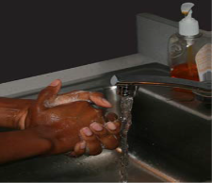
Respiratory Protection Program
Filtering Facepiece Respirators
Doffing:
Only touching the straps, pull the bottom strap over the top strap and your head, and release the strap
Holding the upper strap, pull the respirator forward and away from the face
Discard the respirator into the trash, still using only the straps
Wash your hands with soap and water or hand sanitizer

Slide 11
Respiratory Protection Program
Fit Testers
Fit Testers shall be trained and must be able to:
Ensure that fit test equipment is in proper working order,
Conduct fit tests using an identified VOSH/OSHA-accepted fit test method,
Be able to recognize invalid and failed tests,
Complete appropriate Fit Test Records for each test,
Must be able to demonstrate/identify proper donning & doffing of respirators being fit tested
No special certification is required to be a Fit Tester.

Slide 12
Respiratory Protection Program
QLFT Fit Test Equipment
Fit Test Hood
Two Nebulizers
One for the Sensitivity solution
One for the Test solution
Fit Test Solutions (Bitrex and/or Saccharin)
Sensitivity Solution
Test Solution
Supply of respirators – different makes, models, and sizes.

Slide 13
Respiratory Protection Program
QLFT Fit Test Procedures
Shall not eat, drink (except water), use tobacco products, or chew gum/candy for at least 15 minutes before fit testing begins.
A Fit Test consists of two parts:
Threshold sensitivity screening – to ensure the person can detect the taste of the testing agent, (Bitrex or Saccharin)
Fit Test – to ensure the adequate fit of the selected respirator.
Describe the steps to be performed for each part to the person(s) being tested.
Have the person(s) being fit tested select an acceptable respirator from a sufficient number of makes, models, sizes.

Slide 14
Respiratory Protection Program
QLFT Fit Test Procedures
Threshold Sensitivity Screening:
Position the hood over test subject, instruct the person to breathe through their mouth with tongue slightly extended,
Start injecting the Sensitivity Test Solution from the nebulizer into the hood, squeeze nebulizer hard enough to aerosolize the solution, fully compress and inflate the nebulizer bulb, no more than 30 squeezes.
Have the person tell you as soon as they taste the solution.
Note the number of squeezes – record 1-10 as a 10, 11-20 as 20, and 21-30 as 30.

Slide 15
Respiratory Protection Program
QLFT Fit Test Procedures
Fit Test:
Have the person don the respirator and position the hood over their head, instruct the person to breathe through their mouth with tongue slightly extended,
While standing, the person performs 7 exercises – 60 seconds on each exercise,
At the beginning of each exercise the noted number of squeezes (10, 20,or 30) from the Fit Test nebulizer is injected into the hood,
At 30 seconds of each exercise half the noted number (5, 10, or 15) of squeezes is injected into the hood.

Slide 16
Respiratory Protection Program
QLFT Fit Test Procedures
Fit Test Exercises (see fit test record & test procedure sheet):
Normal Breathing – facing forward
Deep Breathing – facing forward (do not hyper-ventilate)
Turning Head Side-to-Side
Moving Head Up-and-Down
Talking – rainbow passage or equivalent
Bending Over
Normal Breathing – facing forward
Have the person tell you if they taste the test solution at anytime during the test, stop the test at that time.

Slide 17
Respiratory Protection Program
QLFT Fit Test Procedures
Fit Test is considered “Passed” if the person does not report tasting the fit test solution during the exercises.
Fit Test is considered “Failed” if the person reports tasting the fit test solution during any of the exercises.
Try to determine the cause of the leak in the respirator seal.
Check for proper seating along nose, chin, and/or slipping of respirator during movements.
If correctable, clear pallet and repeat the Fit Test.
Repeat the entire Fit Test with a different respirator.
If unable to achieve a “Pass” the person cannot wear a tight-fitting respirator at work.

Slide 18
Respiratory Protection Program
QLFT Fit Test Procedures
Common Errors During Fit Testing:
Not conducting the Threshold Sensitivity Screening,
Using the incorrect solution nebulizer during a Test,
Not standing to perform the Test exercises,
Skipping steps in the Fit Test Procedures,
Attempting to fit test people not trained or medically cleared to wear a respirator,
Not maintaining equipment or Fit Test records
Clean all equipment after the fit testing event is completed and store appropriately.

Slide 19
Respiratory Protection Program
Fit Test Records
Medical Evaluation Questionnaire – This is an employee medical record.
Retained by the PLHCP or maintained in the employee’s health record file.
Medical Clearance (PLHCP recommendation) – This is not a medical record.
A copy goes to the employee and a copy to the employee’s work unit.
Fit Test Record is maintained by the employee’s work unit or the Respiratory Protection Program Administrator.

Slide 20
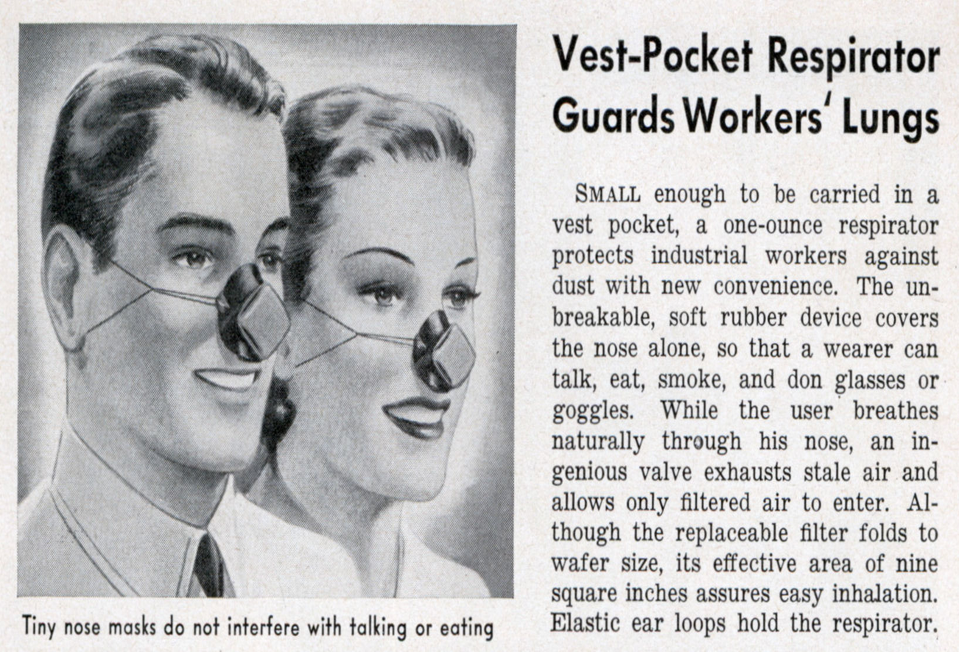
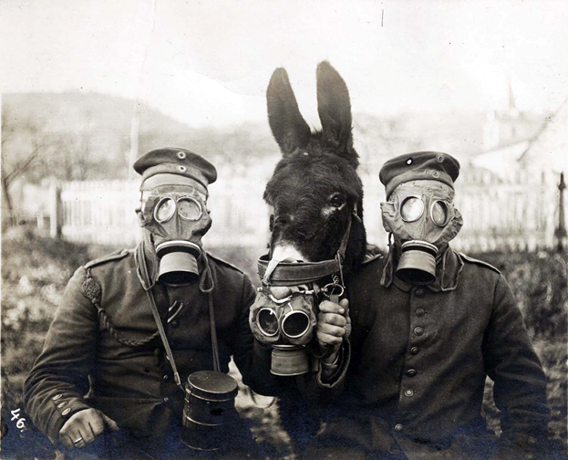
Occupational Health & Safety Programs
Respiratory Protection

Slide 21
Respiratory Protection Programs
Questions?

