Slide 1
How do we impact health?

Slide 2
CDC’s Community Health Improvement Navigator:
the Who, What, Where, and How of Improving Community Health
Notes:
The HOW: Implement interventions or initiatives that work across all 4 action areas for the greatest impact on health and well-being for all.
Choose an evidence-based, balanced approach to community health improvement that is based on shared priorities.
Start by using interventions that work across all 4 action areas.
Note that action in one area may produce positive outcomes in another.
Over time, increase investment in socioeconomic factors for the greatest impact on health and well-being for all.
The CDC CHI Navigator—available at www.cdc.gov/CHInav— includes a Database of Interventions related to these action areas.

Slide 3
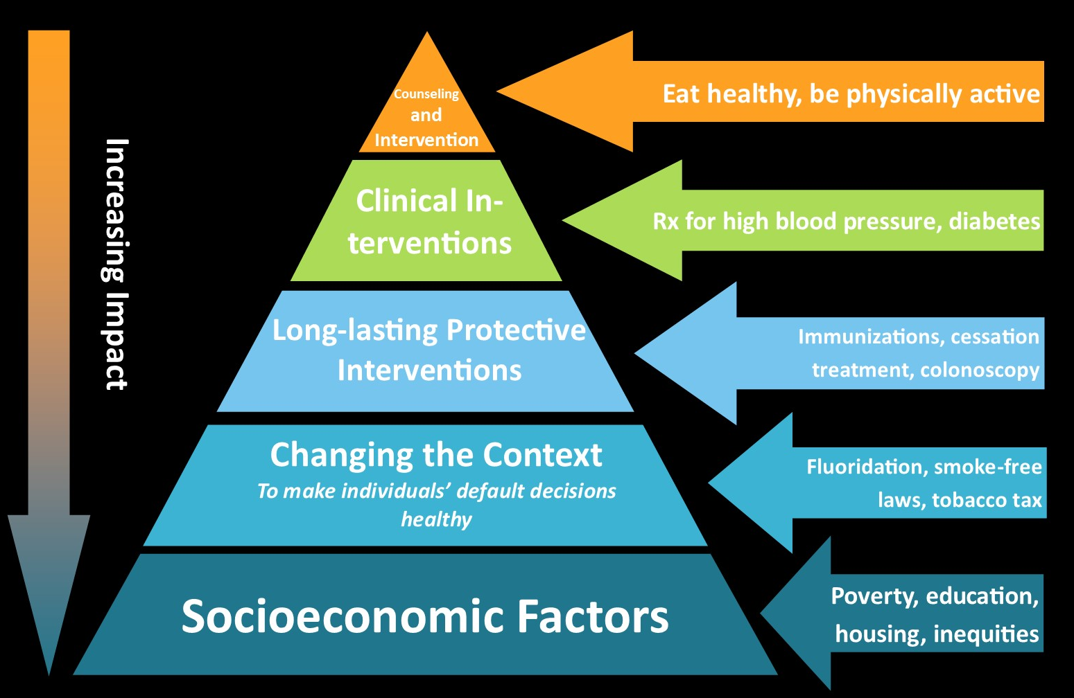
Health Impact Pyramid
Source: CDC, Frieden, T. A Framework for Public Heath Action: The Health Impact Pyramid. Am J Public Health. 2010; April; 100(4): 590–595.
Notes:
3
“A 5-tier pyramid best describes the impact of different types of public health interventions and provides a framework to improve health. At the base of this pyramid, indicating interventions with the greatest potential impact, are efforts to address socioeconomic determinants of health. In ascending order are interventions that change the context to make individuals' default decisions healthy, clinical interventions that require limited contact but confer long-term protection, ongoing direct clinical care, and health education and counseling.
Interventions focusing on lower levels of the pyramid tend to be more effective because they reach broader segments of society and require less individual effort. Implementing interventions at each of the levels can achieve the maximum possible sustained public health benefit.”

Slide 4
Policy, Systems, and Environmental Change
Change Policies
Change the Environment around You
Change Systems and How They Work
Policies at the legislative or organizational level | Change made to the physical environment (or social / economic factors) | Changes made to the rules within an organization; often focuses on changing infrastructure or instituting processes or procedures
Ex: locality cigarette tax (P) or organizational tobacco-free policy (p) | Ex: installing bike signage for bike routes or sidewalk installation and pedestrian friendly intersections to promote walking and biking | Ex: creating a certification process for school bake sales to ensure they are in line with school wellness policy
Notes:
4
Traditional approach: education and counseling for individual behavior change. Per RWJF, policy, systems and environmental change approaches seek to go beyond programming and into the systems that create the structures in which we work, live and play. These approaches often work hand‐in‐hand where, for example, an environmental change may be furthered by a policy or system change. Similarly a policy could be put in place that results in additional environmental changes. The process is not linear. At the end of the day, an effective PSE approach should seek to reach populations and uncover strategies for impact that are sustainable. Efforts may accelerate the adoption or implementation of effective interventions by effectively integrating approaches into existing infrastructures. Such approaches often include advocates, decision and policy makers. Characteristics:
Ongoing
Foundational: often produces behavior change over time
Community/Population level
Part of an ongoing plan
Long term
Sustaining

Slide 5
The Social Ecological Model
Society/ Public Policy
Organizational
Interpersonal
Individual
Community
Local, state, national, and international laws/policies
Cultural values and norms, built environment, media, coalitions, associations, neighborhoods
Schools, work, faith-based, community clinics, agencies
Adapted from McLeroy, K. R., Steckler, A. and Bibeau, D. (Eds.) (1988). The social ecology of health promotion interventions. Health Education Quarterly, 15(4):351-377.
Families, friends, social networks and support systems, peers, CHWs
knowledge, attitudes, behaviors
Notes:
Social Ecological Model (SEM)
The Social Ecological Model (SEM) is a theory-based framework for understanding the multifaceted and interactive effects of personal and environmental factors that determine behaviors, and for identifying behavioral and organizational leverage points and intermediaries for health promotion within organizations. There are five nested, hierarchical levels of the SEM: Individual, interpersonal, community, organizational, and policy/enabling environment (Figure 1). Table 1 provides a brief description of each of the SEM levels. The most effective approach to public health prevention and control uses a combination of interventions at all levels of the model.
This model considers the complex interplay between individual, interpersonal, community, and societal factors. The overlapping rings in the model illustrate how factors at one level influence factors at another level. Besides helping to clarifying these factors, the model also suggests that to affect prevention, it is necessary to act across multiple levels of the model at the same time. This approach is more likely to sustain prevention efforts over time than any single intervention.

Slide 6
Primary, Secondary, and Tertiary Prevention

Slide 7
Group Discussion by MAPP Priority
Activity 1 (20-25 minutes):
As a group, brainstorm as many current community practices (programs, initiatives, activities) as you can think of that are occurring in our community related to your group’s MAPP priority /topic area.
Write each item down on a separate sticky note.
Discuss and place sticky notes on the health impact pyramid poster – where are most of the sticky notes clustered? Are there any gaps?
Activity 2 (15-20 minutes):
As a group, transition to policy, systems, and environmental change poster. Brainstorm as many policy changes as you can think of related to your priority. Repeat for systems and environmental changes.
Write each item down on a separate sticky note.
Place sticky notes under policy, environmental, or systems change on the poster.

Slide 8
Go-To Community Health Sources (Literature)
The CDC CHI Navigator: www.cdc.gov/CHInav— includes a database of Interventions related to these action areas.
Robert Wood Johnson County Health Rankings, What Works for Health: http://www.countyhealthrankings.org/take-action-to-improve-health/what-works-for-health
CDC (various) (e.g. equity and chronic disease): https://www.cdc.gov/nccdphp/dnpao/state-local-programs/health-equity-guide/index.htm
The Community Guide: https://www.thecommunityguide.org/
CDC’s HI-5 (Health Impact in 5 Years): https://www.cdc.gov/policy/hst/hi5/index.html
CDC’s 6/18 Initiative: https://www.cdc.gov/policy/hst/hi5/index.html
Healthy People 2020: https://www.healthypeople.gov/2020/topics-objectives

Slide 9
Go-To Community Health Sources (Community/People)

Slide 10
Homework
Do research:
Consult colleagues, review the literature, research the evidence base and promising practices for your priority area.
Come back in February ready to discuss and share.

Slide 11
2019 MAPP2Health
Putnam Ivey, Healthy Communities Coordinator
Thomas Jefferson Health District
434-972-6241
putnam.ivey@vdh.virginia.gov
Questions?

