Slide 1
MAPP2Health Fluvanna County Data Profile
Notes:
Who has heard of MAPP before?
Who has participated directly in MAPP groups before?
IAC—interagency council

Slide 2
What do you see?
Spend 5-7 minutes walking around and looking at the data posters. Add your stars:
Blue = What stands out to you?
Green = Do you see any differences in the data (better/worse outcomes) by geography, race, age, gender, etc.?
Yellow = Is there a topic where you’d like to see more data or have more discussion?

Slide 3
MAPP Data Available Online: https://public.tableau.com/profile/thomas.jefferson.health.district#!/
Mapping the Prevalence of Obesity in TJHD (2014-2016)
Life Expectancy Estimates at Birth by Census Tract (2008-2012)
Notes:
5

Slide 4
Promote Heathy Eating and Active Living

Slide 5
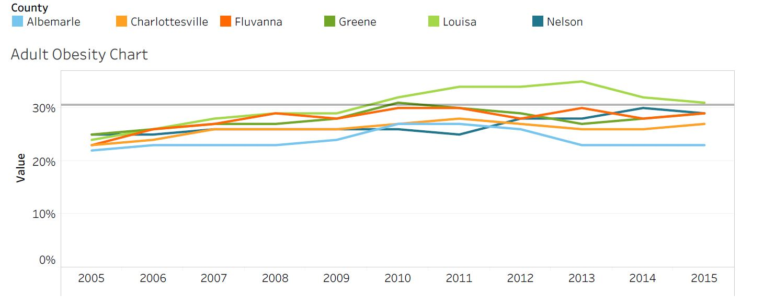
Percent of Obese Adults by TJHD Locality, 2005-2015.
Source: Robert Wood Johnson Foundation (RWJF), County Health Rankings, 2018.
Healthy People 2020 Benchmark = 30.5%
Notes:
Fluvanna has experienced a slight increase in adult obesity since 2005, increasing by 6% (although still below the national HP2020 target). Most recent year of data is 2015 as it lags behind a few years from collection to publication.

Slide 6
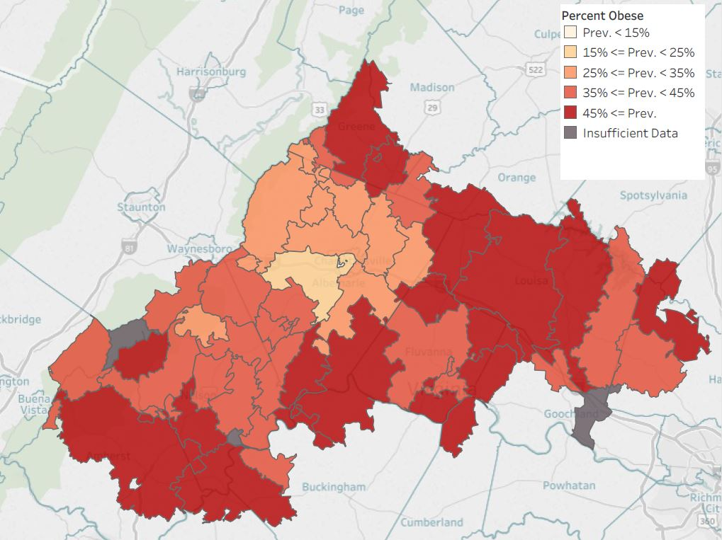
Percent of Obese Adults
by TJHD Zip Code Tabulation Area, 2016.
Source: Translational Health Research Institute of Virginia (UVA Clinical Data Repository), 2017.
Notes:
Mapping obesity across the district. Darker red = higher prevalence of obesity (45%+) and yellow-white is the lower (less than 15%). Parts of Nelson, southern Albemarle that touches Fluvanna, Louisa, and Greene counties have the areas of darkest red.
LIMITATION: UVA outpatient data only; so doesn’t necessarily reflect the entire population (but it has an n of ~200,000 versus the County Health Rankings/BRFSS data n for the district is in the hundreds)
GS Note: these are mapped by Zip Code Tabulation Area (ZCTAs) which sometimes cross county lines.

Slide 7
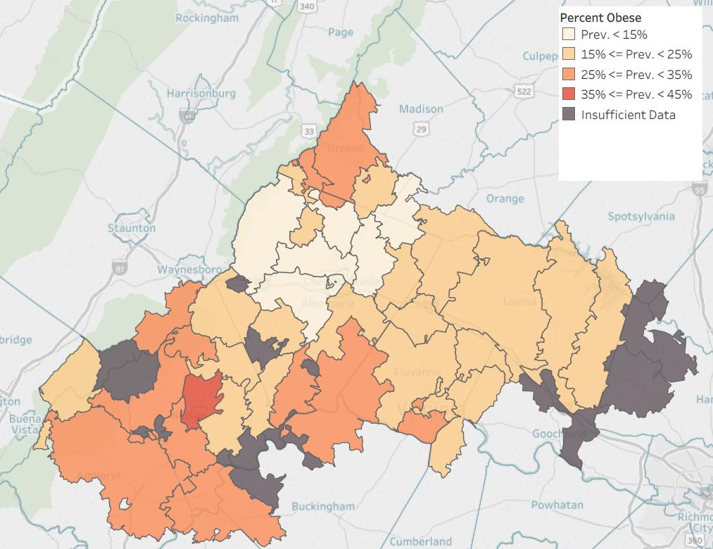
Percent of Obese Children
by TJHD Zip Code Tabulation Area, 2016.
Source: Translational Health Research Institute of Virginia (UVA Clinical Data Repository), 2017.
Notes:
Mapping obesity across the district. This is for children instead of adults. As you can see from the dark gray areas, not enough data for several areas (that is, less children seen at UVA outpatient clinics across the district).

Slide 8
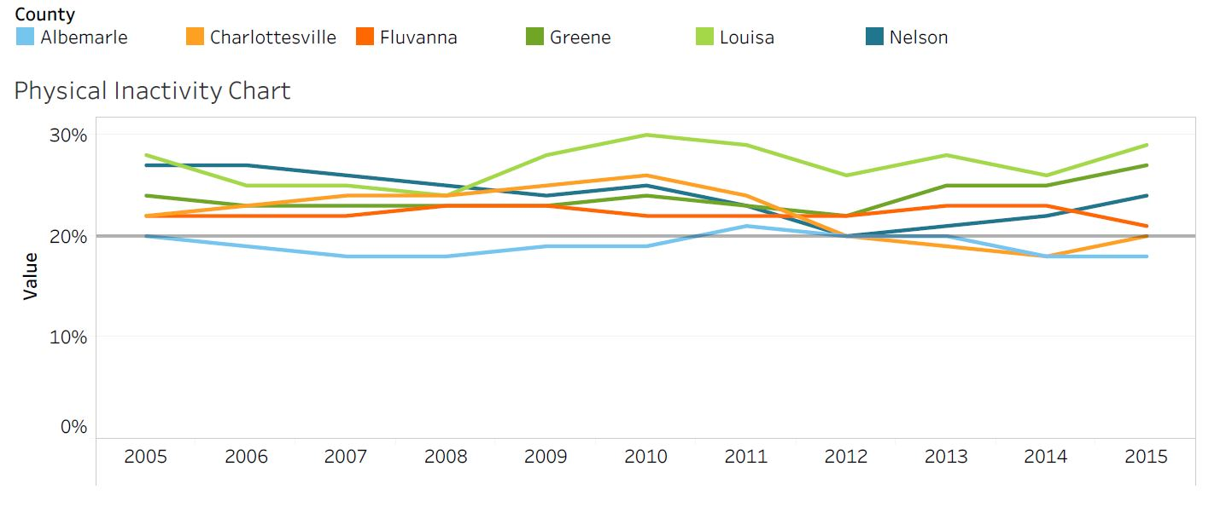
Percent of Adult Physical Inactivity, by TJHD Locality, 2005-2015.
Source: Robert Wood Johnson Foundation (RWJF), County Health Rankings, 2018.
VA Plan for Well-Being Target = 20%
Notes:
Fluvanna has stayed around 22% physical activity—has met the VA plan for well-being target

Slide 9
What Prevents You from Exercising, by TJHD Locality, 2018.
Source: UVA Center for Survey Research and the Thomas Jefferson Health District, Community Health Survey, 2019.

Slide 10
Access to Exercise Opportunities, by TJHD Locality, 2014 & 2016.
Source: Robert Wood Johnson Foundation (RWJF), County Health Rankings, 2018.
Notes:
Since 2014, Fluvanna has increased availability of access to exercise opportunities
Question: do you all know if a new park or community center or YMCA opened between 2014 and 2016?

Slide 11
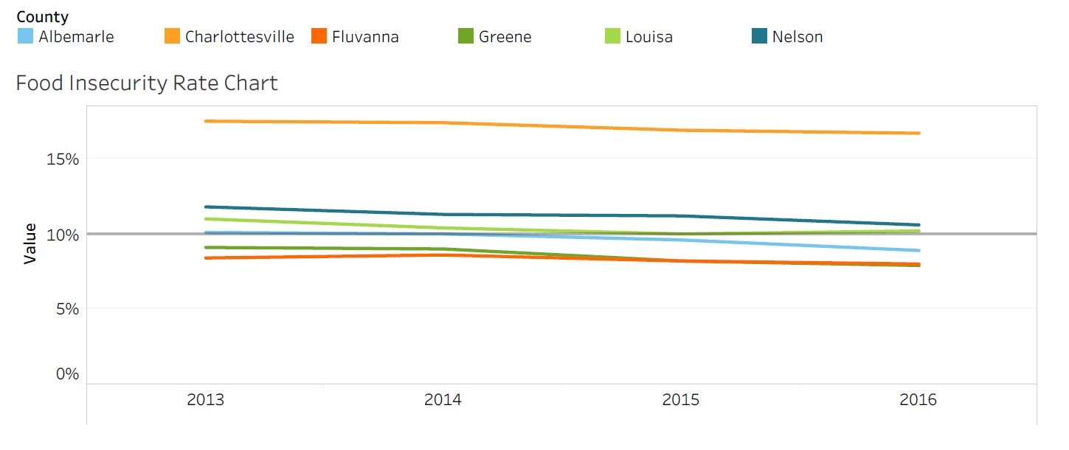
Food Insecurity, by TJHD Locality, 2013-2016. Source: Map the Meal Gap, Feeding America, 2018.
Notes:
Within this 3 year timeframe, Fluvanna has remained around 8% of people experiencing food insecurity

Slide 12
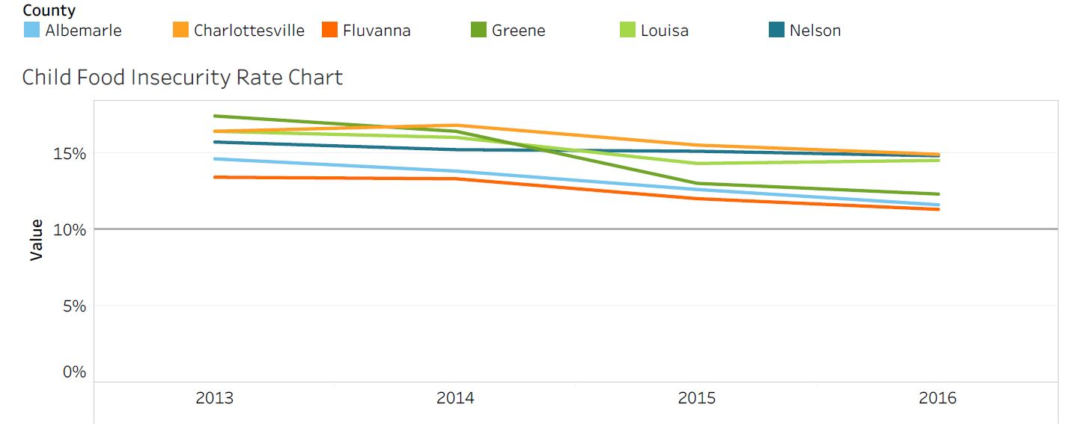
Child Food Insecurity, by TJHD Locality, 2013-2016. Source: Map the Meal Gap, Feeding America, 2018.
Notes:
Fluvanna has experienced a 2% decrease in child food insecurity within the 3 year time frame (and has the lowest child food insecurity rate in the district)

Slide 13
Address Mental Health & Substance Use

Slide 14
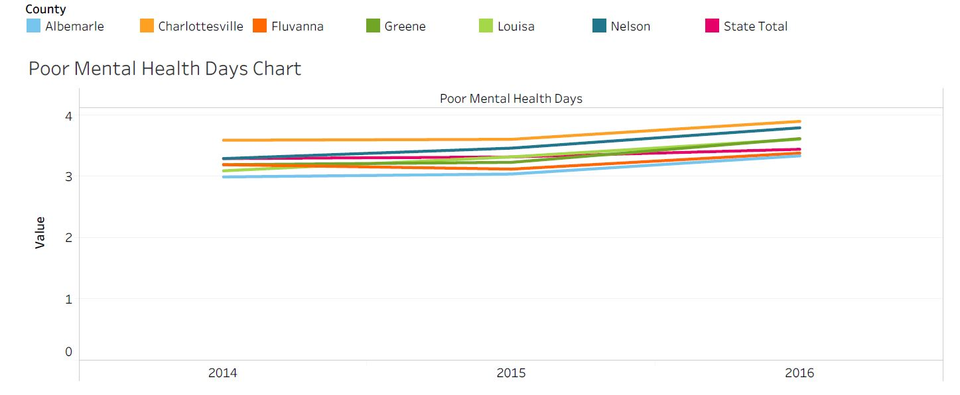
Poor Mental Health Days, by TJHD Locality, 2014-2016. Source: County Health Rankings, 2018.
Notes:
Important measure because an increase in poor mental health days increases risk for development of depression
https://www.ncbi.nlm.nih.gov/pmc/articles/PMC3133938/

Slide 15
Unable to Get Necessary Mental Healthcare, by TJHD Locality, 2018. Source: UVA Center for Survey Research and the Thomas Jefferson Health District, Community Health Survey, 2019.

Slide 16
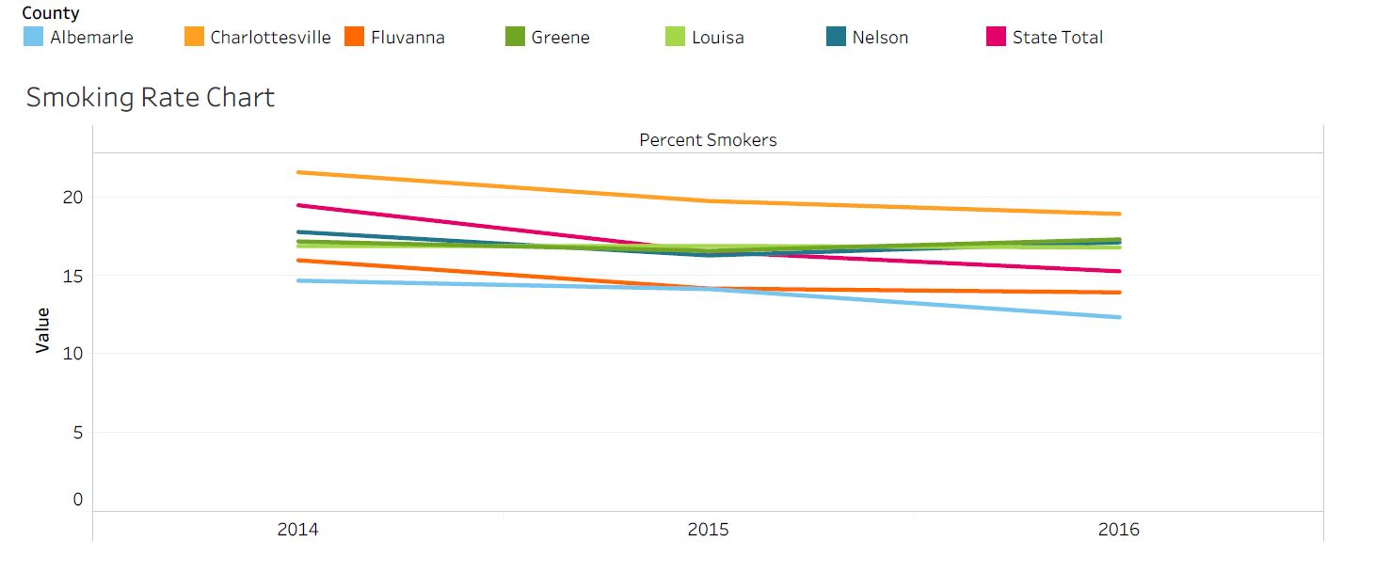
Percent of Adults Smokers, by TJHD Locality, 2014-2016. Source: County Health Rankings, 2018.
Notes:
Fluvanna experienced a 2% decrease in smoking rates and is the second lowest rate in the district

Slide 17
TJHD Overdose Mortality Rates (per 100,000 residents), TJHD and TJHD Localities, 2011-2017 & 2017. Source: Virginia Department of Health, Opioid Addiction Dashboard, 2018 (http://www.vdh.virginia.gov/data/opioid-overdose).
Fluvanna Overdose Mortality Rate, 2011-2017
TJHD Overdose Mortality Rates, by TJHD Locality, 2017
Fluvanna NAS Rate, 2011-2017
Notes:
Case counts between 1 and 4 are suppressed. Use caution when interpreting rates for localities with small populations.
NAS—group of conditions caused when a baby withdraws from certain drugs he’s exposed to in the womb before birth—most often caused by opioids
Fluvanna rate has increased from 3.6 to 11.9 cases per 100,000 people compared to the state rate in 2016 at 6.7
Overdose rates for Fluvanna County in 2017 was 3.8 for both Fentanyl/Heroin and Prescription Opioids

Slide 18
Fluvanna Rate Summary by Age Groups, Rates per 100,000 Residents, 2017. Source: Virginia Department of Health, Opioid Addiction Dashboard, 2018 (http://www.vdh.virginia.gov/data/opioid-overdose).
Overdose Deaths |  |  | ED Visits for Overdose
Age Group | Fentanyl and/or Heroin Overdose | Prescription Opioid Overdose | ED Heroin Overdose | ED Opioid Overdose
0–14 | 0.0 | 0.0 | 0.0 | 67.9
15–24 | 0.0 | 0.0 | 34.9 | 139.7
25–34 | 34.3 | 34.3 | 68.5 | 171.4
35–44 | 0.0 | 0.0 | 29.0 | 29.0
45–54 | 0.0 | 0.0 | 0.0 | 79.7
55–64 | 0.0 | 0.0 | 0.0 | 53.2
65+ | 0.0 | 0.0 | 0.0 | 19.6
All Ages | 3.8 | 3.8 | 15.2 | 72.3
Notes:
Age groups most at risk for overdose deaths and ED visits are between the ages 15 and 54 years old

Slide 19
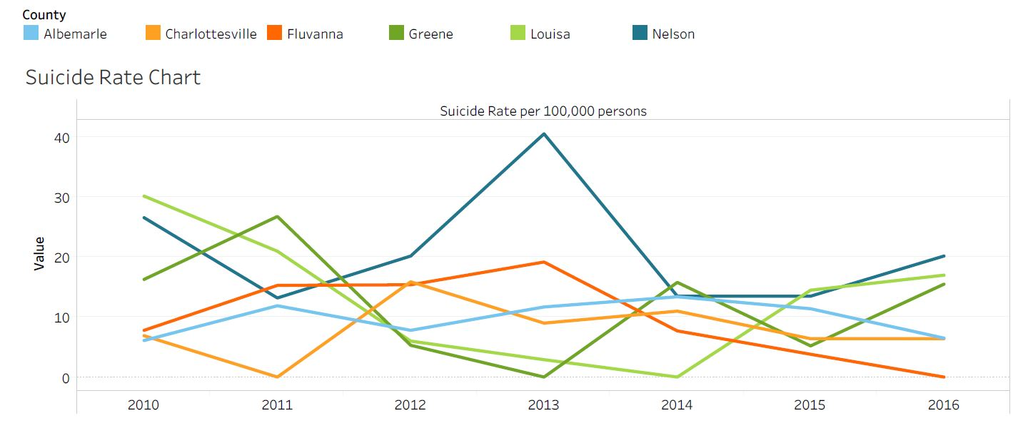
Suicide Rate per 100,000 population, by TJHD Locality, 2010-2016. Source: Office of the Chief Medical Examiner, Virginia Department of Health, 2018.
Notes:
Fluvanna had the third lowest suicide rate in TJHD, after Charlottesville and Albermarle, in 2011 with a rate of 7.8 per 100,000 people
Since 2013 there has been a significant decrease in suicide rates. From 19.2 in 2013 to no suicides in 2016.

Slide 20
Increase Access to Care and Reduce Health Disparities

Slide 21
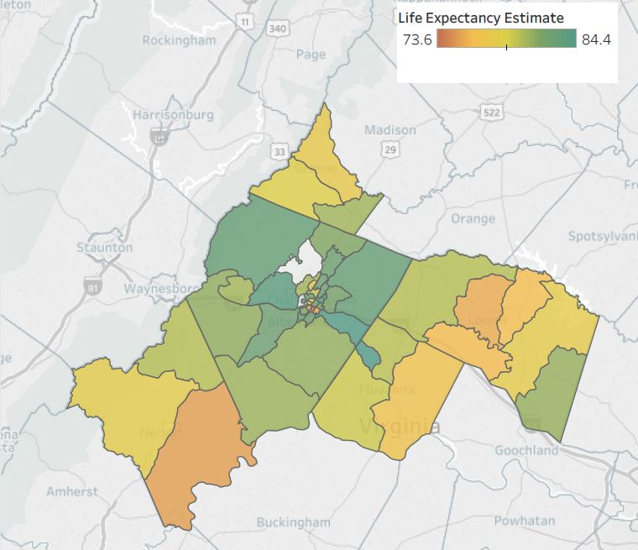
Life Expectancy Estimates at Birth by TJHD Census Tract, 2008-2012. Source: Virginia Department of Health, Office of Vital Records, 2018 and U.S. Census Bureau, 2010 Population Counts, 2018.
Palmyra
Zions Crossroad
Lake Monticello
Kents Store
Fork Union
Columbia
Scottsville
Notes:
The yellow-ish area has a low life expectancy of roughly 77 years
Lighter green indicates a life expectancy around 80 years
The dark green northern part of Fluvanna indicates the highest life expectancy, being ~84 years

Slide 22
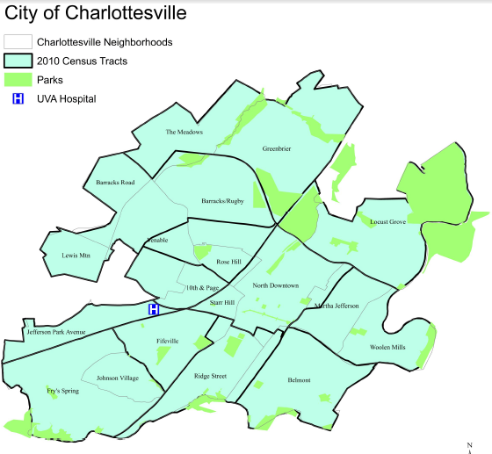
Life Expectancy Estimates (Charlottesville)

Slide 23
Percent of Families Below the Federal Poverty Level, by TJHD Locality, 2008-2016. Source: U.S. Census Bureau, American Community Survey 5-year Estimates, 2018.
Notes:
Since 2008, Fluvanna county has stayed around 6% of families being below the federal poverty line and is the lowest in the district

Slide 24
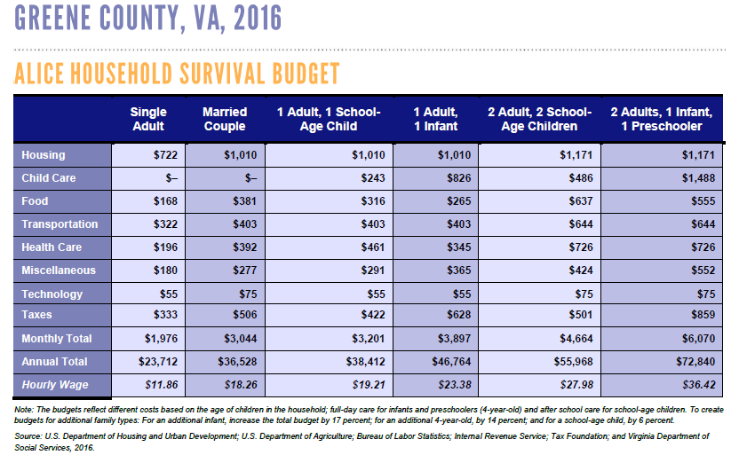
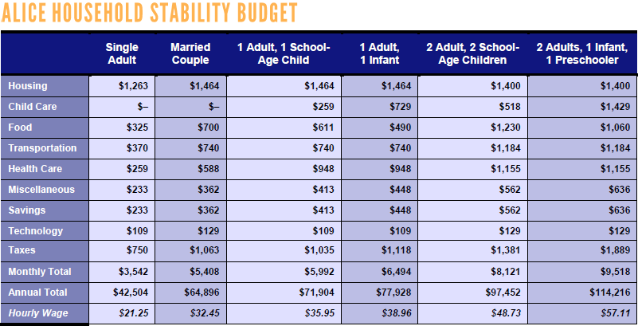
ALICE Cost of Living Estimates, Fluvanna County Survival and Stability Budgets, 2016. (ALICE = Asset Limited, Income Restrained, Employed) Source: United Way, 2018 ALICE Report.
Notes:
The ALICE population represents individuals and families who earn more than the official Federal Poverty Level but less than the basic cost of living. The measure has estimates for housing, childcare, food, transportation, healthcare, tax, and a miscellaneous category. There are estimates for different household and family compositions; there is an estimate for a basic "Survival" budget and a larger "Stability" budget.
W:\Data_TJ Reports\ALICE reports → 2018 Report, look for Fluvanna

Slide 25
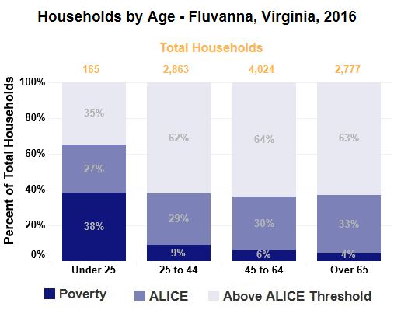
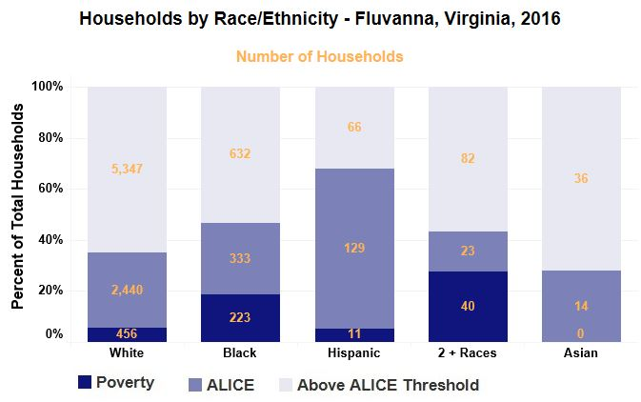
ALICE Cost of Living Estimates, Fluvanna County Households by Age and Race/Ethnicity, 2016. Source: United Way, 2018 ALICE Report.
Notes:
The majority of households living in poverty are under 25 years of age
Even with smaller population sizes, black and mixed households experience higher levels of poverty

Slide 26
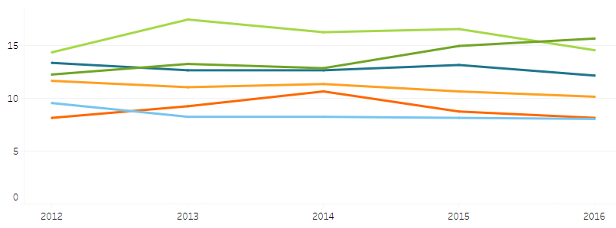
Percent Uninsured, by TJHD Locality, 2012-2016. Source: U.S. Census Bureau, American Community Survey 5-year Estimates, 2018.
Notes:
% of uninsured has remained relatively the same (around 8%) with a slight increase in 2014 (2% increase)
Note: we expect these numbers will change once data are available for post-Medicaid expansion (2019)

Slide 27
Personal Doctor, TJHD Locality, 2018. Source: UVA Center for Survey Research and the Thomas Jefferson Health District, Community Health Survey, 2019.

Slide 28
Unable to Get Necessary Dental Care, TJHD Locality, 2018.
Source: UVA Center for Survey Research and the Thomas Jefferson Health District, Community Health Survey, 2019.

Slide 29
In Past 12 Months Seen a Dentist for Cleaning, TJHD Locality, 2018. Source: UVA Center for Survey Research and the Thomas Jefferson Health District, Community Health Survey, 2019.

Slide 30
Fluvanna Low Birth Weight, by Race. 2008-2016. Source: Virginia Department of Health, Division of Health Statistics, 2018.
Total Low Birth Weight
Black Low Birth Weight
White Low Birth Weight
Notes:
Black low weight births have decreased since 2008. They were a little over 20% and in 2016 there were only ~5% black low births
White low births have remained relatively stable since 2008, being around 6%.

Slide 31
Foster a Healthy and Connected Community for All Ages

Slide 32
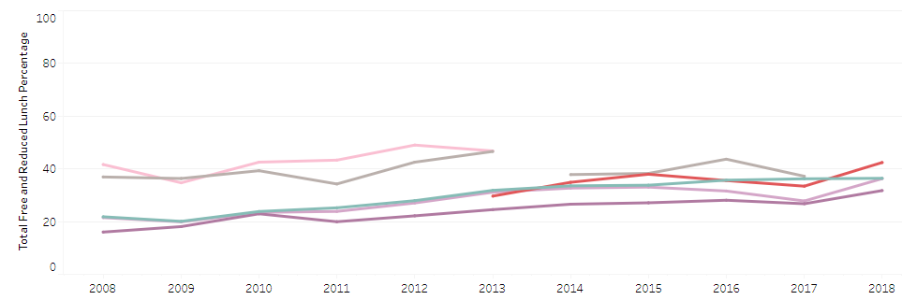
Percent Free and Reduced School Lunch, Fluvanna County Public Schools, 2008-2018. Source: Virginia Department of Education, 2018.
Notes:
Tj tableau

Slide 33
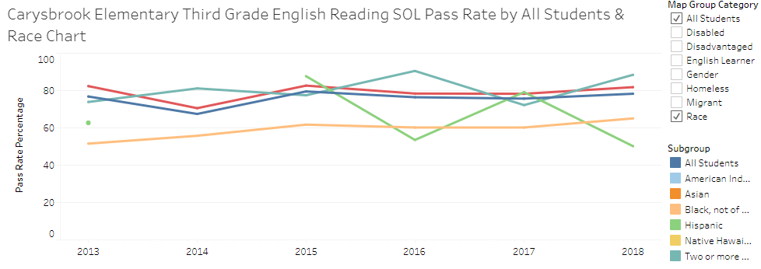
Percent Third Grade English SOL Pass Rate, Carysbrook Elementary School (Fluvanna County), 2008-2018 Class Year. Source: Virginia Department of Education, 2018.

Slide 34
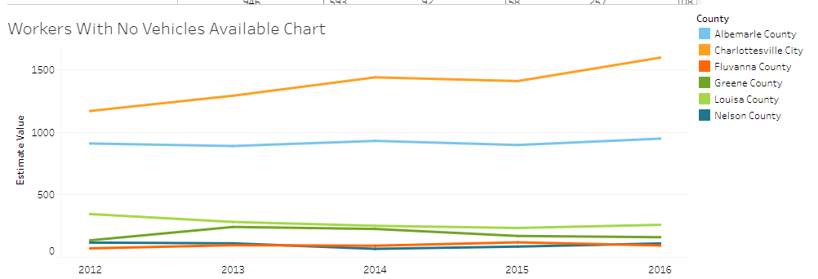
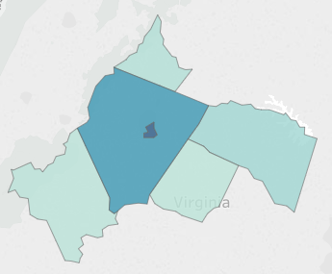
Workers with No Vehicle Available, TJHD Localities, 2012-2016. Source: U.S. Census Bureau, American Community Survey 5-year Estimates, 2018.

Slide 35
2019 MAPP2Health
Questions?
Guleer Shahab, Data Analyst
Thomas Jefferson Health District
434-422-3214
guleer.shahab@vdh.virginia.gov

