Slide 1
MAPP2Health Thomas Jefferson Health District Data Profile

Slide 2
What do you see?
Spend 5-7 minutes walking around and looking at the data posters. Add your stars:
Blue = What stands out to you?
Green = Do you see any differences in the data (better/worse outcomes) by geography, race, age, gender, etc.?
Yellow = Is there a topic where you’d like to see more data or have more discussion?

Slide 3
MAPP Data Available Online: https://public.tableau.com/profile/thomas.jefferson.health.district#!/
Mapping the Prevalence of Obesity in TJHD (2014-2016)
Life Expectancy Estimates at Birth by Census Tract (2008-2012)

Slide 4
Promote Heathy Eating and Active Living

Slide 5
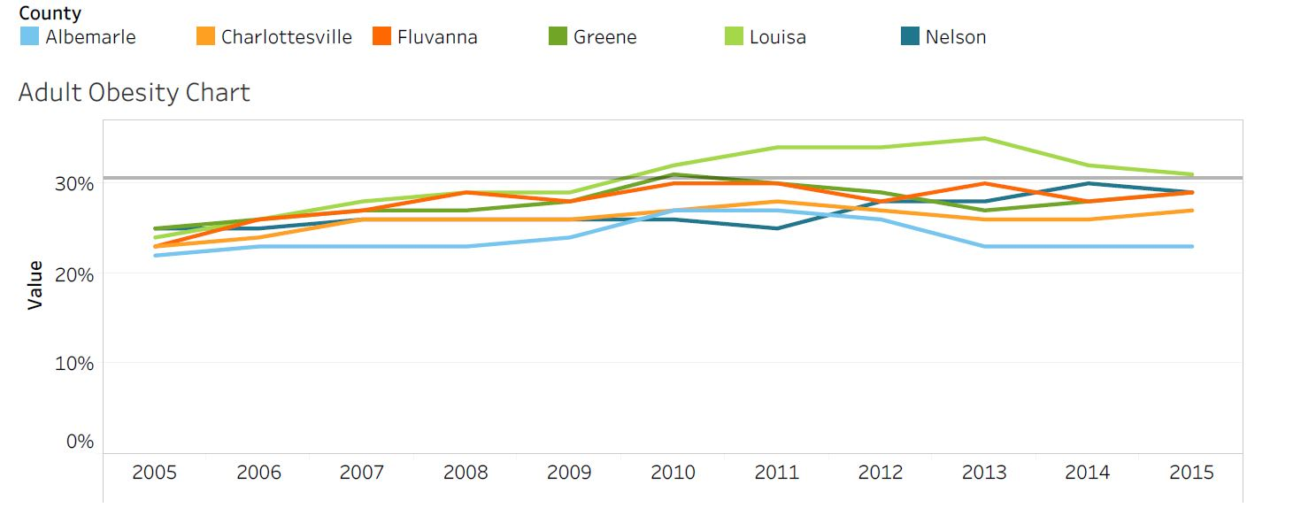
Percent of Obese Adults by TJHD Locality, 2005-2015.
Source: Robert Wood Johnson Foundation (RWJF), County Health Rankings, 2018.
Healthy People 2020 Benchmark = 30.5%
Notes:
All the localities except for Louisa County met the HP 2020 benchmark in 2015
However, across all the localities there has been a slight increase in adult obesity

Slide 6
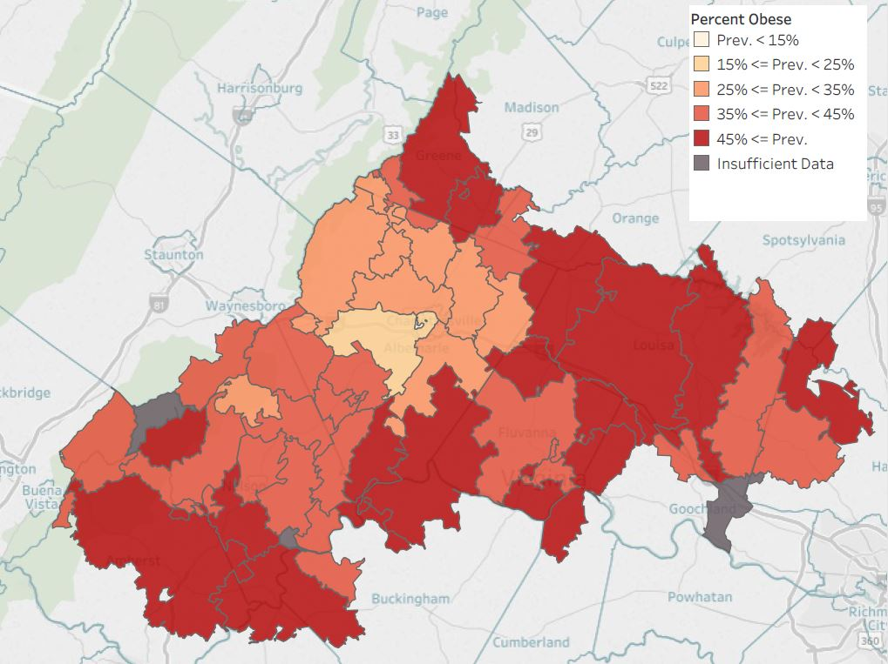
Percent of Obese Adults
by TJHD Zip Code Tabulation Area, 2016.
Source: Translational Health Research Institute of Virginia (UVA Clinical Data Repository), 2017.
Notes:
Mapping obesity across the district. Darker red = higher prevalence of obesity (45%+) and yellow-white is the lower (less than 15%). Parts of Nelson, southern Albemarle that touches Fluvanna, Louisa, and Greene counties have the areas of darkest red.
LIMITATION: UVA outpatient data only; so doesn’t necessarily reflect the entire population (but it has an n of ~200,000 versus the County Health Rankings/BRFSS data n for the district is in the hundreds)
Note: these are mapped by Zip Code Tabulation Area (ZCTAs) which sometimes cross county lines.

Slide 7
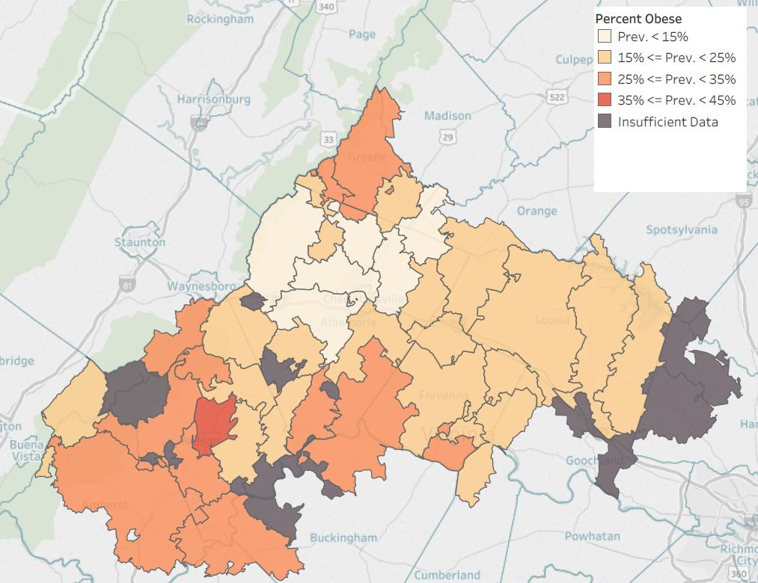
Percent of Obese Children
by TJHD Zip Code Tabulation Area, 2016.
Source: Translational Health Research Institute of Virginia (UVA Clinical Data Repository), 2017.
Notes:
Mapping obesity across the district. This is for children instead of adults. As you can see from the dark gray areas, not enough data for several areas (that is, less children seen at UVA outpatient clinics across the district)

Slide 8
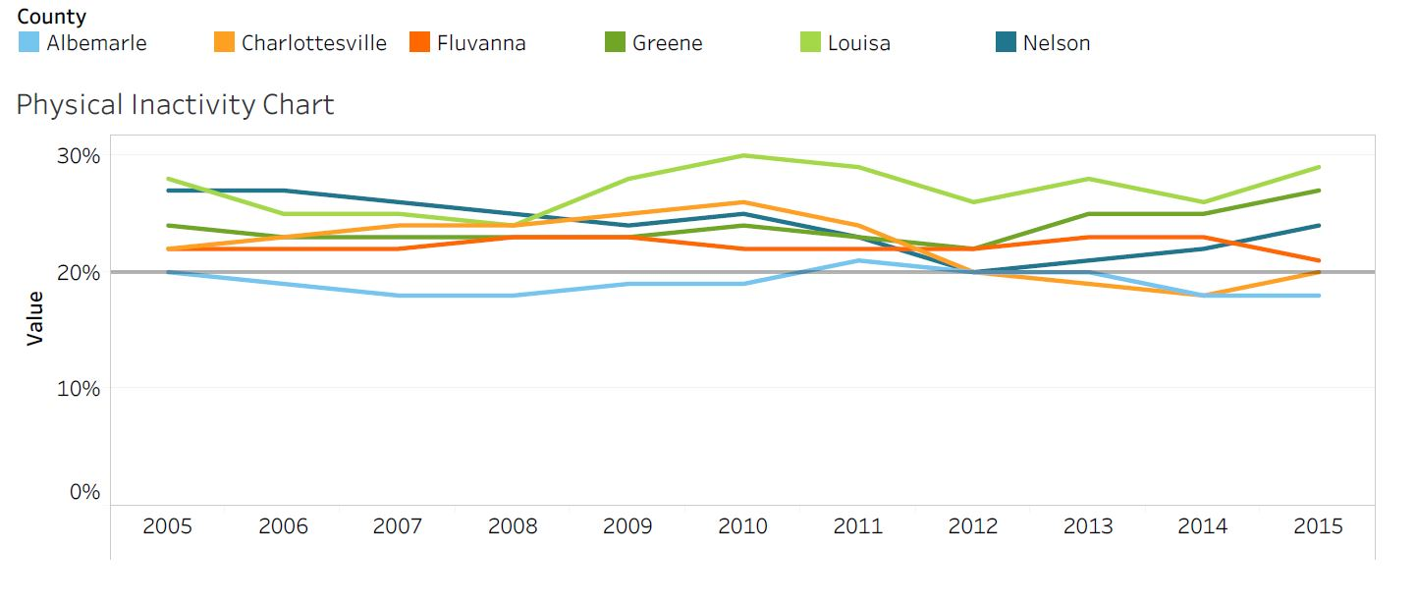
Percent of Adult Physical Inactivity, by TJHD Locality, 2005-2015.
Source: Robert Wood Johnson Foundation (RWJF), County Health Rankings, 2018.
VA Plan for Well-Being Target = 20%
Notes:
Most of the localities do NOT meet the VA plan for well-being—in 2015 Albemarle county was the only locality that met the target

Slide 9
What Prevents You from Exercising, by TJHD Locality, 2018.
Source: UVA Center for Survey Research and the Thomas Jefferson Health District, Community Health Survey, 2019.
Notes:
The top reason across all localities is reporting having no time and health reasons
What, if anything, prevents you from exercising?

Slide 10
Access to Exercise Opportunities, by TJHD Locality, 2014 & 2016.
Source: Robert Wood Johnson Foundation (RWJF), County Health Rankings, 2018.
Notes:
Besides in Charlottesville, less than 80% of people report having access to exercise opportunities

Slide 11
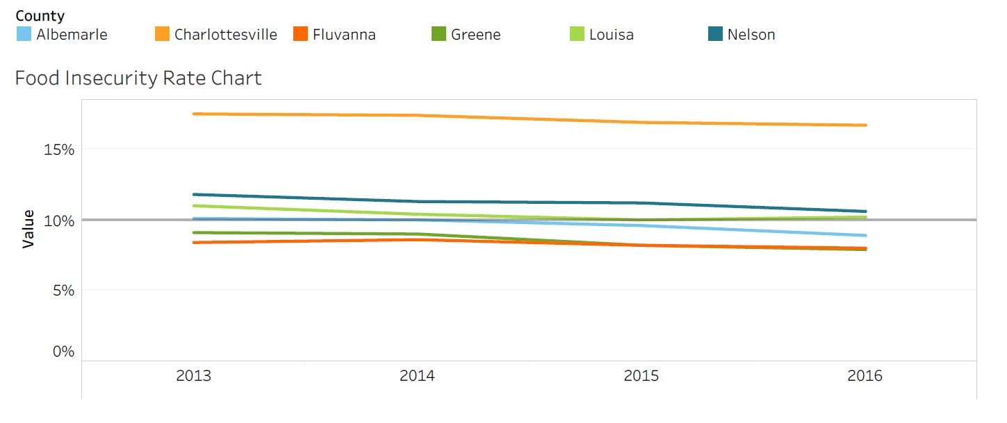
Food Insecurity, by TJHD Locality, 2013-2016. Source: Map the Meal Gap, Feeding America, 2018.
VA Plan for Well-Being Target = 10%
Notes:
Louisa, Nelson, and Charlottesville do not meet the VA target for food insecurity and all have percent's higher than 10%
Food insecurity: lack of access, at times, to enough food for an active, healthy life for all household members and limited or uncertain availability of nutritionally adequate foods. May not always experience food insecurity—may also reflect a households need to make trade-off’s between important basic needs, such as housing or medical bills, and purchasing nutritionally adequate foods.

Slide 12
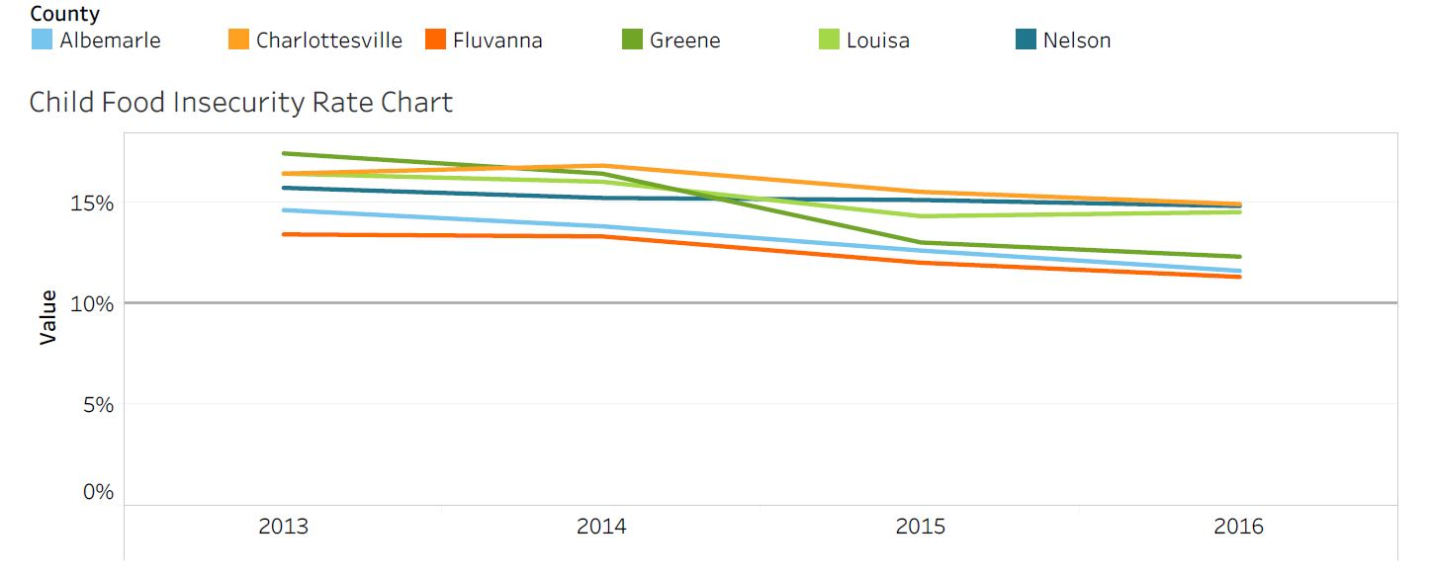
Child Food Insecurity, by TJHD Locality, 2013-2016. Source: Map the Meal Gap, Feeding America, 2018.
VA Plan for Well-Being Target = 10%
Notes:
No locality meets the VA plan for well-being target of decreasing child food insecurity to equal to or less than 10%

Slide 13
Address Mental Health & Substance Use

Slide 14
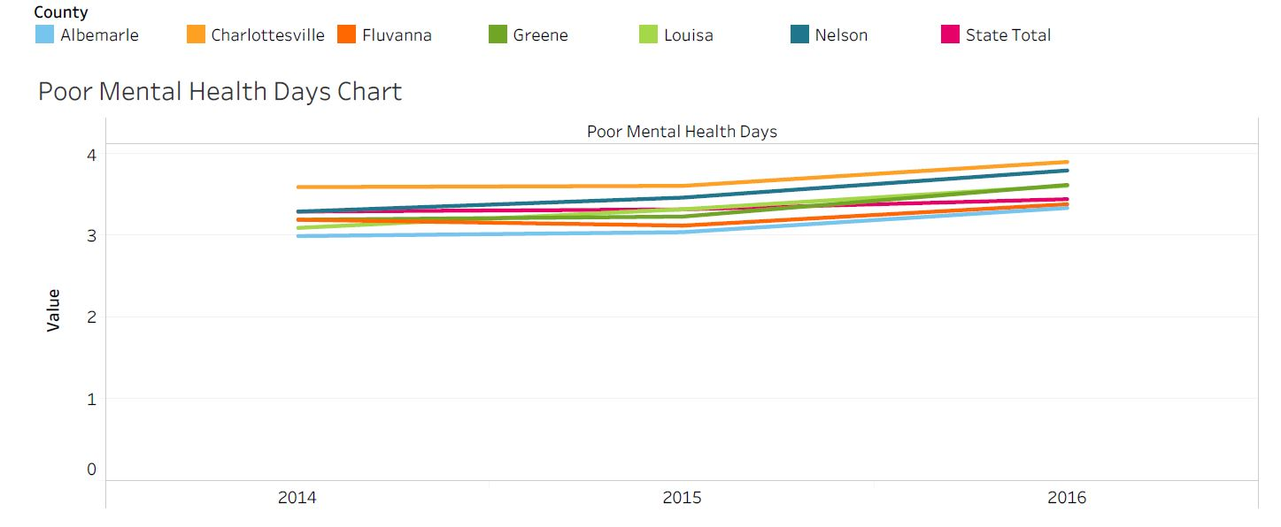
Poor Mental Health Days, by TJHD Locality, 2014-2016. Source: County Health Rankings, 2018.
Notes:
Important measure because an increase in poor mental health days increases risk for development of depression—includes reporting days where mental health isn’t good, including stress and problems with emotions
The number of poor mental health days in Louisa has been steadily increasing
In 2016, only Albemarle and Fluvanna has lowers rates of poor mental health days than the state
https://www.ncbi.nlm.nih.gov/pmc/articles/PMC3133938/

Slide 15
Unable to Get Necessary Mental Healthcare, by TJHD Locality, 2018. Source: UVA Center for Survey Research and the Thomas Jefferson Health District, Community Health Survey, 2019.
Question
Notes:
Over 80% of people in all localities reported they were able to get necessary mental healthcare

Slide 16
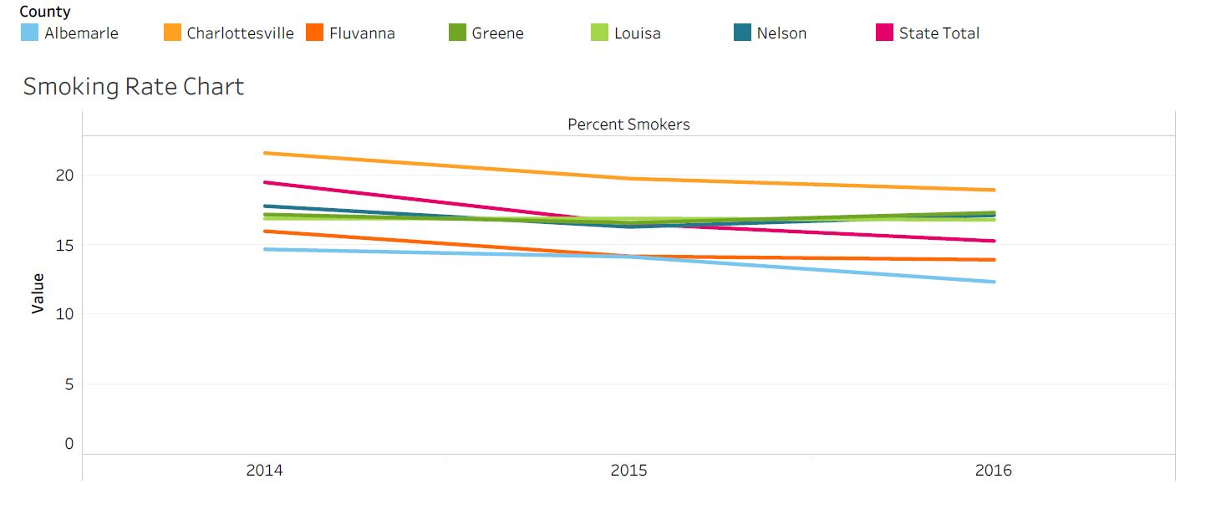
Percent of Adults Smokers, by TJHD Locality, 2014-2016. Source: County Health Rankings, 2018.
Notes:
Fluvanna and Albemarle are the only localities that have a lower percent of adult smokers—Charlottesville has consistently had the highest percent of adult smokers

Slide 17
TJHD Opioid Addiction Indicators (per 100,000 residents), TJHD and TJHD Localities, 2011-2017 & 2017. Source: Virginia Department of Health, Opioid Addiction Dashboard, 2018 (http://www.vdh.virginia.gov/data/opioid-overdose).
TJHD Overdose Mortality Rate, 2011-2017
TJHD Overdose Mortality Rates, by TJHD Locality, 2017, 2017
TJHD NAS Rate, 2011-2017
Notes:
Fentanyl/Heroin overdose rate is higher than the opioid overdose rate in the district, 5.6 compared to 2.4
NAS—group of conditions caused when a baby withdraws from certain drugs he’s exposed to in the womb before birth—most often caused by opioids
TJHD NAS rate is only slightly lower than the state rate, 6.7 vs 6.3

Slide 18
TJHD Rate Summary by Age Groups, Rates per 100,000 Residents, 2017. Source: Virginia Department of Health, Opioid Addiction Dashboard, 2018 (http://www.vdh.virginia.gov/data/opioid-overdose).
Overdose Deaths |  |  | ED Visits for Overdose
Age Group | Fentanyl and/or Heroin Overdose | Prescription Opioid Overdose | ED Heroin Overdose | ED Opioid Overdose
0–14 | 0.0 | 0.0 | 0.0 | 51.5
15–24 | 2.7 | 2.7 | 21.3 | 159.9
25–34 | 17.7 | 8.8 | 67.7 | 161.9
35–44 | 17.3 | 0.0 | 44.9 | 148.4
45–54 | 3.1 | 0.0 | 21.7 | 121.1
55–64 | 3.0 | 3.0 | 5.9 | 82.7
65+ | 0.0 | 2.4 | 4.7 | 42.7
All Ages | 5.6 | 2.4 | 22.0 | 105.8
Notes:
Age groups most at risk for overdose deaths AND ED visits are between the ages 25 and 34 years old
Although the mortality rate for fentanyl/heroin is higher in the district, there is a higher rate of ED visits for opioid overdoses

Slide 19
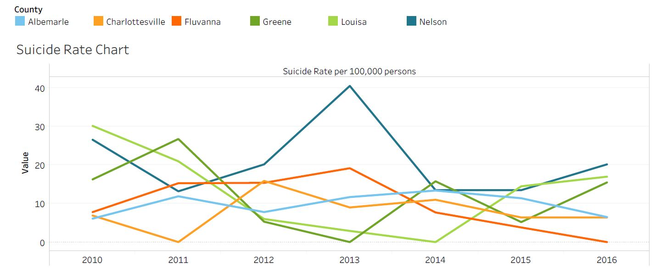
Suicide Rate per 100,000 population, by TJHD Locality, 2010-2016. Source: Office of the Chief Medical Examiner, Virginia Department of Health, 2018.
Notes:
Suicide rates in the district were anywhere between 0-20%

Slide 20
Increase Access to Care and Reduce Health Disparities

Slide 21
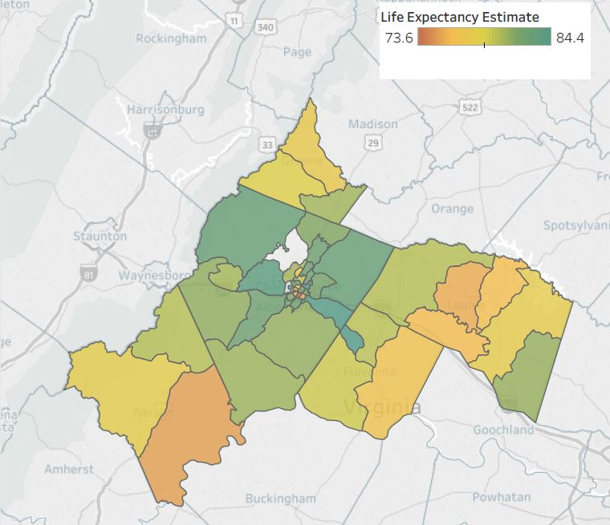
Life Expectancy Estimates at Birth by TJHD Census Tract, 2008-2012. Source: Virginia Department of Health, Office of Vital Records, 2018 and U.S. Census Bureau, 2010 Population Counts, 2018.
Notes:
Albemarle County has the highest life expectancy rates out of all the localities ~84 years of age and Charlottesville has the lowest life expectancy ~73.6
The highest life expectancy in Louisa is ~80 years, which relative to the district is fairly low—the Albemarle, Charlottesville, and Fluvanna all have life expectancy estimates that are higher
The other localities range from ~75-82 years of life.

Slide 22
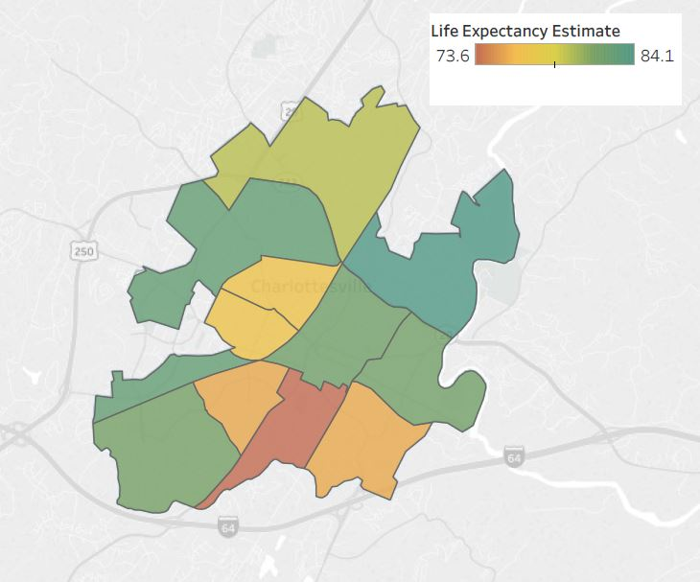
CharlottesvilleLife Expectancy Estimates at Birth by TJHD Census Tract, 2008-2012. Source: Virginia Department of Health, Office of Vital Records, 2018 and U.S. Census Bureau, 2010 Population Counts, 2018.
The Meadows
Greenbrier
Barracks Road
Barracks Rugby
Lewis Mtn
Rose Hill + 10th and Page
Locust Grove
North Downtown
Jefferson Park Avenue
Martha Jefferson
Fifeville
Woolen Mills
Ridge Street
Fry’s Spring
Belmont
Notes:
The lowest life expectancy in Charlottesville is in the Ridge Street area, being ~74 (73.6)—the lowest life expectancy in the entire district
Highest is in Locust Grove: ~84.1
The next lowest is Belmont and Fifeville, being ~76 years of age
Rose Hill Drive + 10th and page have a life expectancy of ~77 years
All other neighborhoods have a life expectancy ~80+ years of age
*mention that this data is centered around 2010 census tract data so spans 2008-2012

Slide 23
Percent of Families Below the Federal Poverty Level, by TJHD Locality, 2008-2016. Source: U.S. Census Bureau, American Community Survey 5-year Estimates, 2018.
Notes:
Charlottesville City has continued to have the highest rate of poverty in the district, followed not so closely by Nelson and Louisa.
Fluvanna and Greene county have the lowest percent of families below the federal poverty level.
Federal poverty level
1 individual: $12,140
Family of 4: $20,780

Slide 24
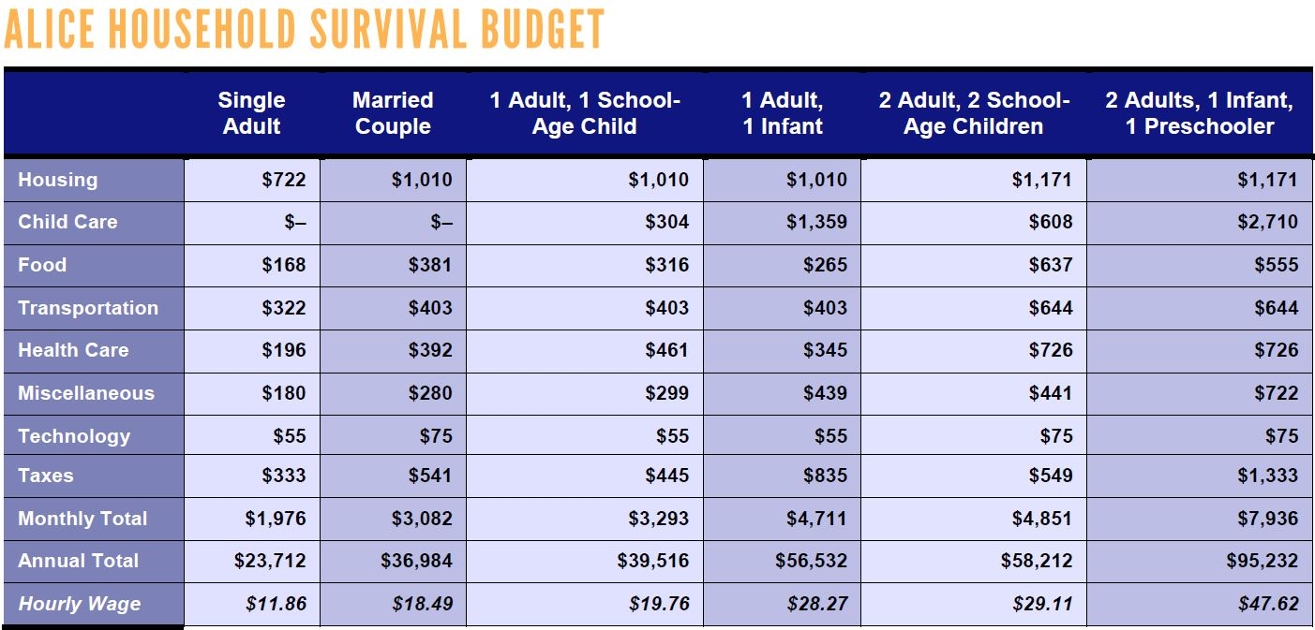
ALICE Cost of Living Estimates, Albemarle County Survival Budgets, 2016. (ALICE = Asset Limited, Income Restrained, Employed) Source: United Way, 2018 ALICE Report.
Notes:
Albemarle County has the highest survival budget for a family of 1 infant and a preschooler—higher than the state rate
The ALICE population represents individuals and families who earn more than the official Federal Poverty Level but less than the basic cost of living. The measure has estimates for housing, childcare, food, transportation, healthcare, tax, and a miscellaneous category. There are estimates for different household and family compositions; there is an estimate for a basic "Survival" budget and a larger "Stability" budget.

Slide 25
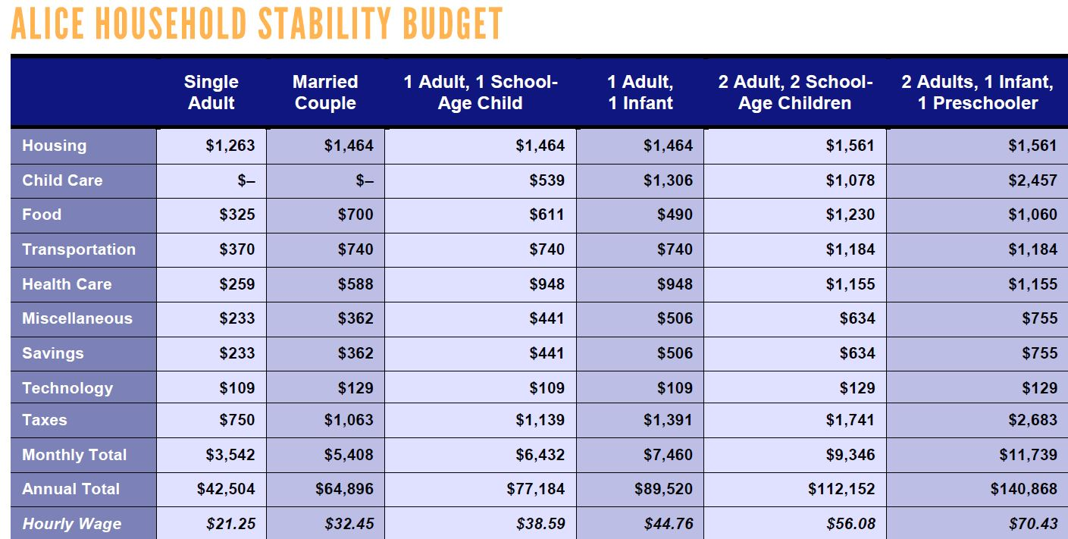
ALICE Cost of Living Estimates, Albemarle County Stability Budgets, 2016. (ALICE = Asset Limited, Income Restrained, Employed) Source: United Way, 2018 ALICE Report.
Notes:
The ALICE population represents individuals and families who earn more than the official Federal Poverty Level but less than the basic cost of living. The measure has estimates for housing, childcare, food, transportation, healthcare, tax, and a miscellaneous category. There are estimates for different household and family compositions; there is an estimate for a basic "Survival" budget and a larger "Stability" budget.

Slide 26
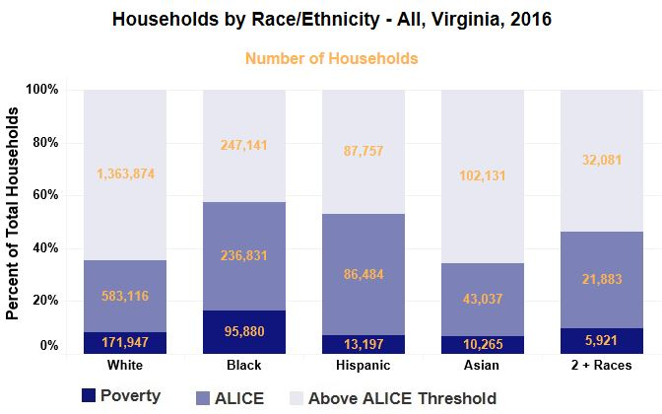
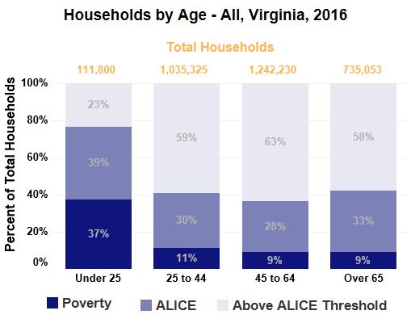
ALICE Cost of Living Estimates, Virginia Households by Age and Race/Ethnicity, 2016. Source: United Way, 2018 ALICE Report.
Notes:
The majority of households living in poverty are under 25 years of age
Even with smaller population sizes, a much larger proportion of Black VA residents are experiencing poverty.
Black, Hispanic, and people that identify as mixed races all have higher proportions of people experiencing poverty than white and Asian residents.

Slide 27
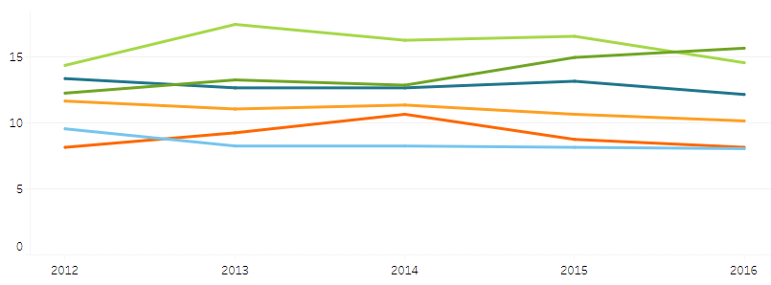
Percent Uninsured, by TJHD Locality, 2012-2016. Source: U.S. Census Bureau, American Community Survey 5-year Estimates, 2018.
Notes:
Louisa was consistently the locality with the highest percent of persons uninsured, but in 2016, there was a slight decrease in % and Greene county is now the highest in the district.
Albemarle and Fluvanna County have the lowest percent of people uninsured.
Note: we expect these numbers will change once data are available for post-Medicaid expansion (2019)

Slide 28
Personal Doctor, TJHD Locality, 2018. Source: UVA Center for Survey Research and the Thomas Jefferson Health District, Community Health Survey, 2019.
Question
Notes:
The lowest percentage of people to report having at least one personal doctor were in Greene and Nelson County.
Do you have one person you can think of as your personal doctor or health care provider?

Slide 29
Unable to Get Necessary Dental Care, TJHD Locality, 2018.
Source: UVA Center for Survey Research and the Thomas Jefferson Health District, Community Health Survey, 2019.
Question
Notes:
A little less than 80% of residents said they are able to get necessary dental care
In the last 12 months, was anyone in your household unable to get necessary dental care or treatment?

Slide 30
In Past 12 Months Seen a Dentist for Cleaning, TJHD Locality, 2018. Source: UVA Center for Survey Research and the Thomas Jefferson Health District, Community Health Survey, 2019.
Question
Notes:
Highest proportion of people reported having not received a cleaning in the past 12 months in Fluvanna and Louisa County
In the past 12 months, have you seen a dentist or dental hygienist for cleaning?

Slide 31
Thomas Jefferson Health District Low Birth Weight, by Race. 2008-2016. Source: Virginia Department of Health, Division of Health Statistics, 2018.
Total Low Birth Weight
Black Low Birth Weight
White Low Birth Weight
Notes:
Since 2008, black low birth weights have experienced less than a 1% decrease.
White low births have experienced a slight decrease since 2008. (~2% decrease)
Black low births are around 4% higher in 2016 compared to white low birth weights.

Slide 32
2019 MAPP2Health
Questions?
Guleer Shahab, Data Analyst
Thomas Jefferson Health District
434-422-3214
guleer.shahab@vdh.virginia.gov

Slide 33
In the last 12 months, was anyone in your household unable to get necessary mental health care or services such as counseling, therapy, and/or psychiatric medication?

Slide 34
Do you have one person you can think of as your personal doctor or health care provider?

Slide 35
In the last 12 months, was anyone in your household unable to get necessary dental care or treatment?

Slide 36
In the past 12 months, have you seen a dentist or dental hygienist for cleaning?

