Slide 1
MAPP2Health Nelson County Data Profile

Slide 2
What do you see?
Spend 10-15 minutes walking around and looking at the data posters. Add your stars:
Blue = What stands out to you?
Green = Do you see any differences in the data (better/worse outcomes) by geography, race, age, gender, etc.?
Yellow = Is there a topic where you’d like to see more data or have more discussion?

Slide 3
What do you see?
Spend 10-15 minutes walking around and looking at the data posters. Add your stars:
Pink = What stands out to you?
Green = Do you see any differences in the data (better/worse outcomes) by geography, race, age, gender, etc.?
Yellow = Is there a topic where you’d like to see more data or have more discussion?

Slide 4
MAPP Data Available Online: https://public.tableau.com/profile/thomas.jefferson.health.district#!/
Mapping the Prevalence of Obesity in TJHD (2014-2016)
Life Expectancy Estimates at Birth by Census Tract (2008-2012)

Slide 5
Promote Heathy Eating and Active Living

Slide 6
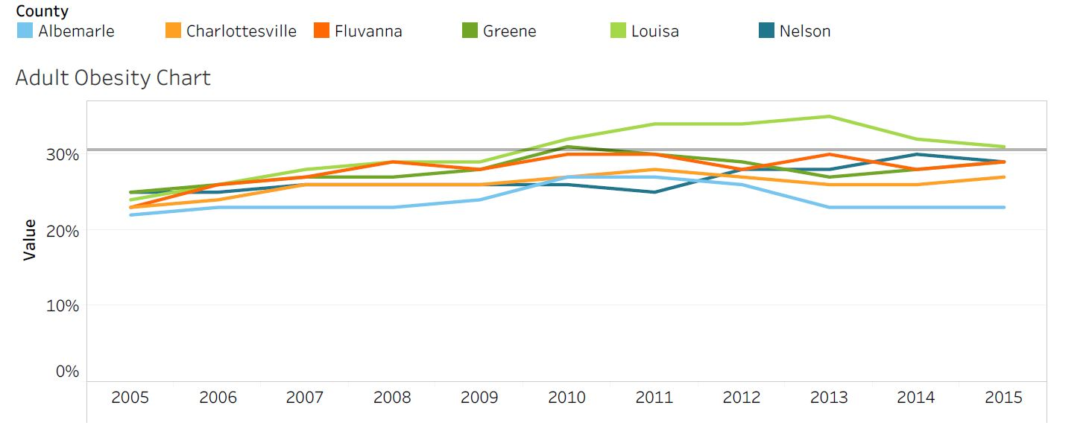
Percent of Obese Adults by TJHD Locality, 2005-2015.
Source: Robert Wood Johnson Foundation, County Health Rankings, 2018.
Healthy People 2020 Benchmark = 30.5%
Notes:
In this 10 year span, Nelson County has experienced a 4% increase and remains a tiny bit below the HP 2020 benchmark

Slide 7
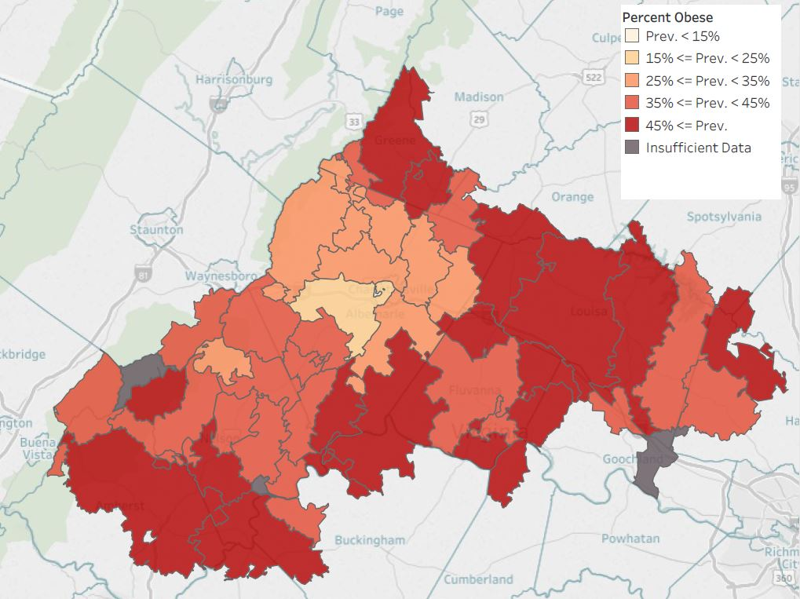
Percent of Obese Adults
by TJHD Zip Code Tabulation Area, 2016.
Source: Translational Health Research Institute of Virginia (UVA Clinical Data Repository), 2017.
Notes:
Mapping obesity across the district. Darker red = higher prevalence of obesity (45%+) and yellow-white is the lower (less than 15%). Parts of Nelson, southern Albemarle that touches Fluvanna, Louisa, and Greene counties have the areas of darkest red.
LIMITATION: UVA outpatient data only; so doesn’t necessarily reflect the entire population (but it has an n of ~200,000 versus the County Health Rankings/BRFSS data n for the district is in the hundreds)
GS Note: these are mapped by Zip Code Tabulation Area (ZCTAs) which sometimes cross county lines.

Slide 8
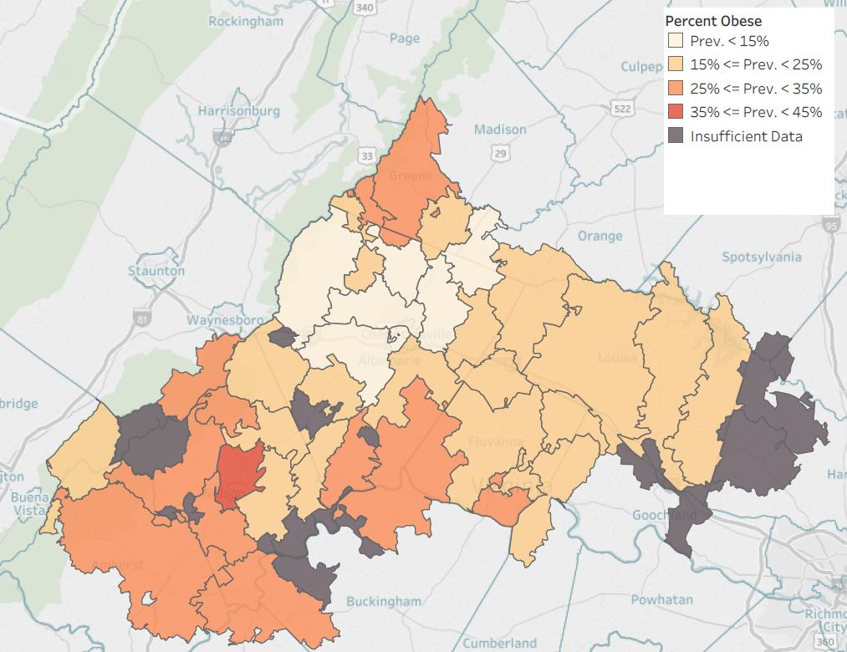
Percent of Obese Children
by TJHD Zip Code Tabulation Area, 2016.
Source: Translational Health Research Institute of Virginia (UVA Clinical Data Repository), 2017.
Notes:
Mapping obesity across the district. This is for children instead of adults. As you can see from the dark gray areas, not enough data for several areas (that is, less children seen at UVA outpatient clinics across the district).

Slide 9
Percent of Overweight and Obese Students Nelson County Public Schools, 2017-2018. Source: Blue Ridge Medical Center, 2019.
Notes:
Slightly upward trend except for in 5th grade students

Slide 10
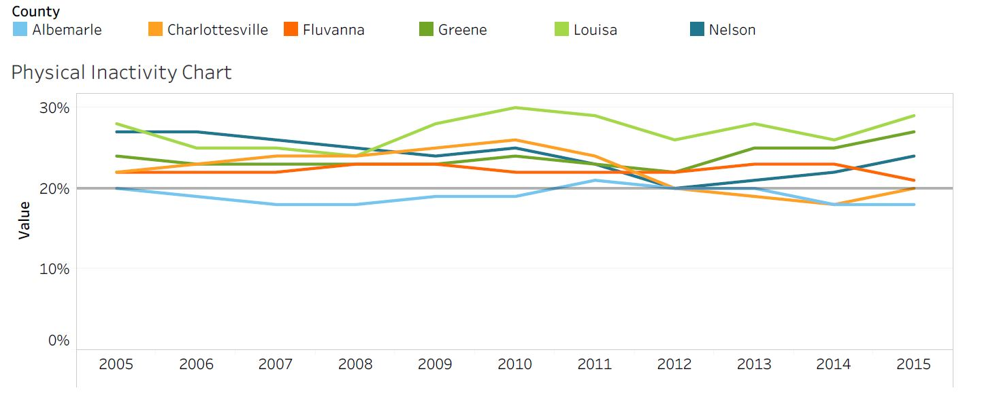
Percent of Adult Physical Inactivity, by TJHD Locality, 2005-2015.
Source: Robert Wood Johnson Foundation, County Health Rankings, 2018.
VA Plan for Well-Being Target = 20%
Notes:
Nelson has experienced a 3% decrease overall in adult physical inactivity and met the VA plan for well-being only in 2012

Slide 11
What Prevents You from Exercising, by TJHD Locality, 2018.
Source: UVA Center for Survey Research and the Thomas Jefferson Health District, Community Health Survey, 2019.
Notes:
Top two reasons in Nelson county= No time and Health Reasons

Slide 12
Access to Exercise Opportunities, by TJHD Locality, 2014 & 2016.
Source: Robert Wood Johnson Foundation, County Health Rankings, 2018.
Notes:
Since 2014, Nelson has slightly increased access to exercise opportunities
Have any gym, parks or recreational centers opened since 2014?

Slide 13
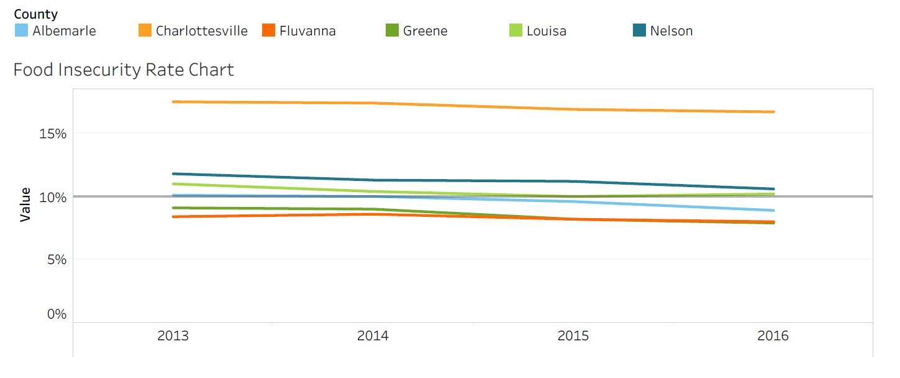
Food Insecurity, by TJHD Locality, 2013-2016. Source: Map the Meal Gap, Feeding America, 2018.
Notes:
Within this 3 year timeframe, Nelson has remained around 11% of people experiencing food insecurity
Food insecurity: lack of access, at times, to enough food for an active, healthy life for all household members and limited or uncertain availability of nutritionally adequate foods. May not always experience food insecurity—may also reflect a households need to make trade-off’s between important basic needs, such as housing or medical bills, and purchasing nutritionally adequate foods.

Slide 14
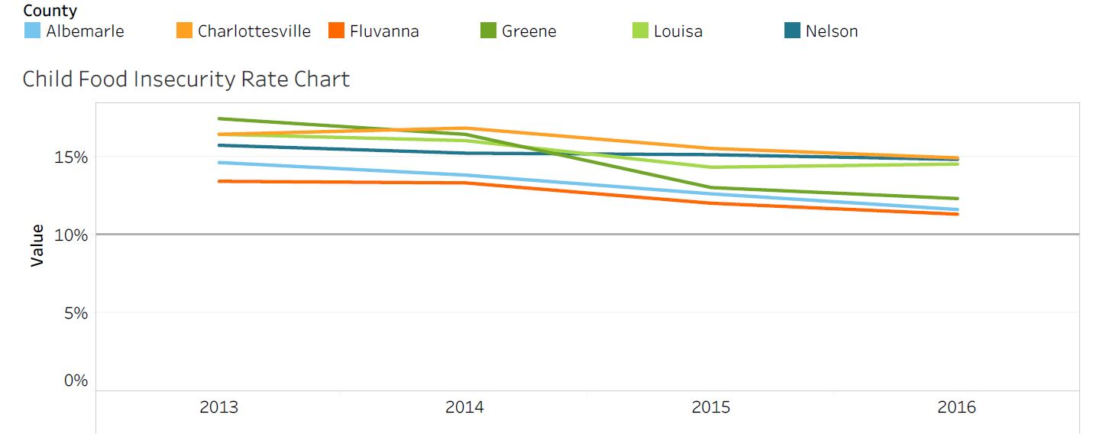
Child Food Insecurity, by TJHD Locality, 2013-2016. Source: Map the Meal Gap, Feeding America, 2018.
Notes:
Nelson has remained around 15% of children experiencing food insecurity and is tied with Charlottesville for highest rate in the district

Slide 15
Address Mental Health & Substance Use

Slide 16
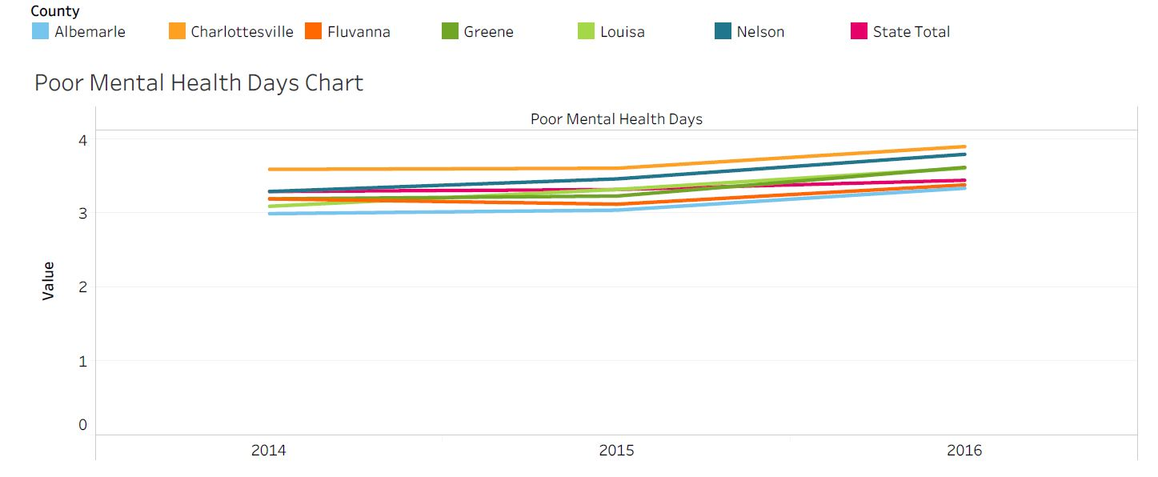
Poor Mental Health Days, by TJHD Locality, 2014-2016. Source: County Health Rankings, 2018.
Notes:
Important measure because an increase in poor mental health days increases risk for development of depression
Nelson has the second highest number of poor mental health days in our district and higher than the state rate
Nelson=3.8 and State=3.5
https://www.ncbi.nlm.nih.gov/pmc/articles/PMC3133938/

Slide 17
Unable to Get Necessary Mental Healthcare, by TJHD Locality, 2018. Source: UVA Center for Survey Research and the Thomas Jefferson Health District, Community Health Survey, 2019.
Notes:
This data comes from a Survey the VDH conducted--gave out 3000 surveys and received respondants around 1000. much higher than BRFSS which only surveys around 230 people
We had to combine Greene and Nelson County because there were not enough respondents—most similar in terms of demographics
Question is a double negative—over 80% of people in Greene and Nelson County are able to get necessary mental healthcare

Slide 18
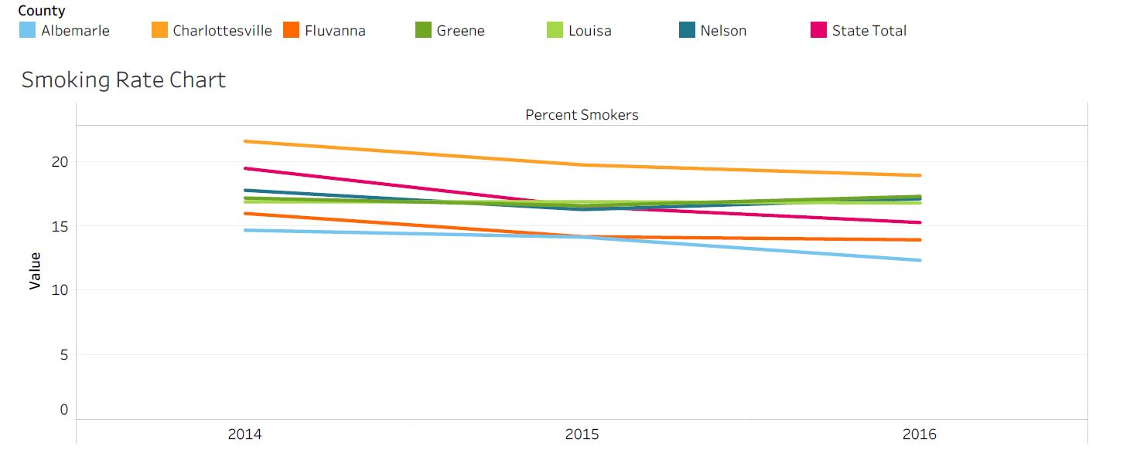
Percent of Adults Smokers, by TJHD Locality, 2014-2016. Source: County Health Rankings, 2018.
Notes:
Nelson has the third highest smoking rate in the district following Charlottesville and Greene county
17.1% adult smokers

Slide 19
TJHD Overdose Mortality Rates (per 100,000 residents), TJHD and Nelson County, 2011-2017. Source: Virginia Department of Health, Opioid Addiction Dashboard, 2018 (http://www.vdh.virginia.gov/data/opioid-overdose).
Nelson
Nelson
Notes:
Overdose rates for Nelson County are higher for Fentanyl/Heroin than for opioids
In 2017 the rate of opioid overdose was 0 while the overdose rate for heroin was 6.7 (lower than the state rate of 11)
NAS—group of conditions caused when a baby withdraws from certain drugs he’s exposed to in the womb before birth—most often caused by opioids
Nelson rate has been decreasing starkly since 2014 and the NAS rate in 2016 was reported as 0—go Nelson!

Slide 20
TJHD Overdose Mortality Rates (per 100,000 residents), TJHD Localities, 2017. Source: Virginia Department of Health, Opioid Addiction Dashboard, 2018 (http://www.vdh.virginia.gov/data/opioid-overdose).
Notes:
Relative to the rest of the district, Nelson County has the second highest rate of fentanyl/heroin overdoses (after louisa county)
Nelson did not have enough overdoses to be included on the map, the numbers were censored because so small

Slide 21
Nelson Rate Summary by Age Groups, Rates per 100,000 Residents, 2017. Source: Virginia Department of Health, Opioid Addiction Dashboard, 2018 (http://www.vdh.virginia.gov/data/opioid-overdose).
Overdose Deaths |  |  | ED Visits for Overdose
Age Group | Fentanyl and/or Heroin Overdose | Prescription Opioid Overdose | ED Heroin Overdose | ED Opioid Overdose
0–14 | 0.0 | 0.0 | 0.0 | 0.0
15–24 | 0.0 | 0.0 | 0.0 | 275.5
25–34 | 0.0 | 0.0 | 145.0 | 72.5
35–44 | 66.7 | 0.0 | 0.0 | 200.0
45–54 | 0.0 | 0.0 | 0.0 | 51.3
55–64 | 0.0 | 0.0 | 0.0 | 39.3
65+ | 0.0 | 0.0 | 0.0 | 0.0
All Ages | 6.7 | 0.0 | 13.5 | 67.3
Notes:
Age groups most at risk for overdose deaths and ED visits are between the ages 25 and 44 years of age
Although the mortality rate for fentanyl/heroin is higher in the district , there is a higher rate of ED visits for opioid overdoses

Slide 22
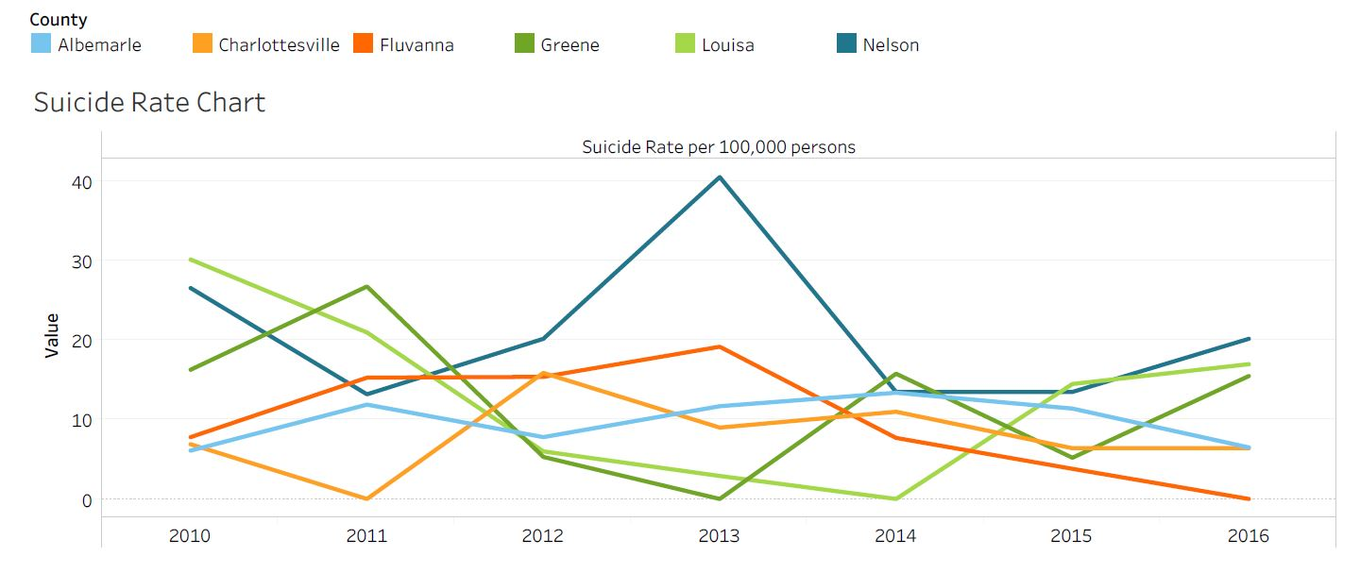
Suicide Rate per 100,000 population, by TJHD Locality, 2010-2016. Source: Office of the Chief Medical Examiner, Virginia Department of Health, 2018.
Notes:
Nelson County has the highest suicide rate in the district ~20 per 100,000 people
There was a spike in suicides in 2013, ~40 per 100,000 people

Slide 23
Increase Access to Care and Reduce Health Disparities

Slide 24
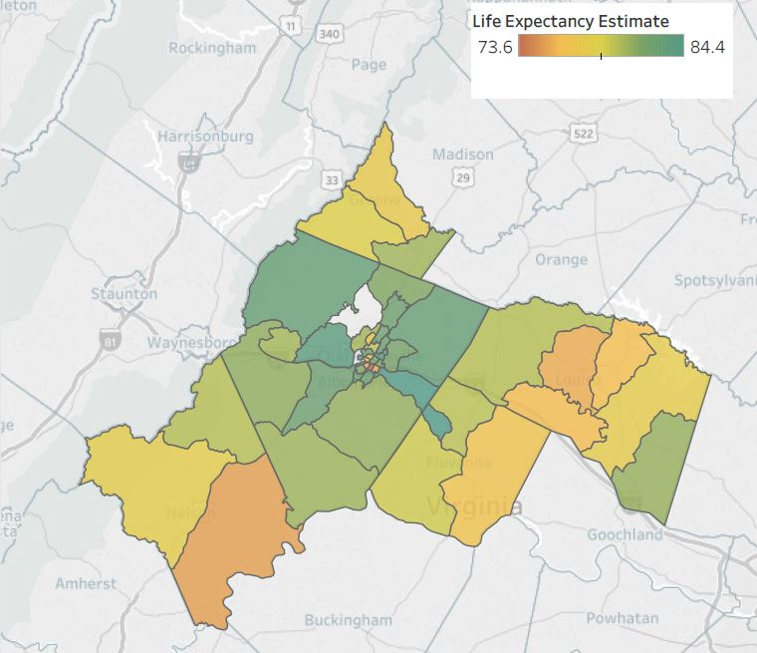
Life Expectancy Estimates at Birth by TJHD Census Tract, 2008-2012. Source: Virginia Department of Health, Office of Vital Records, 2018 and U.S. Census Bureau, 2010 Population Counts, 2018.
Geographic locations & arrows are approximate
250/65
Nellysford
Wintergreen
Montebello
Tyro
Schuyler
Roseland/151
Lovingston
29
Shipman
Arrington
Notes:
Lowest life expectancy in Nelson County is the southern portion ~ 75.3
The yellow area to the west has a life expectancy of ~78.2
The upper northern area has the highest life expectancy of 80.1 years of age which is lower than the highest life expectancy in our district (in Albemarle and Charlottesville)
*mention that this data is centered around 2010 census tract data so spans 2008-2012

Slide 25
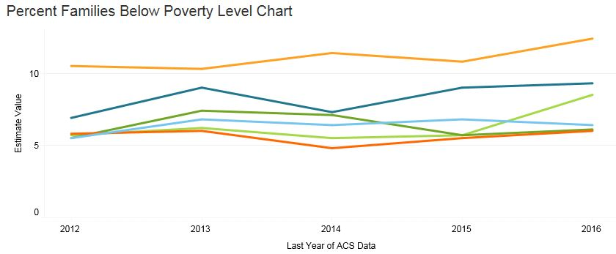
Percent of Families Below the Federal Poverty Level, by TJHD Locality, 2008-2016. Source: U.S. Census Bureau, American Community Survey 5-year Estimates, 2018.
Notes:
Since 2012, the percent of families below the FPL has increased by a little more than 2% and is second highest in the health district

Slide 26
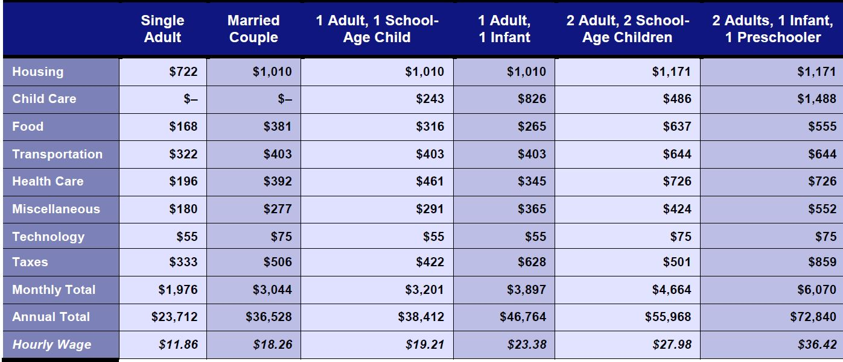
ALICE Cost of Living Estimates, Nelson County Survival and Stability Budgets, 2016. (ALICE = Asset Limited, Income Restrained, Employed) Source: United Way, 2018 ALICE Report.
ALICE Cost of Living Estimates, Nelson County Survival Budget, 2016. (ALICE = Asset Limited, Income Restrained, Employed) Source: United Way, 2018 ALICE Report.
Notes:
The ALICE population represents individuals and families who earn more than the official Federal Poverty Level but less than the basic cost of living. The measure has estimates for housing, childcare, food, transportation, healthcare, tax, and a miscellaneous category. There are estimates for different household and family compositions; there is an estimate for a basic "Survival" budget and a larger "Stability" budget.
W:\Data_TJ Reports\ALICE reports → 2018 Report

Slide 27
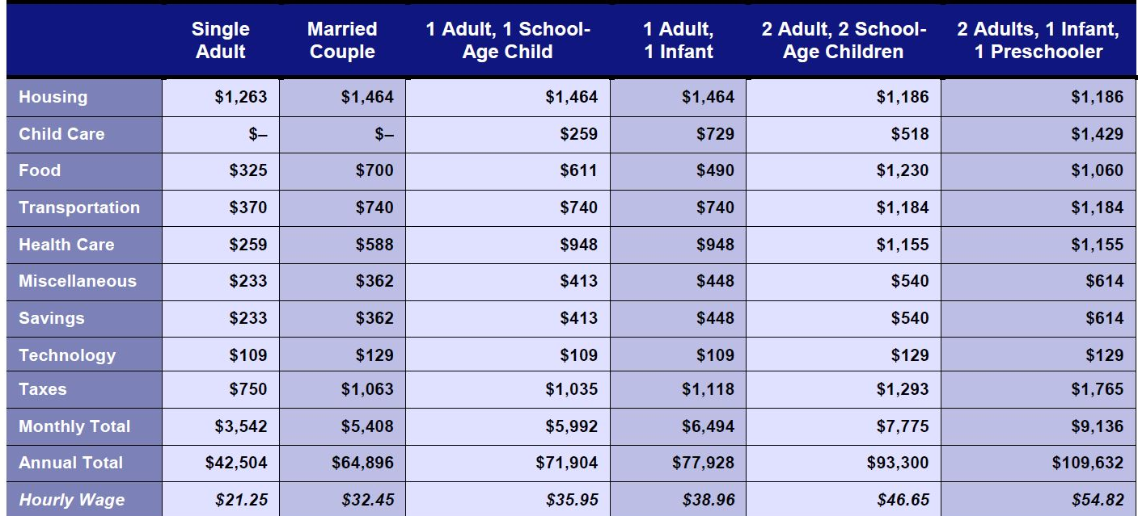
ALICE Cost of Living Estimates, Nelson County Survival and Stability Budgets, 2016. (ALICE = Asset Limited, Income Restrained, Employed) Source: United Way, 2018 ALICE Report.
ALICE Cost of Living Estimates, Nelson County Stability Budget, 2016. (ALICE = Asset Limited, Income Restrained, Employed) Source: United Way, 2018 ALICE Report.
Notes:
The ALICE population represents individuals and families who earn more than the official Federal Poverty Level but less than the basic cost of living. The measure has estimates for housing, childcare, food, transportation, healthcare, tax, and a miscellaneous category. There are estimates for different household and family compositions; there is an estimate for a basic "Survival" budget and a larger "Stability" budget.
W:\Data_TJ Reports\ALICE reports → 2018 Report

Slide 28
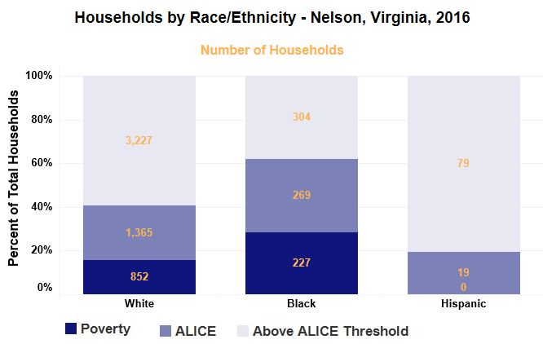
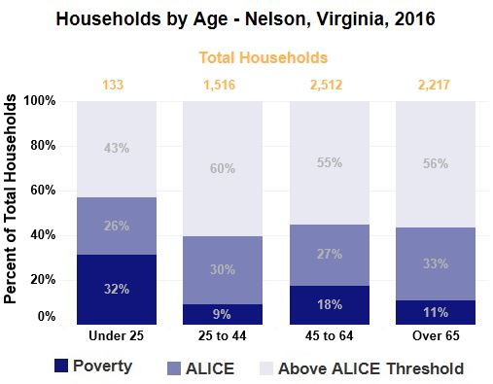
ALICE Cost of Living Estimates, Nelson County Households by Age and Race/Ethnicity, 2016. Source: United Way, 2018 ALICE Report.
Notes:
The majority of households living in poverty are under 25 years of age
Even with smaller population sizes, black and mixed households experience higher levels of poverty

Slide 29
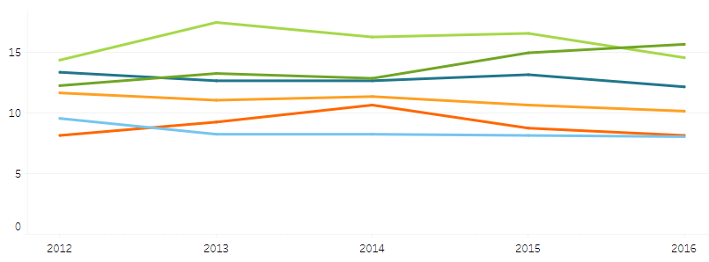
Percent Uninsured, by TJHD Locality, 2012-2016. Source: U.S. Census Bureau, American Community Survey 5-year Estimates, 2018.
Notes:
% of uninsured has remained relatively the same (around 12%) //Third highest rate in the county
Note: we expect these numbers will change once data are available for post-Medicaid expansion (2019)

Slide 30
Personal Doctor, TJHD Locality, 2018. Source: UVA Center for Survey Research and the Thomas Jefferson Health District, Community Health Survey, 2019.
Notes:
The lowest percentage of people to report having at least one personal doctor were in Greene and Nelson County.
Do you have one person you can think of as your personal doctor or health care provider?

Slide 31
Unable to Get Necessary Dental Care, TJHD Locality, 2018.
Source: UVA Center for Survey Research and the Thomas Jefferson Health District, Community Health Survey, 2019.
Notes:
A little less than 80% of residents in Nelson County said they are able to get necessary dental care
In the last 12 months, was anyone in your household unable to get necessary dental care or treatment?

Slide 32
In Past 12 Months Seen a Dentist for Cleaning, TJHD Locality, 2018. Source: UVA Center for Survey Research and the Thomas Jefferson Health District, Community Health Survey, 2019.
Notes:
70% of people in Greene and Nelson County reported having received a dentist cleaning in the past 12 months
In the past 12 months, have you seen a dentist or dental hygienist for cleaning?

Slide 33
Nelson Low Birth Weight. 2008-2016. Source: Virginia Department of Health, Division of Health Statistics, 2018.
Total Low Birth Weight
Black Low Birth Weight
White Low Birth Weight
Notes:
Low birth weights in Nelson County have fluctuated considerably since 2008.
In 2016, Nelson County had a higher percentage of low birth weights than the state (small margin) and than the TJHD
Nelson County=8.7
Virginia=8.1
TJHD=5.6

Slide 34
Foster a Healthy and Connected Community for All Ages

Slide 35
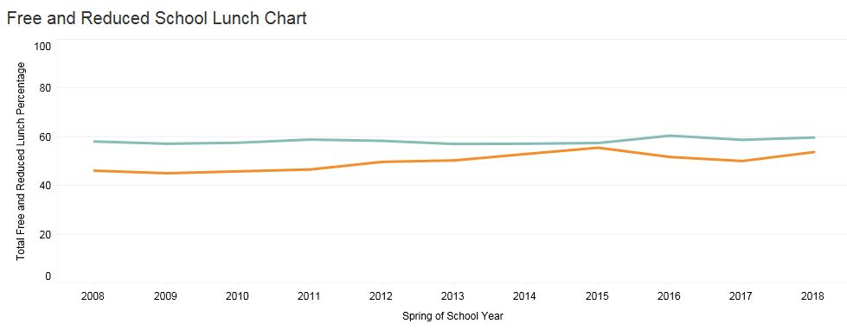
Percent Free and Reduced School Lunch, Nelson County Elementary Schools, 2008-2018. Source: Virginia Department of Education, 2018.
Notes:
Tj tableau

Slide 36
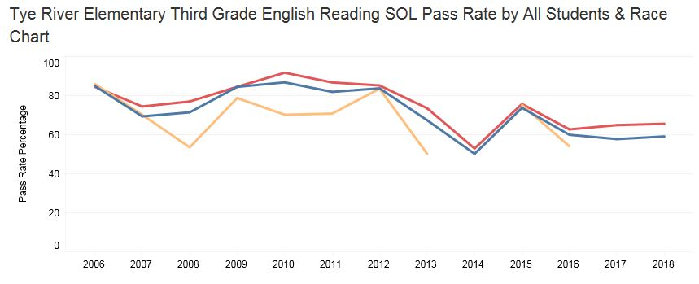
Percent Third Grade English SOL Pass Rate, Tye River Elementary School (Nelson County), 2008-2018 Class Year. Source: Virginia Department of Education, 2018.
Notes:
There doesn’t seem to be any black students as of 2018. However, third grade English SOL pass rates for students that identify as Black has lower pass rates
Numbers were either censored

Slide 37
2019 MAPP2Health
Questions?
Guleer Shahab, Data Analyst
Thomas Jefferson Health District
434-422-3214
guleer.shahab@vdh.virginia.gov

