Slide 1


SHARE
THE FUN...
not the germs
and make
a HEALTHY SPLASH!
Healthy & Safe Swimming Week
May 20-26, 2019

Slide 2


Slide 3

"Pool Chemistry for Healthy and Safe Swimming"
Properly maintain your pool and spa to control the growth of bacteria like Legionella, which can cause severe respiratory infections.
Properly maintain your pool and spa to control the growth of bacteria like Legionella, which can cause severe respiratory infections.

Slide 4
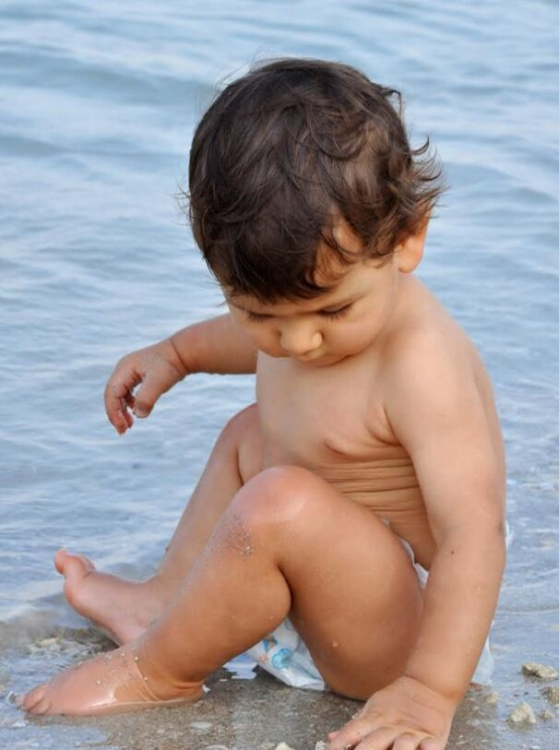

Take children on bathroom breaks and check swim diapers at least once an hour.
Educate you and your family about the steps of healthy swimming during Healthly and Safe Swimming Week! #HSSW2019
Educate you and your family about the steps of healthy swimming during Healthly and Safe Swimming Week! #HSSW2019
www.swimHealthyVA.com

Slide 5
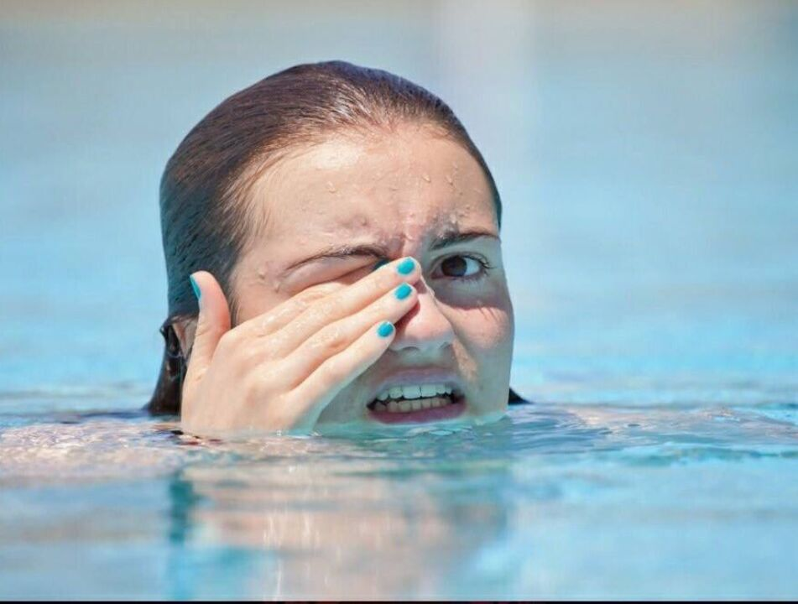
Don't Pee in the Pool!
Don't Pee in the Pool!
Pee in the pool mixes with chlorine, makes swimmers' eyes red, and uses up chlorine, leaving less to kill germs.
#HSSW2019
Pee in the pool mixes with chlorine, makes swimmers' eyes red, and uses up chlorine, leaving less to kill germs.
#HSSW2019
www.SwimHealthyVA.com

Slide 6


Slide 7


Slide 8
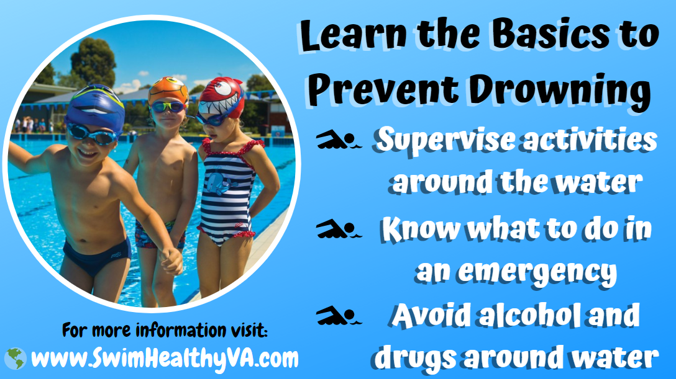

Slide 9


Slide 10
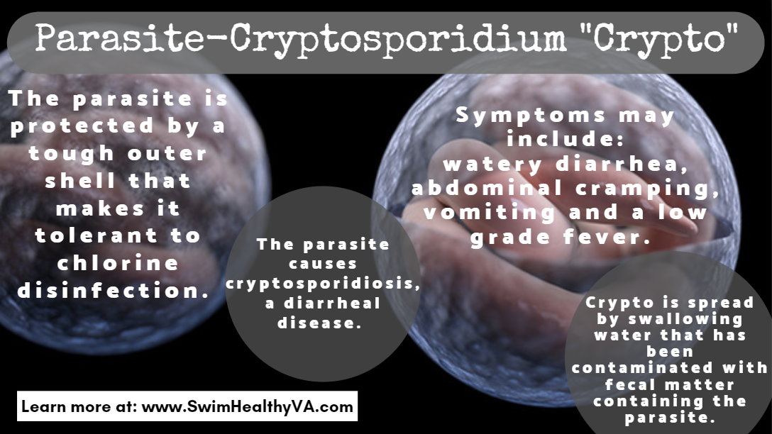

Slide 11
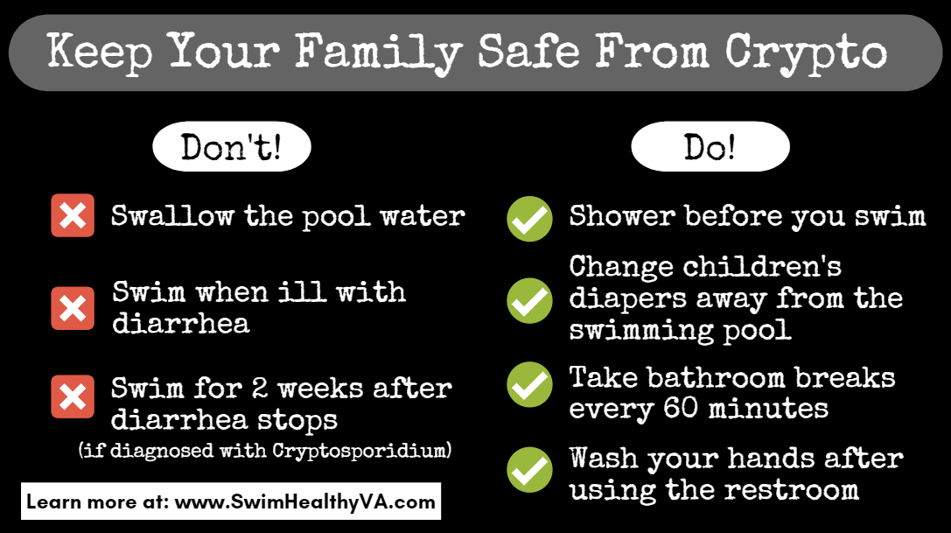

Slide 12
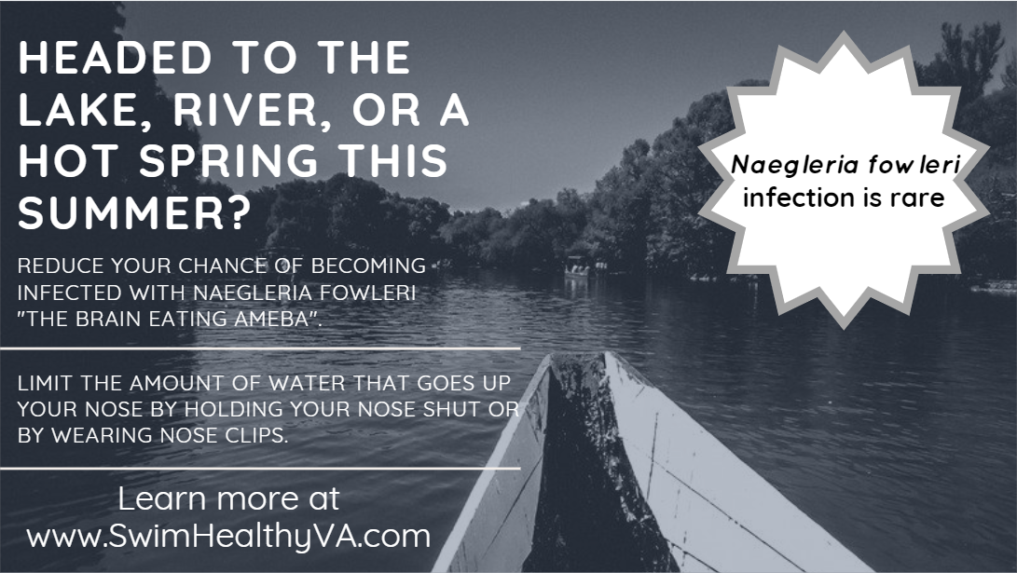

Slide 13
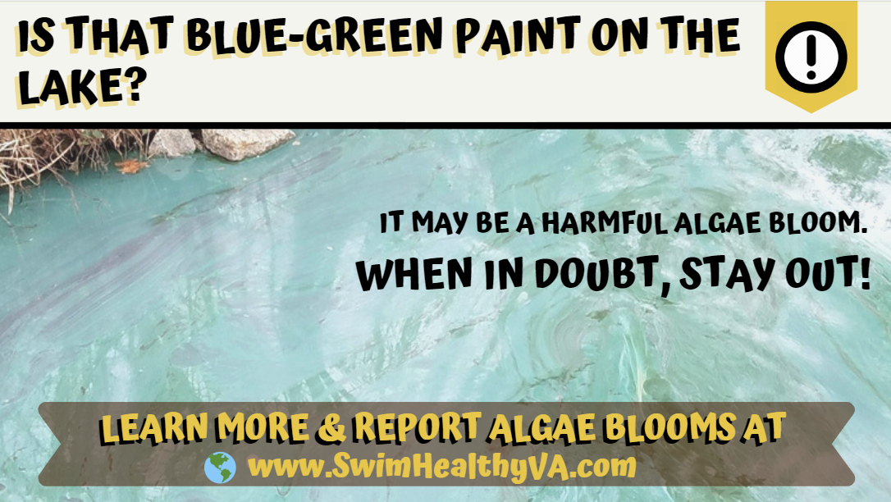

Slide 14


Slide 15


Slide 16

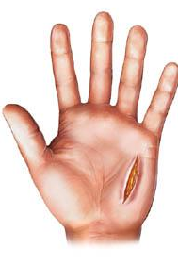
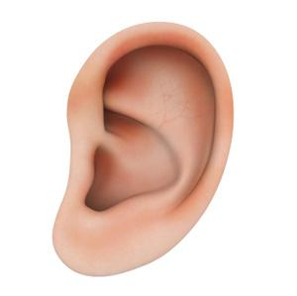

Oh No Vibrio!
How you get Vibriosis:
Eating raw or undercooked seafood, particularly oysters.
Salt water gets into open cuts or sores in skin
Salt water enters the ear while swimming
How you avoid Vibriosis:
Don’t swim with open wounds!
Wear earplugs!
#swimhealthyVA #HSSW2019 www.SwimHealthyVa.com

Slide 17

Vibriosis Prevention Tips
Know the symptoms!
People who get Vibrio infection by eating seafood usually experience diarrhea and vomiting
Don’t swim with skin wounds or cuts
Or use waterproof bandages to cover wounds before getting into the water
Individuals with pre-existing medical conditions are at greater risk
Liver disease, diabetes, cancer, and certain stomach disorders or people who are immune compromised are at greater risk of severe, potential fatal, illness from Vibrio
#swimhealthyVA #HSSW2019 www.SwimHealthyVa.com

