Slide 1
USER TRAINING SESSION
THE VIRGINIA DEPARTMENT OF HEALTH’S
ELECTRONIC DEATH REGISTRATION SYSTEM (EDRS)
PHYSICIAN’S
Notes:
.

Slide 2
Electronic Death Registration System (EDRS)?
  WHAT IS AN EDRS?
  An EDRS allows all participants to electronically register Death Certificates for –
    Attended Deaths – Primary Care Provider (Green Border Death Certificate)
    Unattended Deaths – Medical Examiner (Red Border Death Certificate)
    Spontaneous Fetal Deaths – Primary Care Provider (Yellow Border Death Certificate)
    Induced Terminations of Pregnancies – Primary Care Provider (Brown Border Death Certificate)
  WHY USE AN EDRS?
    Paperless registration of Death Certificates - Anytime, Anywhere, Home, Office, Vacation
    More timely, complete, secure & accurate Death Certificates resulting in minimized business costs and improved services to the families of the decedents
    Readily available Death Statistics
2

Slide 3
Electronic Death Registration System (EDRS)?
  WHAT CAN YOU USE THE EDRS FOR ?
  DECEDENT AFFAIRS
    Creating a Death Certificate
    Completing a death certificate created by a funeral home
    Electronically assigning case to a physician or a pool of physicians
    Electronically requesting demographics certification (if funeral home is an EDRS user)
    Drop certificate to paper (if funeral home is not an EDRS user)
  PHYSICIAN’S STAFF
    Completing a death certificate created by a funeral home
  PHYSICIAN’S
    Completing a death certificate created by a funeral home
    Medical Certification (digital signatures)
3

Slide 4
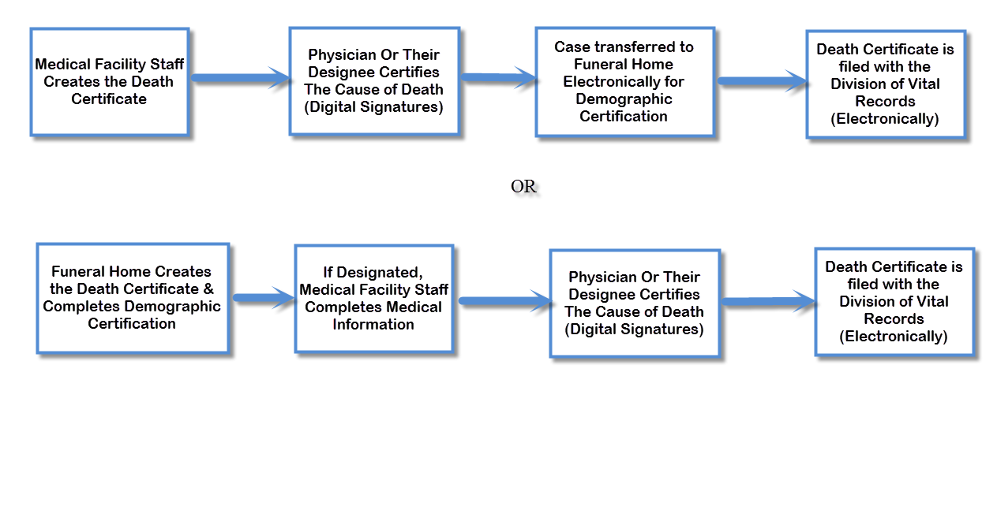
After Implementation of the EDRS
4

