Slide 1
USER TRAINING SESSION
THE VIRGINIA DEPARTMENT OF HEALTH’S
ELECTRONIC DEATH REGISTRATION SYSTEM (EDRS)
LOCAL HEALTH DEPARTMENTS
Notes:
.

Slide 2
Electronic Death Registration System (EDRS)?
  WHAT IS AN EDRS?
  An EDRS allows all participants to electronically register Death Certificates for –
    Attended Deaths – Primary Care Provider (Green Border Death Certificate)
    Unattended Deaths – Medical Examiner (Red Border Death Certificate)
    Spontaneous Fetal Deaths – Primary Care Provider (Yellow Border Death Certificate)
    Induced Terminations of Pregnancies – Primary Care Provider (Brown Border Death Certificate)
  WHY USE AN EDRS?
    Paperless registration of Death Certificates - Anytime, Anywhere, Home, Office, Vacation
    More timely, complete, secure & accurate Death Certificates resulting in minimized business costs and improved services to the families of the decedents
    Readily available Death Statistics
2

Slide 3
Electronic Death Registration System (EDRS)?
  WHAT CAN YOU USE THE EDRS FOR ?
  Certificate printing for issuance
  Approving permits
    Out of state transit permits
    Communicable disease letters
    Disinterment - reinterment permits
  Running a settlement report
3

Slide 4
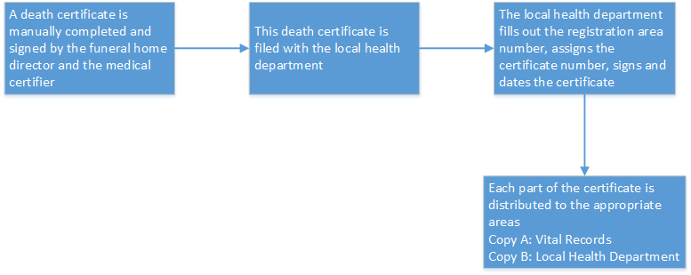
After Implementation of the EDRS
CURRENT PROCESS
4

Slide 5
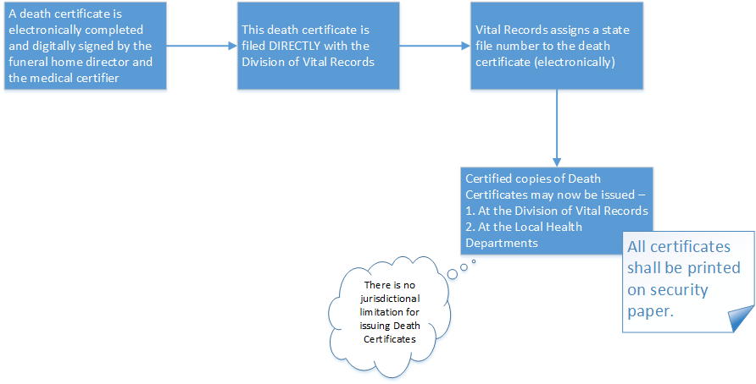
After Implementation of the EDRS
COMPLETE ELECTRONIC CERTIFICATES
5

Slide 6
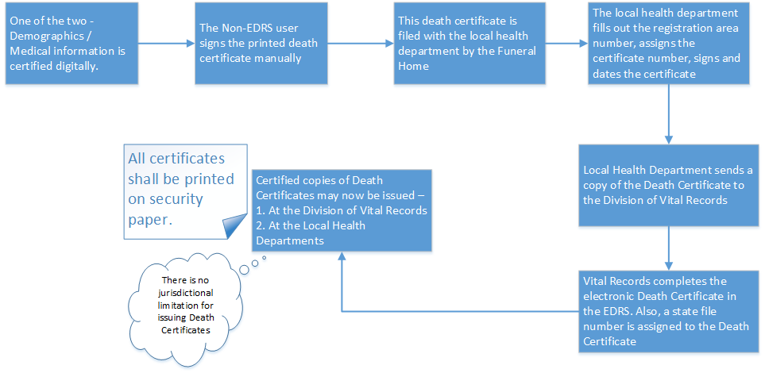
After Implementation of the EDRS
DROPPED TO PAPER CERTIFICATES
6

Slide 7
Electronic Death Registration System (EDRS)
QUESTIONS
6

