Slide 1
USER TRAINING SESSION THE VIRGINIA DEPARTMENT OF HEALTH’S ELECTRONIC DEATH REGISTRATION SYSTEM (EDRS)
DECEDENT AFFAIRS & PHYSICIAN’S STAFF
Notes:
.

Slide 2
Electronic Death Registration System (EDRS)?
WHAT IS AN EDRS?
An EDRS allows all participants to electronically register Death Certificates for –
Attended Deaths – Primary Care Provider (Green Border Death Certificate)
Unattended Deaths – Medical Examiner (Red Border Death Certificate)
Spontaneous Fetal Deaths – Primary Care Provider (Yellow Border Death Certificate)
Induced Terminations of Pregnancies – Primary Care Provider (Brown Border Death Certificate)
WHY USE AN EDRS?
Paperless registration of Death Certificates - Anytime, Anywhere, Home, Office, Vacation
More timely, complete, secure & accurate Death Certificates resulting in minimized business costs and improved services to the families of the decedents
Readily available Death Statistics
2

Slide 3
Electronic Death Registration System (EDRS)?
WHAT CAN YOU USE THE EDRS FOR ?
DECEDENT AFFAIRS
Creating a Death Certificate
Electronically assigning case to a physician or a pool of physicians
Electronically requesting demographics certification (if funeral home is an EDRS user)
Drop certificate to paper (if funeral home is not an EDRS user)
PHYSICIAN’S STAFF
Completing a death certificate created by a funeral home
3

Slide 4
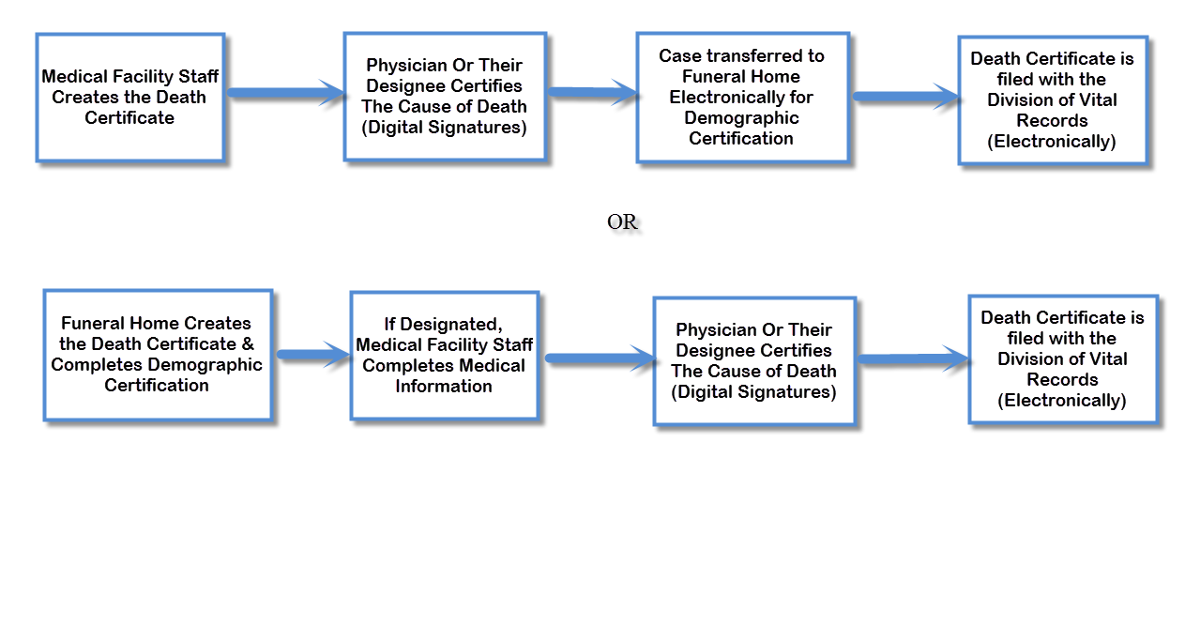
After Implementation of the EDRS
4

