Slide 1
Welcome to the Ch. 932 (2020 Acts of Assembly) Work Group Meeting July 20, 2020 1:00 p.m.
To ensure an orderly meeting all attendees have been muted. We will allow 5 minutes at the start of the meeting for everyone to log on and begin at 1:05p .m.
If you are a member of the media, please contact Rebekah Allen in the chat panel.
This meeting will be recorded.
If you have called in on your phone and using a computer please mute your mic and turn off the sound on your computer.
Notes:
Alex start the meeting; will tell attendees what to do.

Slide 2
Call to Order and Welcome

Slide 3
Introductions & Roll Call
Work Group Member | Organization or Agency
Alaysia Black Hackett | Chief Diversity Officer
Megan Healy | Chief Workforce Development Advisor
Judy Jackson | Department for the Blind and Vision Impaired
Karen Brimm | Department for the Deaf and Hard of Hearing
Joani Latimer | Department of Aging and Rehabilitative Services
Gail Thompson | Department of Aging and Rehabilitative Services
Jewel Bronaugh | Department of Agriculture and Consumer Service
Kathryn Paxton | Department of Agriculture and Consumer Service
Charlette Ridout | Board of Nursing, Department of Health Professions
Elizabeth Carter | Healthcare Workforce Data Center, Department of Health Professions
Corie Tillman Wolf | Board of Long-Term Care Administrators, Department of Health Professions
Kurt Elward | Department of Medical Assistance Services
Barbara Seymour | Department of Medical Assistance Services
Randall Stamper | Virginia Community College System
Notes:
Alex: Please introduce yourself in the order you appear.

Slide 4
Introductions & Roll Call
Work Group Member | Organization or Agency
Todd Barnes | Department of Veterans Services
Heather Legere | Department of Veterans Services
Sam Kukich | Dignity for the Aged
Bob Kukick | Dignity for the Aged
Erin Hines | Dignity for the Aged
Susan Hines | Dignity for the Aged
Jen A. Kiggans | Senate, General Assembly
Christina Holloway | Beach Health and Wellness
Dana Parsons | LeadingAge Virginia
Alicia Cundiff | LeadingAge Virginia
April Payne | Virginia Health Care Association | Virginia Center for Assisted Living
W. Scott Johnson | Virginia Health Care Association | Virginia Center for Assisted Living
Vivienne McDaniel | Virginia Nurses Association
Notes:
Alex: Please introduce yourself in the order you appear.

Slide 5
Introductions & Roll Call
Work Group Member | Organization or Agency
Joseph Hilbert | Office of Governmental and Regulatory Affairs, Department of Health
Heather Anderson | Office of Health Equity, Department of Health
A. Carole Pratt | Office of Governmental and Regulatory Affairs, Department of Health
Rebekah E. Allen | Office of Licensure and Certification, Department of Health
Notes:
Alex: Please introduce yourself in the order you appear.

Slide 6
Ch. 932 (2020 Acts of Assembly) Work Group - Agenda
Public Comment Period
Review of Work Group Roadmap and Revisions | Ms. Allen
Initial Discussions regarding Curriculum and Educational Debt | Work Group Members
Discussions of Next Steps | Dr. Pratt, Ms. Allen, Work Group Members
Other Business | Dr. Pratt, Ms. Allen, Work Group Members

Slide 7
Written Public Comment
Written comments were emailed to members on Friday & Sunday
Posted on OLC’s website at https://www.vdh.virginia.gov/licensure-and-certification/laws-regulations-and-guidelines/current-legislative-work-groups-reports/ under Ch. 932 (2020 Acts of Assembly) in the “Meetings” section
As a reminder, a summary of written comments will be included in the work group’s final report
Written comments should be sent to Rebekah.Allen@vdh.virginia.gov and Carole.Pratt@vdh.virginia.gov

Slide 8
Public Comment Period
There is a two minute time limit for each person to speak.
We will be calling from the list generated through registration.
After the 2 minute public comment limit is reached we will let you complete the sentence and will mute you and move on to the next attendee.
We will call the name of the person on list and also the name of the person is next on the list.
Notes:
Joe will read the names
Mylam will do the timer
Alex will announce start and end.
Joe will announce next participant.

Slide 9
Revised Work Group Roadmap

Slide 10
Last Meeting’s Proposed Focus Areas
Educational Pipeline
Middle school and high schools
College and university
Continuing education
Educational Debt
Health Care Financing
Recruitment and Retention

Slide 11
Education
Pipeline
Middle schools and high schools
College and university
Continuing education (including leadership)
Career changes and transitions
Curriculum
Special needs of resident population
Special needs of student population
Student debt

Slide 12
Health Care Financing
Payer mix
Reimbursement rates
Financial incentive programs
Quality of care
Staffing

Slide 13
Recruitment and Retention
Salary and wages
Other employment benefits
Staffing ratios
Advancement opportunities
Leadership opportunities

Slide 14
Curriculum & Student Debt

Slide 15
Curriculum – Service Learning
Va. Code § 22.1-253.13:4(D) establishes the minimum requirements the Board of Education must include in its graduation requirements
8VAC20-131-51 contain graduation requirements, effective beginning with students entering ninth grade in 2018-2019 school year
CTE (career and technical education) course is required in lieu of AP, IB, or honors courses
Service learning does not necessarily translate to credits for graduation
Local school divisions may incorporate these opportunities into their local electives upon Board approval, which could count towards graduation
May be opportunity to work with individual divisions on local electives if there is a regionally-targeted need

Slide 16
Curriculum - Service Learning
Fairfax County - https://www.fcps.edu/activities/service-learning
Fairfax County Public Schools are documenting the successful completion of service learning projects for students in grades 6, 8, and 12.
Grade 6: 5 hours
Grade 8: 15 hours
Grades 9–12: Students should complete 10 service hours per year for a total of 40 hours. Students may choose to complete 50+ hours to qualify for the Virginia Board of Education diploma seal for excellence in civics education. See Virginia Department of Education for criteria.

Slide 17
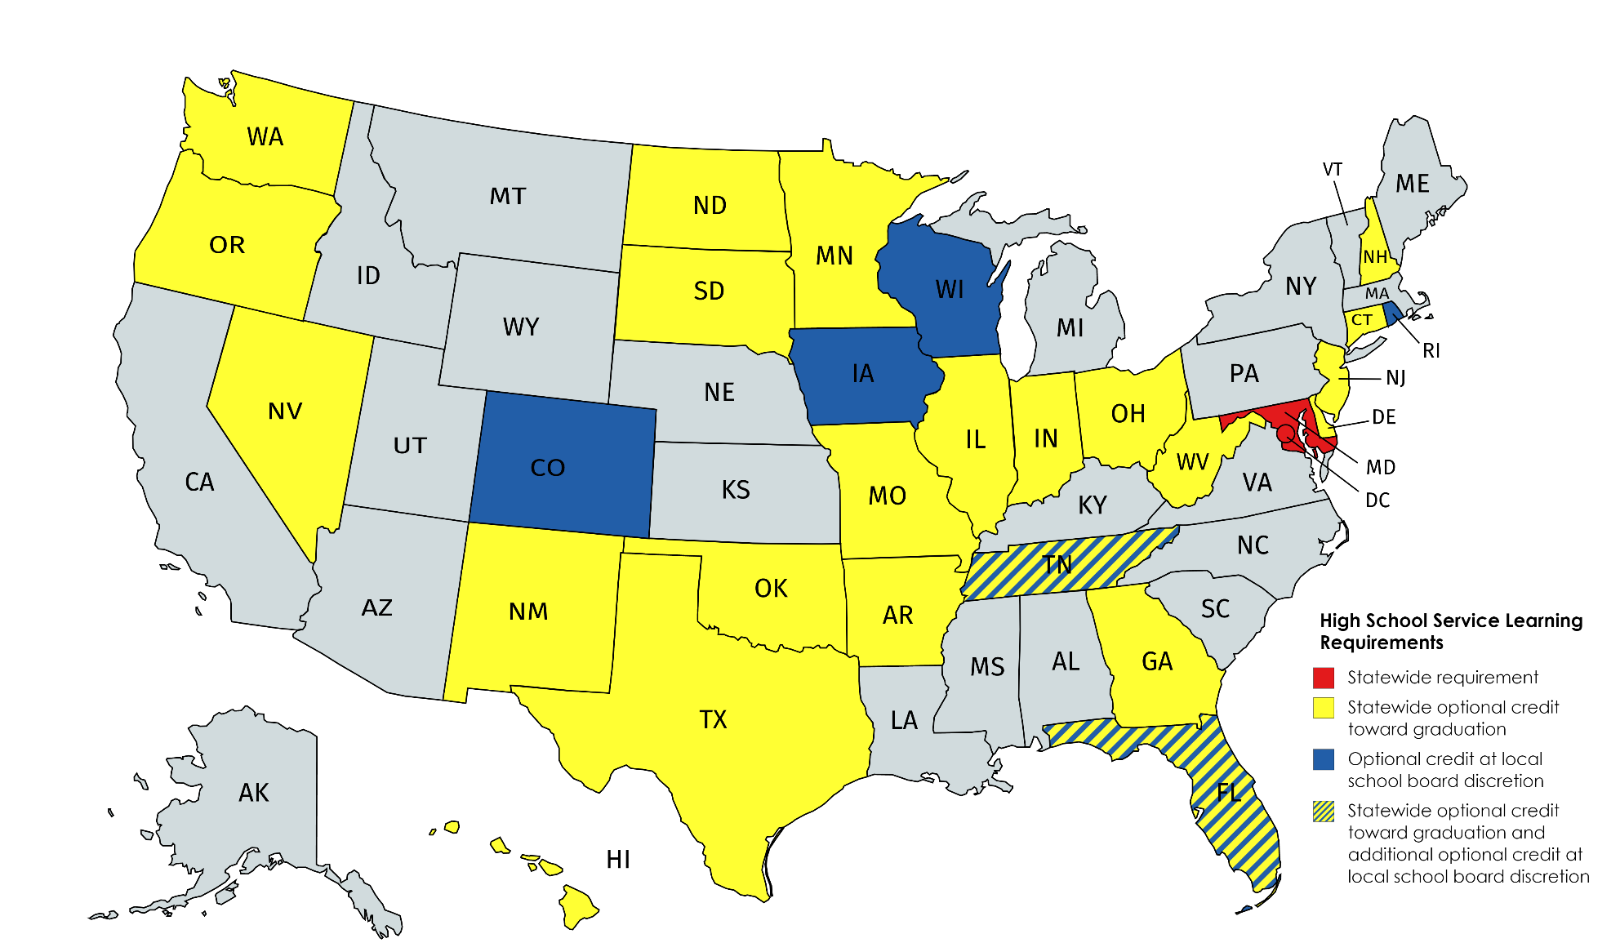
Curriculum – Service Learning

Slide 18
Curriculum – Service Learning
Maryland - required to complete either:
75 hours of student service that includes preparation, action, and reflection components and that, at the discretion of the local school system, may begin during the middle grades; or
a locally designed program in student service that has been approved by the state Superintendent of Schools.
District of Columbia:
Students are required to complete 100 hours of volunteer community service to graduate. The specific community service projects are established by the local education agency.

Slide 19
Curriculum – Targeted Programs in Virginia
United Way of Southwest Virginia - https://unitedwayswva.org/
Covering 21 localities representing 20% of Virginia's geography, UWSWVA has a student enrichment program called IGNITE and a current pipeline program in IT
Potential to be expanded for nursing home careers with additional funding
Southwestern Virginia Rural AHEC (Area Health Education Center) pipeline program
High School Outreach Tours
SEE (Summer Experiential Experience) STEM Camp
Virginia Scholars Program

Slide 20
Curriculum – Targeted Programs in Virginia
High School Outreach Tours
Introduction to anatomy, simulated medical conditions using high-tech manikins, and healthcare professions
Approximately 600 high school students participate each year
SEE (Summer Experiential Experience) STEM Camp
Introduction to anatomy, physiology, and healthcare professions through modules and learning workshops
Virginia Scholars Program
Two-year interdisciplinary program for students enrolled in health career certificate or degree programs from the undergraduate level up
40 hours of didactic and 40 hours of clinical activities each year that are in addition to regular coursework required by the academic program.
Completion results in a $500 payment and a Virginia Scholars Certificate

Slide 21
Curriculum – Special Needs Populations
Maximizing information dissemination about health care careers for deaf, hard of hearing, blind, and vision impaired communities
Enhancing educational curricula and training programs to assist these individuals in preparing for and obtaining employment in health care
Creating employer awareness about deaf, hard of hearing, blind, and vision impaired workforce
Using the Minnesota Employment Center model as a business resource

Slide 22
Curriculum – Special Needs Populations
Transitions from military service to civilian careers
Virginia Transition Assistance Program (VTAP)
Military Medics and Corpsmen (MMAC) Program
In serving military veterans, training competencies/general knowledge to include:
Military Culture and Values
Behavioral Health/Substance Use issues associated with Military Service and Trauma
Veteran Financials Benefits to include Disability and Aid and Attendance
Veteran Healthcare Resources to include access and limitations to availability of VAMC, CBOC, and Vet Center services.
Dispelling myths and stereotype associated with veteran community
Awareness of potential for political draw that can be associated with veteran issues
Veterans are well informed of their civil rights and liberties and are assertive in upholding them – this is to be respected and appreciated

Slide 23
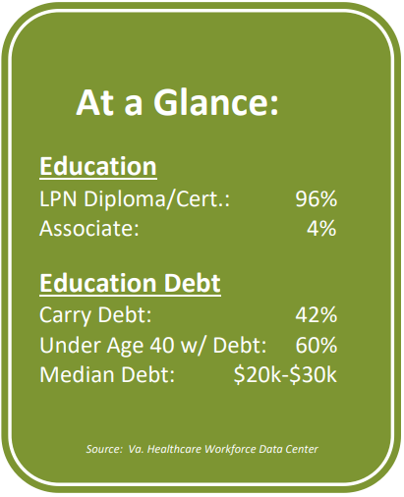
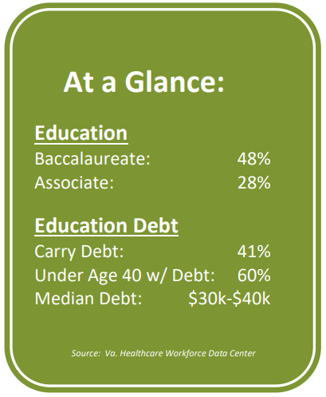
Debt
Licensed Practical Nurse
Registered Nurse

Slide 24
Debt
Virginia State Loan Repayment Program - loan repayment assistance for eligible healthcare providers who agree to serve in a Health Professional Shortage Area (HPSA) in a qualified field of practice in Virginia
Recipients must agree to practice full-time for a minimum of 2 years at an eligible site
Awards must be matched by the practice site. Up to $140,000 (including the community match) is available over 4 years
Applicants from the tobacco region do not have to secure a match.

Slide 25
Next Steps

Slide 26
Other business

Slide 27
adjourn

