Slide 1
Welcome to the Ch. 932 (2020 Acts of Assembly) Work Group Meeting August 17, 2020 1:00 p.m.
To ensure an orderly meeting all attendees have been muted. We will allow 5 minutes at the start of the meeting for everyone to log on and begin at 1:05 p.m.
If you are a member of the media, please contact Rebekah Allen in the chat panel.
This meeting will be recorded.
If you have called in on your phone and using a computer please mute your mic and turn off the sound on your computer.
Notes:
Alex start the meeting; will tell attendees what to do.

Slide 2
Call to Order and Welcome

Slide 3
Roll Call
Work Group Member | Organization or Agency
Alaysia Black Hackett | Chief Diversity Officer
Meaghan Green | Chief Workforce Development Advisor
Judy Jackson | Department for the Blind and Vision Impaired
Karen Brimm | Department for the Deaf and Hard of Hearing
Joani Latimer | Department of Aging and Rehabilitative Services
Gail Thompson | Department of Aging and Rehabilitative Services
Jewel Bronaugh | Department of Agriculture and Consumer Service
Kathryn Paxton | Department of Agriculture and Consumer Service
Charlette Ridout | Board of Nursing, Department of Health Professions
Elizabeth Carter | Healthcare Workforce Data Center, Department of Health Professions
Corie Tillman Wolf | Board of Long-Term Care Administrators, Department of Health Professions
Kurt Elward | Department of Medical Assistance Services
Barbara Seymour | Department of Medical Assistance Services
Randall Stamper | Virginia Community College System

Slide 4
Roll Call
Work Group Member | Organization or Agency
Todd Barnes | Department of Veterans Services
Heather Legere | Department of Veterans Services
Sam Kukich | Dignity for the Aged
Bob Kukich | Dignity for the Aged
Erin Hines | Dignity for the Aged
Susan Hines | Dignity for the Aged
Lionel DeCuir | Dignity for the Aged
Jen A. Kiggans | Senate, General Assembly
Christina Holloway | Beach Health and Wellness
Dana Parsons | LeadingAge Virginia
Alicia Cundiff | LeadingAge Virginia
April Payne | Virginia Health Care Association | Virginia Center for Assisted Living
W. Scott Johnson | Virginia Health Care Association | Virginia Center for Assisted Living
Vivienne McDaniel | Virginia Nurses Association

Slide 5
Roll Call
Work Group Member | Organization or Agency
Joseph Hilbert | Office of Governmental and Regulatory Affairs, Department of Health
Heather Anderson | Office of Health Equity, Department of Health
A. Carole Pratt | Office of Governmental and Regulatory Affairs, Department of Health
Rebekah E. Allen | Office of Licensure and Certification, Department of Health

Slide 6
Ch. 932 (2020 Acts of Assembly) Work Group - Agenda
Public Comment Period
Claude Moore Scholars | William A. Hazel Jr. M.D. Claude Moore Charitable Foundation
Medicaid Rate Setting and Sources of Virginia Medicaid Funding | Sonja-Lee Austin Department of Medical Assistance Services
DMAS & Medicaid Incentive Programs | Terry Smith, Tim Catherman, Evelyn Hardwick Department of Medical Assistance Services
Workforce Development Programs | Meaghan Green Office of the Chief Workforce Advisor
Recruitment & Retention: Medicaid Funding, Recommendations for Workforce, and Pathways for Implementation | Keith Hare Virginia Health Care Association – Virginia Center for Assisted Living
Discussions of Next Steps | Ms. Allen & Dr. Pratt
Other Business | Ms. Allen & Dr. Pratt

Slide 7
Written Public Comment
Written comments were emailed to members on Monday morning
Posted on OLC’s website at https://www.vdh.virginia.gov/licensure-and-certification/laws-regulations-and-guidelines/current-legislative-work-groups-reports/ under Ch. 932 (2020 Acts of Assembly) in the “Meetings” section
As a reminder, a summary of written comments will be included in the work group’s final report
Written comments should be sent to Rebekah.Allen@vdh.virginia.gov and Carole.Pratt@vdh.virginia.gov

Slide 8
Public Comment Period
There is a two minute time limit for each person to speak.
We will be calling from the list generated through registration.
After the 2 minute public comment limit is reached we will let you complete the sentence and will mute you and move on to the next attendee.
We will call the name of the person on list and also the name of the person is next on the list.

Slide 9


Slide 10


Chapter 932 Work Group
William A. Hazel Jr. M.D.
Monday, August 17, 2020

Slide 11
The mission of Claude Moore Scholars (CMS) is to be a piece of the healthcare workforce pipeline by supporting students pursuing a career in healthcare and preparing them to be job and/or higher education ready upon the completion of high school. In doing so, CMS exposes students to new opportunities, enables them to support themselves and their families, and supports the development of a robust healthcare workforce to fill the need for high demand positions.

Slide 12
Flow of Funds
OVERVIEW:
The Foundation provides grant funding to community colleges and public-school systems to develop and maintain Career and Technical Education (CTE) programs in health sciences.
Community-college led grant recipients apply for and distribute grant funding to a department/division of the community college and multiple supported public-school systems. The public-school systems that receive funding through the community colleges are not identified in the agreements with Claude Moore and the community colleges do not have separate agreements with the public-school systems.
Public-school systems apply for and distribute funding to specific high schools in their school district where health sciences courses and occupational pathways are taught. The specific high schools that that receive grant funding through their public-school system are not identified in the agreements.
CMCF Grants
Associated foundations
Immediate grant recipients
Higher Education
(CCs and Universities)
Public School Systems
Dept/Division of CC
Public School Systems
Intermediaries
High Schools
High Schools
High Schools
High Schools
High Schools
Other sources of funding for CTE programs:
Use of Funds for CTE Programs in Health Sciences
Perkins
Other nonprofits (e.g., ECNC)
Use of funds
Student dual enrollment / tuition costs + fees
Teacher credentialing costs to teach DE
Teacher salary
Instructional material / Consumables
Equip-ment
Facility refurnishing / improvement
Strategic planning sessions
G3
Employers
Community Resources
Investment to make sure pathways, design, and infrastructure meet CMS strategic objectives

Slide 13
Current Claude Moore Ecosystem
Claude Moore Scholars Program – By the Numbers:
Currently supporting 23 Virginia school systems through 7 grant sites
Over 5,900 students have participated
Over 1,000 Industry Certification, Credentials & Licenses have been earned
Over 9,000 college credits have been earned
Claude Moore Charitable Foundation
Government & Advocacy Groups
Networking / facilitating conversation; State industry lobby
Curricula and licensing requirements, regional support, funds
Funds
Clinical observations/rotations, internships, mentoring, jobs
Public School Systems
Students/employees, school programs that meet the needs of the employers
Employers
Other Foundations and nonprofits
Funds
Students*
Higher Education Institutions
Clinical observations/rotations, internships, mentoring, jobs
*Note: Parents and families are also a key stakeholder group in this relationship

Slide 14






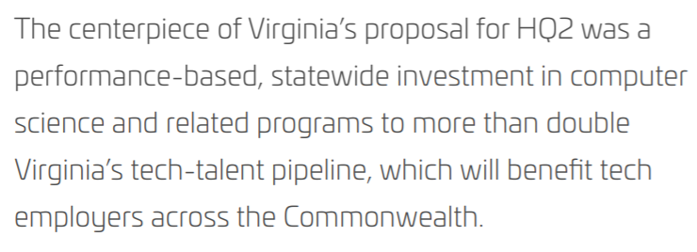
Going Forward
ALIGNED NEED
Stronger healthcare workforce pipeline
Healthcare Workforce
Education Systems
HOW DO WE GET THERE?
POTENTIAL MODEL
Philanthropy
Government
Business

Slide 15
National workforce outlook: 2018-2028 (from GMU analysis)
Occupation | Base Year # of Jobs 2018 | Job Outlook 2018-28 | Employment Change 2018-28 | Hourly Wage / Annual Wage | Education/ Training Required
Emergency Medical Technician/Paramedic¹ | 262,100 | 7% (faster than avg) | 18,700 | $16.50 $34,320 | Postsecondary nondegree²
Certified Nursing Assistant³ | 1,564,200 | 9% (faster than avg) | 137,800 | $28,540 | Postsecondary nondegree
Licensed Practical Nurse⁴ | 728,900 | 11% (much faster than avg) | 78,100 | $22.23 $46,240 | Certificate/ diploma
Clinical/Medical Laboratory Technicians & Technologists⁵ | 331,700 | 11% (much faster than avg) | 35,100 | $25.16 $52,330 | Associates/ Bachelors
Pharmacy Technicians⁶ | 420,400 | 7% (faster than avg) | 31,500 | $15.72 $32,700 | Certificate/ diploma
Radiologic Technologist⁷ | 250,000 | 9% (faster than avg) | 23,300 | $29.44 $61,240 | Associates degree
Surgical Technologist⁸ | 112,100 | 9% (faster than avg) | 9,700 | $22.74 $47,300 | Postsecondary nondegree
Medical (Health) Informatics⁹ | 215,500 | 11% (much faster than avg) | 23,100 | $40,350 | Postsecondary nondegree
Patient Care Tech¹⁰ | 686,600 | 23% (much faster than avg) | 154,900 | $16.16 $33,610 | Postsecondary nondegree
Notes:
1. Bureau of Labor Statistics, U.S. Department of Labor, Occupational Outlook Handbook, EMTs and Paramedics, on the internet at https://www.bls.gov/ooh/healthcare/emts-and-paramedics.htm (visited March 12, 2020).
2. Postsecondary nondegree award is a program that leads to a certificate or other award, but not a degree.
3. Bureau of Labor Statistics, U.S. Department of Labor, Occupational Outlook Handbook, Nursing Assistants and Orderlies, on the Internet at https://www.bls.gov/ooh/healthcare/nursing-assistants.htm (visited February 02, 2020).
4. Bureau of Labor Statistics, U.S. Department of Labor, Occupational Outlook Handbook, Licensed Practical and Licensed Vocational Nurses, on the Internet at https://www.bls.gov/ooh/healthcare/licensed-practical-and-licensed-vocational-nurses.htm (visited February 17, 2020).
5. Bureau of Labor Statistics, U.S. Department of Labor, Occupational Outlook Handbook, Clinic/Medical Laboratory Technologists and Technicians, on the internet at https://www.bls.gov/ooh/healthcare/clinical-laboratory-technologists-and-technicians.htm (visited March 12, 2020).
6. Bureau of Labor Statistics, U.S. Department of Labor, Occupational Outlook Handbook, Pharmacy Technicians, on the internet at https://www.bls.gov/ooh/healthcare/pharmacy-technicians.htm (visited March 12, 2020).
7. Bureau of Labor Statistics, U.S. Department of Labor, Occupational Outlook Handbook, Radiologic and MRI Technologists, on the internet at https://www.bls.gov/ooh/healthcare/pharmacy-technicians. https://www.bls.gov/ooh/healthcare/radiologic-technologists.htm (visited March 12, 2020).
8. Bureau of Labor Statistics, U.S. Department of Labor, Occupational Outlook Handbook, Surgical Technologists, on the internet at https://www.bls.gov/ooh/healthcare/surgical-technologists.htm (visited March 12, 2020).
9. The Office of Management and Budget (OMB) recently approved the addition of the new Standard Occupational Classification (SOC) 29-9020 and detailed SOC 29-9021 Health Information Technologists and Medical Registrars that includes health informatics to the 2018 revision of the Standard Occupational Classification System. Data are not yet available for Health Informatics. Data provided are for the closest match to this emerging occupation, Medical Records and Health Information Technicians. Bureau of Labor Statistics, U.S. Department of Labor, Occupational Outlook Handbook, Medical Records and Health Information Technicians, on the internet https://www.bls.gov/ooh/healthcare/medical-records-and-health-information-technicians.htm (visited March 12, 2020).
10. Patient Care Technician is not identified as an occupational specialty by the Bureau of Labor Statistics. Medical assistants are similar occupation, however, provide a mix of administrative and clinical tasks. Patient Care Technicians are more focused on clinical tasks. Data are not available for Patient care techniciains. Data provided are for Medical Assistants. Bureau of Labor Statistics, U.S. Department of Labor, Occupational Outlook Handbook, Medical Assistants, on the internet https://www.bls.gov/ooh/healthcare/medical-assistants.htm (visited March 12, 2020).

Slide 16
Overview: Amazon Tech Talent Pipeline
KEY POINTS:
Initiative will help to produce an additional 31,000 technology graduates over the next 20 years
11 universities are expected to share a total of $961.5 million in state funding over the next two decades for the expansion of their degree programs and construction of new facilities
The funding will be awarded on an annual basis and is subject to the universities meeting certain enrollment and fundraising targets set by the state
Partners are subject to performance-based agreements to be negotiated with each public community college, four-year college, and university across Virginia that wants to participate
State funding will be provided to recruit faculty, address capital needs, and provide ongoing enrollment support
ADDITIONAL INFORMATION:
https://www.nvtc.org/ThemeDev/Insights/Tech_Talent_Initiative_Workforce_Development.aspx (shared from Tammie)
https://hqnova.com/assets/pdfs/NOVA_Higher-Ed.pdf
https://www.insidehighered.com/news/2019/11/08/virginia-pledges-1-billion-computer-science-degree-expansion

Slide 17
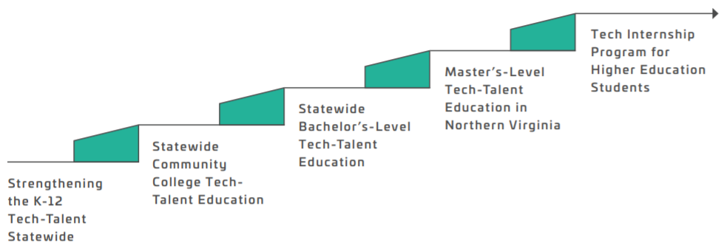
Program Design: Amazon Tech Talent Pipeline
The overall program includes five components: (1) a K-12 tech-talent pipeline initiative; (2) a community college program; (3) bachelor’s-level education; (4) master’s-level education; and (5) a tech internship program for higher education students.
Indicates particularly relevant to CMS program
This investment will enable the Commonwealth to provide ongoing professional development to current and future teachers; create, curate, and disseminate high-quality curriculum and resources; support summer and after-school programming for students; and facilitate meaningful career exposure and work-based learning opportunities in high-demand fields
State leaders will collaborate with the Virginia Community College System (VCCS) and community college leaders to craft performance-based community college tech talent programs that will complement the bachelor’s- and master’s level tech-talent education programs
Performance-based tech-talent investment fund through which 7 higher education institutions across Virginia can receive startup funds for faculty recruitment, state capital investment (where required), and enrollment funding necessary to expand the number of bachelor’s degrees they confer annually in computer science and closely related fields (e.g., computer engineering)
These performance-based, master’s-degree-level investments will be provided on a dollar-for-dollar matching basis for philanthropic funds raised by George Mason University for its Arlington campus and Virginia Tech University for a new graduate-level Innovation Campus expected to be located in Alexandria
The State Council of Higher Education for Virginia (SCHEV) will develop a higher education program to ensure that all students in baccalaureate programs in computer science and related fields have access to high-quality work-based learning, such as internships, apprenticeships, research experiences, and cooperative education programs

Slide 18
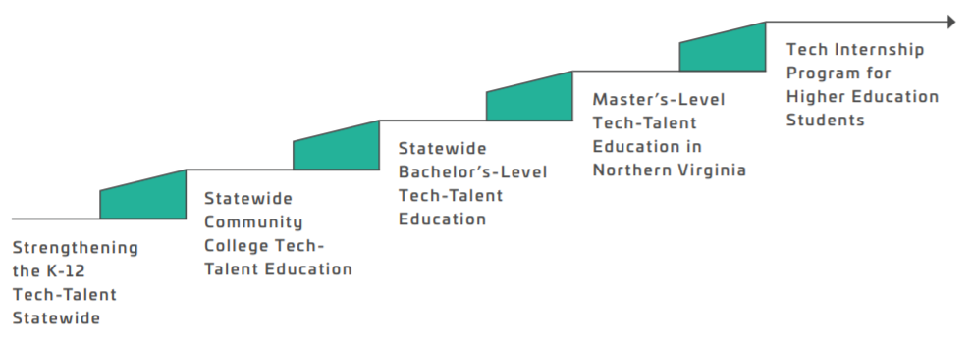
What Do We Mean By “Healthcare Workforce Pipeline”?
Continued Professional Education
Populations engaged throughout pipeline:
Students: K-12, Community college, Universities
Adult learners
Displaced workers
Professionals
Military populations and veterans
Ex-offenders
Advanced Degree from Universities
Bachelors Degree from Universities
Certificate/ Associates Degree from Community Colleges
K-12 Education (including CTE Programs)
Other initiatives related to developing the VA workforce pipeline:
AHECs | VA Area Health Education Centers that support for health career education, advancement, pipeline development and job placement; led by VHWDA
G3 | Governor’s “Get Skilled, Get a Job, Give Back” initiative that gives financial support to low- and middle-income students for community college
Virginia Ready | Retraining initiative to support unemployed and displaced workers to combat COVID-19 job losses; supported by coalition of leading businesses
GO Virginia | State-led Growth and Opportunity program with regional offices; launched by business leaders to drive private-sector growth and foster regional collaboration
Health Accelerators | A program with the Community Colleges where MFA is a partner
Roanoke Pilot | 2020 pilot program led by Del. Austin and Cynthia Lawrence with 3 public school systems and 5 employers; currently have state funding, with future funding flows TBD
Throughout the pipeline:
Work-­based learning opportunities (e.g., internships, apprenticeships)
Stackable credentials (e.g., degrees and certificates)
Virtual learning
Professional and career development (e.g. application & interview prep)
Mentorship

Slide 19
Healthcare Education Career Pathways
Healthcare Career
Pathway 1: Non-Clinical/Non-Specialized
Front Desk/Registration Administrative Specialist
Dental Assistant
Home Health / Nursing Aid
Medical Assistant
Physical Therapy Aid
Community Health Worker
Pathway 2: GED + Lic./Cert.
Certified Medical Assistant
EMT / Paramedic
Dental Assistant
IT / Support Analyst
Certificate or License
WORK
Pathway 3: Associates Degree + Lic./Cert.
Radiology Tech
Medical Lab Tech
Pharmacy Tech
Surgical Tech
Registered Nurse
Health Informatics
Respiratory Therapy
Pathway 4: Bachelors Degree + Lic./Cert.
Radiology Science
Pharmaceutical Science
Surgical Technology
Nursing (BSN, MSN)
Medical Science
Health Informatics
Certificate or License
Advanced Degree
WORK
WORK
Certificate or License
4-year University
4-year University
Pathway 5: Advanced Degree + Lic./Cert.
Radiology Science (MD)
Pharmaceutical Science
Nursing (BSN, MSN)
Medical Science (NP, MD, DO)
Health Informatics (MA)
Surgeon
WORK
WORK
WORK
Certificate or License
Community College
Community College
Community College
Pathway 1
Pathway 2
Pathway 3
Pathway 4
Pathway 5
High School GED Graduate
Certification / Licensure
Associated Deg. / Community College
Bachelors Deg. / 4-year University
Advanced Deg.
Other example: NOVA Career Ladder - https://www.nvcc.edu/workforce/research/_docs/Healthcare-Career-Ladder-Final.pdf

Slide 20
External Research: Themes and Trends
Increasing demand for online instruction
Increasing community college enrollment
Uncertainty of classroom instruction (in-person, virtual, or hybrid)
Concern about learning losses in K-12 schools
Rising interest in dual-enrollment courses
Students reconsidering attendance at 4-year institutions in fall 2021
Lack of digital infrastructure and/or internet access for some populations
Increasing evidence on the future payoff of dual-enrollment courses
Closing of some higher education institutions due to financial strain
Sources: https://www.cgdev.org/blog/six-ways-covid-19-will-shape-future-education, https://www.the74million.org/article/college-classes-for-hs-students-have-been-growing-in-popularity-but-with-k-12-schools-shuttered-covid-is-fueling-a-dual-enrollment-boom/

Slide 21

Potential Role of Stakeholders in Supporting Health Sciences Programs
# | Need | Local / State Government | Employers (i.e. Healthcare Systems) | Claude Moore | Other Philanthropies
1 | Public school infrastructure and staff
2 | Teacher and staff salary
3 | Learning curriculum
4 | Regulation for teaching credentials / licensing
5 | Teacher credentialing costs and fees
6 | Student dual enrollment / tuition costs and fees
7 | Instructional material / consumables
8 | Equipment
9 | Facility refurnishing and improvement
10 | Internships / apprenticeships
11 | Transportation to courses or WBL
12 | Regional structure and local community collaboration support
13 | Sustainable support for CTE program needs

Slide 22

Virginia’s Healthcare Workforce Pipeline
2.2 M
Virginians live in mental healthcare shortage areas¹
1.6 M
Virginians live in primary care shortage areas¹
The Problem
KEY IMPACTS & CHALLENGES IN VIRGINIA’S CURRENT PIPELINE
1.3 M
Virginians live in dental care shortage areas¹
There are healthcare workforce shortages across Virginia that create barriers to accessing care and lead to poorer health outcomes. In addition, there is a lack of support (e.g., training and awareness) for young people to pursue diverse and sustainable healthcare careers in their local communities.
Possibility of “broadcast teaching” for remote delivery of courses
New channels and flexibility available to meet requirements for internships and clinical hours
34% to 57% of healthcare needs go unmet in these specialty areas¹
20%
3%
Proposed Solution
Rising demand for telehealth and need to update training and credentialing programs
Build out the educational and training pipeline to support a robust healthcare workforce in each community. Filling the need for high demand positions requires early engagement in middle and high school, strong health sciences programs, opportunities for dual enrollment, and portable & stackable credentials at higher educational institutions (among other things).
More optimized, efficient use of qualified faculty and potential to adjust state requirements and regulations
Nearly 20% of all job openings were in the health sciences in 2013²
YET Only 3% of high school career and technical education courses in Virginia are in the health sciences²
Recruiting a diversity of students and expanding knowledge of opportunities available
What’s Needed?
121,556 jobs
Recognized credit for prior learning in meeting certificate or training requirements
The healthcare and social assistance industry in Virginia is projected to require an additional 121,556 jobs from
2018 to 2028³
What’s needed for the proposed solution?
Early engagement and recruitment of diverse populations
Planning for health sciences programs
Engaged, passionate student cohorts
Credentialed, qualified teachers
Mentoring, advising, and other "wrap around" services
Equipment, instructional material, and classrooms
Ability to earn college credit through dual enrollment
Recognized credit for those courses (stackable, portable)
Internships, clinical experiences, & work-based learning
Transportation to learning locations
Data to inform areas and positions of highest need
Rising demand for education programs (i.e. nursing) and ways to increase the capacity of institutions
This is the largest growth industry in the state, followed by professional, scientific, and technical services⁴
Importance of a workforce that reflects the demographic & social characteristics of the communities it serves
2018
2028
Sources: 1) Kaiser Family Foundation, 2) Virginia’s Workforce Development Programs, 3) Virginia Employment Commission, 4) Projected to 2026: Virginia Job Outlook

Slide 23
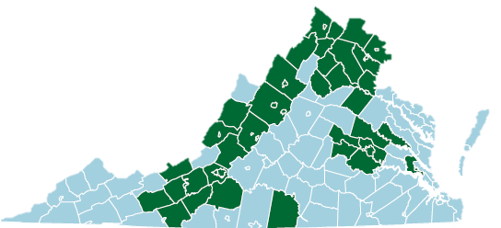
Claude Moore Scholars Program
The mission of Claude Moore Scholars (CMS) is to contribute to developing the healthcare workforce pipeline by supporting students pursuing a career in healthcare and preparing them to be job and/or higher education ready upon the completion of high school. In doing so, CMS exposes students to new opportunities, enables them to support themselves and their families, and supports the development of a robust healthcare workforce to fill the need for high demand positions.
ROLES OF CLAUDE MOORE CHARITABLE FOUNDATION
ABOUT CLAUDE MOORE SCHOLARS
Identify and Engage Early on, engage middle and high school students and their families in potential healthcare career opportunities, including allied health positions
Since the program’s inception in 2003, about 6,000 students have participated, earning over 1,000 industry certifications/licenses and over 9,000 college credits.
CMS provides workforce training and certification in:
Licensed Practical Nursing/Certified Nursing Assistant
Emergency Medical Technician
Medical Laboratory Technology
Pharmacy Technology
Radiology Technology
Surgical Sterilization Technology
Health Informatics
CMS is currently active in Northern Virginia, the Northern Shenandoah Valley, the Greater Richmond area, and in Greater Roanoke. The program includes 23 school districts, 5 higher education organizations (i.e., community college and university), and numerous employers
Catalyze Provide initial funding and extras for health sciences programs (beyond tax payer dollars) , including support to CTE health sciences teachers
Influence Engage with politicians and advocacy groups at the state level to facilitate a broader conversation about the healthcare workforce pipeline
Network Build and sustain partnerships within each community and across the state to sustain the program
Convene Create a learning collaborative and virtual community of practice to share insights across partners and localities
Contact Information: Dr. Bill Hazel (whazel@claudemoore.org), Lynn Tadlock (ltadlock@claudemoore.org)
GOALS GOING FORWARD
Expansion Scale across the state to communities that demonstrate need and readiness, and that align to the mission of the program
Effectiveness Improve effectiveness of program and impact of funding by building new, and enhancing current, partnerships
Data Research and collect data to demonstrate the impact of the program and better understand priority areas for expansion
Diversity Diversify the types of students served and the funding options available to grantees based on the highest needs in each community

Slide 24

NURSING FACILITY Rate Setting
Sonja Lee-Austin
Provider Reimbursement Manager
Sara Benoit
Provider Reimbursement Analyst

Slide 25
Nursing Facility Medicaid Reimbursement
Managed Care Organizations (MCOs) Cover the Majority of Nursing Facility
Half of Expenditures are Covered by Federal Financial Participation (FFP)
DMAS expends nearly $1 billion annually for nursing facilities
Notes:
Majority of reimbursement is by MCOs
$1B on NF

Slide 26

Nursing Facility Price-Based Methodology 12VAC30-90-44
Creating Rates
Rates
Locate Regulations
Gather Data Sources
Apply Calculations
https://law.lis.virginia.gov/admincode/title12/agency30/chapter90/section44/

Slide 27
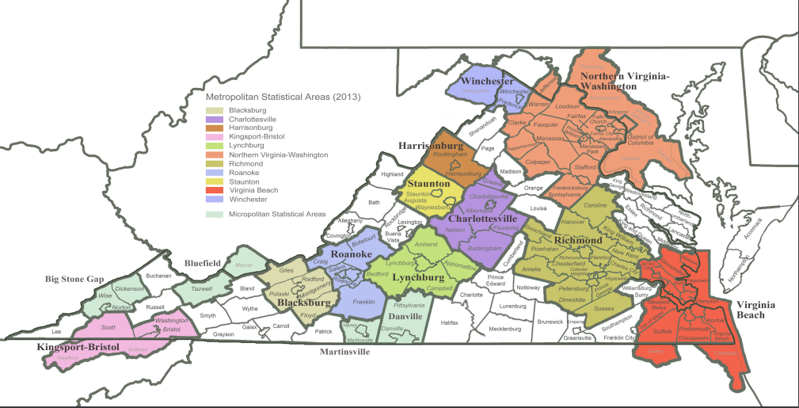
Peer Groups
Definition:
A group of facilities that share similar characteristics.
Facilities within a peer group are typically located close to each other, provide a similar services, and can be similar in size.
Peer groups help providers get paid more accurately.
Providers in more expensive areas are paid more while providers in less expensive areas are paid less.
Notes:
Derived from wage indexes
Metropolitan Statistical Areas mapping – determine if Urban 3 or Urban 4
Urban 3 is “special” – includes Northern VA
Urban 4 is catch-all (peer group very big – most of facilities, other groups are small)
Micropolitian are considered Rural
Use census data
Peer groups – like experience – urban NOVA, rural North, South, small facilities

Slide 28
Data Sources
Fee-for-Service Data
MCO Data
Provider Cost Report Data
Patient Acuity
Inflation
Grouper Software
Peer Groups

Slide 29
Cost Categories and Reimbursement Equation
Direct Costs
47%
Indirect Costs
44%
Capital Costs (building and fixed equipment)
9%
Nurse Aid Training (NATCEP)
>1%
Criminal Records Checks (CRC)
>1%
Direct Operating Costs
(Nursing & Ancillaries)
X RUG Case Mix
Indirect Operating, Capital, NATCEP & CRC Costs
Per Diem Rate
Notes:
Use reported Medicaid costs, patient days and case mix data (CMI) to calculate daily costs by facility
Patient Acuity/Case Mix is determined at the facility by the MDS Coordinator
Assign each facility to a peer group
Determine a direct and indirect day-weighted median for each peer group using costs
Direct
Direct cost > nursing > clinical care
Direct cost about 50% of total care
Indirect cost about 40%
Capital about 10%
CRC really small
Indirect
Includes Dietary
Apply adjustment Factors
Apply “profit cap” for low cost facilities
Provider rates are recalculated every 3 years using cost data.
Reimbursement Rates are prospective.
Providers are responsible for managing an individual’s cost of care
Individuals are grouped into clinical/resource categories for reimbursement. (RUGs)
Cost data are divided into peer groups to account for differences in geographical cost differences or facility size
Rates based on NF cost per day from Cost Reports – base data is their cost
Establish rate at higher cost for direct cost because clinical care is high priority
Rate higher for direct than indirect
Adjust rate by clinical adjustment factor – encourage facilities

Slide 30
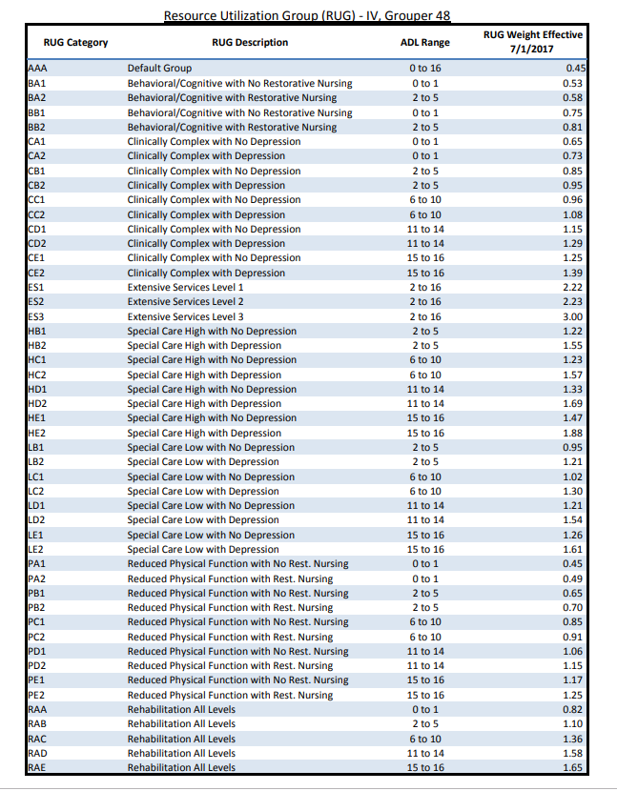
Resource Utilization Groups (RUG)
RUG Codes are Broken Down into Clinical Categories
RUG measures resources needed for different levels of acuity
Each RUG has a number between 0.45 and 3.00
The Case Mix Index (CMI) is calculated from RUG Weights to obtain the average patient acuity by facility
Higher numbers indicate a higher use of resources and expenses
The CMS Minimum Data Set (MDS) survey instrument is a standard questionnaire
MDS assessments are required for reimbursement

Slide 31
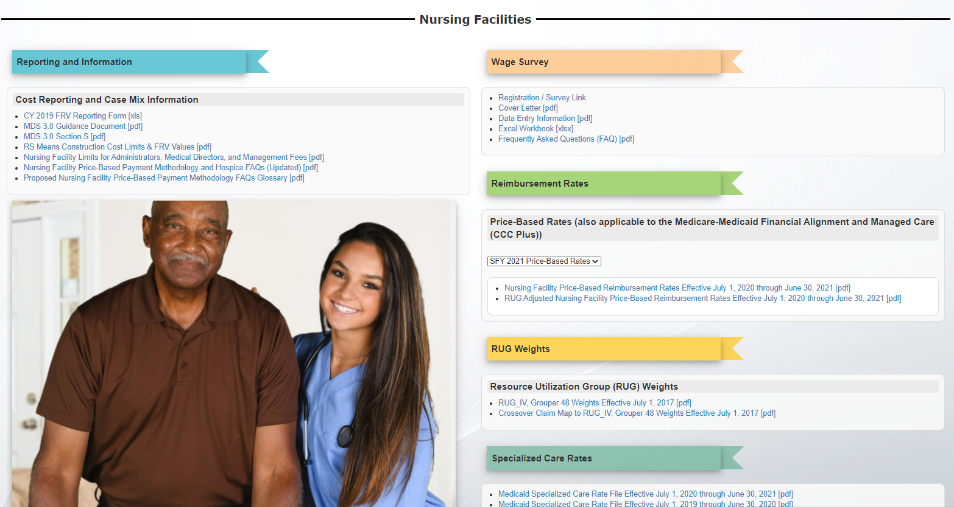
DMAS Nursing Facility Web Resources
https://www.dmas.virginia.gov/#/nursingfacilities

Slide 32
Virginia Civil Monetary Penalty (CMP) Projects in Nursing Facilities
August 17, 2020
Division for Aging & Disability Services
Service Collaboration Trust Adaptability Problem-Solving

Slide 33
Agenda
Overview
Use of Funds
Program Cycle
State Fiscal Year 2019 Projects
State Fiscal Year 2020 Projects
COVID-19 Communicative Technology
Service Collaboration Trust Adaptability Problem-Solving

Slide 34
CMP Funds Overview
The CMP Fund is a collection of monetary penalties that CMS may impose against Skilled Nursing Facilities (SNFs), nursing Facilities (NFs), for either the number of days or for each instance a facility is not in substantial compliance with one or more Medicare and Medicaid participation requirements for Long-Term Care Facilities (LTC).
The requirements for participation with Medicare and Medicaid for (LTC) facilities may be found at 42 CFR 483.430
In all states, CMP funds are used for projects that directly benefit individuals residing in a nursing facility.
Service Collaboration Trust Adaptability Problem-Solving
Notes:
42 CFR 483.430 - Condition of participation: Facility staffing.
Sanctions from the surveys
Can range from DPNA → Fines

Slide 35
CMP Funds Overview
The goal of the CMP Funds is to help protect and improve the quality of life and care for individuals residing in nursing facilities.
Projects must be approved by CMS.
New CMS directive requires states to formalize the CMP application process.
DMAS is required to report annually on collection and spending activities to the General Assembly.
Service Collaboration Trust Adaptability Problem-Solving

Slide 36
Allowable Projects
Not to exceed three (3) years
Direct Improvements to Quality of Care
Consumer Information
Resident or Family Councils
Training
Culture Change
Emergency Preparedness
Examples are taken from S & C Letter 12-13-NH, issued on December 16, 2011
Service Collaboration Trust Adaptability Problem-Solving
Notes:
Examples of previously funded projects from other states
Resident Transition due to NF Closure or Downsizing
Transition Preparation

Slide 37
Nursing Facility Closures or Disasters (Extreme Cases)
Virginia maintains a base funding to provide assistance, support, and protection for individuals in the event that a nursing facility:
Closes voluntarily
Closes involuntarily
Loses Medicare or Medicaid certification and individuals require relocation
Experiences an emergency or natural disaster, including when individuals must be evacuated or transferred to alternative locations
Service Collaboration Trust Adaptability Problem-Solving
Notes:
Separate from the funds used for special projects.

Slide 38
Prohibited Uses
Making capital improvements to a facility
Fund for items or services that are already the responsibility of the nursing facility (non-supplanting)
Projects or activities intended to achieve compliance
Funding projects, items or services that are not related to improving the quality of life and care for individuals residing in a nursing facility
Examples come from State Operations Manual, Chapter 7 “Survey and Enforcement Process for Skilled Nursing Facilities and Nursing Facilities (rev. 160, 09-23-16)
Service Collaboration Trust Adaptability Problem-Solving
Notes:
Disapproved uses decided by CMS.

Slide 39
Prohibited Uses Cont.
Projects for which a conflict of interest or the appearance of a conflict of interest exists
Long-Term projects (greater than 3 years)
Temporary manager salaries – New adjustment
Supplementary funding of federally required services
Long-Term Care Ombudsman salaries
Service Collaboration Trust Adaptability Problem-Solving

Slide 40
DMAS Application Process-Original
RFA and Medicaid Bulletin
January 2020
Cover Sheets
February 3, 2020
February 28, 2020
Applications
March 2, 2020
March 31, 2020
April 1, 2020
DMAS Review and Approval
April 30, 2020
CMS Review and Approval
May 1, 2020
June 15, 2020
Contracting
June 15, 2020
July 1, 2020
Service Collaboration Trust Adaptability Problem-Solving
Notes:
MEMO – Provide notice of the funds, and information about applying. Wanted to reach Medicaid providers and stakeholders
Covers – Helped give a quick glance at projects that were coming in, and assess capacity for available funds and reviewing
Application – 10 pages, asked about outcomes, deliverables and research on projects
Guidelines – Help support applications, get them in tip top shape
CMS Review- Final approval, and questions about projects aligning with CMP guidelines
Site Visits – Check in with projects, seeing where the work is happening, kick off working relationships
Reporting- Projects will submit; review of project timeline, accomplishments and spending
External Notice – Memo
CMP Request for Funding Cover Sheet
CMP Request for Funding Application
DMAS Internal Review
CMS Submission & Review
Project Site Visits
Contracting & Quarterly Reporting

Slide 41
DMAS Application Process-Adjusted for COVID-19
RFA and Medicaid Bulletin
January 2020
Cover Sheets
February 3, 2020
February 28, 2020
Applications
March 2, 2020
July 15, 2020
Postponed until 2021
Review, Approvals, and Contracting
Service Collaboration Trust Adaptability Problem-Solving
Notes:
MEMO – Provide notice of the funds, and information about applying. Wanted to reach Medicaid providers and stakeholders
Covers – Helped give a quick glance at projects that were coming in, and assess capacity for available funds and reviewing
Application – 10 pages, asked about outcomes, deliverables and research on projects
Guidelines – Help support applications, get them in tip top shape
CMS Review- Final approval, and questions about projects aligning with CMP guidelines
Site Visits – Check in with projects, seeing where the work is happening, kick off working relationships
Reporting- Projects will submit; review of project timeline, accomplishments and spending
External Notice – Memo
CMP Request for Funding Cover Sheet
CMP Request for Funding Application
DMAS Internal Review
CMS Submission & Review
Project Site Visits
Contracting & Quarterly Reporting

Slide 42
Postponing 2020 Cycle
Deadline for full apps already extended until June 15th
Applicants, LeadingAge, VHCA, expressing concern about ability to meet deadline with other priorities.
Concern over project start date and COVID-19 related restrictions/limitations.
DMAS will continue with extensions for those projects which received multi-year funding.
CMS has approved postponing review of applications.
Guidance for Communicative Technology states: “Furthermore, approval of proposals to use CMP funds for other purposes may be temporarily suspended during this public health emergency.”
Service Collaboration Trust Adaptability Problem-Solving

Slide 43
SFY 2019 Projects
Service Collaboration Trust Adaptability Problem-Solving

Slide 44
Person Centered Trauma-Informed Care Training
DMAS contracted with VCU School of Gerontology
Purpose to provide CNAs trauma-resilience training
54 CNAs participated in 9 training sessions
95 Interdisciplinary team members from 21 nursing facilities participated in trainings and curriculums
Project successfully concluded November 2019
Service Collaboration Trust Adaptability Problem-Solving

Slide 45
Advanced Nurse Aide Revitalization Project for Rockingham County
Purpose to create and deliver a curriculum for Advanced Certification for CNAs
To learn additional skills to improve care and well-being of nursing facility residents
Create a career path and advancement ladder for better staff retention and to decrease burnout
DMAS Contracted with LeadingAge Virginia
Delayed start due to COVID-19
Service Collaboration Trust Adaptability Problem-Solving

Slide 46
Restorative Sleep Program
Purpose to create a positive nighttime environment by addressing common sleep disturbances
Consultants to provide education and training workshops on sleep disturbances, their effects and methods to address them
DMAS contracted with Riverside Center for Excellence in Aging and Lifelong Health
Project was affected by COVID-19 and an amended agreement was signed to continue work through December 31, 2020
Service Collaboration Trust Adaptability Problem-Solving

Slide 47
Reducing Preventable Rehospitalizations
Purpose to provide statewide training to providers on INTERACT 4.0 Tools
Tools coordinate communication between nursing facilities and hospitals to elevate overall quality of care for residents by reducing preventable readmissions
DMAS contracted with Virginia Health Care Association
Project was interrupted by COVID-19 and an amended agreement was signed to continue work through December 31, 2020
Service Collaboration Trust Adaptability Problem-Solving

Slide 48
Holistic Wellness
Project involves a two-pronged approach:
Education: person centered Eden Alternative training
Engagement: the Birdsong Initiative, a program for residents utilizing personalized person-centered and user-friendly computer tablets
Project led by Birmingham Green through contract a with DMAS
Project was affected by COVID-19. Ongoing trainings are on hold.
Service Collaboration Trust Adaptability Problem-Solving

Slide 49
Music and Memory Initiative
Purpose to implement and sustain person-centered, non-pharmacological intervention (MUSIC & MEMORY®) for residents with dementia:
To positively affect behavior and stimulate emotions; and,
To provide continuous, web-based, micro-learning to staff to help them understand the value of personalized music and when and how to use it
DMAS contracted through George Mason University
Interventions are on hold due to COVID-19 restrictions
Service Collaboration Trust Adaptability Problem-Solving

Slide 50
SFY 2020 Projects
Service Collaboration Trust Adaptability Problem-Solving

Slide 51
Virginia Wound Care Excellence Program for Certified Nursing Facilities
Project focused on wound care, a major challenge within nursing facilities
Virtually educating nurses in wound care through 11 courses and a certifying final exam certifying 150 nurses in wound care
DMAS contracted with VOHRA Wound Physicians.
The Project successfully completed in June 2020 with 150 nurses certified in wound care. The number of long-stay residents with pressure ulcers decreased 43% in participating facilities.
Service Collaboration Trust Adaptability Problem-Solving

Slide 52
Peer Mentoring Program at Westminster Canterbury Lynchburg
Purpose to develop a Peer Mentoring Program to advance a culture of Person-Directed Living:
Provide peer mentors with resources needed to guide, coach, and assist CNAs within the household utilizing person directed services
DMAS contracted with Westminster Canterbury Lynchburg. The facility is working with consultant, PHI.
Consultant is continuing working on curriculum development, but team meetings focusing on implementation are on hold due to COVID-19.
Service Collaboration Trust Adaptability Problem-Solving

Slide 53
COVID-19 Communicative Technology
In Spring of 2020 CMS launched the Communicative Technology initiative in response to COVID-19 and issued guidance for Infection Control and Prevention.
Nursing facilities could request up to $3,000 in CMP funds per facility to purchase devices and accessories for residents to share. Devices must be able to support both virtual social and telehealth visits.
DMAS approved 195 facilities to use CMP funds to purchase communicative technology for a total cost of $491,523.
Service Collaboration Trust Adaptability Problem-Solving

Slide 54

Questions
CMPFunds@dmas.virginia.gov
Service Collaboration Trust Adaptability Problem-Solving

Slide 55

Nursing Home Clinical Workforce in the Commonwealth
Meaghan Green
Office of the Chief Workforce Advisor to
Governor Ralph Northam
Notes:
Megan

Slide 56

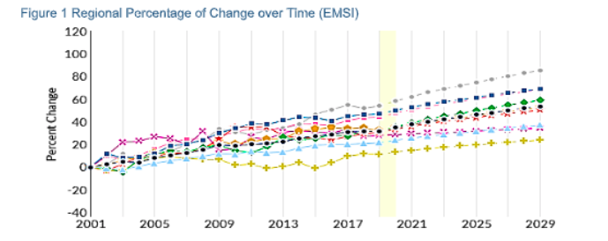
What We Know
Positive projected employment growth in long term care facilities
Number expected to increase across all regions

Slide 57
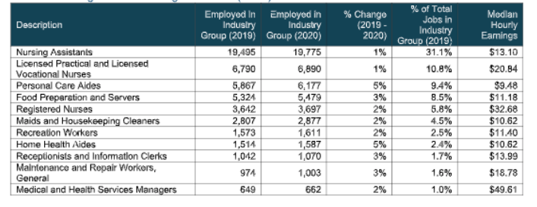
What We Know

Slide 58


Opportunities Presented by the COVID-19 Crisis

Slide 59
Top 3 Sectors with Greatest Projected Unemployment

Slide 60
Top Occupations Within Three Target Industries
Notes:
These occupations are a prime target for retraining. How can we move individuals into new positions that offer them greater job stability.

Slide 61
Wages
Notes:
Nursing assistants make up a little over a third of the personnel and receive $13.10 an hour. According to MIT, a living wage in Virginia averages
$14.00 an hour. Over the years, many retail and fast food restaurants pay this same wage or higher.

Slide 62


Training

Slide 63

Training
The VA Ready Scholars program was created for people who are recently out of work due to the economic impact of Covid-19.
$1000 Credential Achievement Award and opportunities to interview with VA Companies

Slide 64
COVID-19 Training
$3.3 Million - National Dislocated Worker Grant for disaster assistance
VCCS is ready to deploy two healthcare aide education programs, with the majority of training online:
Track 1 - Available to students with some healthcare background and training
Track 2 - Available to displaced workers and students with no healthcare background or training
The goals of the initiative are 1) rapid implementation, 2) online training, 3) to help close the healthcare workforce gap, and 4) result in continued employment post-pandemic.

Slide 65
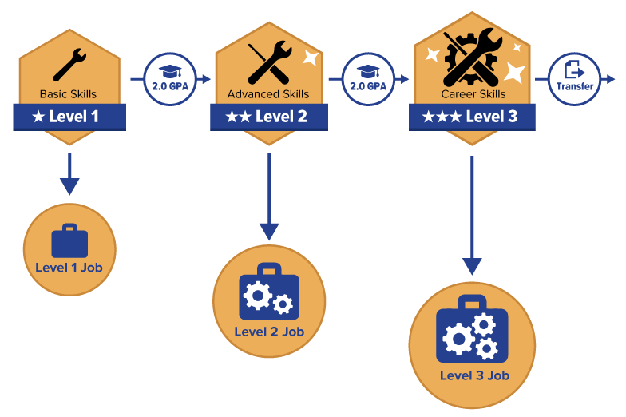
Career Pathways
G3: Get a Skill, Get a Job, Give Back
The G3 Grant Program makes community college more affordable for low- to middle- income families seeking employment in high-demand sectors such as technology, skilled trades, healthcare, early childhood education, and public safety.

Slide 66
Lessons Learned from the COVID-19 Crisis

Slide 67
Retention Strategies
Pay Increases | Hourly pay increases proportional to regional living wage standards
Transportation, Childcare, etc. | Connections to childcare, weekly childcare or transportation stipends, gas cards, etc.
Peer Mentoring | Relationships with peers can help workers with feelings of isolation, challenges on the job, and problem solving
Education and a Career Path | Opportunities for career advancement through education for the majority of workers with less than an associate’s degree
Notes:
Peer mentoring programs

Slide 68


Keith Hare
President and CEO
Chapter 932 Work Group Meeting
August 17, 2020

Slide 69

342 Provider Members
250 Nursing Homes
30,193 beds, representing 92.5 % of Virginia’s total NH beds
92 Assisted Living Facilities
6,339 Assisted Living Beds
75% for-profit | 25% not-for-profit/government affiliated
Notes:
VHCA-VCAL Membership
342 Provider Members
250 Nursing Homes | 30,193 Nursing Beds | 92.5% of Virginia’s nursing beds
92 Assisted Living Facilities | 6,339 Assisted Living Beds

Slide 70

Virginia’s Nursing Facilities
“Typical” NH has ~120 dually-certified beds
Short-term rehab services (usu. Medicare)
Long-term services and supports (almost exclusively Medicaid)
Before COVID, occupancy averaged 86% (i.e., the average NH was providing care for ~102 patients/residents)
90K patients served each year
Employ nearly 30,000 FTEs
More than half are direct care and therapy providers
Personnel costs = largest expense
Notes:
90,000 patients served each year
Most are short-term rehabilitation stays with successful return to the home environment
Virginia’s LTC facilities* support an estimated $9.95 billion in economic activity
79,034 direct jobs | 26,867 indirect and induced jobs | 105,901 total jobs

Slide 71
Residents in Our Care
6 in 10 Virginia Nursing Home Residents Rely on Medicaid for Their Care
Breakdown of Nursing Facility Utilization Data by Payer
Source: Virginia Health Information, 2016
Notes:
Occupancy (pre-COVID) was estimated at 86%, meaning on any given day, the typical nursing facility would be providing care for about 102 patients/residents
On average, about two-thirds of the care is long-term care funded by Medicaid
Medicare-covered short stays represents another 15.5% of utilization
The remaining utilization is from other government payers (Veteran’s Administration, for example), commercial insurance, and private pay
Many long-term care residents start as “private pay” until they diminish their assets and achieve Medicaid eligibility (no more than $2,000 in assets)

Slide 72
Residents in Our Care
Average age of a long-stay resident = 79.1 years
Highly dependent for assistance needing help with 8.1 ADLs*
54% of have some form of dementia
*Virginia’s metrics for long-term care residents are higher than the national average, meaning their care needs are greater.
Notes:
Occupancy (pre-COVID) was estimated at 86%, meaning on any given day, the typical nursing facility would be providing care for about 102 patients/residents
On average, about two-thirds of the care is long-term care funded by Medicaid
Medicare-covered short stays represents another 15.5% of utilization
The remaining utilization is from other government payers (Veteran’s Administration, for example), commercial insurance, and private pay
Many long-term care residents start as “private pay” until they diminish their assets and achieve Medicaid eligibility (no more than $2,000 in assets)

Slide 73

Medicaid & Nursing Home Care
Despite the higher acuity, Virginia’s Medicaid rates for NF care are among the lowest in the country
10% below the national average
Even with the temporary $20 increase due to COVID costs, Virginia’s average rate is still below the national average
Since 2008, it is estimated that Virginia Medicaid has underfunded nursing facility care by over $600 million
2021 = a $75 million shortfall (pre-COVID)
Notes:
Underfunding is defined at reimbursement below costs

Slide 74
Medicaid & Nursing Home Care
Although Medicaid is about 2/3 of NF utilization, it represents less than half of the revenue for the typical NF
Medicare / other payers subsidize the low Medicaid rates
Average operating margin (patient revenue in excess of operating expenses) = 1.7% for Virginia NF
Nearly 4 in 10 nursing facilities had negative margins
Source: Virginia Health Information, 2018 data (most recent available)

Slide 75
The Impact of COVID-19
Significant drop in occupancy
Through July, NFS have experienced an 11% drop in daily census – higher in facilities with outbreaks
A reduction in occupied beds does not mean equally reduced costs
Resultant loss in revenue
Estimated at $141 million (March-July), which equals 5.9% of annual patient revenue
Notes:
Last but not least, there have been significant drops in the number of patient/residents being cared for in nursing facilities, resulting in a significant decline in revenue supporting nursing facility costs
A reduction in occupied beds does not translate to equally reduced costs
Through July, Virginia nursing facilities have experienced a nearly 11% drop in the daily census
This drop is even more significant in facilities experiencing outbreaks
The associated lost revenue is estimated to be over $130 million through July, and this trend and effect is likely to continue for the foreseeable future
In terms of magnitude, $130 million (five months) equates to roughly 5.5% of annual patient revenue (VHI data cited earlier), that without this revenue decline resulted in a margin of only 1.7%)

Slide 76
The Impact of COVID-19
LTC facilities have been at the center of the fight against COVID-19
Determining factors in nursing facility outbreaks according to independent academic analysis:
Location of a nursing home
Asymptomatic spread
Availability of testing
Notes:
Not factors in outbreaks:
Quality ratings
Infection citations
Staffing
Note: new study from JAMA is attributing it to staffing.

Slide 77
COVID Resources and Needs
COVID-related costs have been staggering
PPE use and costs have seen dramatic increases
Personnel costs have increased dramatically though hero pay, overtime, contract staffing, daycare, sick leave, etc.
Testing costs are significant
Notes:
While the funding relief has been very welcome and has essentially allowed nursing facilities in Virginia to continue to operate, the COVID costs have been staggering
Personal Protective Equipment (PPE) use and costs have seen dramatic increases
Personnel costs have increased dramatically though “Hero” pay, overtime, contract staffing, daycare, sick leave, etc.
Costs associated with COVID Testing are significant
While diagnostic tests may be covered by Medicare/Medicaid/Insurance, routine testing (for re-opening and on-going monitoring) is often not covered
Last but not least, there have been significant drops in the number of patient/residents being cared for in nursing facilities, resulting in a significant decline in revenue supporting nursing facility costs
A reduction in occupied beds does not translate to equally reduced costs
Through July, Virginia nursing facilities have experienced a nearly 11% drop in the daily census
This drop is even more significant in facilities experiencing outbreaks
The associated lost revenue is estimated to be over $130 million through July, and this trend and effect is likely to continue for the foreseeable future
In terms of magnitude, $130 million (five months) equates to roughly 5.5% of annual patient revenue (VHI data cited earlier), that without this revenue decline resulted in a margin of only 1.7%)

Slide 78
The Impact of COVID-19
Nursing facilities have received funding to help fight the pandemic
CARES Act – Provider Relief Funds – used for:
Testing
PPE
Staffing (overtime and hero pay)
$20/per resident/per day Medicaid add-on
Provided by the Governor and General Assembly during the public health emergency
Notes:
Nursing facilities have received significant funding to help address the COVID pandemic
As mentioned on a previous slide, the Governor and General Assembly have provided an additional $20 per day per Medicaid recipient during the emergency
Congress passed the CARES Act which contained significant direct provider relief, from which nursing facilities have received funding
The Governor recently provided an additional $33 million (not yet distributed) from CARES Act funding received by the Commonwealth

Slide 79
Workforce Solutions
Temporary Nurse Aide
COVID-19 response
Governor’s Healthcare Workforce Advisory Council
Virginia Community College System
FastForward Virginia
Claude Moore Foundation
Claude Moore Scholar Program
VHCA-VCAL Nurse Scholarship
490 scholarships awarded since 1998 for individuals who commit to working in LTC
Scholarships total $640,475

Slide 80


Slide 81
Next Steps

Slide 82
Other business

Slide 83
adjourn

