Slide 1
Welcome to the Ch. 932 (2020 Acts of Assembly) Work Group Meeting August 4, 2020 1:00 p.m.
To ensure an orderly meeting all attendees have been muted. We will allow 5 minutes at the start of the meeting for everyone to log on and begin at 1:05p .m.
If you are a member of the media, please contact Rebekah Allen in the chat panel.
This meeting will be recorded.
If you have called in on your phone and using a computer please mute your mic and turn off the sound on your computer.
Notes:
Alex start the meeting; will tell attendees what to do.

Slide 2
Call to Order and Welcome

Slide 3
Introductions & Roll Call
Work Group Member | Organization or Agency
Alaysia Black Hackett | Chief Diversity Officer
Megan Healy | Chief Workforce Development Advisor
Judy Jackson | Department for the Blind and Vision Impaired
Karen Brimm | Department for the Deaf and Hard of Hearing
Joani Latimer | Department of Aging and Rehabilitative Services
Gail Thompson | Department of Aging and Rehabilitative Services
Jewel Bronaugh | Department of Agriculture and Consumer Service
Kathryn Paxton | Department of Agriculture and Consumer Service
Charlette Ridout | Board of Nursing, Department of Health Professions
Elizabeth Carter | Healthcare Workforce Data Center, Department of Health Professions
Corie Tillman Wolf | Board of Long-Term Care Administrators, Department of Health Professions
Kurt Elward | Department of Medical Assistance Services
Barbara Seymour | Department of Medical Assistance Services
Randall Stamper | Virginia Community College System
Notes:
Alex: Please introduce yourself in the order you appear.

Slide 4
Introductions & Roll Call
Work Group Member | Organization or Agency
Todd Barnes | Department of Veterans Services
Heather Legere | Department of Veterans Services
Sam Kukich | Dignity for the Aged
Bob Kukick | Dignity for the Aged
Erin Hines | Dignity for the Aged
Susan Hines | Dignity for the Aged
Jen A. Kiggans | Senate, General Assembly
Christina Holloway | Beach Health and Wellness
Dana Parsons | LeadingAge Virginia
Alicia Cundiff | LeadingAge Virginia
April Payne | Virginia Health Care Association | Virginia Center for Assisted Living
W. Scott Johnson | Virginia Health Care Association | Virginia Center for Assisted Living
Vivienne McDaniel | Virginia Nurses Association
Notes:
Alex: Please introduce yourself in the order you appear.

Slide 5
Introductions & Roll Call
Work Group Member | Organization or Agency
Joseph Hilbert | Office of Governmental and Regulatory Affairs, Department of Health
Heather Anderson | Office of Health Equity, Department of Health
A. Carole Pratt | Office of Governmental and Regulatory Affairs, Department of Health
Rebekah E. Allen | Office of Licensure and Certification, Department of Health
Notes:
Alex: Please introduce yourself in the order you appear.

Slide 6
Ch. 932 (2020 Acts of Assembly) Work Group - Agenda
Public Comment Period
Suggestions for Health Care Curriculum and Career Pathways for Special Needs Populations | Department for the Deaf and Hard of Hearing Department for the Blind and Vision Impaired
Suggestions for Transitions to Civilian Careers In Health Care and Nursing Homes | Department of Veterans Services
Initial Discussions on Heath Care Financing – Payer Mix Reimbursement Rates Financial Incentive Programs | Ms. Allen & Dr. Pratt
Discussions of Next Steps | Ms. Allen & Dr. Pratt
Other Business | Ms. Allen & Dr. Pratt

Slide 7
Written Public Comment
Written comments were emailed to members on Friday & Sunday
Posted on OLC’s website at https://www.vdh.virginia.gov/licensure-and-certification/laws-regulations-and-guidelines/current-legislative-work-groups-reports/ under Ch. 932 (2020 Acts of Assembly) in the “Meetings” section
As a reminder, a summary of written comments will be included in the work group’s final report
Written comments should be sent to Rebekah.Allen@vdh.virginia.gov and Carole.Pratt@vdh.virginia.gov

Slide 8
Public Comment Period
There is a two minute time limit for each person to speak.
We will be calling from the list generated through registration.
After the 2 minute public comment limit is reached we will let you complete the sentence and will mute you and move on to the next attendee.
We will call the name of the person on list and also the name of the person is next on the list.
Notes:
Joe will read the names
Mylam will do the timer
Alex will announce start and end.
Joe will announce next participant.

Slide 9
Health Care Curriculum and Career Pathways

Slide 10
Training workforce personnel who are Deaf or Hard of Hearing (DHH)
Training programs must be receptive to working with trainees with disabilities, and provide them with what they need in order to receive an education that is equitable to the education that their peers who do not have disabilities receive.
Trainees who are DHH may need accommodations in order to access the curriculum. The trainee must be the one to decide the appropriate accommodations. These may include:
Amplified equipment
Facilitating lip-reading
Providing and working alongside an interpreter
Apps & writing tools

Slide 11
Curriculum Suggestions
Include learning objectives regarding:
How to work with consumers (nursing home residents) who are DHH, suc as:
Communication accommodations – people who are deaf may need different accommodations than people who are hard of hearing
How to work with an interpreter
How to recognize a decline in hearing
The impact of hearing loss on a person’s health and well-being

Slide 12
Career Pathways for Workforce Personnel who are DHH
Personnel who are DHH may serve in virtually any capacity if provided with accessible conditions
Employers must be receptive to employing people with disabilities, prevent discrimination
Employers should understand the accommodations necessary for access to communication and employment.
Employers should understand that accommodations are the responsibility of the employer, not the employee (obligations under the ADA and Section 504 of the Rehab Act)

Slide 13
Transitions to Civilian Careers In Health Care and Nursing Homes

Slide 14
Military Medics and Corpsmen Program (MMAC)
The MMAC team recruits, reviews and refers candidates to healthcare employers statewide.
The hiring decisions and scope of practice are up to the employers. While
MMAC does not provide licensure and certification or direct financial assistance – MMAC does clear the path for veterans’ next mission: being part of Virginia’s civilian healthcare team.
Veterans provide the MMAC team their employment and education goals and the MMAC teams will help put veterans on the path to reach them.

Slide 15
MMAC Three-Step Process
Step One: Recruit
World Wide Pool: Veterans or Transitioning Service Members with direct healthcare experience or wishing to apply their military experience and education in healthcare
MMAC-Qualified: Medics, Corpsmen, Medical Techs 6-12 Months Pre/Post Discharge
Step Two: Review
Honorable/General Discharge and DD214 Required
General Scope of Practice (GSOP) Reviewed to Determine if MMAC-Qualified
Civilian-Style Resume Reviewed and Improved/Created if Needed
Step Three: Refer
Applicant Matched to Partner Healthcare Employer (PHE) and Region Requested
Team MMAC advocates and shares applicant background with PHE Point of Contact

Slide 16
MMAC Hiring Pathways
MMAC Qualified:
Honorably/Generally Discharged Medic, Corpsmen, Medical Technician
Majority of GSOP Skills Performed Within 12-Months of Application Date
No Veteran Left Behind:
Honorably/Generally Discharged Service Member with Clinical Experience
Majority of GSOP Skills Not Performed Within 12-Months of Application
Non-Clinical Experience in HVAC, IT, HR, Supply Chain, Safety/Security, etc.
Healthcare Leadership:
Honorably/Generally Discharged Service Member in former leadership role
Clinical Operations or Management Experience in IT, HR, Supply Chain, etc.

Slide 17
Benefits of MMAC
Employment opportunities for veterans, transitioning service members and military spouses in the high-demand healthcare field.
Staffing support for LTC and healthcare systems.
“Soft Skills” gained during military service applied in the civilian healthcare setting.

Slide 18
MMAC Potential Barriers
LTC regulations may prohibit care by non-credentialed individuals
This would be best followed up with the long-term care facility itself
MMAC legislation allows specifically Medics and Corpsmen reviewed and referred by our program to provide care without specific credentials
Care provided is within a defined scope of practice as outlined in an MOA with the healthcare facility.
Civilian credentialing/licensing reciprocity: There is no recognition by state/CMS regulatory bodies of civilian equivalency of certain military allied health specialties that could apply to LTC settings. These roles could be Physical Therapy, lab tech, CNA, LPN, and respiratory tech.

Slide 19
MMAC Potential Barriers (cont.)
Civilian educational credits:
There is no standard recognition of military medical education and awarding of equivalent credit hours
Several groups are taking on this issue on a state and national basis, but nothing substantial has come about.
One bright spot is that the Virginia Community College System has their Credits to Careers Program that is very functional and user friendly.
General Awareness: A challenge is raising the awareness of the MMAC Program (and employment programs in general) and the healthcare employment opportunities provided by the program.

Slide 20
Virginia Transition Assistance Program (VTAP)
Offers transitioning service members and their spouses by providing peer-to-peer support and makes referrals that address specific needs.
Referral services could include, but is not limited to:
Resume review
Introduction to the Virginia Labor Market index
Connection with the Virginia Values Veterans (V3) certified companies for employment, and other DVS programs as applicable.
The VTAP core areas of focus are those seeking:
Employment
Education
Entrepreneurship

Slide 21
VTAP (cont.)
VTAP has a network of employers and other resources that have made a commitment to transitioning service members and their spouses.
VTAP partners to offer multiple connection points with those seeking employment through networking events, job fairs, hiring events, and electronic communications promoting jobs and events.
VTAP Goals:
Peer to peer support to transitioning service members and their spouses.
Outreach for the Commonwealth of Virginia, answering the question “Why Virginia?”
Partner with federal, state, local, nonprofit, and employers to provide the best possible resources to service members and spouses

Slide 22
Virginia Values Veterans (V3) Program
Department of Veterans Services partners with federal and state agencies, as well as members of the private sector, to develop the V3 Program.
Increases employment opportunities and promotes economic development by training and certifying organizations in Veterans workforce best practices.
Focuses on training employers rather than the Veterans themselves.
Veterans are seasoned workers with desirable character traits, such as:
Honest and Dependable
Quick Learners
Safety-Conscious
Skilled in Advanced Technology
Creative Problem Solvers with Good Judgement
Able to Work with a Wide Variety of People

Slide 23
V3 Program (cont.)
Through general training, participants of the V3 Program will understand more about:
U.S. military culture; the extensive training and skills sets of Veterans; and how hiring former military may be a solution to your business challenges.
Veteran unemployment rates and common obstacles to hiring Veterans.
How to develop a business case for hiring Veterans.
Best practices in recruiting, hiring and retaining Veterans.
Where to find helpful resources and tools.
How to apply lessons learned to various scenarios.
The V3 certification process.

Slide 24
Program Managers for DVS Programs
Military Medics and Corpsmen (MMAC)
Mark Whiting
Program Manager
(804) 482-8508
Virginia Transition Assistance Program (VTAP)
Kete Fetters
Program Manager
(804) 482-8533
Virginia Values Veterans (V3) Program
Ross M. Koenig
Program Manager
(804) 482-8537

Slide 25
Health Care Financing

Slide 26
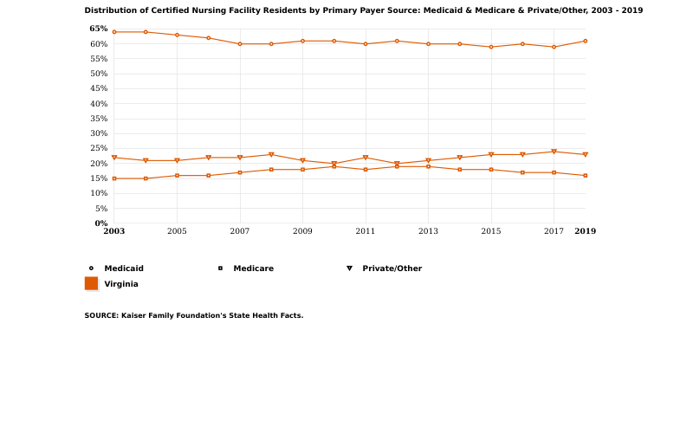
Payer Mix for Virginia Certified Nursing Facilities

Slide 27
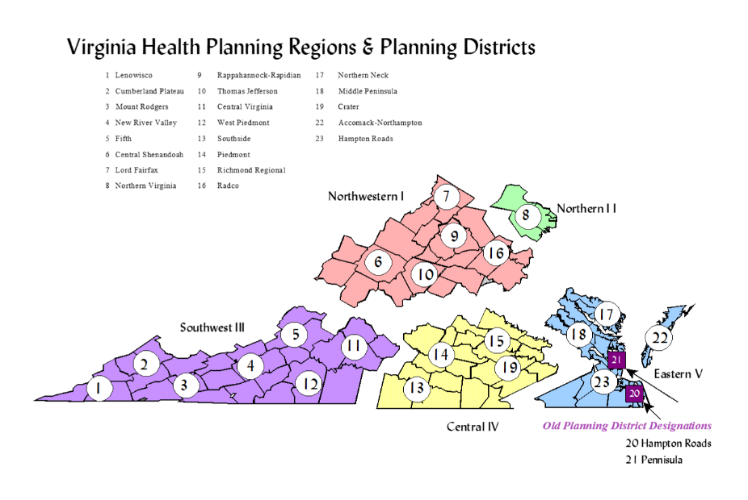
Virginia Data on Nursing Homes
Data obtained from Virginia Health Information (VHI) for the most recently available year (2018)
Data broken down by HPR, then by organization type
Mean and median values calculated
Yellow indicates high/low values
Green stripe indicates widest gap between mean and median

Slide 28
Total FTEs
Region | Ownership | Mean | Median
HPR I | Not-for-profit | 101.96 | 67
 | For profit | 103.52 | 102
HPR II | Not-for-profit | 96.04 | 59
 | For profit | 155.24 | 156
HPR III | Not-for-profit | 135.20 | 115
 | For profit | 110.74 | 105
HPR IV | Not-for-profit | 159.32 | 132
 | For profit | 113.46 | 113
HPR V | Not-for-profit | 108.49 | 103.90
 | For profit | 95.84 | 90.35

Slide 29
Total Nursing FTEs
Region | Ownership | Mean | Median
HPR I | Not-for-profit | 59.54 | 38.6
 | For profit | 62.63 | 60.3
HPR II | Not-for-profit | 57.52 | 33.7
 | For profit | 93.91 | 92.7
HPR III | Not-for-profit | 80.54 | 71.95
 | For profit | 65.42 | 63.5
HPR IV | Not-for-profit | 78.32 | 69.75
 | For profit | 67.51 | 68.3
HPR V | Not-for-profit | 62.94 | 52.25
 | For profit | 59.78 | 54
Notes:
CNAs, LPNs, NPs, RNs

Slide 30
Medicaid Participation
Region | Ownership | Mean | Median
HPR I | Not-for-profit | 37.2% | 29.2%
 | For profit | 66.7% | 69.1%
HPR II | Not-for-profit | 65.4% | 63.3%
 | For profit | 51.1% | 57.6%
HPR III | Not-for-profit | 51.6% | 53.7%
 | For profit | 64.2% | 69.7%
HPR IV | Not-for-profit | 60.6% | 64.1%
 | For profit | 62.6% | 66.4%
HPR V | Not-for-profit | 49.5% | 53.1%
 | For profit | 67.0% | 71.8%
Notes:
FROM VHI: Expressed as a percentage, it is the amount of patient days for patients enrolled in the Medicaid program in relation to total patient days. The number of patient days has been adjusted to account for outpatient service revenue. The desired direction is toward a higher value.

Slide 31
Net Medicaid Revenue Per Adjusted Patient Day
Region | Ownership | Mean | Median
HPR I | Not-for-profit | $177.82 | $200.05
 | For profit | $193.20 | $191.32
HPR II | Not-for-profit | $238.26 | $222.79
 | For profit | $244.05 | $229.06
HPR III | Not-for-profit | $240.71 | $203.62
 | For profit | $177.37 | $176.73
HPR IV | Not-for-profit | $338.80 | $194.38
 | For profit | $186.62 | $185.18
HPR V | Not-for-profit | $230.72 | $192.08
 | For profit | $180.72 | $180.31
Notes:
The net Medicaid dollar amount expected to be collected per adjusted patient day for patients enrolled in the Medicaid program. Patient days are adjusted by case mix and by outpatient and ancillary service revenues. The desired direction is toward a lower value.

Slide 32
Net Patient Revenue Per Adjusted Patient Day
Region | Ownership | Mean | Median
HPR I | Not-for-profit | $279.11 | $264.57
 | For profit | $264.56 | $254.82
HPR II | Not-for-profit | $312.55 | $312.35
 | For profit | $343.49 | $345.70
HPR III | Not-for-profit | $293.58 | $267.93
 | For profit | $248.25 | $237.60
HPR IV | Not-for-profit | $451.98 | $263.76
 | For profit | $257.32 | $243.89
HPR V | Not-for-profit | $270.84 | $263.18
 | For profit | $239.81 | $232.66
Notes:
FROM VHI: The dollar amount expected to be collected per adjusted patient day. Patient days are adjusted by case mix and by outpatient and ancillary service revenues. The desired direction is toward a lower value.

Slide 33
Total Labor Cost Per Adjusted Patient Day
Region | Ownership | Mean | Median
HPR I | Not-for-profit | $217.73 | $187.63
 | For profit | $155.40 | $154.55
HPR II | Not-for-profit | $211.83 | $225.29
 | For profit | $207.91 | $195.99
HPR III | Not-for-profit | $186.69 | $170.28
 | For profit | $154.88 | $140.68
HPR IV | Not-for-profit | $370.42 | $224.84
 | For profit | $153.54 | $155.52
HPR V | Not-for-profit | $199.79 | $199.02
 | For profit | $134.40 | $128.16
Notes:
FROM VHI: The personnel expense per adjusted patient day. Patient days are adjusted by case mix and by outpatient and ancillary service revenues. The desired direction is toward a lower value.

Slide 34
Revenue and Gains in Excess of Expenses and Losses
Region | Ownership | Mean | Median
HPR I | Not-for-profit | $485,624.11 | $125,878.00
 | For profit | $247,396.82 | $227,792.00
HPR II | Not-for-profit | $322,691.20 | $102,745.00
 | For profit | $833,935.53 | $813,676.00
HPR III | Not-for-profit | $87,200.00 | $177,550.50
 | For profit | $411,674.15 | $412,283.00
HPR IV | Not-for-profit | ($849,504.75) | ($658,458.00)
 | For profit | $358,071.97 | $277,291.50
HPR V | Not-for-profit | ($846,160.65) | ($813,605.00)
 | For profit | $423,375.45 | $358,955.00
Notes:
FROM VHI: The net amount of change in the net assets of the facility. The sum of Operating income and Non-operating income. Note: In proprietary facilities this is called Net Income. This is the value that should be used in the calculation of Total margin.

Slide 35
Reimbursement Rates
Nursing home rates are rebased every three years and updated on an annual basis
Each nursing home has its own reimbursement rate
Price-based reimbursement rates (effective July 1, 2020): https://www.dmas.virginia.gov/files/links/5365/SFY%202021%20PRICE%20BASED%20RATES%20UPDATED%20MASTER%20UPDATED%207_7_2020.pdf
RUG-adjusted price-based reimbursement rates (effective July 1, 2020): https://www.dmas.virginia.gov/files/links/5364/SFY%2021%20RUG%20ADJUSTED%20RATES%20UPDATED%20MASTER%20UPDATED%207_7_2020.pdf
Price-based rates are a provider’s base rate. The RUG-adjusted rates are what a claim will be paid according to the RUG(s) submitted on the claim
Notes:
RUG - A resident classification system that classifies residents by the intensity of each resident’s needs. DMAS currently uses a RUGs III grouper and is transitioning to RUGS IV. The number of classifications can vary based on the population and purpose.
The formula to calculate nursing facility price-based rate per diem is = ((Direct rate X RUG weight) + Indirect rate + NATCEP + Criminal Records + Plant Rate).

Slide 36
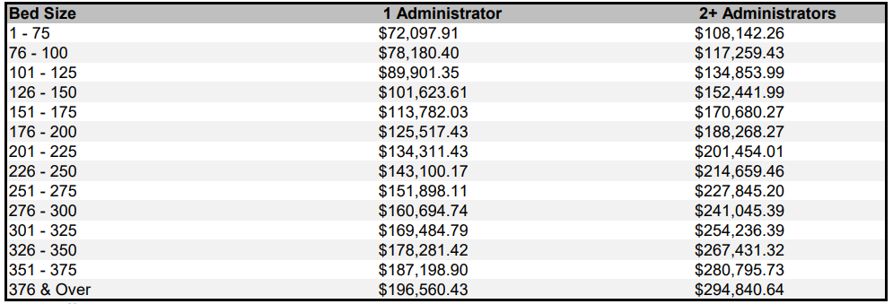
Reimbursement Rates (cont.)
DMAS also caps management fees ($5.92 per day), medical director fees ($14,602 per day), and nursing home administrator/owner compensation:

Slide 37
Tax Incentive Programs
Work Opportunity Tax Credit (WOTC) - federal tax credit incentive for private-sector businesses for hiring individuals from any of ten target groups who have consistently faced significant barriers to employment.
Disabled Access Credit – federal tax credit incentive for small businesses that incur expenditures for the purpose of providing access to persons with disabilities. They may take the credit each and every year they incur access expenditures.
Eligible small business is one that earned $1 million or less or had no more than 30 full time employees in the previous year
No nursing home
Notes:
Target Groups:
Veteran
Long-term Temporary Assistance for Needy Families (TANF) recipient
Short-term TANF recipient
SNAP (food stamps) recipient
Designated community resident
Vocational rehabilitation referral
Ex-felon
Supplemental Security Income (SSI) recipient
Summer youth employee
Qualified long-term unemployment recipient

Slide 38
Potential State Tax Incentive Programs
State individual income tax credit for CNAs, LPNs, and/or RNs who work in Virginia nursing homes
Create a state version of the Disabled Access Credit and modify the eligibility guidelines so that for-profit nursing homes could qualify
Not-for-profits are exempt from income tax
Create an alternative tax relief program for not-for-profit nursing homes that would allow them to offset part of their payroll tax for expenditures aimed at providing access to employees with disabilities

Slide 39
Next Steps

Slide 40
Other business

Slide 41
adjourn

